Slide 1
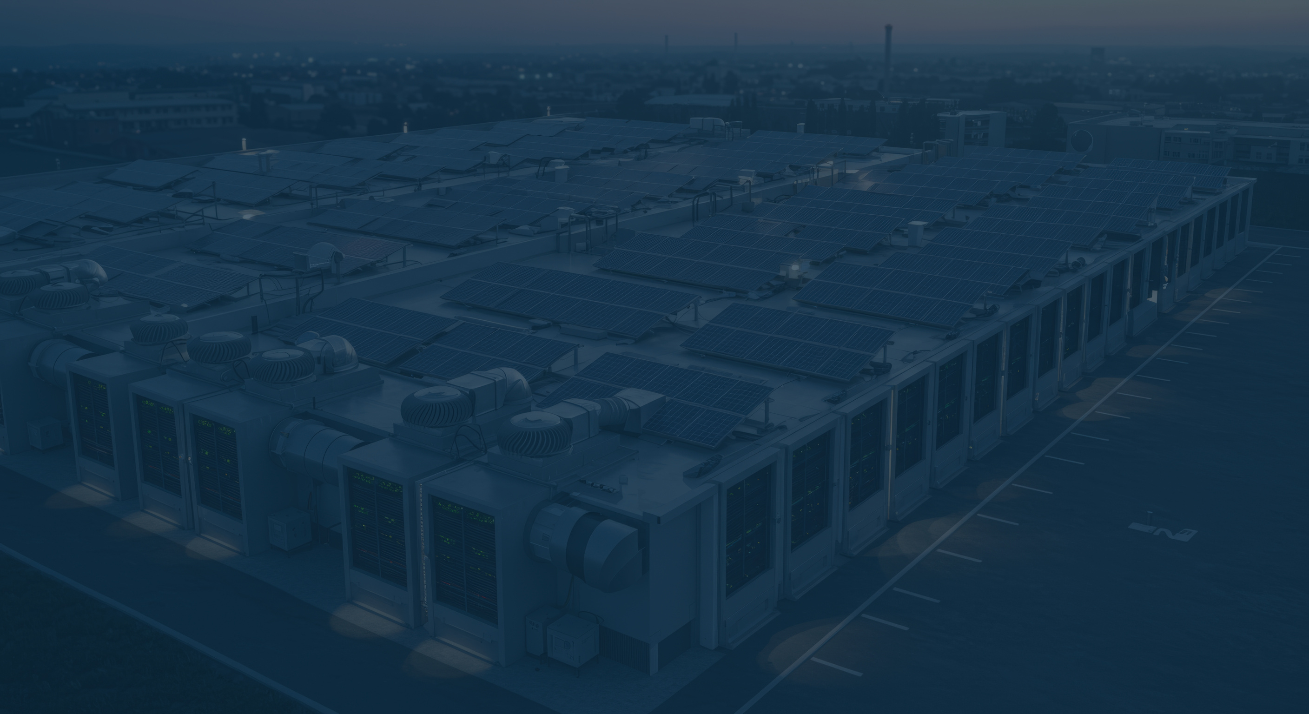

EdgeTunePower
WWW.EDGETUNEPOWER.COM

Slide 2

AI loads and network stability challenges
AI loads and generator shaft fatigue
AI load smoothing with Energy Storage
  Parallel
  In-line UPS
Considerations for early-stage technology selection
Live demo of Data Center Test-bed (digital twin in Real Time)
Large Loads and System Stability

Slide 3
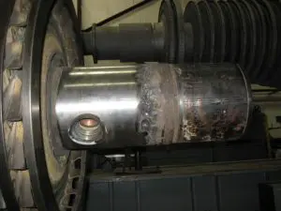
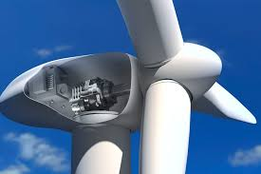
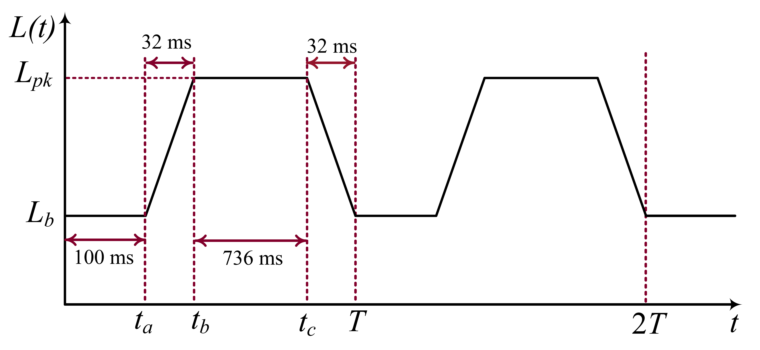

Why, When, Where, How much

Slide 4

Beauty comes from differences and harmony
What if they all just play one note?!
A well-known technique for Horror movies OST

Slide 5
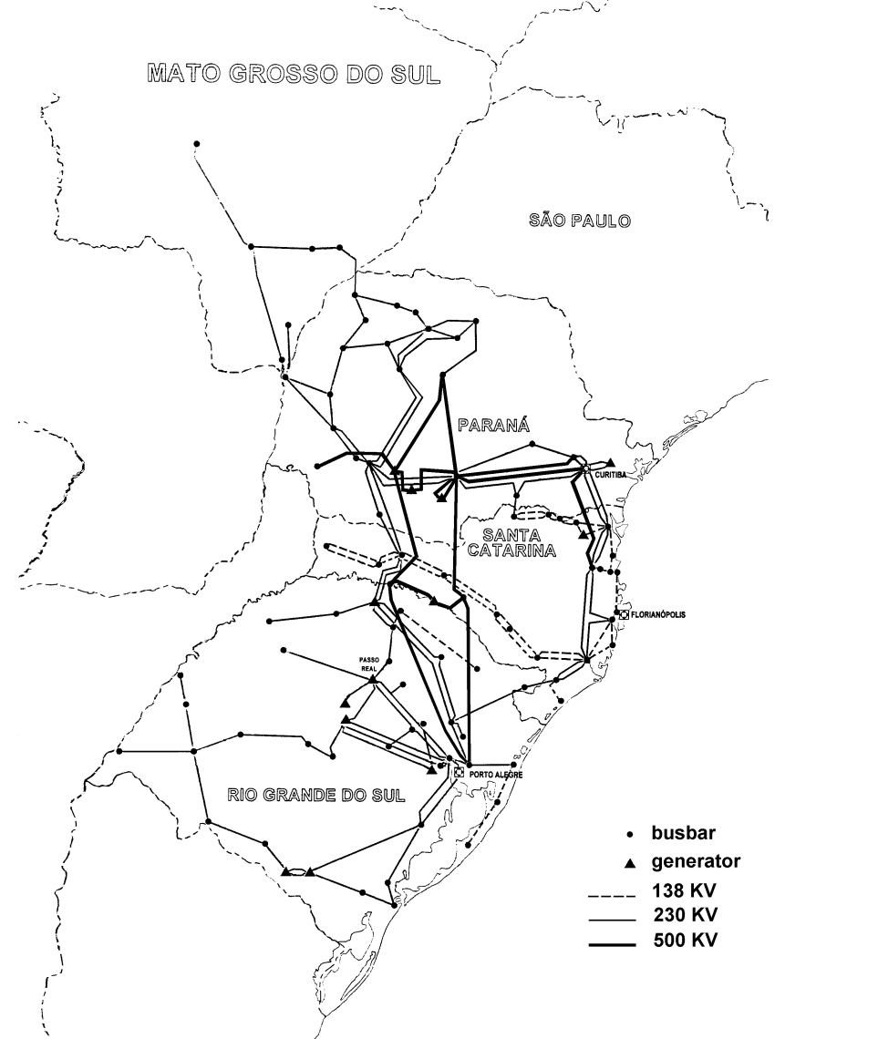
Magnitude and Frequency of oscillation

Slide 6
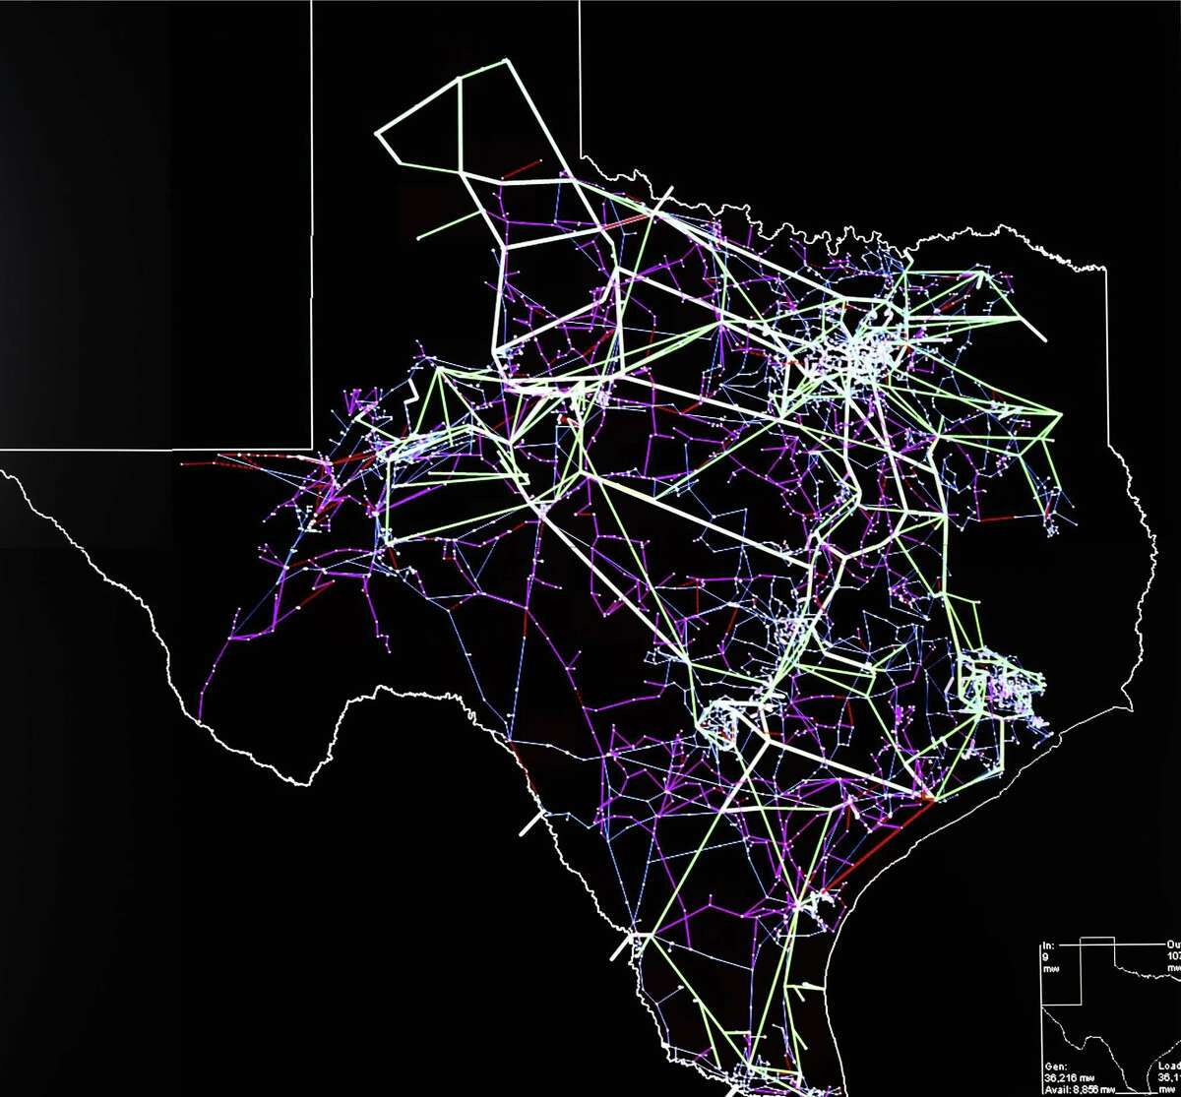

Location, Location, and Location
Land
Site Selection
Transmission Capacity
Available Power
Network

Slide 7

Nearby facility
Land
Site Selection
Transmission Capacity
Available Power
Network

Slide 8
The Handshake (Oscillations)
Land
Site Selection
Transmission Capacity
Available Power
Network

Slide 9

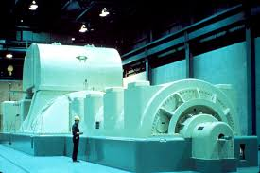
Energy storage could help in load smoothing
26 Hz
16 Hz
36 Hz

Slide 10
Energy storage could help in load smoothing
26 Hz
16 Hz
36 Hz

Slide 11
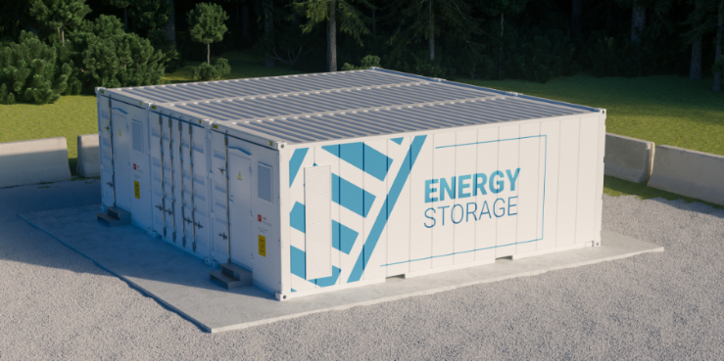
Energy Storage for load smoothing
Land
Site Selection
Transmission Capacity
Available Power
Network

Slide 12
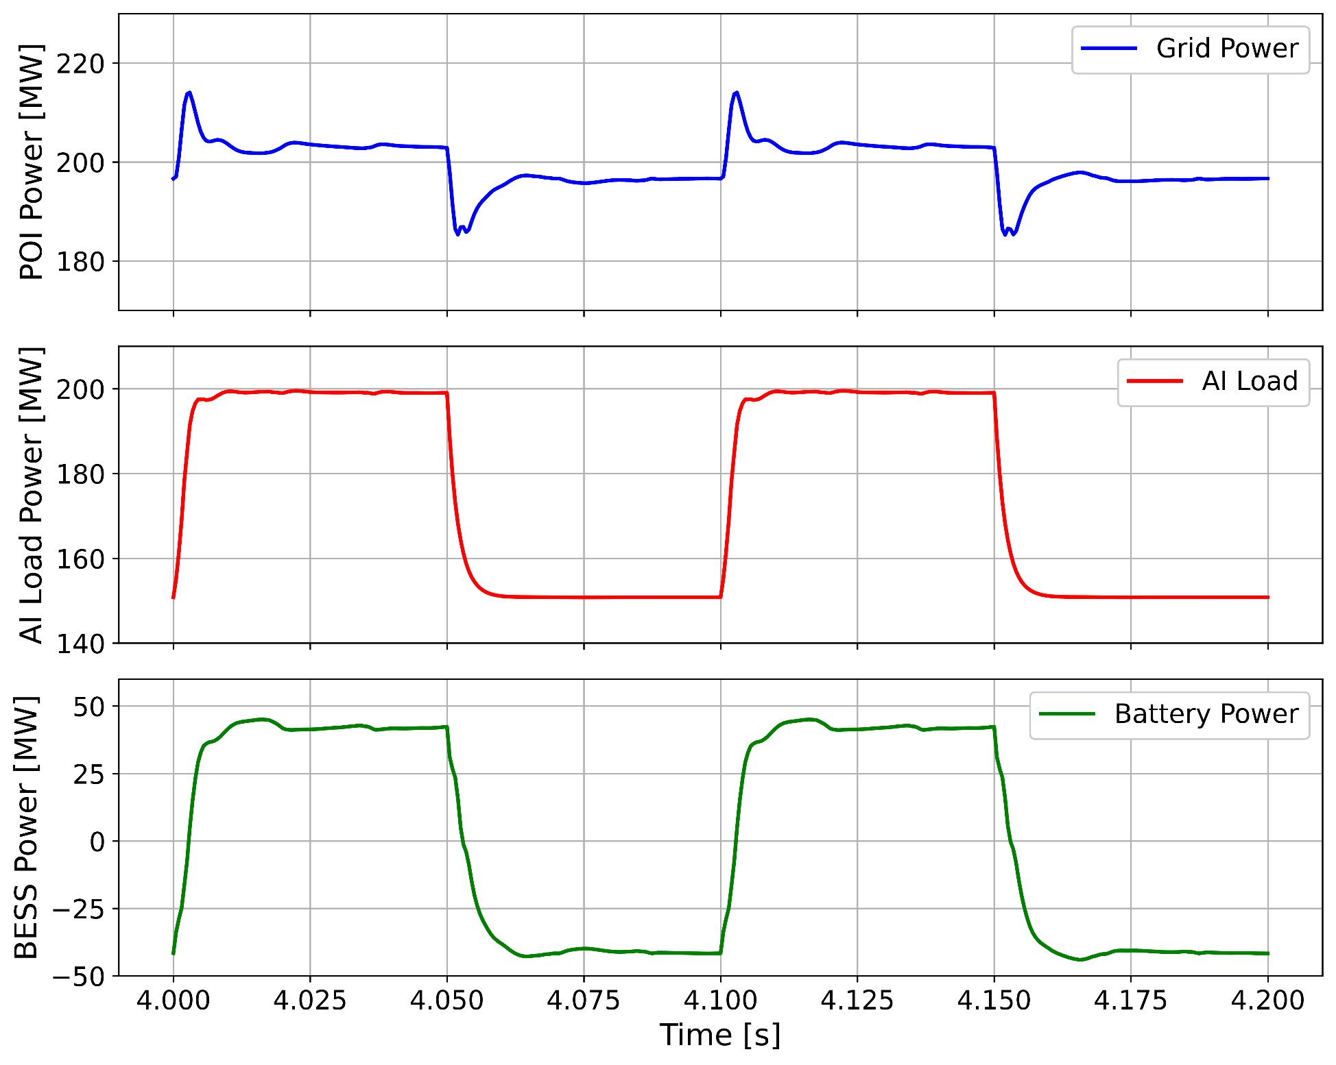
Early-Stage Technology Selection
Offline Electro Magnetic Transient (EMT) Studies
EMT simulation
Less than 10 MW

Slide 13
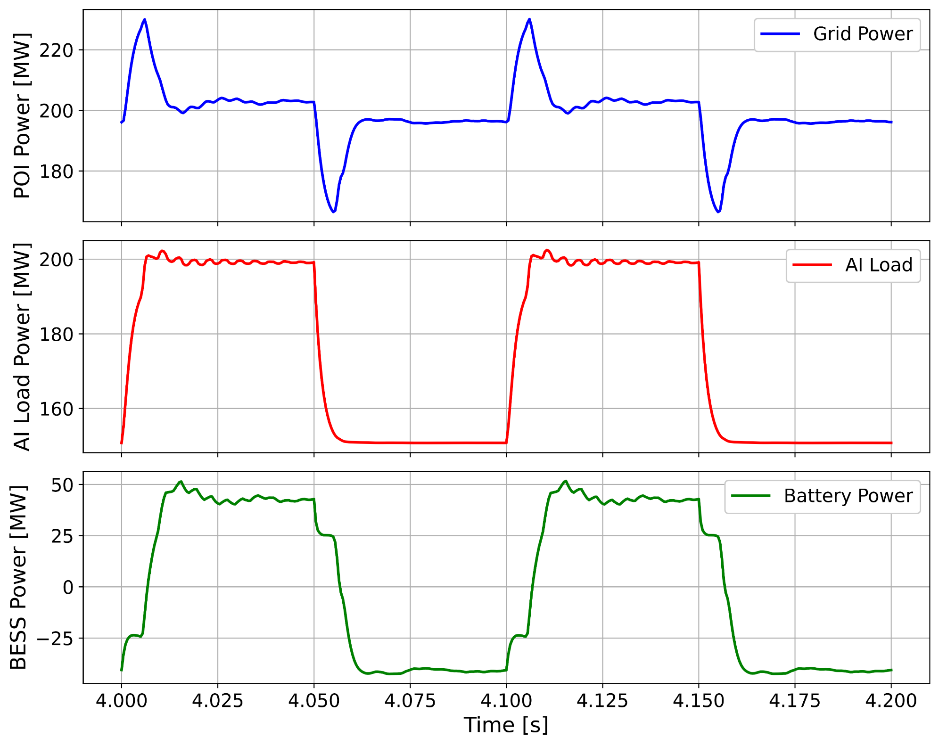
Early-Stage Technology Selection
Real controller testing
Hardware in the loop simulation
Around30 MW

Slide 14
What went wrong?
Milliseconds of delay can drastically change the results
20 msec
20 msec
20 msec
20 msec
20 msec
20 msec
20 msec
20 msec
20 msec

Slide 15
Milliseconds of delay can drastically change the results
DNP3, MODBUS TCP/RTU, IEC-61850, IEEE C37 (Synchro phasor)
Differences in simulation and actual controllers
20 msec
20 msec
20 msec
Communication Delay
20 msec
20 msec
20 msec
20 msec
20 msec
20 msec
20 msec

Slide 16
Nondeterministic (it could be anything)
20 msec
20 msec
20 msec
Communication Delay
20 msec
20 msec
20 msec
10 msec
20 msec
20 msec
20 msec

Slide 17
Parallel setup
Novel approach available in the market
In-line (UPS) setup

Slide 18

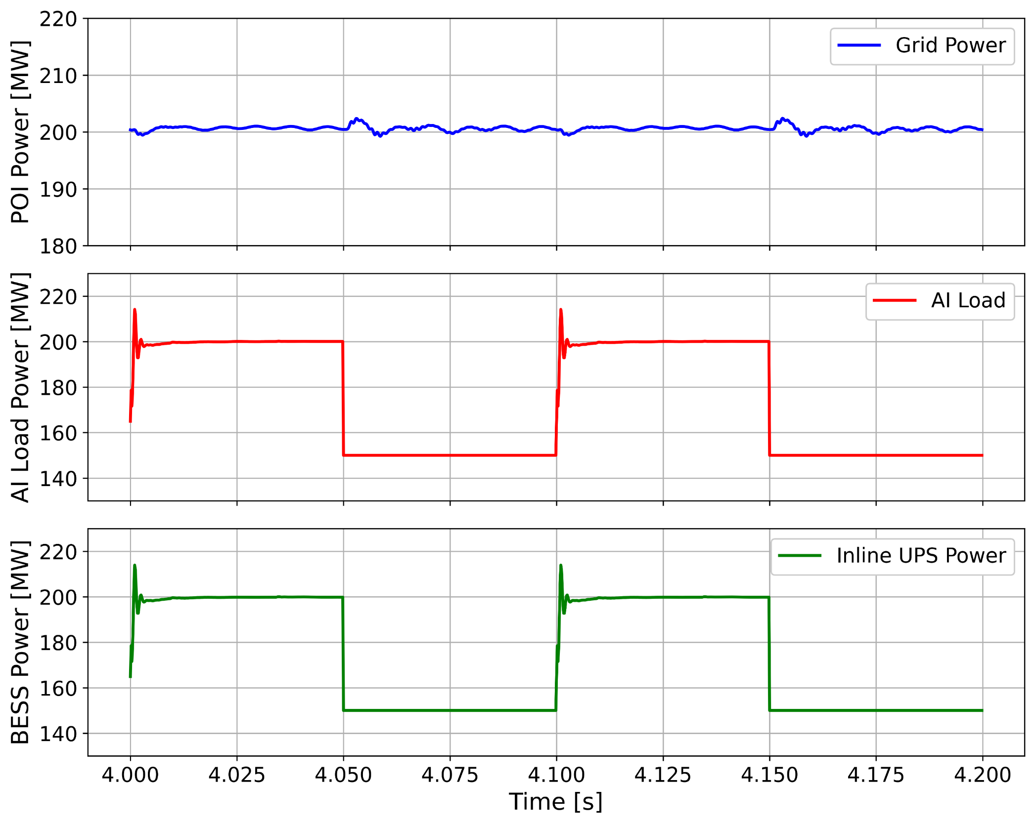
Parallel setup
In-line (UPS) setup
Parallel BESS (30 MW peak Seen at the POI)
In Line UPS BESS (Contant Power at the POI)
No delay
20 ms delay

Slide 19
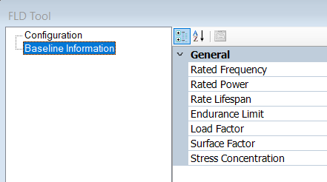
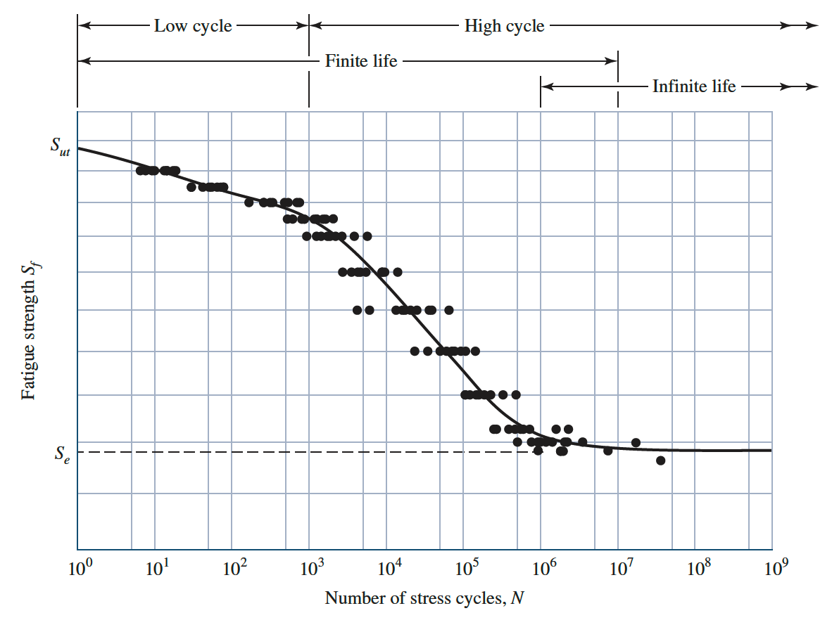
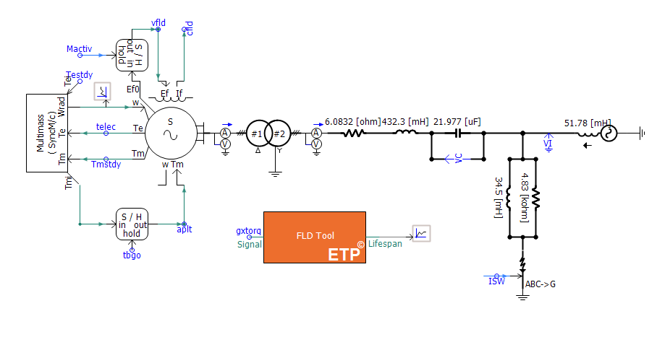
How to quantify and make decision? (it is Mechanical not Electrical)
Using the stress-lifespan approach, we developed a module in PSCAD to estimate the degradation of the lifespan caused by SSTI.
The module takes the torque signal form PSCAD, and uses the mechanical information inputted by the user to estimate lifespan degradation.
Generator type, shaft model and materials, load factor, surface factor, stress damping and correction, etc.

Slide 20
Offline EMT can do the perfect job if we consider:
Accurate modeling
Benchmarking with Real Controller
Communication mediums must be considered
Long simulation might be needed (couple of minutes)
Several Scenarios must be considered

Slide 21
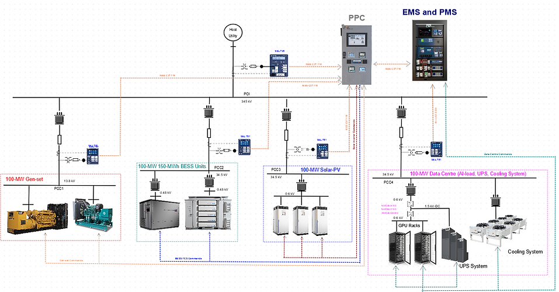
Hardware in the loop testing and live demonstration (data center Testbed)

Slide 22
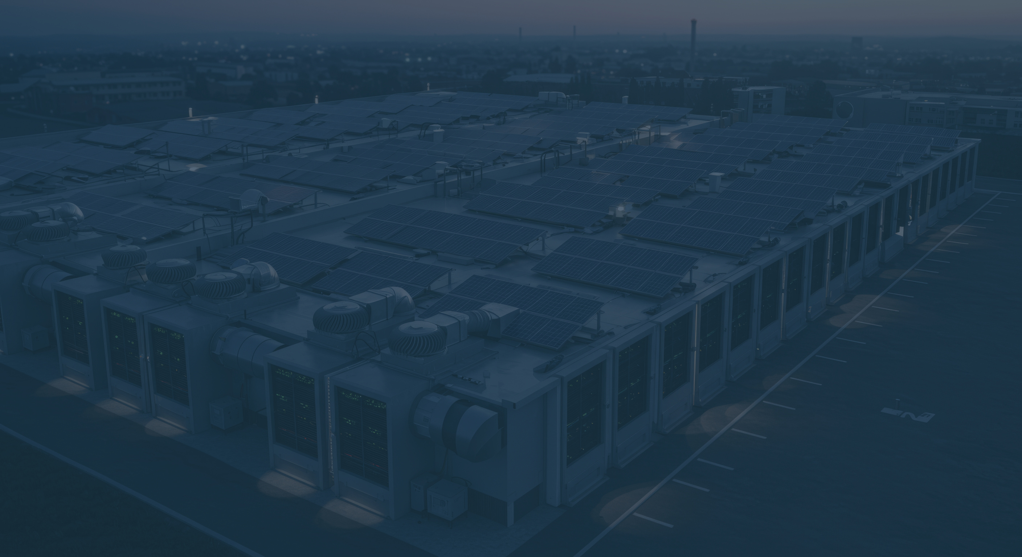
as
Empowering Your Business At the Edge
THANK YOU
s.maleki@edgetunepower .com
a.ghasaei@edgetunepower.com
WWW.EDGETUNEPOWER.COM

