Slide 1
Credit Exposure Update
Credit Finance Sub Group
ERCOT Public
April 28, 2026

Slide 2
Monthly Highlights: February 2026 – March 2026
Market-wide average Total Potential Exposure (TPE) decreased from $ 2.01 billion in February to $1.86 billion in March
Forward adjustment factors on average increased during the month
    Discretionary Collateral is defined as Secured Collateral in excess of TPE,CRR Locked ACL and DAM Exposure
  Average Discretionary Collateral decreased from $ 5.45 billion in February compared to $4.44 billion in March
No unusual collateral call activity

Slide 3
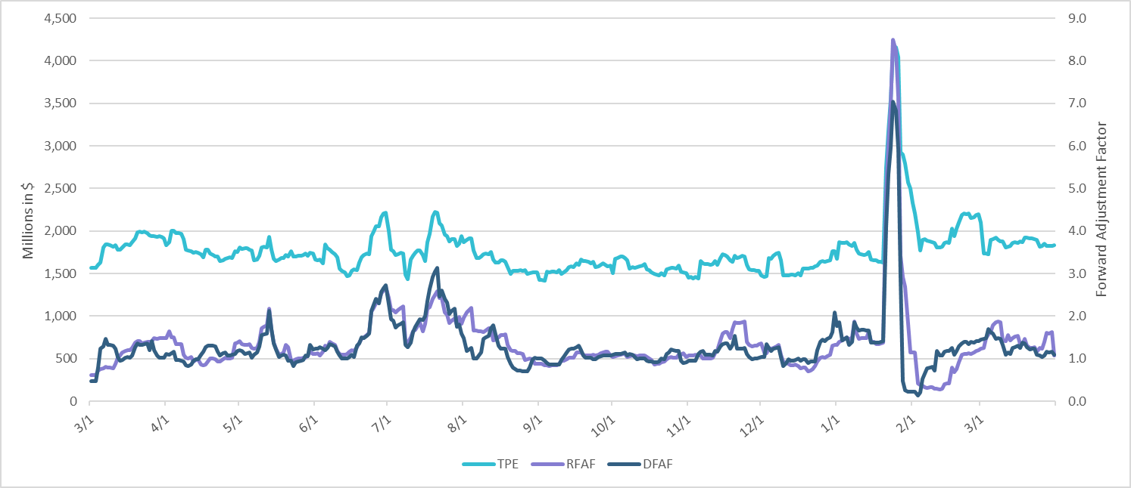
TPE and Forward Adjustment Factors: March 2025 – March 2026

Slide 4
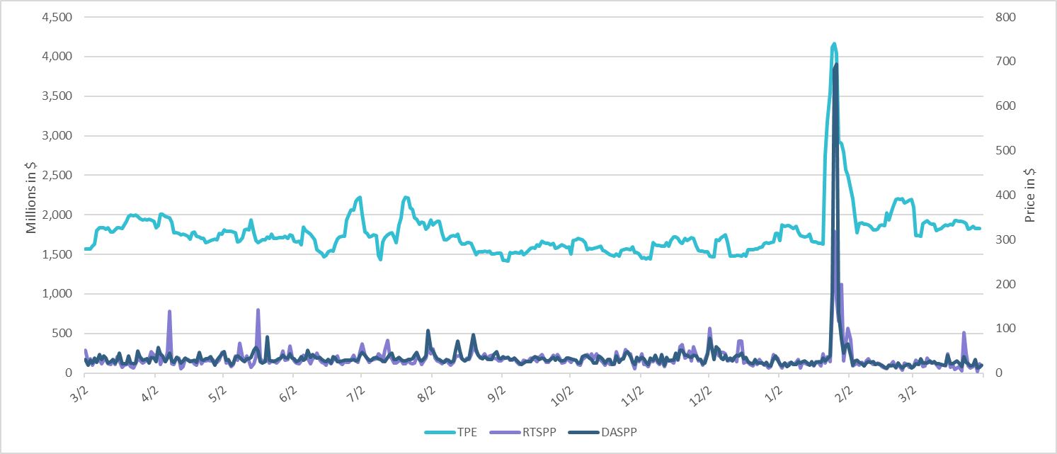
TPE/Real-Time & Day-Ahead Daily Average Settlement Point Prices for HB_NORT:H March 2025 – March 2026

Slide 5
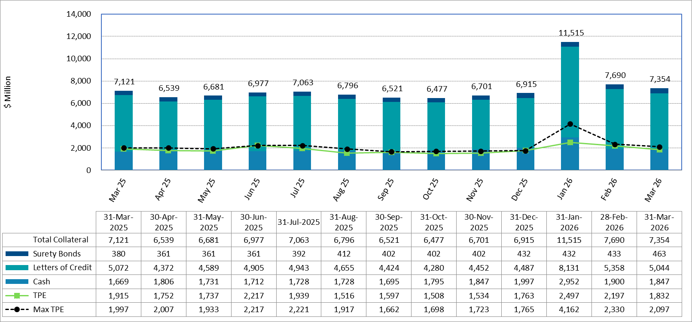
Available Credit by Type Compared to Total Potential Exposure (TPE):
March 2025 – March 2026
Numbers are as of month-end except for Max TPE
Max TPE is the highest TPE for the corresponding month

Slide 6
Issuer Credit Limits vs Total LC Amounts Per Issuer: March 2026
As of March 31, 2026
There are a total of 36 banks that have issued LCs.

Slide 7
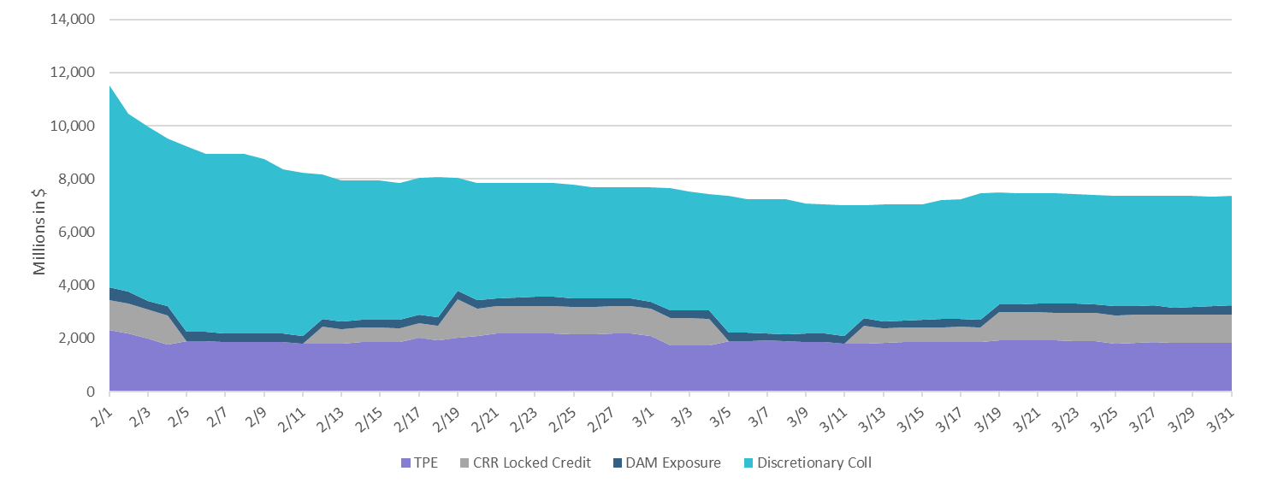
Discretionary Collateral February 2026 – March 2026

Slide 8
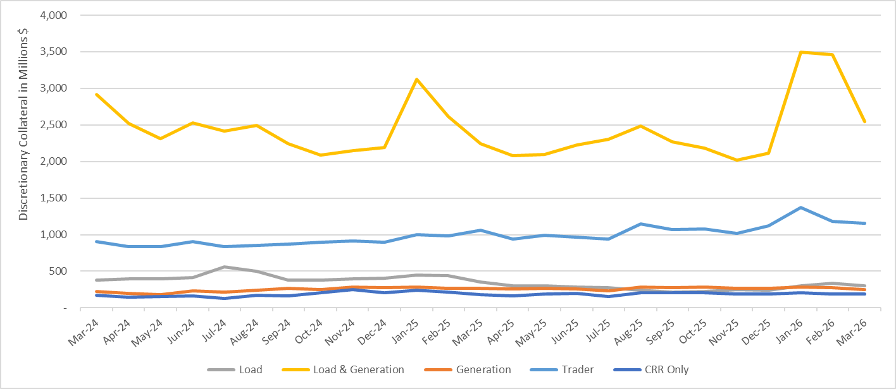
Discretionary Collateral by Market Segment March 2024 - March 2026

Slide 9
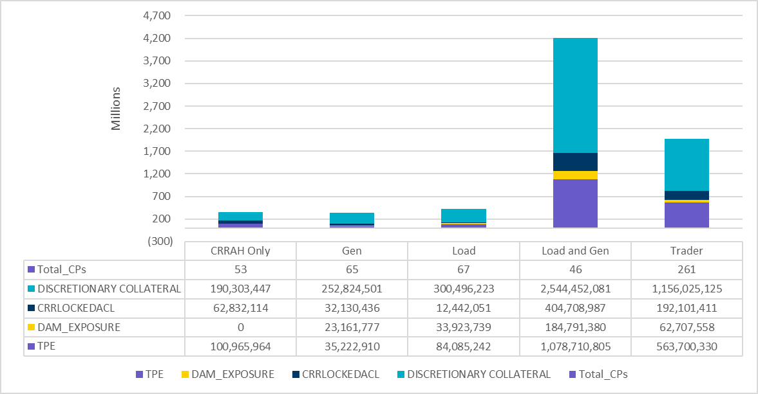
TPE and Discretionary Collateral by Market Segment - March 2026
Load and Generation entities accounted for the largest portion of discretionary collateral

Slide 10
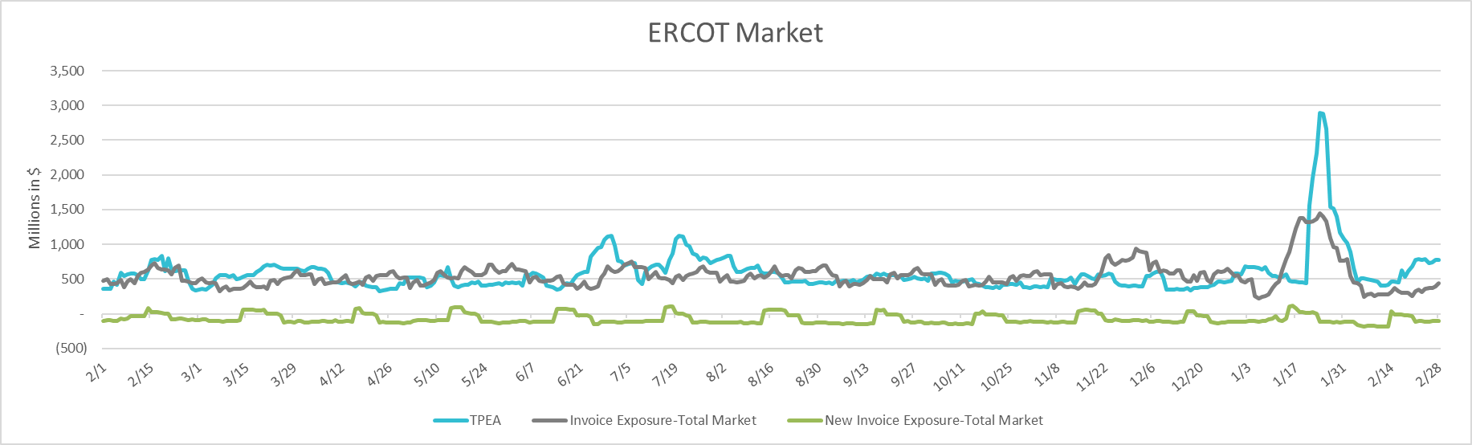
TPEA Coverage of Settlements February 2025 - February 2026
Invoice Exposure | Historical | Future
Existing Invoice Exposure | RTLCNS + UDAA | M1 Days (including current day) Forward Charge Invoice Amounts
New Invoice Exposure | 7 Days Back Net Invoice Amounts (Charges & Credits) | M1 Days (including current day) Forward Net Invoice Amounts (Charges & Credits); Excluding: 1) Securitization Invoices; 2) CRR Auction Invoices; and 3) Subchapter N Funds Distribution Invoice

Slide 11
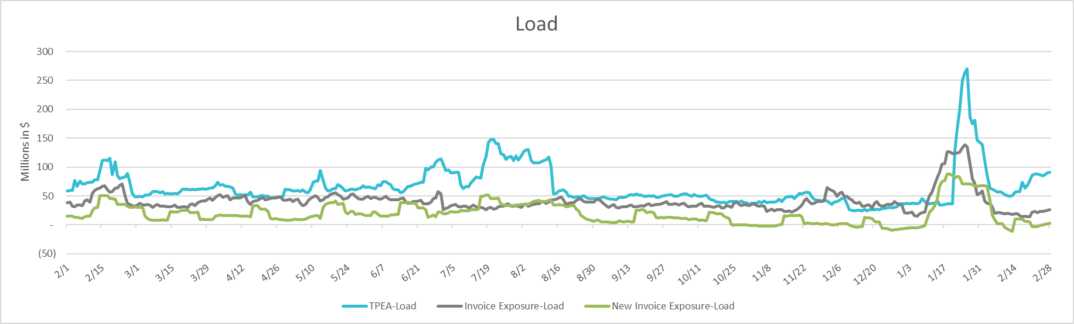
TPEA Coverage of Settlements February 2025 - February 2026
Invoice Exposure | Historical | Future
Existing Invoice Exposure | RTLCNS + UDAA | M1 Days (including current day) Forward Charge Invoice Amounts
New Invoice Exposure | 7 Days Back Net Invoice Amounts (Charges & Credits) | M1 Days (including current day) Forward Net Invoice Amounts (Charges & Credits); Excluding: 1) Securitization Invoices; 2) CRR Auction Invoices; 3) Subchapter N Funds Distribution Invoice

Slide 12
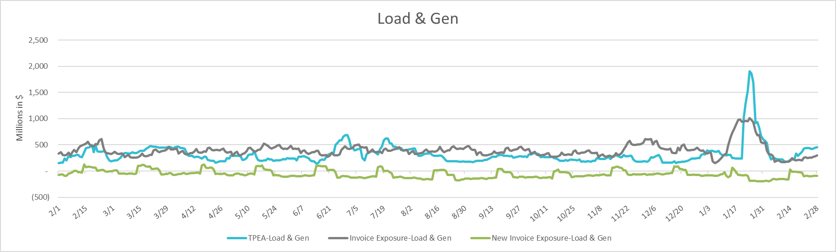
TPEA Coverage of Settlements February 2025 - February 2026
Invoice Exposure | Historical | Future
Existing Invoice Exposure | RTLCNS + UDAA | M1 Days (including current day) Forward Charge Invoice Amounts
New Invoice Exposure | 7 Days Back Net Invoice Amounts (Charges & Credits) | M1 Days (including current day) Forward Net Invoice Amounts (Charges & Credits); Excluding: 1) Securitization Invoices; 2) CRR Auction Invoices; 3) Subchapter N Funds Distribution Invoice

Slide 13
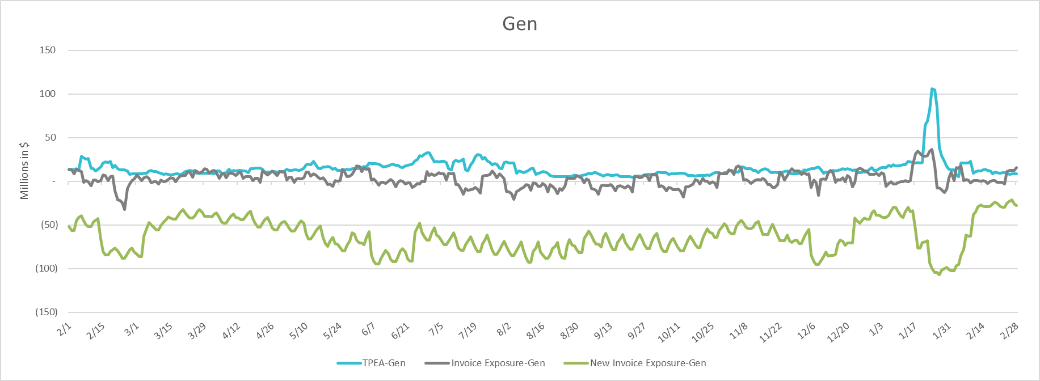
TPEA Coverage of Settlements February 2025 - February 2026
Invoice Exposure | Historical | Future
Existing Invoice Exposure | RTLCNS + UDAA | M1 Days (including current day) Forward Charge Invoice Amounts
New Invoice Exposure | 7 Days Back Net Invoice Amounts (Charges & Credits) | M1 Days (including current day) Forward Net Invoice Amounts (Charges & Credits); Excluding: 1) Securitization Invoices; 2) CRR Auction Invoices; 3) Subchapter N Funds Distribution Invoice

Slide 14
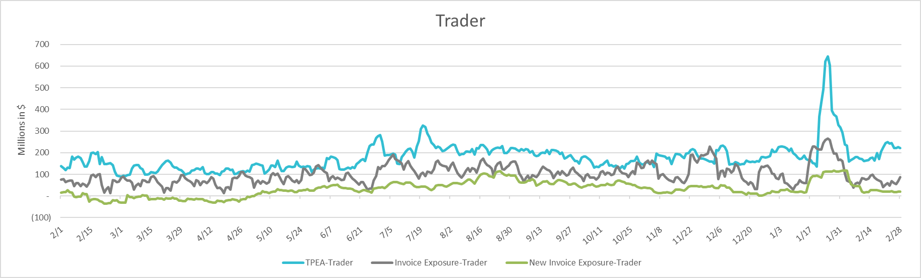
TPEA Coverage of Settlements February 2025 - February 2026
Invoice Exposure | Historical | Future
Existing Invoice Exposure | RTLCNS + UDAA | M1 Days (including current day) Forward Charge Invoice Amounts
New Invoice Exposure | 7 Days Back Net Invoice Amounts (Charges & Credits) | M1 Days (including current day) Forward Net Invoice Amounts (Charges & Credits); Excluding: 1) Securitization Invoices; 2) CRR Auction Invoices; 3) Subchapter N Funds Distribution Invoice

Slide 15
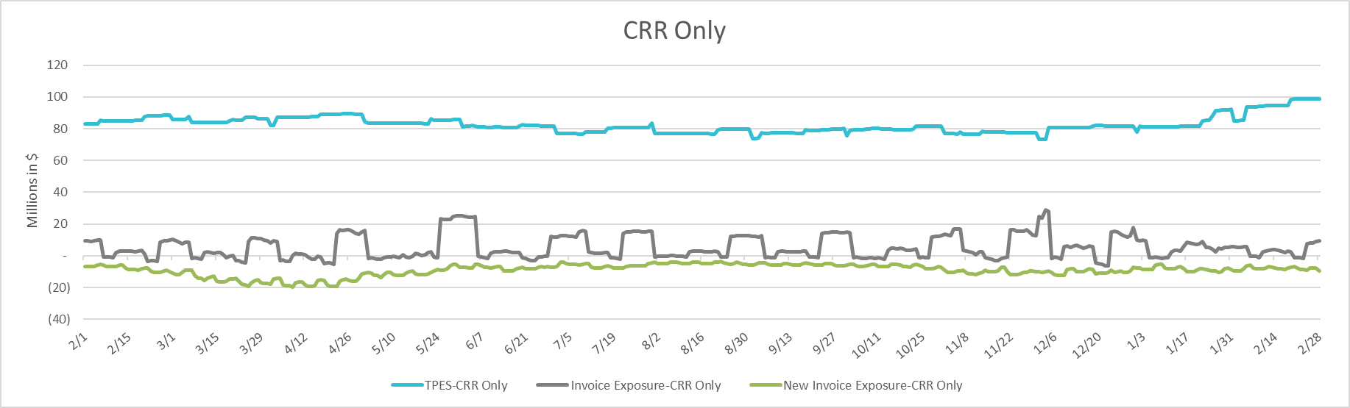
TPEA Coverage of Settlements February 2025 - February 2026
Invoice Exposure | Historical | Future
Existing Invoice Exposure | RTLCNS + UDAA | M1 Days (including current day) Forward Charge Invoice Amounts
New Invoice Exposure | 7 Days Back Net Invoice Amounts (Charges & Credits) | M1 Days (including current day) Forward Net Invoice Amounts (Charges & Credits); Excluding: 1) Securitization Invoices; 2) CRR Auction Invoices; 3) Subchapter N Funds Distribution Invoice

Slide 16
Questions

