Slide 1
Project Update
April 15, 2026
Troy Anderson
ERCOT Portfolio Management

Slide 2
Project Update Agenda
  Recent / Upcoming Project Highlights
  2026 Release Targets
  Other Project Updates
  Impact Analysis Accuracy Report – 2023-2025
  Priority/Rank Recommendations for Revision Requests with Impacts
    None
  Technology Working Group (TWG)
    Next meeting is 4/23/2026
  Prioritization Update
    2026 Project Planning
  Reports at Upcoming PRS Meetings
  June
    Aging Revision Request Prioritization
Location of Revision Request Project Information: http://www.ercot.com/services/projects

Slide 3
Recent / Upcoming Project Highlights
2026 February Off-Cycle Release – 3/2/2026 Complete
  NPRR1277 – Revisions to EAL Formula
2026 March Release – 3/25/2026-3/26/2026 Complete
  NPRR1287 – Revision to Outage Coordination
  8 data products added to ERCOT Data Portal for public API access
    See 3/24/2026 market notice for details
2026 April Release – 4/29/2026-4/30/2026 In Flight
  8 data products added to ERCOT Data Portal for public API access
    See 4/3/2026 market notice for details
    Additional market-facing changes will be delivered over the remaining releases in 2026
Note: Projected Go-Live dates are subject to change.
Please watch for market notices as the effective dates approach.
3

Slide 4
2026 Release Targets – Approved NPRRs / SCRs / xGRRs
R1
R3
R5
January 1/28-1/29 | February 2/25-2/26 | March 3/25-3/26 | April 4/29-4/30 | May 5/27-5/28 | June 6/24-6/25
NPRR1234(c) PGRR131 NPRR1283 NPRR1285 NPRR1299 | NPRR1266 NPRR1277 | NPRR1287 Add’l Public Data Products in ERCOT Data Portal | CRR Historical Data Removal |  | SCR820
R2
R4
R6
ü
ü
ü
ü
ü
ü
ü
E
4/24
1/1
3/1
ü
ü
E
2/1
3/2
SCR820 TO/QSE Testing (see 2/19/2026 TWG)
Cipher Security Upgrades (see 2/19/2026 TWG)
RTC+B Stabilization
July 7/29-7/30 | August 8/26-8/27 | September 9/30-10/1 | October 10/28-10/29 |  | December 12/16-12/17
DPC Automation |  | NPRR1198 NPRR1303 | NPRR1281
R7
R8
R9
R10
R11
E
NS
E
P
Go-live dates can differ from Protocol effective dates – Please refer to market notices for more details
APPENDIX
Red Text: New additions and target release changes
Strike-Through Text: Previous target release
(a), (b), etc.: Multiple phase release
Project Status Codes
NS = Not Started
I = Initiation
P = Planning
E = Execution
H = On Hold
NPRR1234(c) – RIOO changes for End-Use
Industry Classification to Loads
Release targets are subject to change

Slide 5
Other Project Updates
NPRR1188 – Implement Nodal Dispatch and Energy Settlement for Controllable Load Resources and NPRR1244 – Clarification of Controllable Load Resource Primary Frequency Response Responsibilities
  Go-live target = 2027 R1 (January)
NPRR1290 Phase 2 – Gap Resolutions and Clarifications for RTC+B – EDIT
  Stand-alone project – Adding NPRR1323 to scope (pending Board and PUCT approval)
  Assessing resource availability to deliver mid-year 2026
  Will report back to PRS in May with target go-live date
NPRR1201 – Limitations on Resettlement Timeline & Default Uplift Exposure Adjustments
  Targeting July 2026 start with go-live in late 2026
NPRR1238 – Voluntary Registration of Loads with Curtailable Load Capabilities
  Part of Large Load Curtailment Manager project (Initiated in February 2026)
  Targeting partial implementation by summer 2026 with full scope delivered by end of 2026
  NPRR1238 portion expected to go-live late in 2026
NPRR936 / NPRR1288 – CRR Enhancements Project
  Gate to Execution late May / early June 2026
  Targeting go-live in Q4 2026
5

Slide 6

Variance from IA Cost Range – Revision Request Projects
13
5
Exceeds IA Range
11 Projects
7
Percent Variance from IA Cost Range
17
14
10
11
16
Within IA Range
8 Projects
3
21
1
2
4
8
9
15
18
19
20
6
Below IA Range
2 Projects
2023
7 Projects
12 Revision Requests
2024
13 Projects
21 Revision Requests
2025
1 Project
1 Revision Request
If actual spend falls within the IA range the variance is 0
Note: Graph compares the posted IA cost range with the actual project spend
6

Slide 7
Variance from IA Duration Range – Revision Request Projects
13
Exceeds IA Range
10 Projects
20
11
Percent Variance from IA Duration Range
5
18
21
14
16
19
Within IA Range
9 Projects
1
2
3
4
6
7
9
10
12
17
15
Below IA Range
2 Projects
8
2023
7 Projects
12 Revision Requests
2024
13 Projects
21 Revision Requests
2025
1 Project
1 Revision Request
If actual duration falls within the IA range the variance is 0.
Note: Graph compares the posted IA duration range with the actual project duration
7

Slide 8
Variance from IA Cost Range – Revision Request Projects
7
Exceeds IA Range
11 Projects
Actual $ Variance from IA Range
5
13
Within IA Range
8 Projects
17
14
16
1
2
3
4
8
9
10
11
15
18
19
20
21
12
6
Below IA Range
2 Projects
2023
7 Projects
12 Revision Requests
2024
13 Projects
21 Revision Requests
2025
1 Project
1 Revision Request
If actual spend falls within the IA range the variance is 0
Note: Graph compares the posted IA cost range with the actual project spend
8

Slide 9
Variance from IA Duration Range – Revision Request Projects
13
20
Exceeds IA Range
9 Projects
Number of Months from IA Range
5
11
18
14
16
19
21
Within IA Range
10 Projects
1
2
3
4
6
7
9
10
12
17
8
Below IA Range
2 Projects
15
2023
7 Projects
12 Revision Requests
2024
13 Projects
21 Revision Requests
2025
1 Project
1 Revision Request
If actual spend falls within the IA range the variance is 0
Note: Graph compares the posted IA cost range with the actual project spend
9

Slide 10
Revision Request Project Legend
NPRR1154, Include Alternate Resource in the Availability Plan for the Firm Fuel Supply Service, Market
SCR822, Create Daily Energy Storage Integration Report and Dashboard, Market
NPRR1020, EPS Metering - Allow Some Integrated Energy Storage Designs to Calculate Internal Loads, Market
NPRR1103, NPRR1114, Securitization Phase 2A- Maine Invoice and Credit Exposure, ERCOT
SCR807 and SCR816 implementation, Market
SCR789, Update NMMS Topology Processor to PSS_E 34 (35) Capability – Phase 2, ERCOT
NPRR863, NPRR1085, NPRR1096, NPRR1148, Creation of ERCOT Contingency Reserve Service (ECRS), Market
NPRR1139, Adjustments to Capacity Shortfall Ratio Share for IRRs, ERCOT
NPRR1183, ECEII Definition Clarification and Updates to Posting Rules for Certain Documents without ECEII, ERCOT
SCR819, NPRR1111, Improving IRR Control to Manage GTC Stability Limits, ERCOT
NPRR1092, Reduce RUC Offer Floor and Limit RUC Opt-Out Provision, Market
SCR799, ERCOT Outage Study Cases in the System Operations Test Environment (SOTE), Market
NPRR1040, Compliance Metrics for Ancillary Service Supply Responsibility, Market
NOGRR249, NERC FAC Standard Changes Alignment, ERCOT
NPRR1131, NPRR1058, Controllable Load Resource Participation in Non-Spin, ERCOT
NPRR1026, BESTF-7 Self-Limiting Facilities, ERCOT
NPRR1149, NPRR1121, NPRR1090, NPRR962, ERCOT
NPRR1186, Implement consideration of ESR SOC in ERCOT tools and studies, ERCOT
NPRR1002, NPRR1132, NPRR1153, RIOO-IS_RS ESR-Single Model & Validation Rules Update, ERCOT
NPRR1095, SCR817, TX SET 5_0, Market
NPRR1145 Use of EMS Calculated ERCOT-Wide TLFs in Lieu of Seasonal Base Case ERCOT-Wide TLFs for Settlement, ERCOT
10

Slide 11
Priority / Rank Recommendations for Revision Requests with Impacts
Recommendations for…
Revision Request | Description | Priority | Rank | Comments
NPRR1292 | Granular Product Type for CRR TOU | TBD | TBD | Additional time needed to complete IA
NPRR1307 | Revised Definition of Mitigation Plan | TBD | TBD | Additional time needed to complete Revised IA
PPL Rank Information
Next 2026 Rank in Business Strategy = 4820 Next 2029 Rank in Business Strategy = 5300
Next 2027 Rank in Business Strategy = 4910 Next Rank in Regulatory = 430
Next 2028 Rank in Business Strategy = 5110

Slide 12
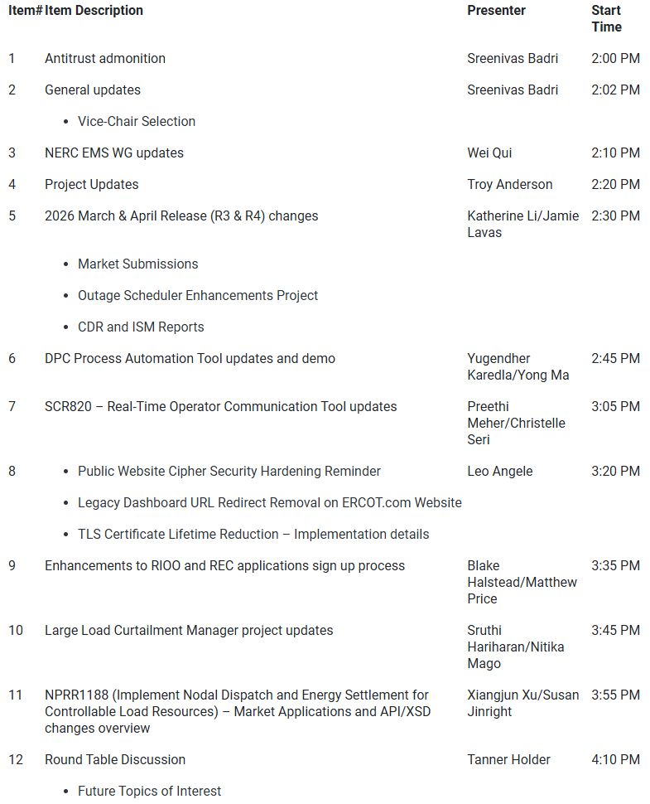
Technology Working Group (TWG)
Agenda for TWG meeting held on 3/26/2026:
Next TWG scheduled for 4/23/2026

Slide 13
2026 Project Planning
ERCOT understands that Market Participants need lead time to implement changes in their systems for many Revision Requests
Approved Revision Request Project Starts
  NPRR936 – CRR Account Holder Limits
  NPRR1188 – Implement Nodal Dispatch and Energy Settlement for Controllable Load Resources
  NPRR1198 – Congestion Mitigation Using Topology Reconfigurations
  NPRR1201 – Limitations on Resettlement Timeline & Default Uplift Exposure Adj
  NPRR1238 – Voluntary Registration of Loads with Curtailable Load Capabilities
  NPRR1244 – Clarification of CLR Primary Frequency Response Responsibilities
  NPRR1277 – Revisions to EAL Formula
  NPRR1281 – Improvements to Alternate FFSS Resource Designation
  NPRR1288 – Remove Multiple Month Transactions in CRR Auctions
  NPRR1290 Phase 2 – Gap Resolutions and Clarifications for RTC+B + NPRR1323
  SCR818 Phase 2 – Changes to Incorporate GIC Modeling Data into Existing Modeling Applications
  SCR831 – Short Circuit Model Integration
Revision Request Projects with Potential for 2026 Implementation
  SCR829 – API for the NDCRC Application
Other priority Review Request projects may start in 2026 with a future year Go-Live
  DRRS (NPRR1309), Residential Demand (NPRR1296), Firming (NPRR1328)
Green Text: Deemed “High Priority” at 2025 Prioritization Workshop

