Slide 1
SCR820 – Real-Time Operator Communication System (RTOC)
Preethi Meher & Christelle Seri
Apr 23, 2026

Slide 2
SCR820 – RTOC Tool
Agenda
Status updates
Market Testing Updates
Recap Tool Access
Primary Contacts
Demo

Slide 3
Status Updates
Project updates
TO testing has started, and we received acknowledgments from most of the companies
The tool was successfully utilized during Week 4 of the ERCOT BlackStart training.
Control Room Operations is planning to send communications through RTOC tool for testing purpose in parallel with hotline calls for routine tasks
Development updates
The first version of the SOL Exceedance data displays has been developed. We are currently gathering feedback from business users and making updates based on their input.
Development of the default dashboard is in progress.
defects and enhancement requests identified in the initial communications release are planned to be addressed in May (R5) and June (R6) releases. R5 production release deployment date: 05/28 and R6 production release deployment date: 6/25

Slide 4
SCR820 – Project Timelines
Project Timeline
Phase | Milestone | Target Date
Planning | Requirements & Design Finalized | Complete
Development | Development & Internal ERCOT Testing | Apr 2026
TOs/QSEs Testing | Market Testing | Apr – May 2026
TOs Parallel Operations | TOs Parallel Operations | June – July 2026
TOs Go Live | TOs Go Live | July 2026
QSEs Parallel Operation | QSEs Parallel Operation | TBD
QSEs Go Live | QSEs Go Live | TBD
Market Notice: M-A032326-01 Access and familiarization of the Real- Time Operation Communications (RTOC) tool

Slide 5
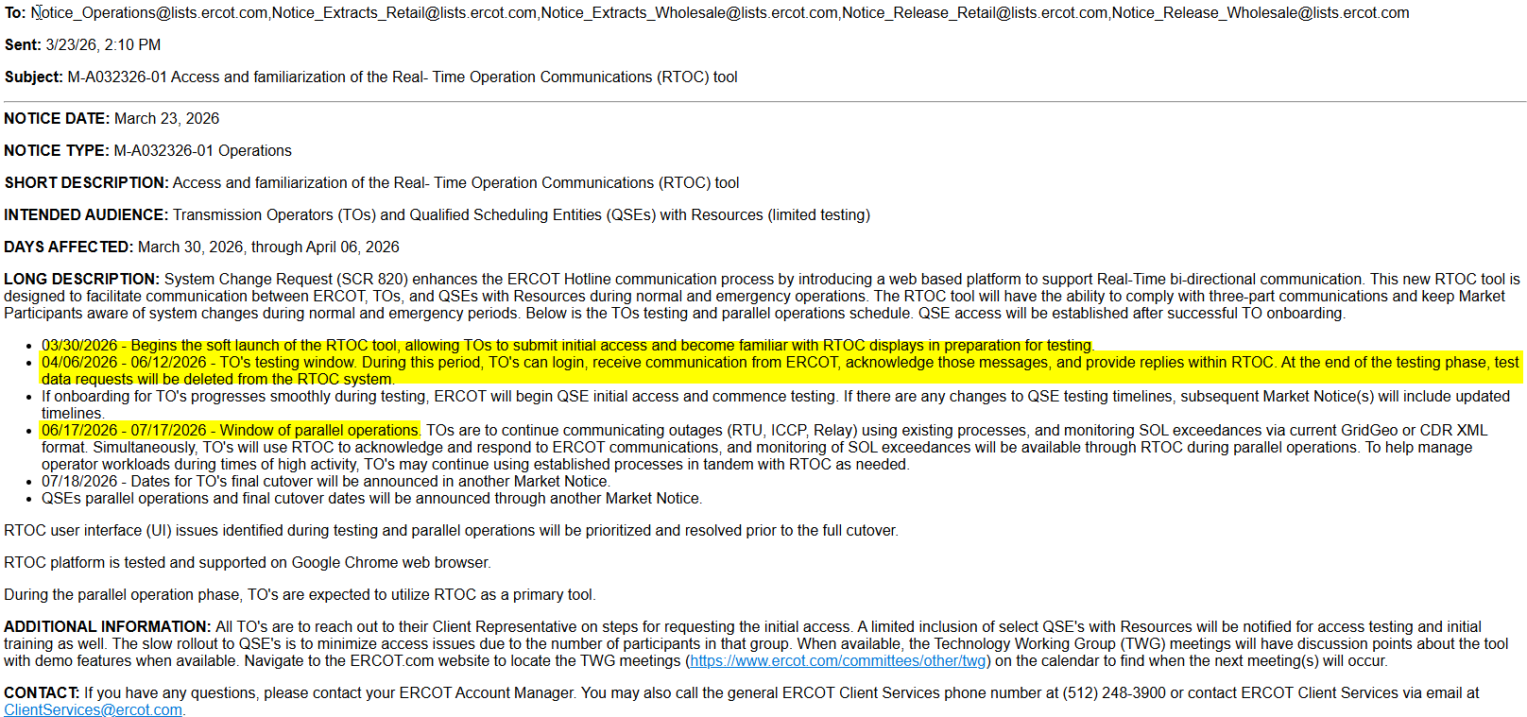
Testing and Parallel Operations Timelines
Market Notice sent out on 03/23/2026:
M-A032326-01 Access and familiarization of the Real- Time Operation Communications (RTOC) tool

Slide 6
Key Highlights
What messages will RTOC handle?
Anything that requires a hotline call today
Examples include:
Operational alerts
Outage notifications
System conditions
These same communications will now be delivered through RTOC for centralized access
How will notifications work?
Audible alerts for critical messages when logged in.
Visual notifications for operational updates.
API integration is under consideration
How Will RTOC Handle QSE Relationships?
Main QSE will have access to the tool
Main QSE should communicate on behalf of sub-QSEs

Slide 7
Market Testing Updates
Companies onboarded and logged into the application during market testing
TOs – 16 – Total Users – 64
QSEs – 4 – Total Users - 12
We are following up with remaining TOs to start testing as well.
16 TOs and 4 QSEs users were able to successfully login and navigate through all the displays.
Control Room Operations is planning to send communications through RTOC tool for testing purpose in parallel with hotline calls for routine tasks.
No major issues were reported by TOs/QSEs so far.
We are planning to send another Market Notice to onboard QSEs for testing.
TOs Testing period ends – June 12th.

Slide 8
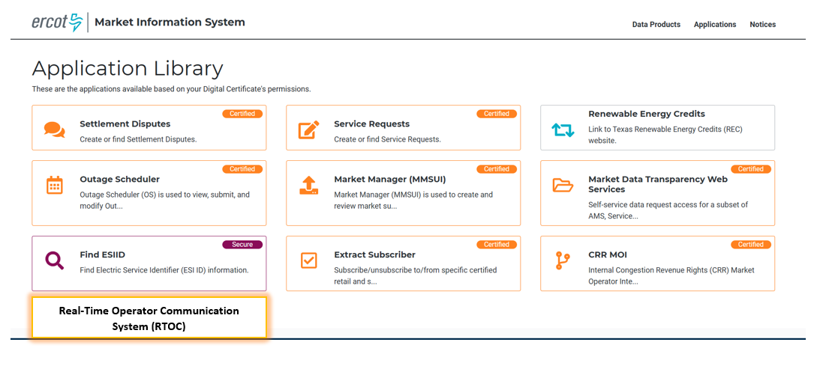
RTOC Tool Access
Access control
Application access will be granted via digital certificates
New roles must be added to the certificate for authorization
Operator (RTOC_M_OPERATOR)
ReadOnly (RTOC_M_VIEW)
Link will be available on mis.ercot.com application library (It will be enabled after the completion of the market testing)
Available to request

Slide 9
Provide Primary Contact Information
We need your help to streamline communication for RTOC Market Testing.
Please share the following details for your organization:
Primary Contact Name
Email Address
Role/Designation
Why?
To provide testing-related communications
Share application URL, updates, and instructions promptly
How to Submit:
Email your details to: ERCOTRTOCSupport@ercot.com

Slide 10
RTOC Tool changes in May Release
Enhancements:
RTOC-188 Communication - Change the styling for unread messages in inbox
RTOC-110 Communications - Scan Attachments
Defects:
RTOC-199 Communication - Acknowledge button displaying even when recipient not required to acknowledge
RTOC-189 Communication - Advance Search for QSE/TSP is not working for acknowledged status
RTOC-195 Communication - validate the message length
RTOC-205 Enhance Communication Screen design to use full screen
May Release (R5) will go into RTOC Production system on 05/28/2026 and available for Market Testing from this date.

Slide 11
SCR820 – RTOC Tool
Default dashboard demo

Slide 12
SCR820 – RTOC Tool
Thank you

