Slide 1
RIOO Enhancements Matthew Tomjack April 23, 2026
Outline:
Load Resource Ownership Change
Substation & Unit Retirement RSCR Update

Slide 2
Overview
Two new capabilities added to RIOO-RS for Resource Entities
Load Resource ownership changes and Substation/Unit retirement can be done using RSCR workflow process
These changes are targeted to be released to Production June 25th, 2026

Slide 3
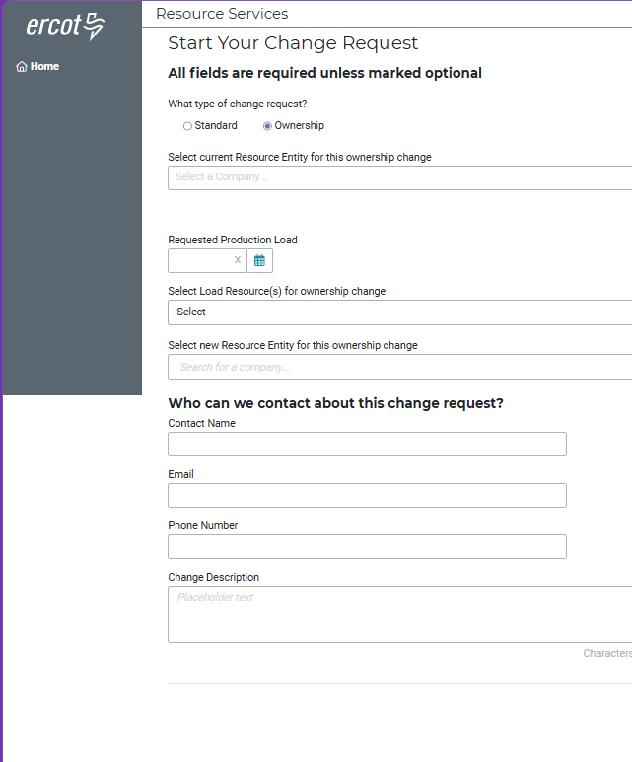
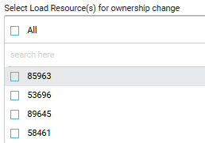
Load Resource Ownership Changes
RSCR workflow is updated to support Load Resource Ownership change
A new change request type ‘Ownership’ was added
This is a single page change request where RE users can use the multiselect feature to select and update the ownership of load resources
Ownership RSCR upon submission will go through ERCOT review and approval process and the changes will be effective on the PLD

Slide 4
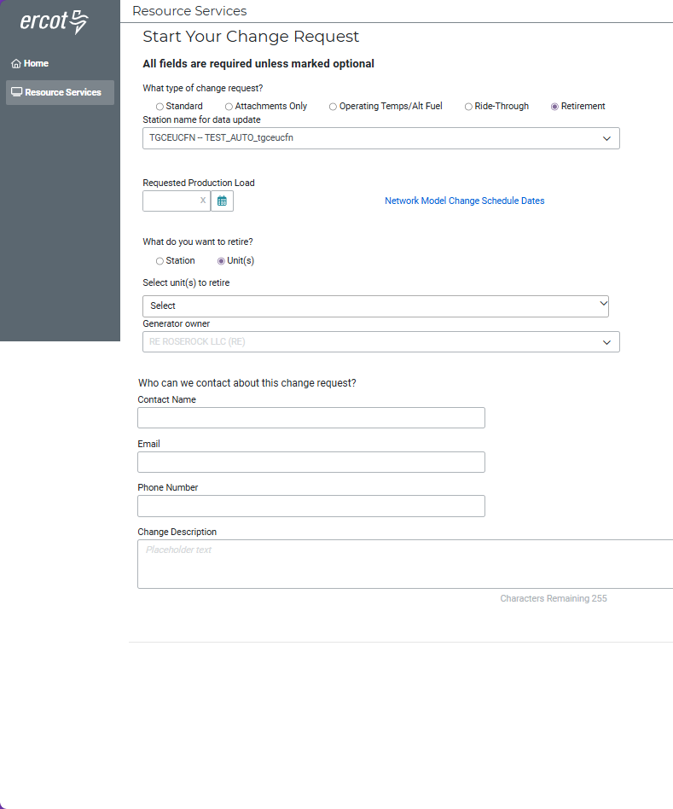
Retirement of Units & Stations
Substation and Unit retirement is currently done using Standard RSCR in RIOO
RSCR workflow is updated to support Substation and Unit retirement change using a new change request type - ‘Retirement’
This is a single page change request where RE users can use the multiselect feature to retire a Unit
Users are also able to retire a station by selecting the Station radio button
Retirement RSCR will go through ERCOT review and approval process after it has been submitted

Slide 5
Why This Matters
Reduced manual processing
Ownership & Retirement changes no longer require email coordination
Improved turnaround times
Submissions flow directly to ERCOT for review
Higher data quality
Structured, purpose‑built forms reduce errors and eliminate workaround processes
Enhanced user experience
All actions are completed within RIOO through standardized workflows

Slide 6
Thank you!

