Slide 1
Outage Scheduler (OS) Enhancements Project Updates – Pre-existing overlapping Outages Handling
Katherine Li
Chandra Bussa
April 23, 2026
Outline:
Outage Scheduler Enhancement
Sample - Overlapping Resource Outages With Zero HSL
Sample - Overlapping Resource Outages with Same LSL & HSL
Sample - Outages with Nature of Work of Other or Unknown
Sample - Resource Planned Outage Limits Warning
Sample - Maintenance 2 & Maintenance 3 Outage Planned Start
Pre-existing Overlapping Outages Handling
Key Takeaways
  OS Enhancement change samples
  Pre-existing Overlapping Outages Handling

Slide 2
Outage Scheduler (OS) Enhancements Project
OS Enhancement introduces following changes
  Provide new warning messages when proposed resource planned outage(s) exceeding MSRPOC
  Overlapping resource outages with zero HSL are not allowed
  Overlapping resource outages with same LSL and/or HSL are not allowed
  For M2 outages, entering a Planned Start less than 1 day before the start is not allowed
  For M3 outages, entering a Planned Start less than 3 days before the start is not allowed
  If an Outage has a Nature of Work (NofW) of (“Other” or “Unknown”), it is required that
    either change the NofW, If applicable, or a note must be added to the Supporting Notes section before the outage can be COMPLETED
  If an Outage has a Nature of Work(NofW) that is not (“Other” or “Unknown”), it may only be changed to a different NofW that is not (“Other” or “Unknown”)
    The only time we expect a NofW of (“Other” or “Unknown”) is when an outage is created.
There are no XSD changes.
These changes are available in MOTE for Market Participants testing from the week of February 2, 2026.
OS Enhancement Project went live on 03/26/2026 with March (R3) release.

Slide 3
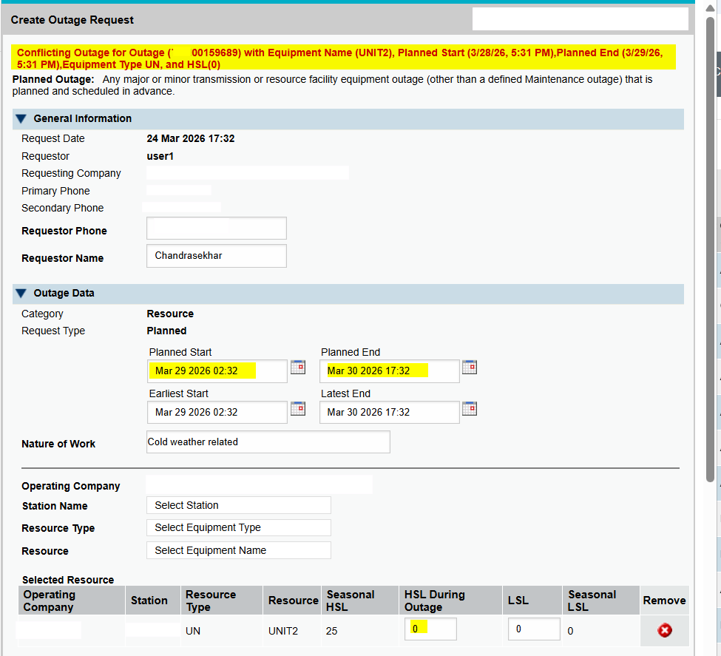
Sample 1 - Overlapping Resource Outages With Zero HSL
Overlapping resource outages with Zero HSL are not allowed.
Existing Outage:

Slide 4
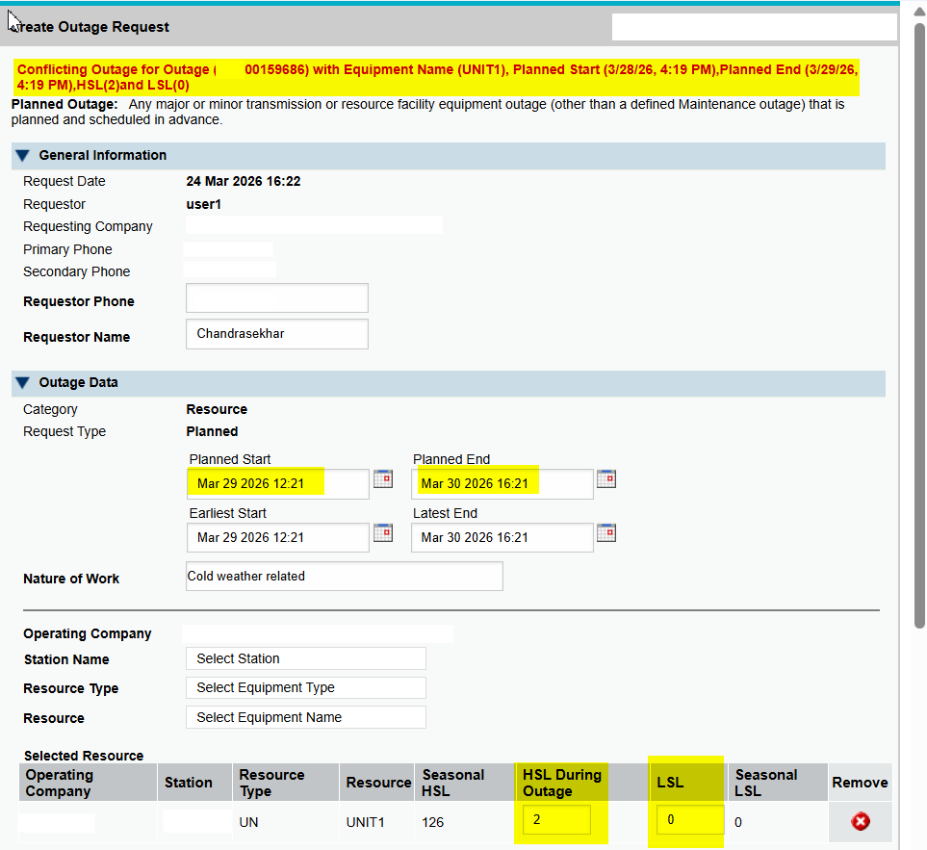
Sample 2 - Overlapping Resource Outages with Same LSL & HSL
Overlapping resource outages with same LSL & HSL are not allowed.
Existing Outage:

Slide 5
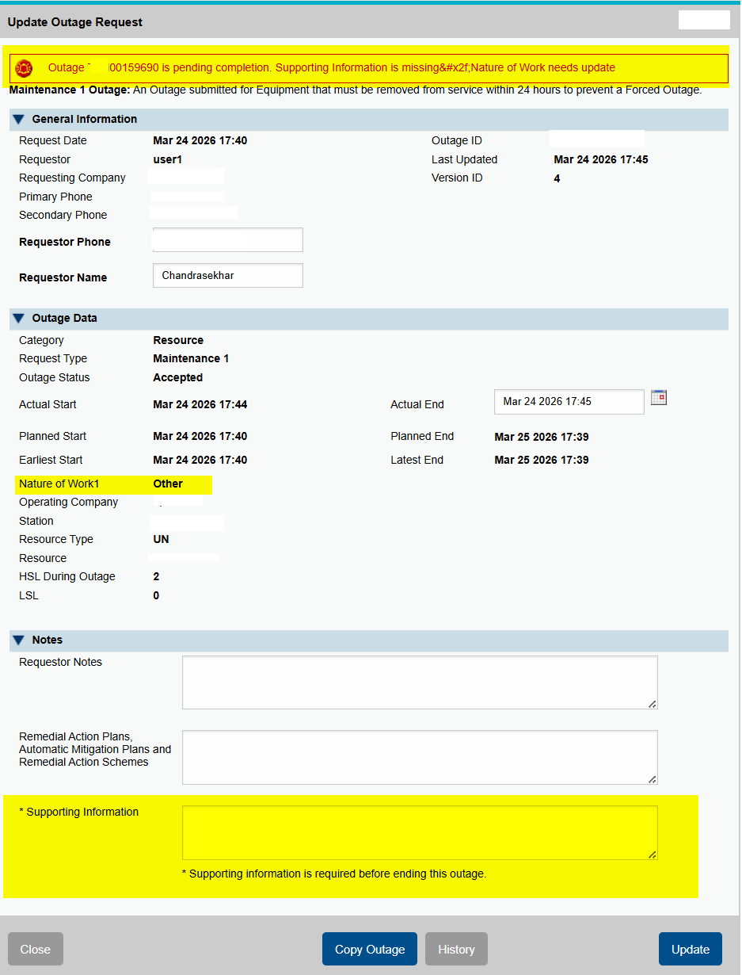
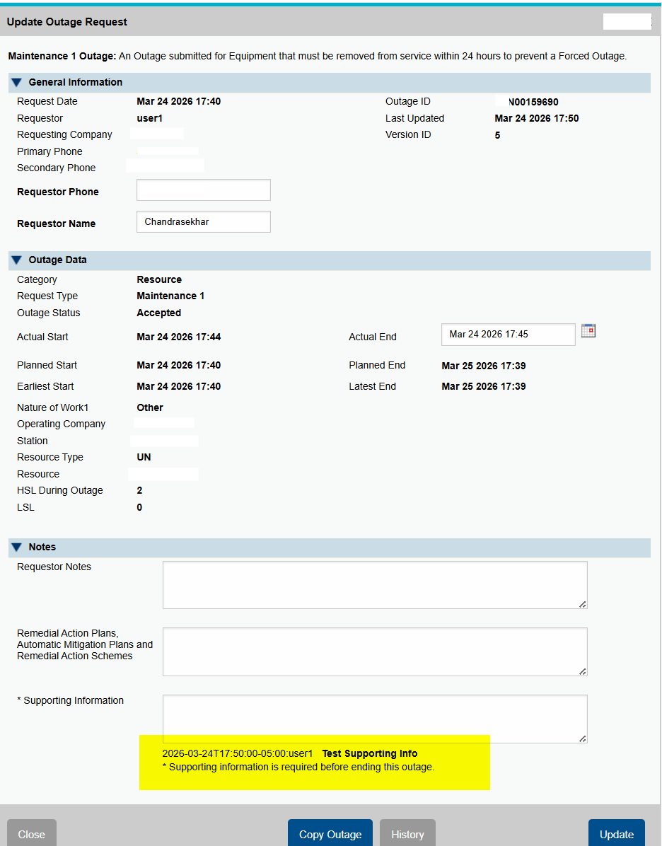
Sample 3 – Outages with Nature of Work of Other or Unknown
A warning would be displayed for an outage with Nature of Work as Others or Unknown if Supporting Information is NOT provided and the outage would be in pending complete.
- Support Information is needed when ending an outage - Outage is ended successfully with Supporting Information provided.

Slide 6
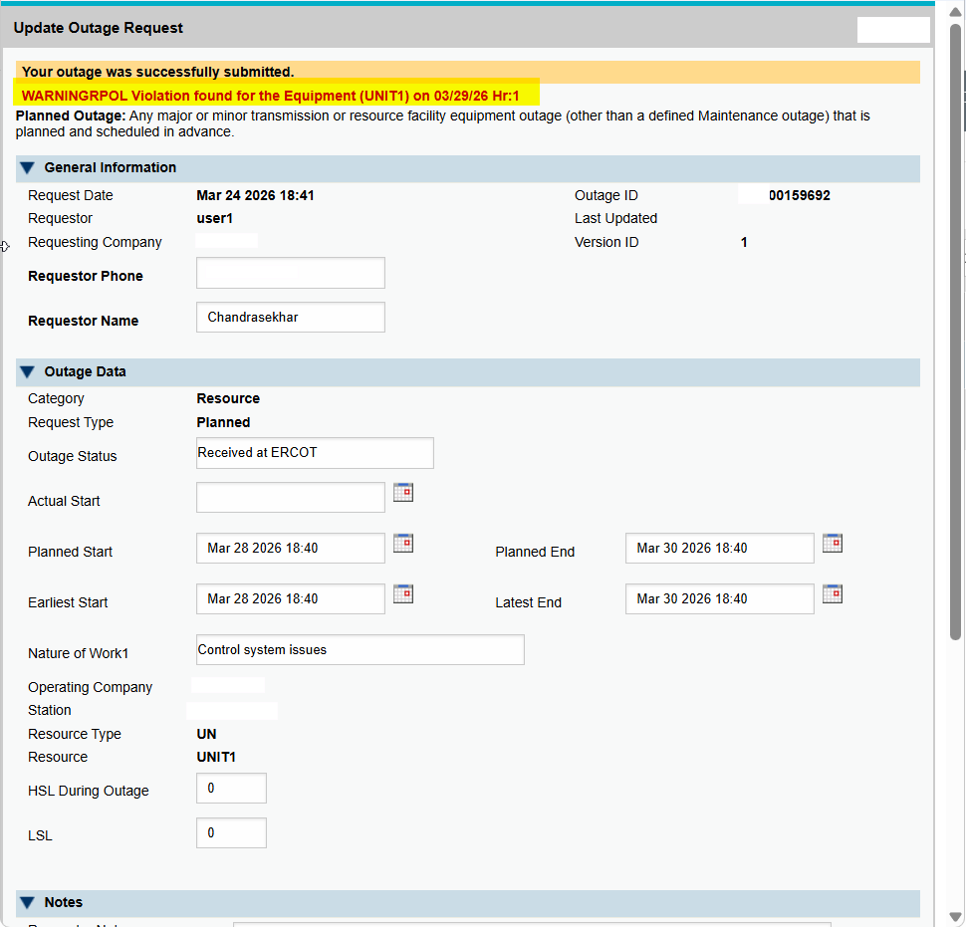
Sample 4 – Resource Planned Outage Limits Warning
A new warning messages is provided when a proposed resource planned outage exceeding RPOL (Resource Planned Outage Limit).

Slide 7
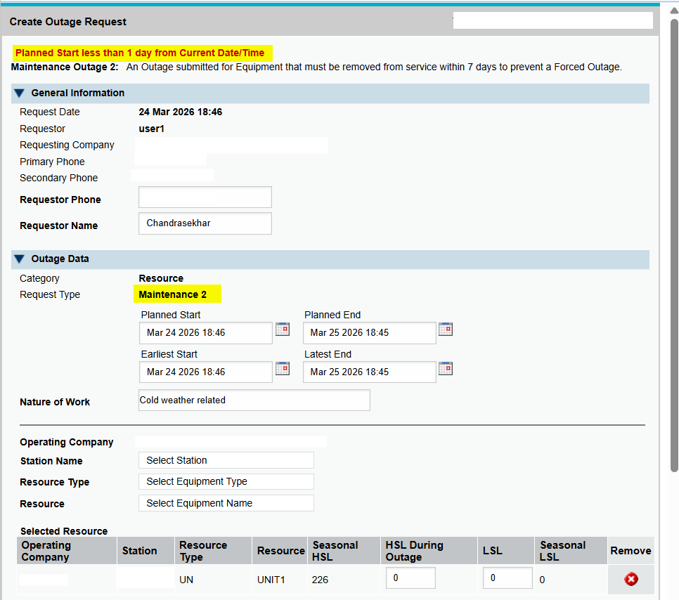
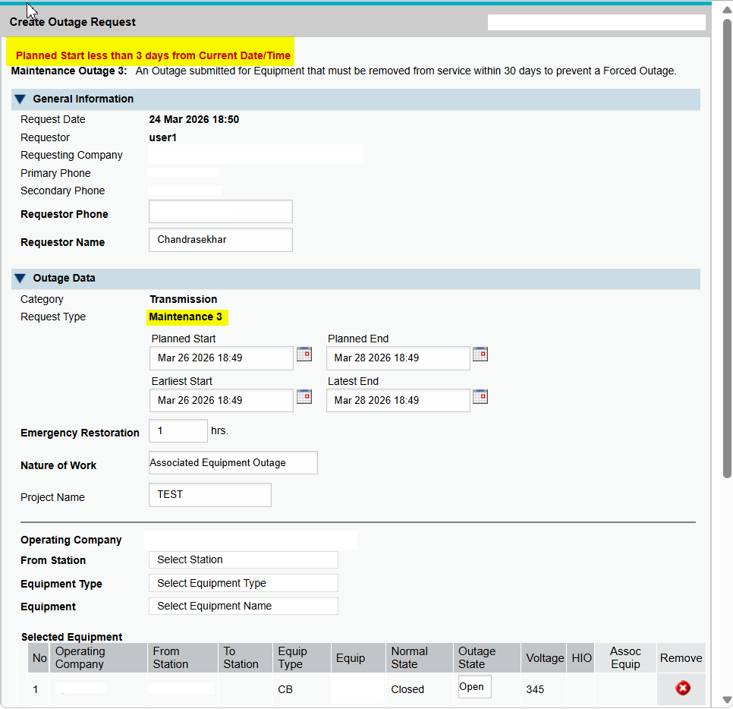
Sample 5 – Maintenance 2 and Maintenance 3 Outage Planned Start
A new warning messages is provided when a proposed resource planned outage exceeding RPOL (Resource Planned Outage Limit).
- Maintenance 2 Planned Start < one day - Maintenance 3 Planned Start < three days

Slide 8
Pre-existing Overlapping Outages Handling
ERCOT does do NOT plan to have system changes to automatically handle the pre-existing overlapping outages.
ERCOT will assist Market Participants to handle the pre-existing overlapping outages, including outages with same LSL and HSL, or zero-HSL.
  Step 1: QSE initially reaches out to ERCOT by Service Desk ticket(s) (recommended)
    a Service Desk ticket with a note to include the conflicting outage identifiers, and the outage they want to update.
    QSEs can also reach out to their respective ERCOT Client Services Account manager with same request
  Step 2: ERCOT will modify
    Zero-HSL outages:
      one outage with HSL = 1 and others with different values
    Non-zero HSL outages
      one outage with HSL or LSL different for the other overlapping outages
      An example of two overlapping outages with LSL = 1 and HSL = 5, ERCOR will update one outage to be different from the other like HSL= HSL +1, or LSL = LSL +1
  Step 3: MP can then update the outages as needed, and notify ERCOT once the MP’s updates complete
  Step 4: ERCOT will reverse HSL, or LSL, back to the precious values for the outage(s)

Slide 9
Pre-existing Overlapping Outages Handling
Example 1 - three overlapping outages with zero-HSL
  IDENTIFIER EQUIPMENT_HSL
  AAAAAAA743 0
  AAAAAAA373 0
  AAAAAAA793 0
ERCOT modifies the outages’ HSLs to non-zero values
  IDENTIFIER EQUIPMENT_HSL
  AAAAAAA743 0
  AAAAAAA373 1
  AAAAAAA793 2
MP updates as needed and notifies ERCOT once its updates complete
ERCOT reverts HSL back to 0 after MP updates the outages
  IDENTIFIER EQUIPMENT_HSL
  AAAAAAA743 0
  AAAAAAA373 0
  AAAAAAA793 0
Example 2 - two overlapping outages with same HSL & LSL
  IDENTIFIER EQUIPMENT_HSL EQUIPMENT_LSL
  BBBBBBBB178 82 70
  BBBBBBBB099 82 70
ERCOT modifies the outages’ HSL & LSL not matching with the other
  IDENTIFIER EQUIPMENT_HSL EQUIPMENT_LSL
  BBBBBBBB178 83 71
  BBBBBBBB099 82 70
MP update as needed and notify ERCOT once its updates complete
ERCOT reverts HSL and LSL back to previous values after MP updates the outages
  IDENTIFIER EQUIPMENT_HSL EQUIPMENT_LSL
  BBBBBBBB178 82 70
  BBBBBBBB099 82 70

Slide 10
Questions/Comments?
Katherine.Li@ercot.com
Sreenivas.Badri@ercot.com

