Slide 1
NPRR 1188 – Market Applications and API XSD changes
Xiangjun Xu
Susan Jinright
April 23,2026
Outline:
NPRR 1188 overview
SCED and DAM changes
Market Manager UI & External webservice changes
Key Takeaways
NPRR 1188 project is in requirements development and design phase, impacts QSEs Market Submissions EWS APIs.

Slide 2
NPRR 1188 Overview
NPRR 1188 enables nodal dispatch for Controllable Load Resources (CLR) that are not ALR’s
Aggregate Load Resources (ALR) will continue to be settled at Load Zones (LZ)
New Resource Nodes (RN) and ERCOT-Polled Settlement (EPS) meters will be added for CLR’s that are not ALR’s.
CLRs should have the Meters installed in the field and go through qualification process to be able to participate in the market from the Go-Live date.
Tentative go-live date: Jan 2027

Slide 3
SCED and DAM Changes for CLR’s that are not ALR’s
SCED
  Changed from LZ to nodal dispatch
  EPS meters and RN’s will be added
  New telemetry: ONTEST and ONHOLD – basepoint will be set to telemetry MW
  OUTL status – not consuming energy, telemetry MW = 0
DAM
  Can submit energy bids for DAM Ahead Market
  RN’s will be added
  DAM LPC = 0, dispatch range will be [0, MPC-LPC] in DAM

Slide 4
External Webservice XSD Changes
RTMEnergyBid will be renamed to EnergyBidCurve, as it will be used for both Realtime and Day Ahead Markets:
api-specs/ews/xsds at ews_NPRR1188 · ercot/api-specs · GitHub
ErcotTransaction.xsd
ErcotTransactionTypes.xsd

Slide 5
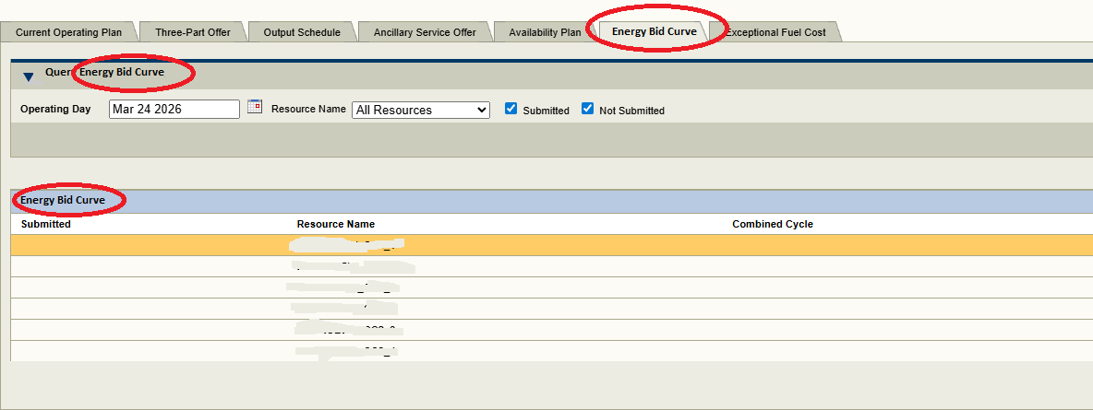
Market Manager (MMS UI) Changes

Slide 6
Questions/Comments?
Xiangjun.Xu@ercot.com

