Slide 1
NPRR 1188 – ICCP Telemetry handbook updates Tejaswi Potluri/Kevin McGarrahan April 23, 2026
Outline:
NPRR 1188 ICCP handbook updates to include two new resource status codes for Load Resources
Key Takeaways
NPRR 1188 project is in requirements development and design phase.

Slide 2
NPRR 1188 Overview
NPRR 1188 enables nodal dispatch for Controllable Load Resources (CLR) that are not ALR’s
Tentative go-live date: Jan 2027
Adds two new resource statuses for Load Resources
Status Code (RSTR) | Label | Description | Device | Notes
259 | ONTEST | On-line blocked from SCED for operations testing | Load Resource (CLR and NCLR) | Available for COP and real time telemetry.
260 | ONHOLD | CLR is On-Line but temporarily unavailable for Dispatch by SCED or providing Ancillary Service due to a valid and verifiable operational reason. | Load Resource (CLR only) | Not applicable for COP. Available for real time telemetry only. For SCED, Resource Base Points will be set equal to the telemetered net real power of the Resource available at the time of the SCED execution.

Slide 3
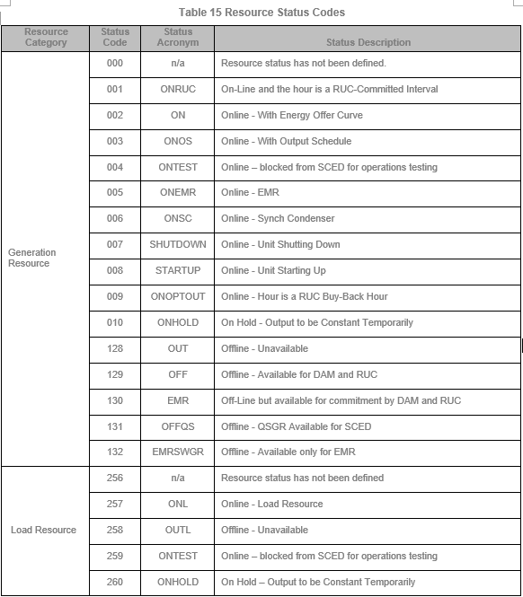
Draft ICCP handbook updates
A draft version of ICCP handbook updates are shown here
The updated version of the ICCP handbook will be posted to ercot.com closer to the go-live date of this NPRR.
Posting of the ICCP handbook with NPRR1188 updates will be communicated in future TWG meetings.

Slide 4
Questions/Comments?

