Slide 1
ERCOT
Technology Working Group (TWG)
Weijun Ji
Sreenivas Badri
April 23, 2026
Outline:
Antitrust Admonition
Agenda
Sequence of discussion Items

Slide 2
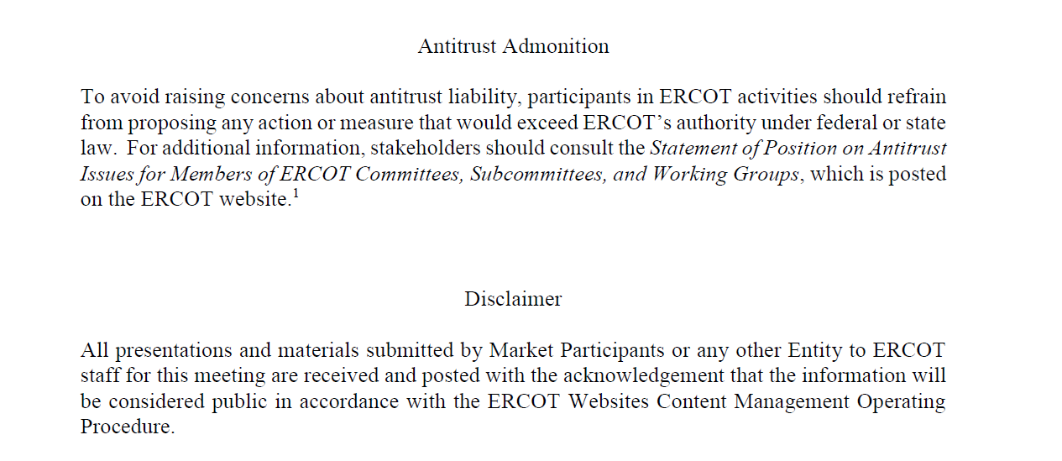
ERCOT TWG

Slide 3
Agenda
Item # | Item Description | Presenter | Start Time
1 | Antitrust admonition | Sreenivas Badri | 2:00 PM
2 | Project Updates | Troy Anderson | 2:05 PM
3 | Public Website Cipher Security Hardening - Reminder | Leo Angele | 2:20 PM
4 | 2026 April and May Release (R4 & R5) changes Market Submissions Data and Information Products | Katherine Li/Jamie Lavas | 2:25 PM
5 | Outage Scheduler Enhancements Project updates – pre-existing overlapping outages handling | Katherine Li | 2:40 PM
6 | SCR820 – Real-Time Operator Communication Tool (RTOC) - Market Testing updates | Preethi Meher/Christelle Seri | 2:45 PM
7 | DPC Process Automation Tool – Market Testing updates and Demo | Yugendher Karedla/Yong Ma | 3:00 PM
8 | Large Load Curtailment Manager project updates | Luke Butler/Kevin McGarrahan/Susan Jinright | 3:15 PM
9 | NPRR1188 Implementation updates XSD changes Telemetry changes CLR Metering Requirements & Go-Live Options | Xiangjun Xu/Kevin McGarrahan/Calvin Opheim | 3:25 PM
10 | RIOO - Load Resource Ownership and Substation/Unit Retirement RSCR updates | Matthew Tomjack | 3:50 PM
11 | Round Table Discussion Future Topics of Interest | Weijun Ji | 4:00 PM
12 | Adjourn | Weijun Ji | 4:10 PM

Slide 4
Project Updates
  Project updates – Troy Anderson

Slide 5
Public Website Cipher Security Hardening - Reminder
  Public Website Cipher Security Hardening – Reminder – Leo Angele

Slide 6
2026 April and May (R4 & R5) Release changes
      Market Submissions – Katherine Li
      Data and Information Products – Jamie Lavas

Slide 7
Outage Scheduler Enhancements Project updates
      Pre-existing overlapping outages handling – Katherine Li

Slide 8
SCR820 – Real-Time Operator Communication Tool updates
SCR820 – Real-Time Operator Communication Tool (RTOC) – Market Testing updates and Demo -
Preethi Meher/Christelle Seri

Slide 9
DPC Process Automation updates
DPC Process Automation Tool updates – Market Testing updates and Demo
-Yugendher Karedla/Yong Ma

Slide 10
Large Load Curtailment Manager (LLCM)
Large Load Curtailment Manager (LLCM) Project updates -
Luke Butler/Kevin McGarrahan/Susan Jinright

Slide 11
NPRR1188 – Implementation Updates
        XSD changes – Xiangjun Xu
        Telemetry changes – Tejaswi Potluri
        CLR Metering Requirements & Go-Live Options – Calvin Opheim

Slide 12
DPC Process Automation updates
RIOO - Load Resource Ownership and Substation/Unit Retirement RSCR updates - Matthew Tomjack

Slide 13
ERCOT TWG – Round Table Discussion
ERCOT TWG – Round Table Discussion
  Future Topics of Interest
  Topics and presentations from TWG members

Slide 14
Thank You
Questions/Comments/Feedback?
You can reach Sreenivas at
Sreenivas.Badri@ercot.com and Weijun at weijun.ji@lcra.org

