Slide 1
2026 April & May(R4 & R5 ) Releases – Market Submissions Changes Katherine Li April 23, 2026
Outline:
2026 April (R4) Release
2026 May (R5) Release
Key Takeaways
Submission change for COP in April release

Slide 2
2026 April (R4) Release – Market Submission Changes
2026 April (R4) Release will be deployed into Production on 04/29/2026.
It contains one validation change for Current Operating Plan (COP) submission: a Quick Start Generation Resource (QSGR) with Off-Line Non-Spinning Reserve (Non-Spin) qualification will be allowed to submit its COP with non-zero Non-Spin capability.
Without the fix, a QSGR is NOT able to submit its COP with non-zero NSPIN capability unless it is qualified for On-Line NSPIN.
This issue was reported by one market participant in early April.

Slide 3
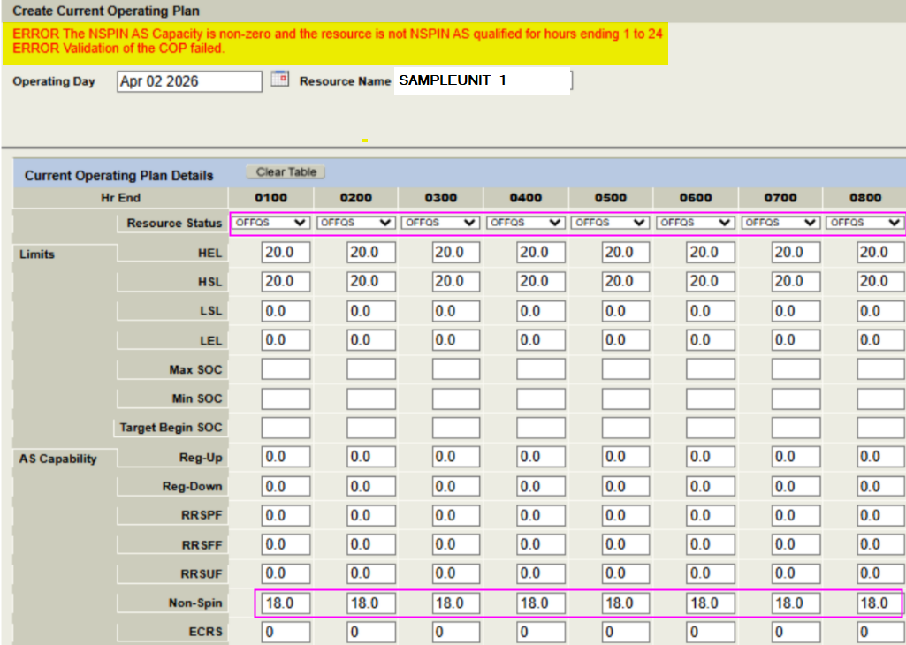
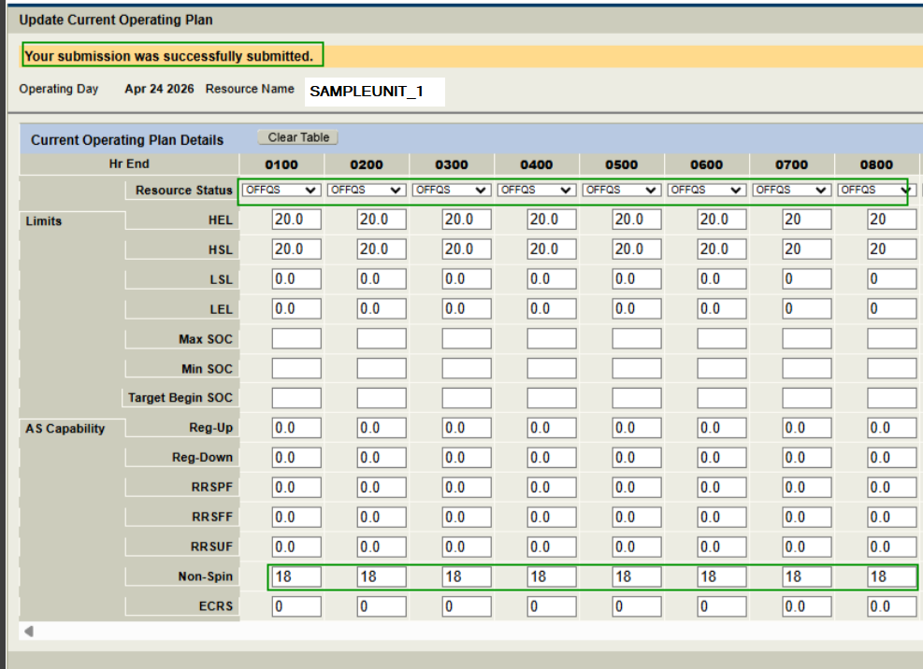
2026 April (R4) Release – Market Submission Changes – An Example
Prior to April release
With the change in April release

Slide 4
2026 May (R5) Release – Market Submission Changes
May (R5) release does not have any Market submissions changes planned that may impact Market Participants.
2026 May (R5) Release will be deployed into Production on 05/28/2026.

Slide 5
Questions/Comments?
Katherine.Li@ercot.com
Sreenivas.Badri@ercot.com

