Slide 1
NDSWG Meeting
April 2026

Slide 2
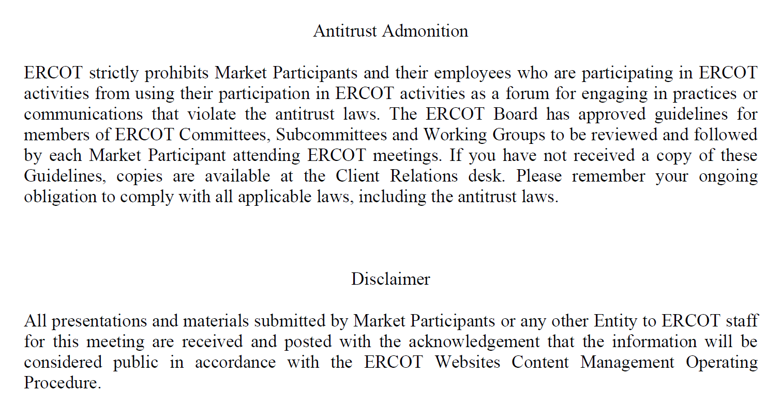

Slide 3
Topics
UDG workshop on April 30, 2026
Temporary/retirement equipment cleanup – seeking feedback from the working group
CIM16 update
Requests and reminders:
  Providing LLI number on large load submissions
  Notification on status changes on requests
  Additional Data Required status
  One-line diagram on contingency CAMRs
Pending and upcoming work:
  Reports to be updated as requested from the previous meeting
  Contingency overview training
  ICCP Handbook update

Slide 4
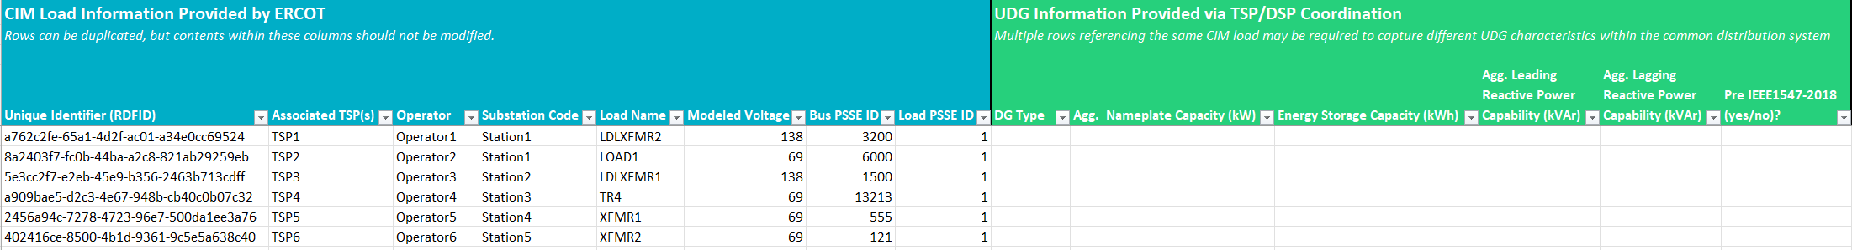
UDG Workshop
NPRR 1265 – Unregistered Distributed Generator(UDG)
Workshop on April 30, 2026
  Market Notice will be sent on Thursday, April 23, 2026
  Materials will be posted prior to workshop. Please review!
  Suggestions and ideas are welcome
Pre-populated forms will be generated and posted to the MIS website
Notes:
HB 3390 – passed on June 2, 2023
NPRR 1265 – posted December 2024 and PUCT approved November 2025

Slide 5
Temporary/retirement equipment cleanup
Goal is to keep the model accurate and aligned with what is in the field.
ERCOT have generated a list of equipment using the outage scheduler data(retired or past planned dates)
Bulk verification requests sent to TSPs and have received feedback.
Recurring cadence of cleanup requests – every two months?
Additional cleanup – non dynamically rated equipment that have weather zone populated. ERCOT will submit a NOMCR for May ML2

Slide 6
CIM 16 update
CIM 16 version of NMMS loading into Itest environment
SCR 813 – adds coordination prompt when jointly-rated equipment is modified
  Delivery by end of April 2026
CIM 16 Training – Q4 2026

Slide 7
Requests and reminders
  Providing LLI number on large load submissions
  Notification on status changes on requests
  Additional Data Required status
  One-line diagram on contingency CAMRs

Slide 8
Pending and upcoming work
  Reports to be updated as requested from the previous meeting
  Contingency overview training
  ICCP Handbook update

Slide 9
Other Topics
  Open discussion

