Slide 1
2025 Frequency Analysis and Trends
PDCWG Meeting
April 15, 2026

Slide 2
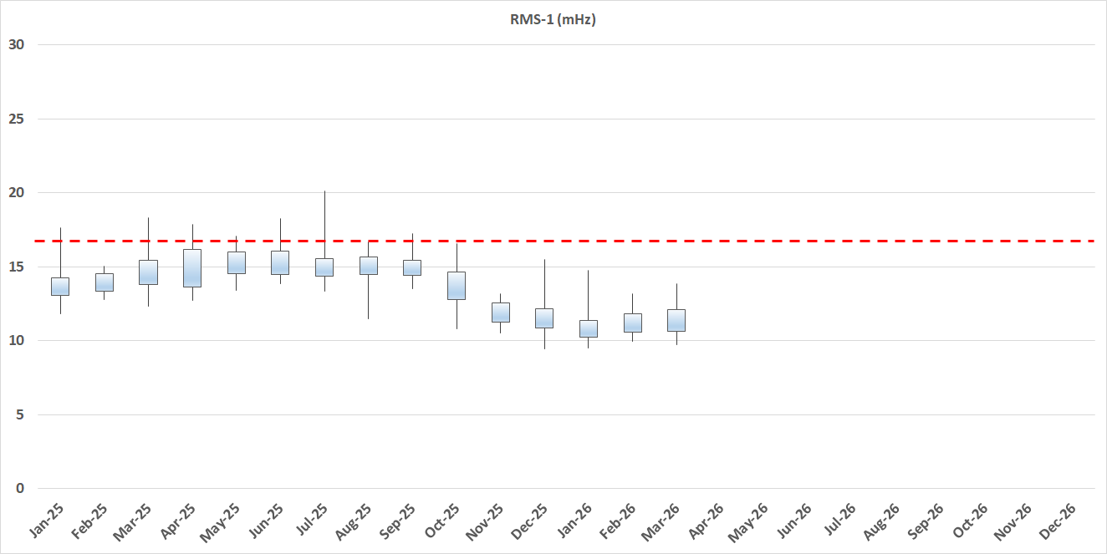
Tuning improvements made in Oct 2025 and Dec 2025
Improvements seen in CPS-1 and RMS-1
Change in frequency profile following tuning changes

Slide 3
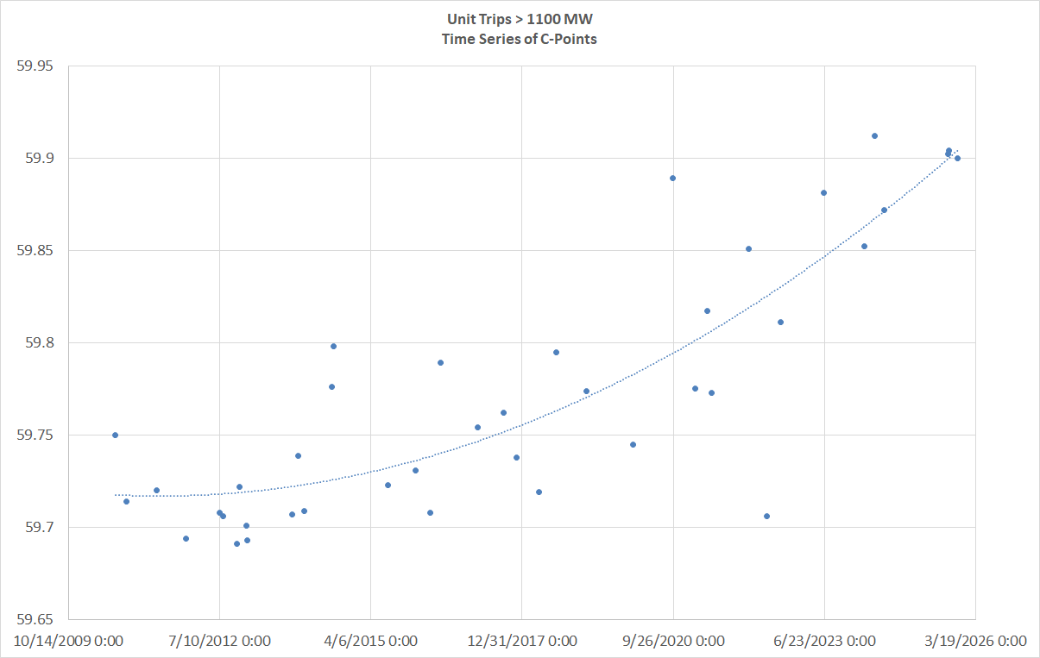
Unit Trips > 1100 MW
Time Trend of C-point Frequency

Slide 4
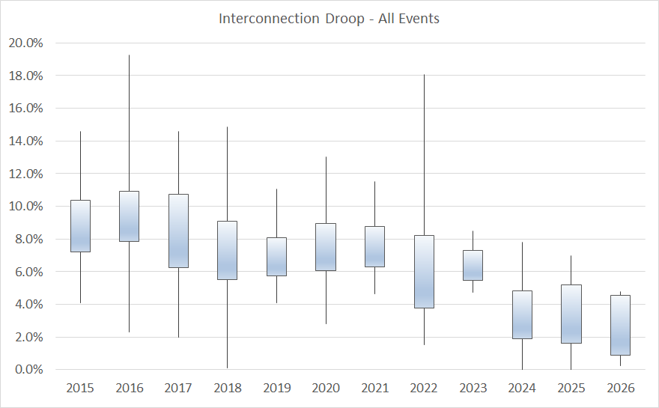
Interconnection-level equivalent droop

Slide 5
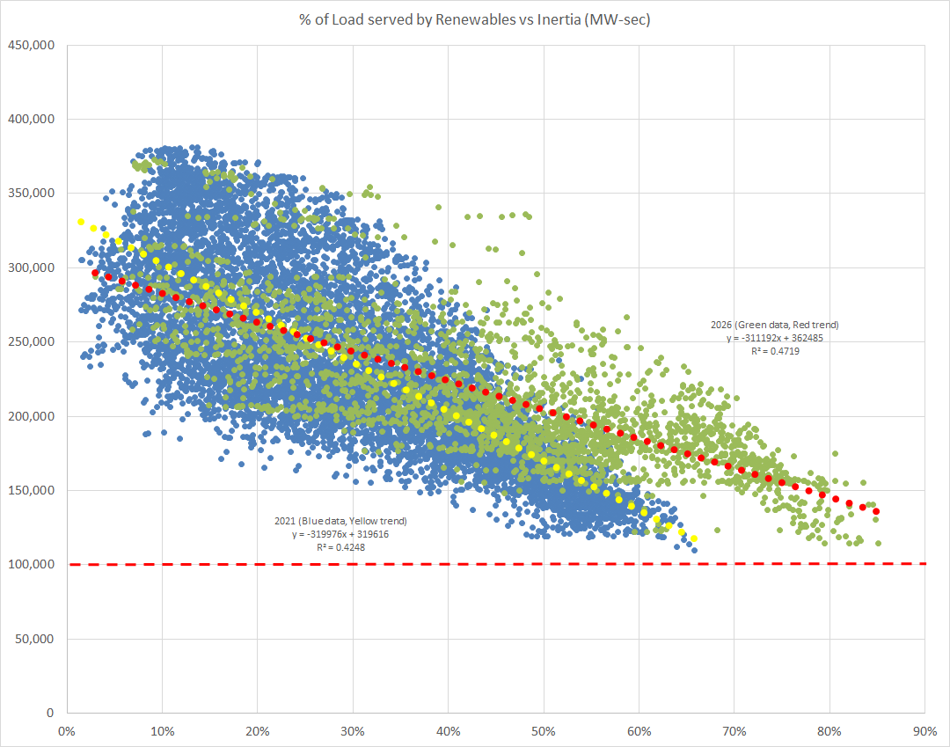
Comparison of Inertia vs Renewable Penetration
2021 (blue) vs 2026 (green)
Year | Count of Hours Renewable % > 70%
2023 | 1
2024 | 39
2025 | 163
2026 YTD | 253

Slide 6
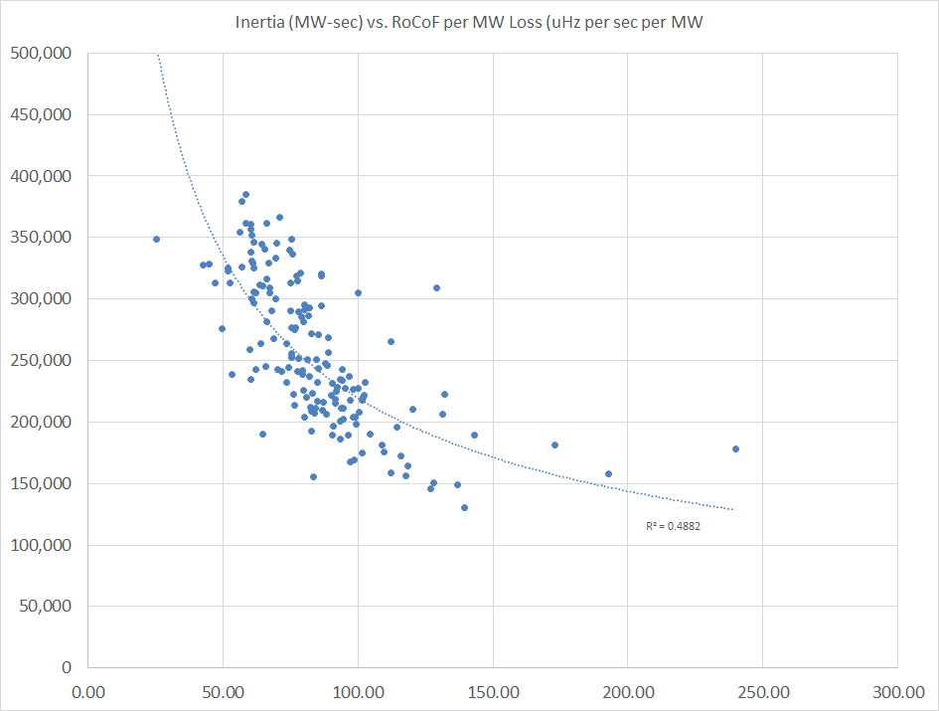
Initial RoCoF at t₀:
Inertia and RoCoF
Theoretical RoCoF calculation on left. Graph shows theoretical inertia vs RoCoF/GW loss.
Actual ERCOT measurements below using same variables

Slide 7
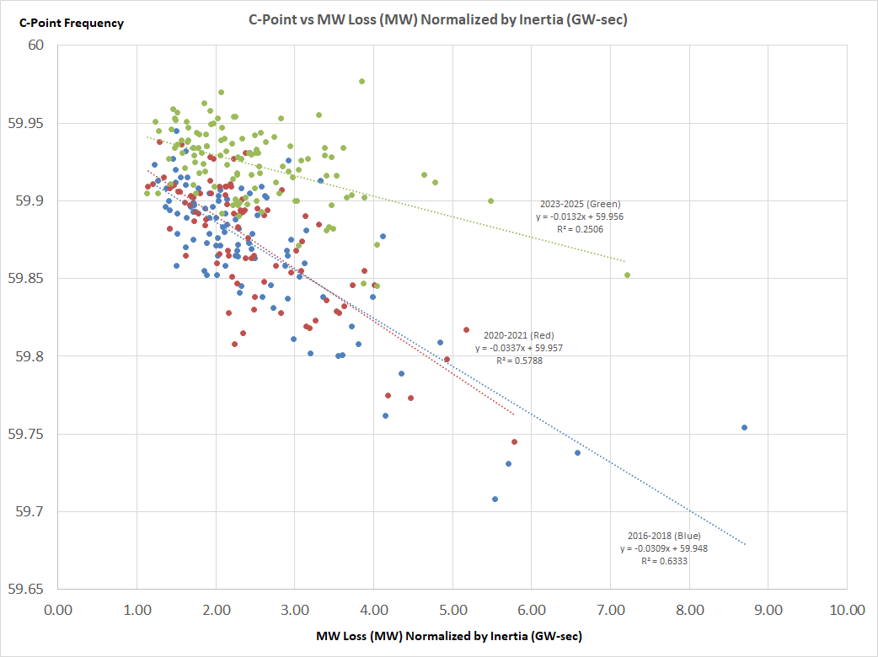
Plot of C-point Frequency vs MW loss normalized by Inertia
Multi-year year blocks of data
Frequency response A-C reflects similar trend

Slide 8
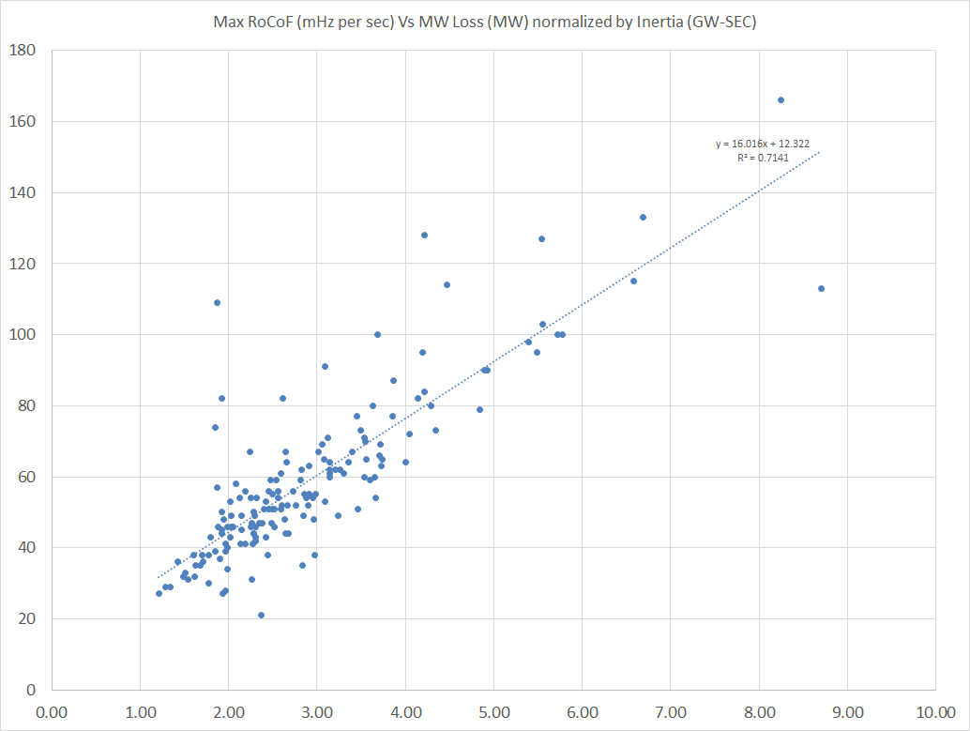
Max RoCoF vs MW loss normalized by Inertia
2016-2025 inclusive

Slide 9
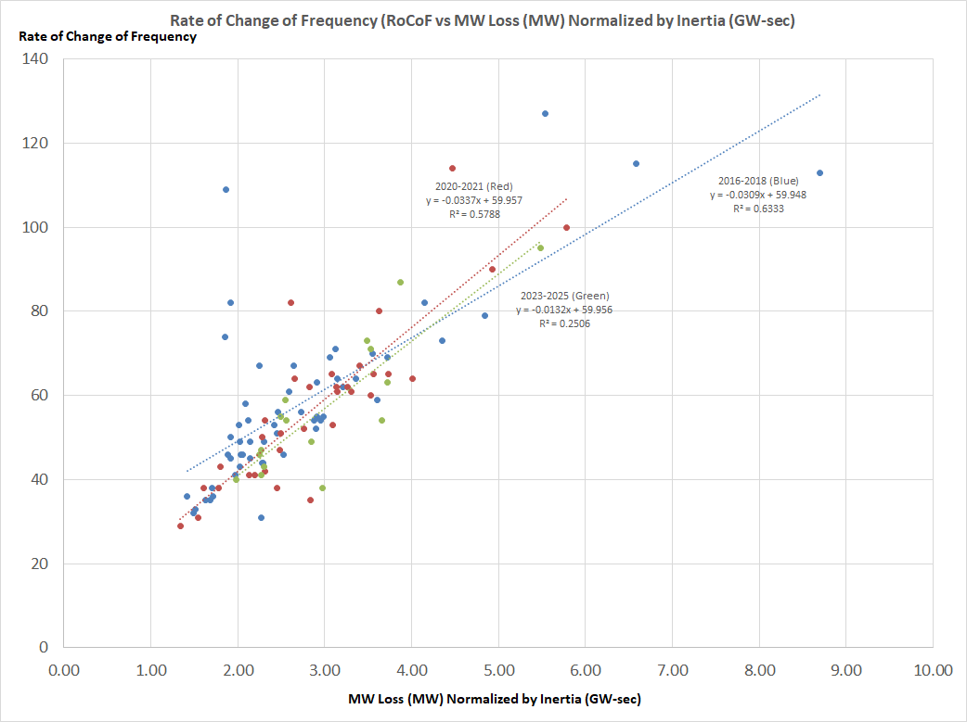
Plot of Max RoCoF measured vs MW loss normalized by Inertia
Multi-year blocks of data

Slide 10
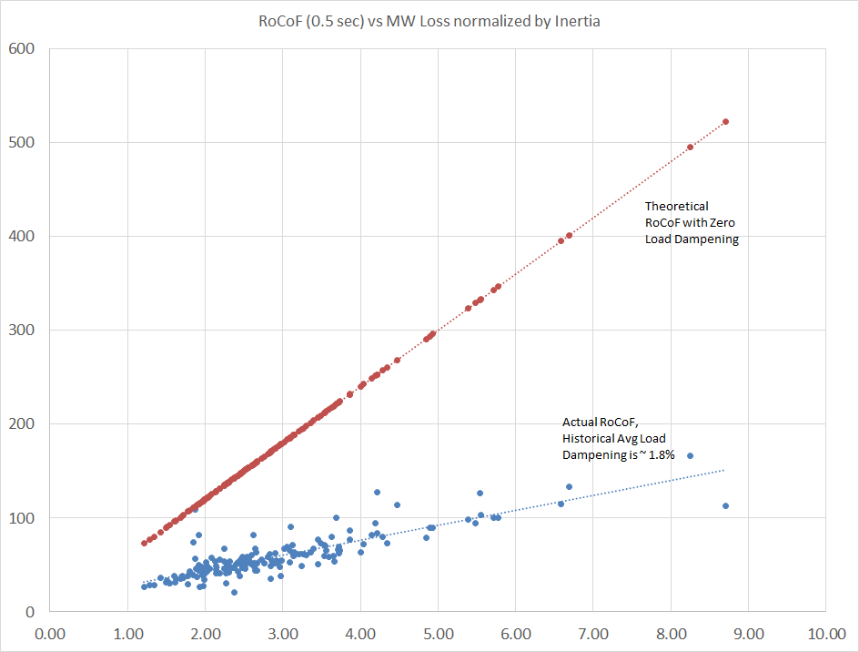
Equation for frequency deviation at 0.5 s
Inertia and RoCoF
Theoretical frequency deviation calculation on left at 0.5 sec.
Theoretical RoCoF with zero load dampening (D) is shown by the red dotted line. Actual ERCOT measurements are shown by the blue points, slope of trend line indicates average load dampening of ~1.8%

Slide 11
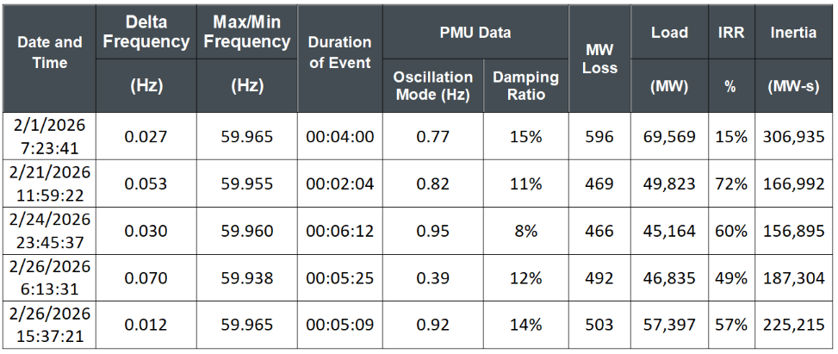
Oscillations measured during Frequency Events
Oscillation frequency and damping ratio reported for each frequency event
Measured by PMU data
Included in monthly Operations reports to ROS

Slide 12
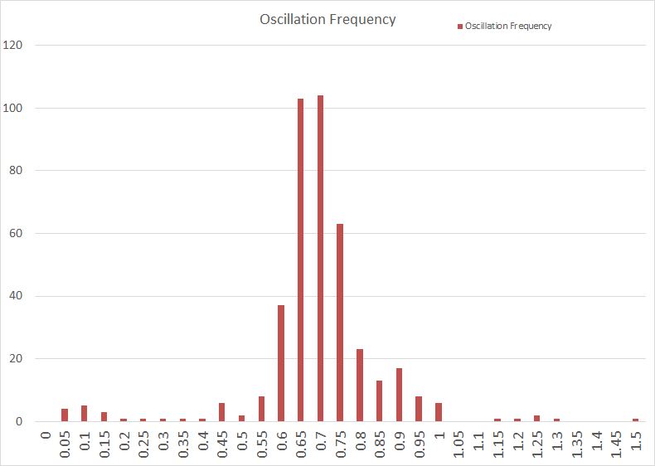
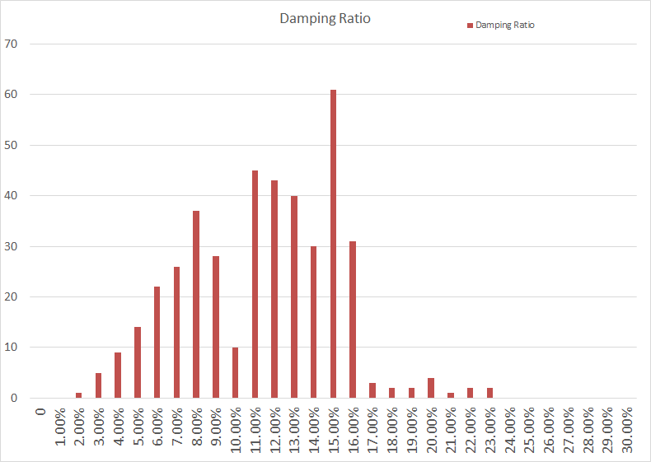
Dominant oscillation frequency from FMEs is between 0.65 – 0.75 Hz
Damping ratios should be 3% or greater

Slide 13
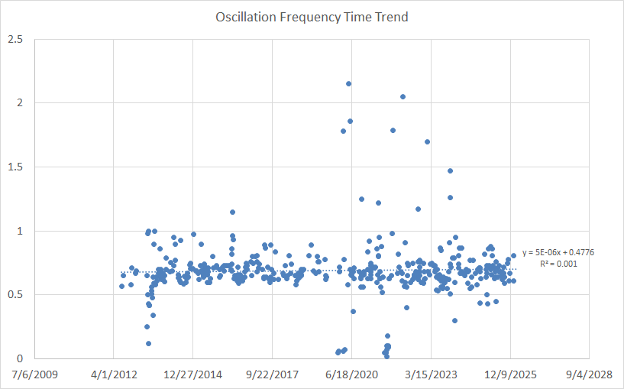
Time trend of oscillation frequency
Very little changes

Slide 14
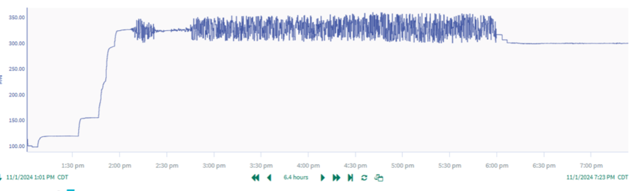
Other Oscillation Events due to IBRs and Large Loads
Event Type | # of events in 2025
IBR Ride-Through Events | 12
Large load Ride-Through Events | 12
Large load Oscillation Events | 1
IBR Oscillation Events | 24
IBR Large MW Change Events (no fault) | 39
Large Load oscillation event 11/1/2024
23 Hz oscillation frequency

Slide 15
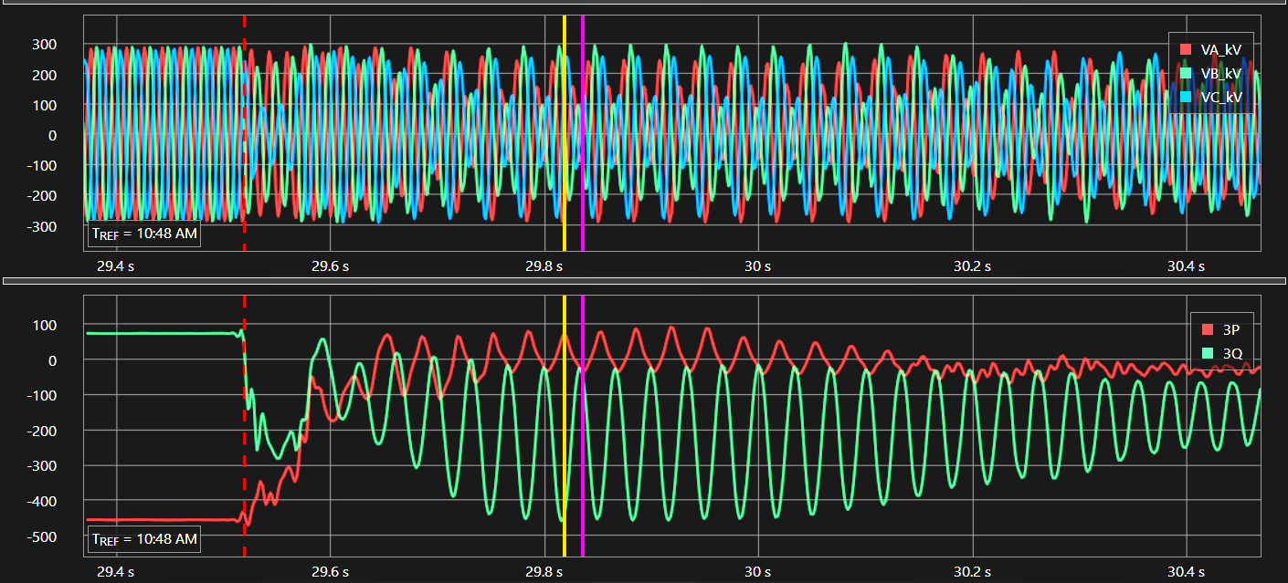
Rio Grande Valley IBR SSCI oscillation event March 2023
IBR placed in series with series cap station following contingency outage

Slide 16
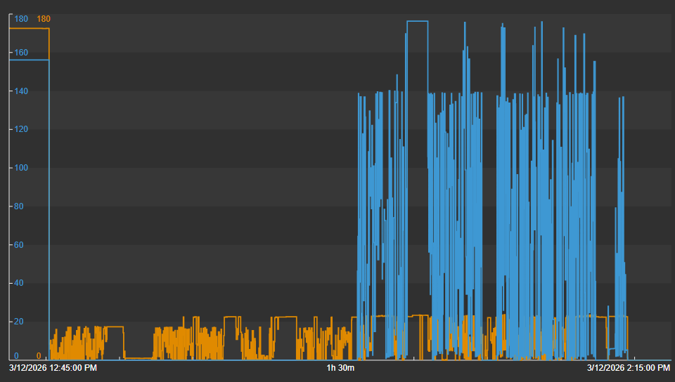
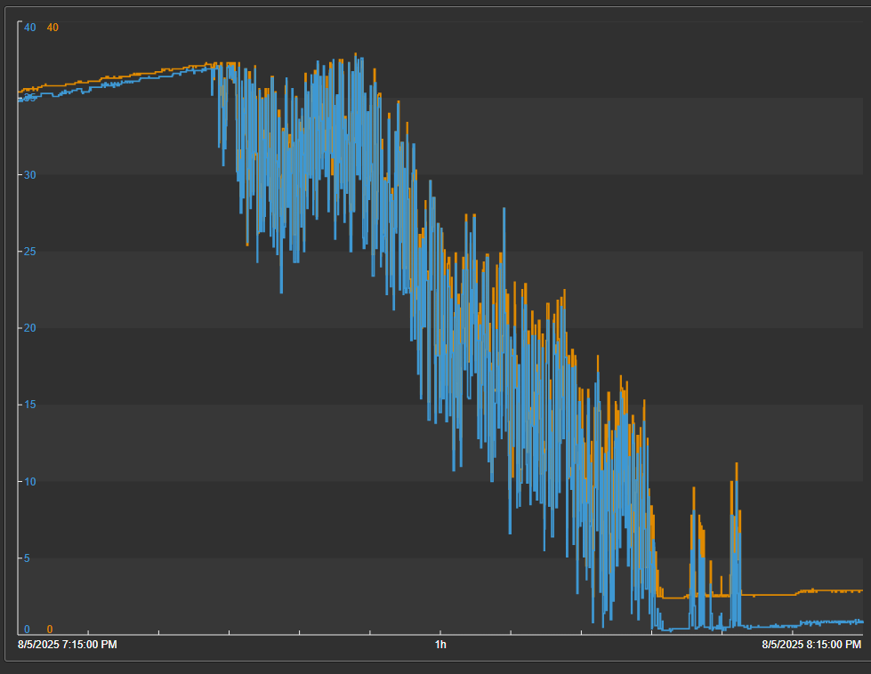
Solar plant site MW oscillations, ~160 MW swings
Solar plant site MVar oscillations

Slide 17
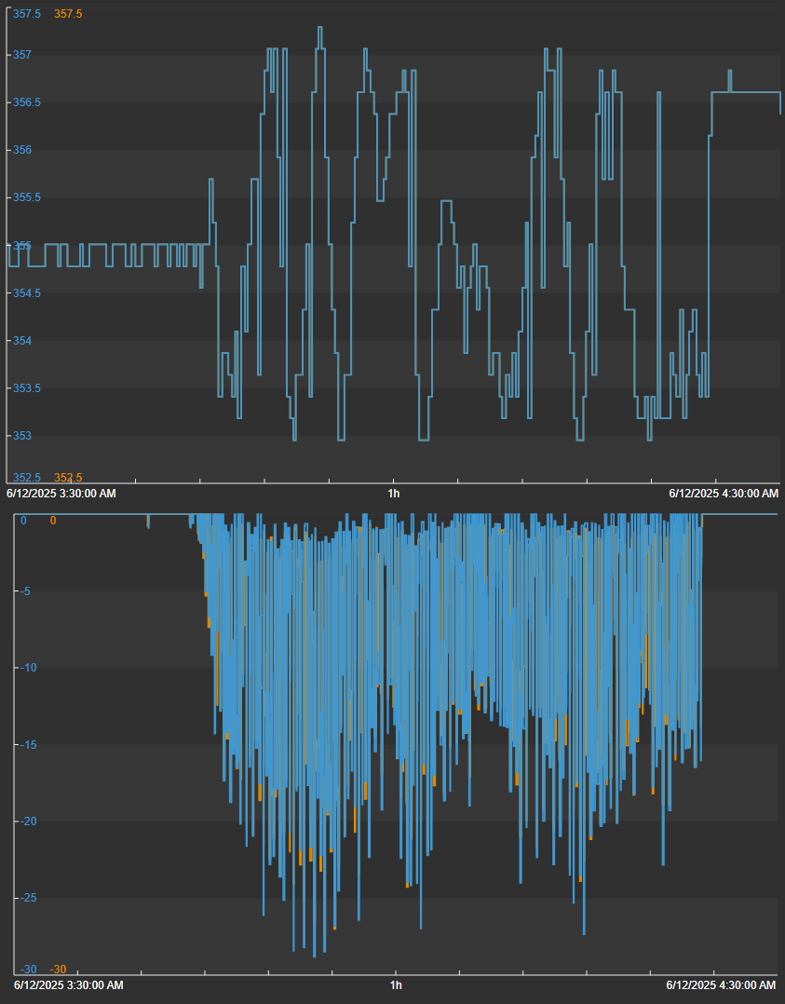
345kV voltage swings due to ~50 MVAR oscillations from two BESS facilities

Slide 18
Thoughts for PDCWG to Consider
BAL-001-TRE
  Standard revisions almost complete to incorporate ESRs
  Additional items were found during review of the standard
  Ongoing issues with wind unit inability to provide PFR when curtailed to zero
  Is another SAR warranted to address these or issues in the standard?
Oscillation events
  What is PDCWG’s role in analyzing these events?
  Possible collaboration with IBRWG and LLWG
Critical inertia level
  Original value calculated almost 10 years ago
  What is PDCWG’s role in review or calculation of critical inertia?

Slide 19
??????????

