Slide 1
ERCOT Annual Inertia Analysis Jorge Cantu ERCOT Operations Planning PDCWG April 15, 2026
Purpose
Provide an update on System Level Inertia with a focus on 2025 with some insights to 2026.
Key Takeaway(s)
Lowest system inertia in 2025 was 118.3 GW*s on March 18th 12:00 PM, there was 298 MW FFR available.
Overall Increase in IRR Penetration in the Spring and Summer months.
Our lowest hours of inertia have moved from the night hours to the middle of the day due to high growth in solar generation.
In 2025 and 2026, we are statistically carrying more FFR during the day hours compared to recent years and due to the influence of FFR on Critical Inertia, the resulting Critical Inertia levels are lower during the day hours.
Our new minimum system inertia of 114.7 GW*s happened March 14th 2026 12:00 PM, there was 430 MW FFR available.

Slide 2
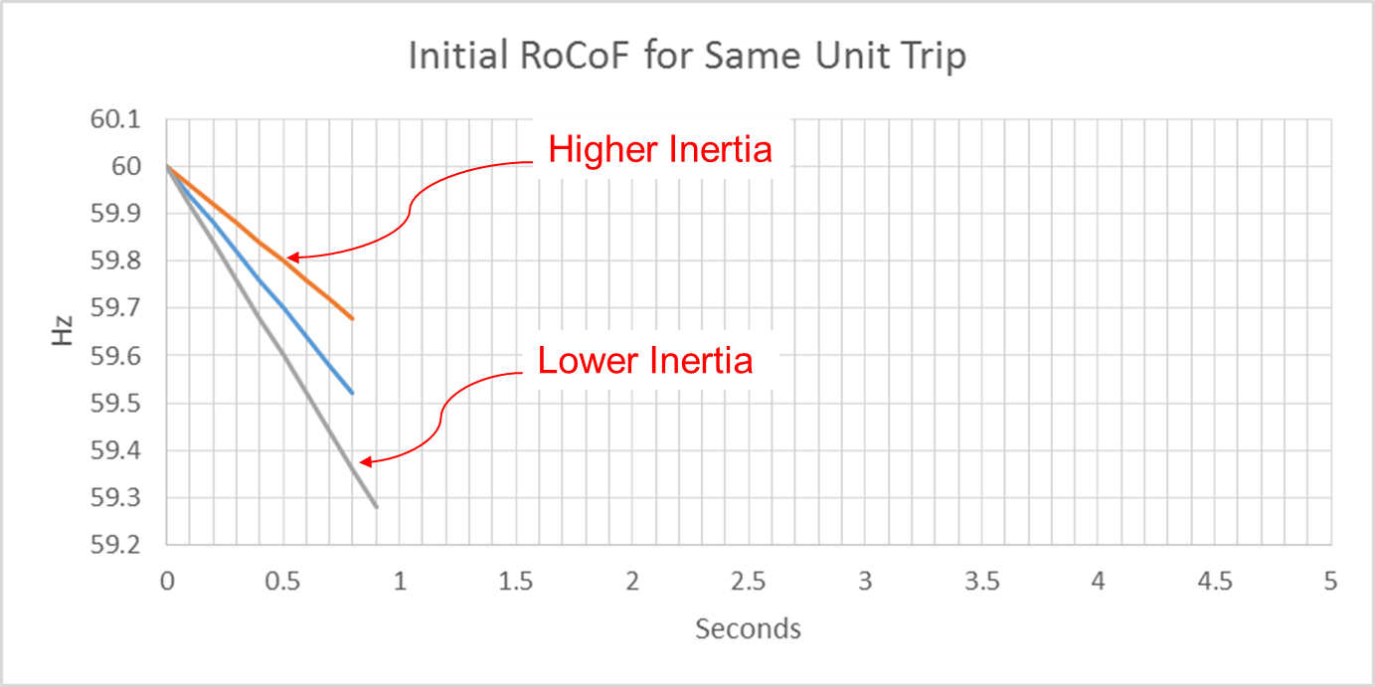
Effect of Synchronous Inertia on System Frequency
With the increasing integration of inverter-based resources (IBRs), fewer synchronous machines are online, potentially resulting in extended periods of lower overall system inertia.
Higher system inertia → Lower RoCoF
Lower system inertia → Higher RoCoF
With the implementation of Fast Frequency Response (FFR) the static value of 100 GW*s for Critical Inertia is more dynamic now.
UFLS trigger
RoCoF: Rate of Change of Frequency

Slide 3
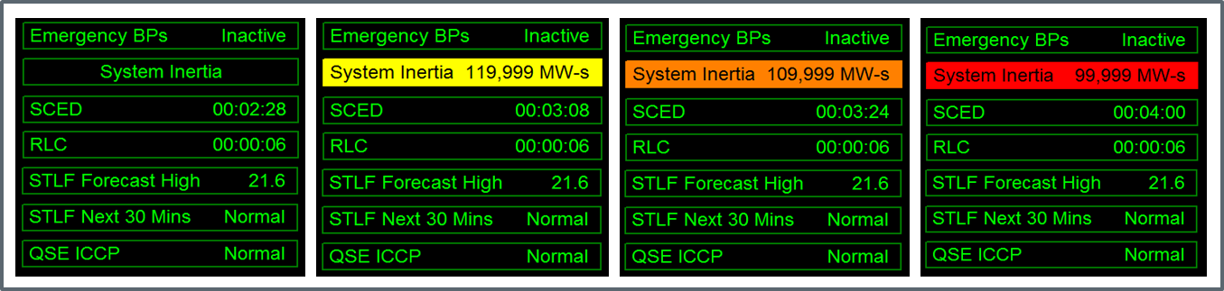
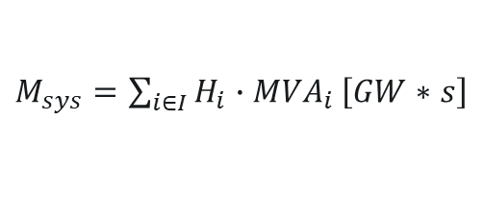
Inertia Calculation and Monitoring
In 2013, as instantaneous wind power penetration reached 30%, ERCOT started analyzing impacts of IBR on system inertia.
In 2015, ERCOT implemented a real-time inertia calculation using inertia parameters of each individual synchronous generator and its status (on/off) telemetry.
$M_{sys}=\sum_{i∈I}{H_{i}∙{MVA}_{i}}\left[GW∗s\right]$
where I is the set of online synchronous generators or condensers, MVA_{i} is MVA base of on-line synchronous generator or synchronous condenser i, and H_{i} is inertia constant for on-line generator or synchronous condenser i in a system (in seconds on machine MVA_{i})
Monitor grid conditions closely when system inertia < 120 GW*s
Take Actions when system inertia < 105 GW*s
Target increasing system inertia >= 105 GW*s

Slide 4
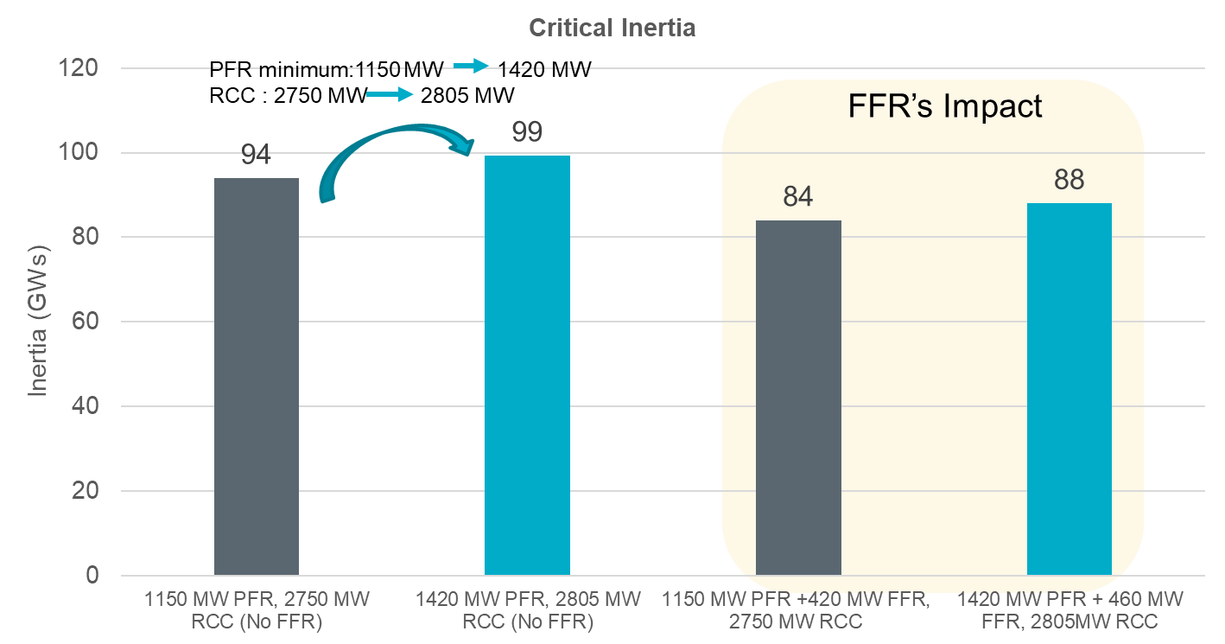
Fast Frequency Response (FFR) Added in 2020
What is FFR?
The automatic deployment and provision by a Resource of their obligated response within 15 cycles after frequency meets or drops below 59.85HZ. Resources must be capable of sustaining their obligated response for at least 15 minutes.
Studies indicate that FFR can help reduce the minimum level of Inertia at which ERCOT grid can operate reliably.

Slide 5
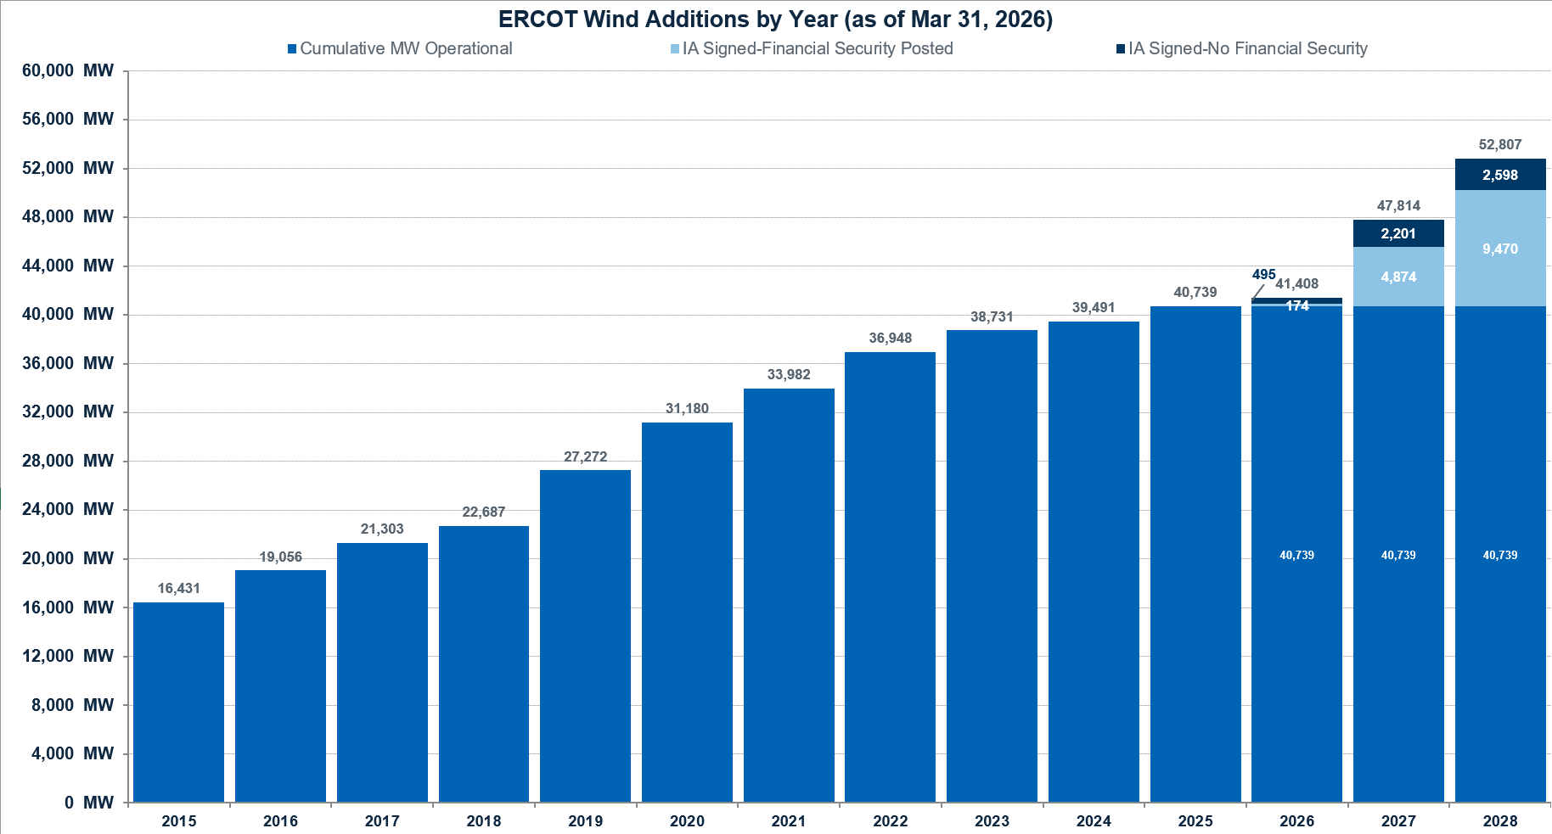
Wind Generation Capacity
+760 MW
+1,248 MW
+2,966 MW
+1,783 MW
+2,802 MW
+3,908 MW
+4,585 MW
+1,384 MW
+2,247 MW
+2,625 MW

Slide 6
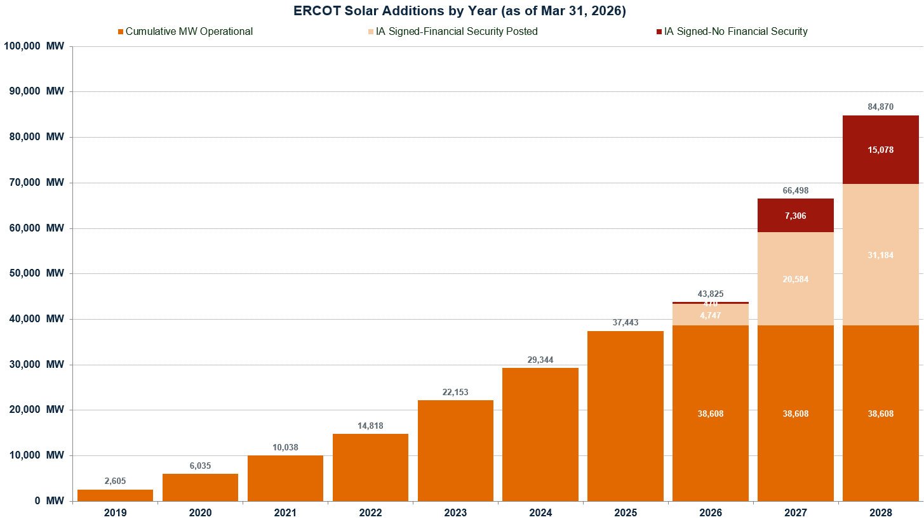
Solar Generation Capacity
+8,099 MW
+7,191 MW
+7,335 MW
+4,780 MW
+4,003 MW
+3,430 MW

Slide 7
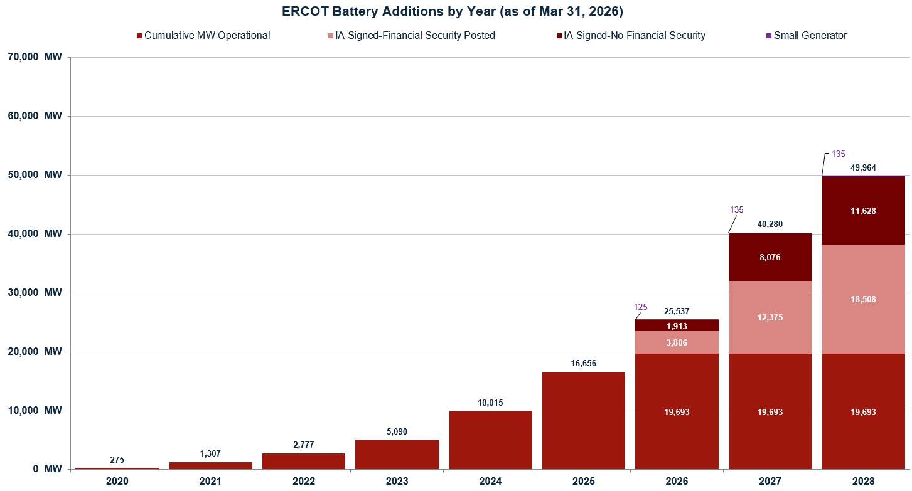
Battery Capacity
+6,641 MW
+4,925 MW
+2,313 MW
+1,032 MW
+1,470 MW

Slide 8
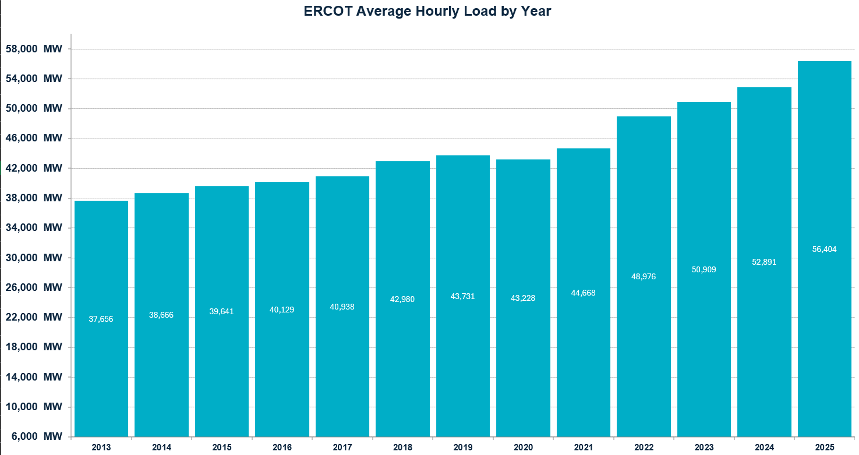
ERCOT Average Hourly Load by Year

Slide 9
Inertia Analysis

Slide 10
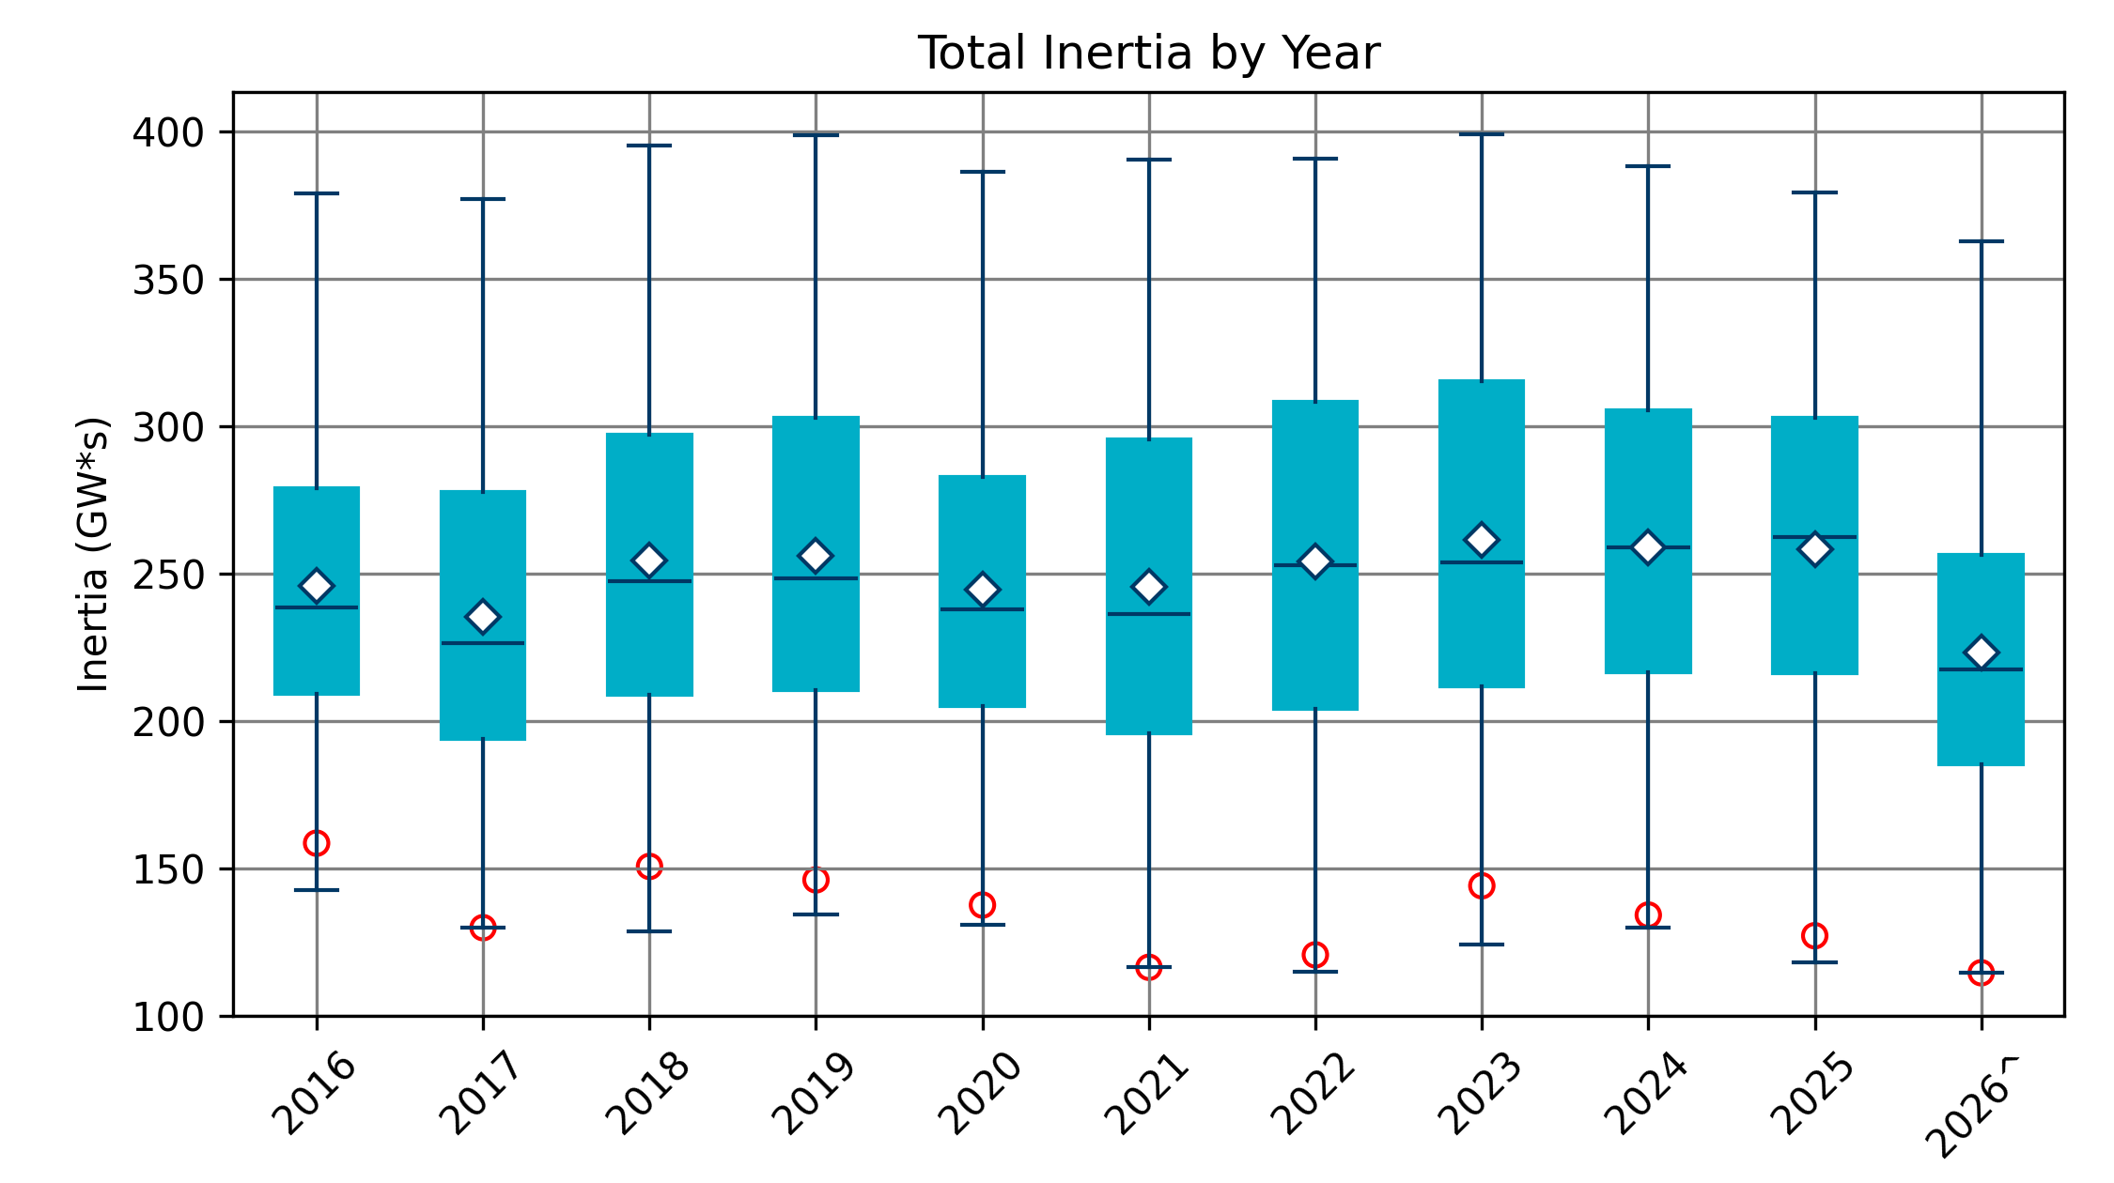
Total Inertia 2016-2026
Date and Time | 2016 4/10 2:00 AM | 2017 10/27 4:00 AM | 2018 11/03 3:30 AM | 2019 3/27 1:00 AM | 2020 05/01 2:00 AM | 2021 03/22 1:00 AM | 2022 03/21 2:00 AM | 2023 04/18 3:00 AM | 2024 03/29 4:00 AM | 2025 03/18 12:00 PM | 2026* 03/14 12:00 PM
Min synch. Inertia (GW*s) | 143 | 130 | 128.8 | 134.5 | 131.1 | 116.6 | 115.0 | 124.3 | 129.9 | 118.3 | 114.7
System load at minimum synch. Inertia (MW) | 27,831 | 28,425 | 28,397 | 29,883 | 30,679 | 31,767 | 33,784 | 35,578 | 37,039 | 49,130 | 48,013
Non-synch. Gen. in % of System Load | 47 | 54 | 53 | 50 | 57 | 66 | 65 | 61 | 68 | 74 | 81
FFR Award | N/A | N/A | N/A | N/A | 0 | 0 | 0 | 0 | 134 | 298 | 430
Critical Inertia (GW*s) | 100 | 100 | 100 | 100 | 100 | 100 | 100 | 100 | 93 | 92 | 87

Slide 11
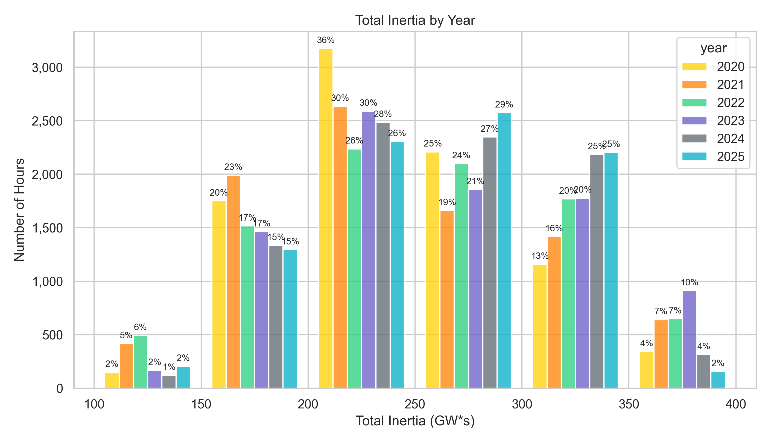
Total Inertia by Group 2020-2025
In 2025, similar hours below 150 GW*s to previous years and more hours between 250 and 350 GW*s

Slide 12
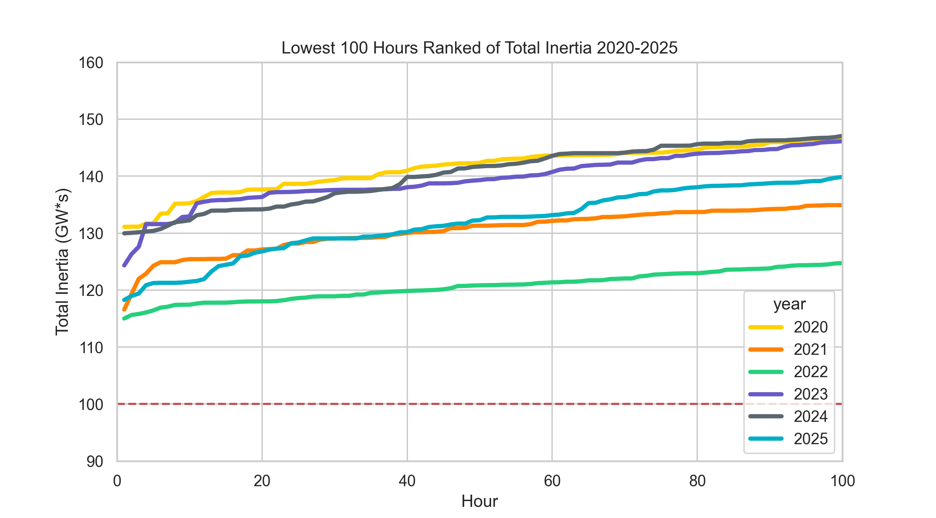
Lowest 100 Hours Ranked of Total Inertia 2020-2025
The lowest 100 inertia hours in 2025 saw similar trends to 2021, but saw higher inertias for 60% of these hours
 | 2020 | 2021 | 2022 | 2023 | 2024 | 2025
Lowest Inertia Hour (GW*s) | 131 | 117 | 115 | 124 | 130 | 118
100th Lowest Inertia Hour (GW*s) | 147 | 135 | 125 | 146 | 147 | 140

Slide 13
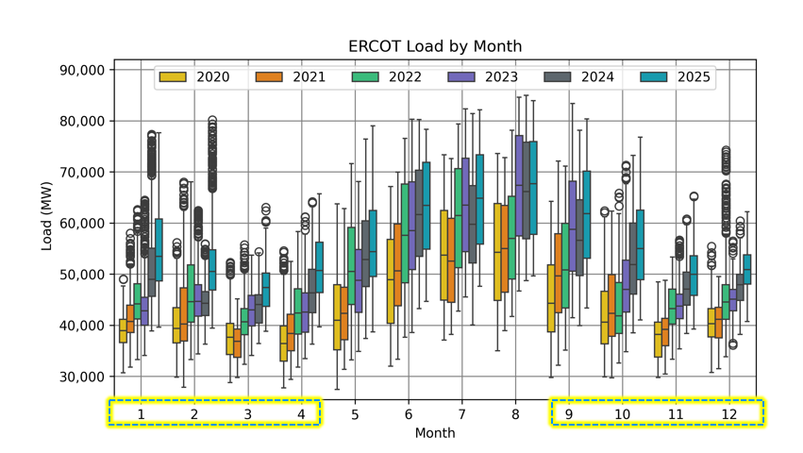
ERCOT Load by Month 2020-2025
Overall Load increase can be seen in the Winter, Spring, and Fall months.

Slide 14
IRR Penetration

Slide 15
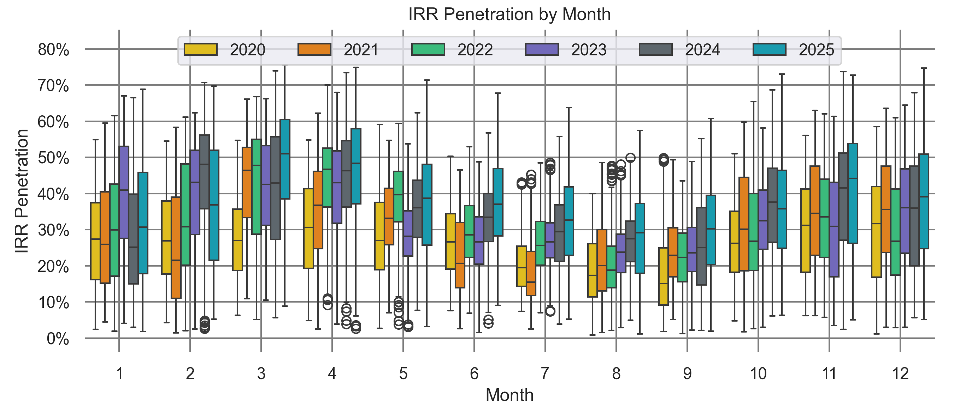
IRR Penetration by Month 2020-2025
Overall Increase in IRR Penetration in the Spring and Summer months.
Generation makeup from Solar and Wind has greatly increased from 2020 to 2025.

Slide 16
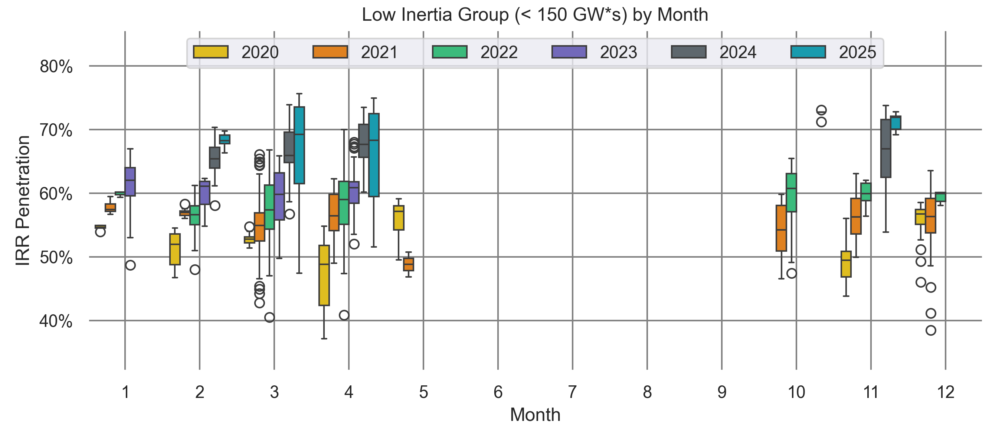
IRR Penetration Low Inertia Group (< 150 GW*s) by Month 2020-2025
In the spring of 2025, IRR Penetration rose greatly compared to previous years during the lowest Inertia Hours of the year.
Only February, March, April, and small amount of November saw Inertia below 150 GW*s

Slide 17
Net Load Correlation

Slide 18
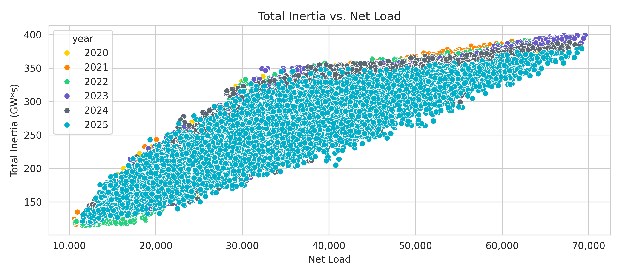
Correlation between Inertia and Net Load
During our higher Inertia periods, we are not reaching higher Inertia numbers with high Net Loads when compared to previous years.
Net Load = Load – Wind Generation – Solar Generation

Slide 19
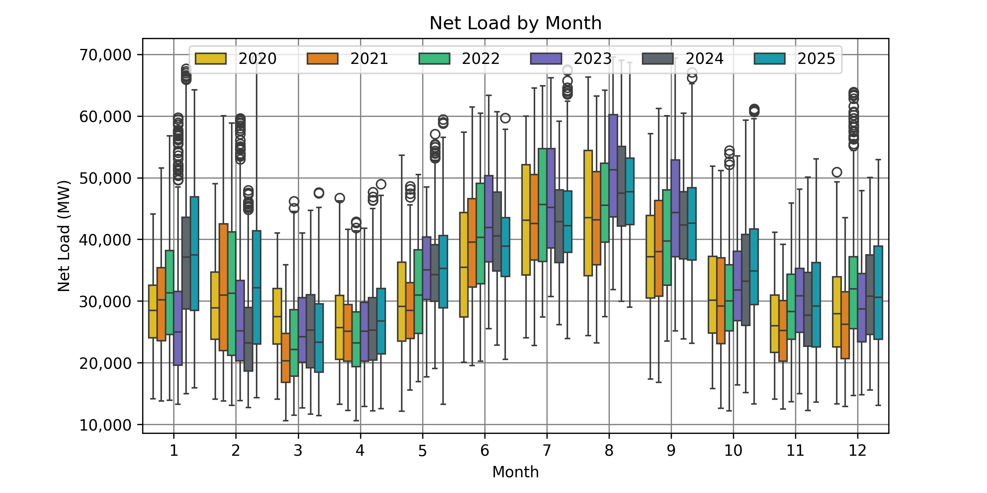
Net Load by Month 2020-2025
In 2025, the median net load decreased or experienced minimal change in the months of May – September and increased slightly in the months of October – December and increased in the months of January and February.

Slide 20
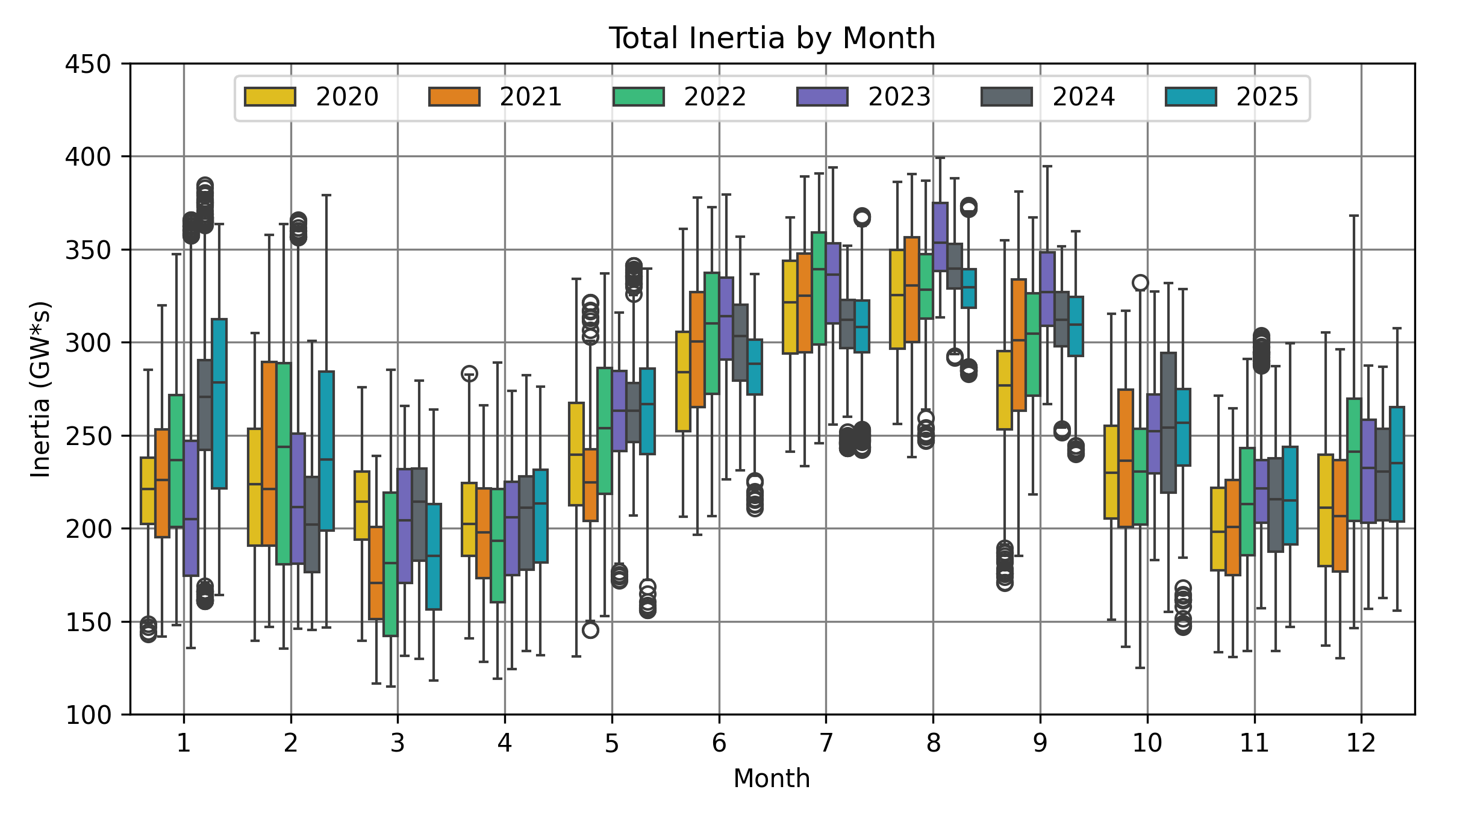
Total Inertia by Month 2020-2025

Slide 21
Combined Cycle Correlation

Slide 22
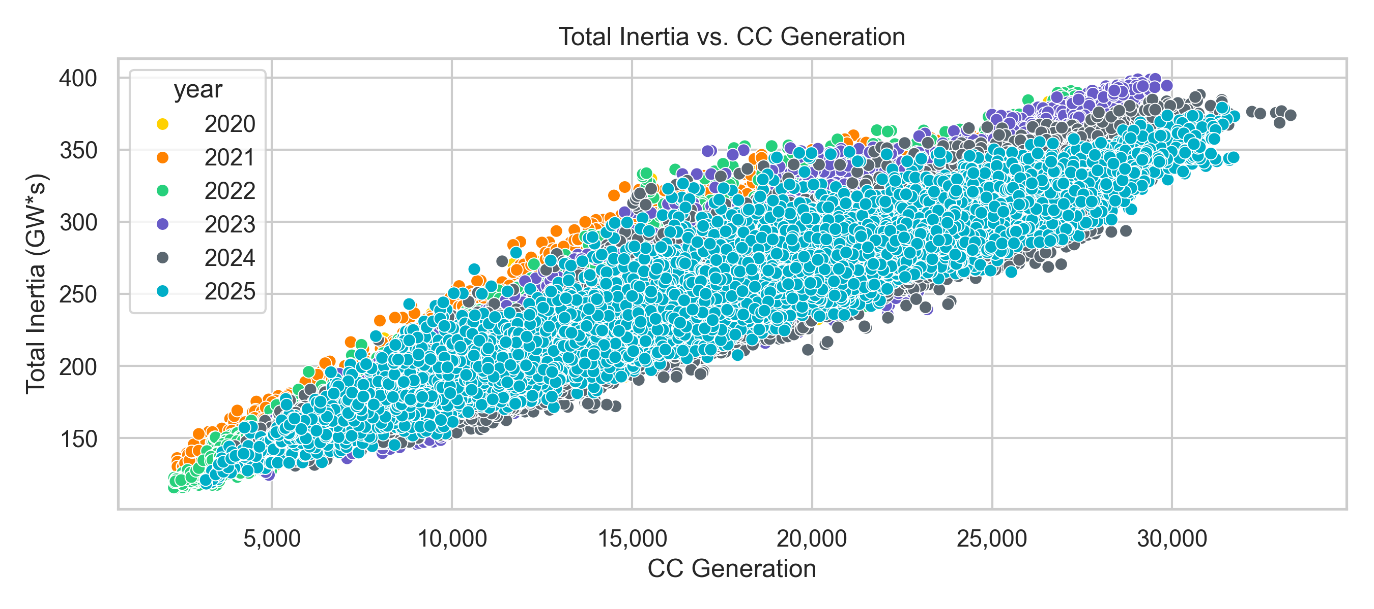
Correlation between CC Generation and Total Inertia
Total Inertia and CC Generation exhibit a strong correlation.
Like Netload, we are not reaching higher Inertia numbers with high CC Generation when compared to previous years.

Slide 23
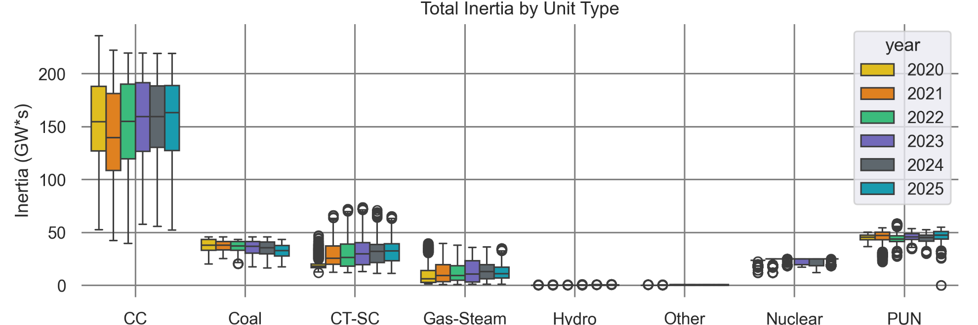
Total Inertia by Unit Type 2020-2025
Combined Cycles make up a large majority of our total Inertia with other conventional units following behind by a large margin.
Over the last few years, the Inertia Combined Cycles provide has stayed the same.

Slide 24
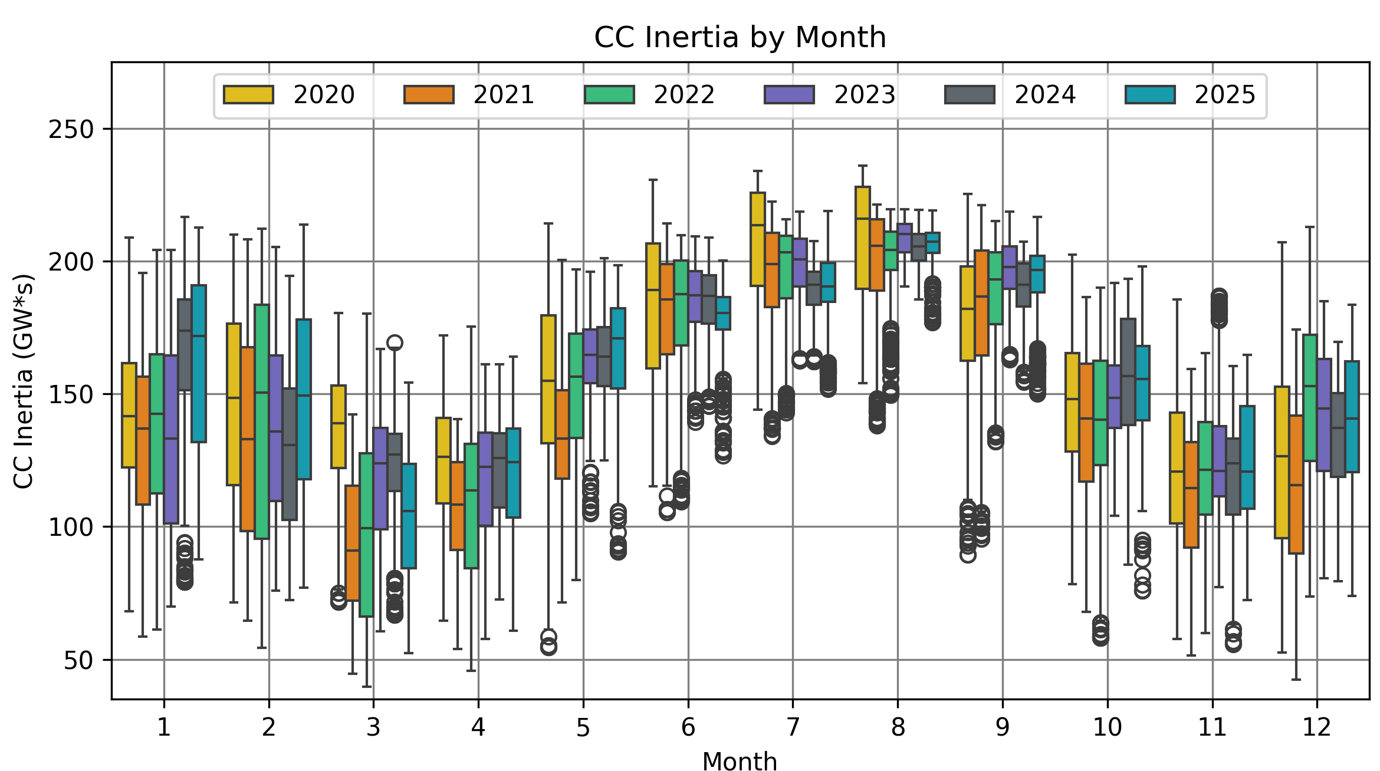
CC Inertia by Month 2020-2025
Combined Cycles Inertia during January 2025 saw an overall increase like 2024 but saw more volatility. On the other hand, the summer months saw lower and more stable inertia when compared to its previous years.
Opportunity to take outages for CCs happen during the spring.

Slide 25
Lowest Inertia During Day Hours

Slide 26
Average Inertia per Hour 2020-2025
In 2025, lowest hours of inertia have moved from the night hours to the middle of the day.

Slide 27
Average Inertia per Hour 2020-2025 (Seasonal)
Winter average Inertia contains previous year December data
Y-Axis scales are different in each chart

Slide 28
Average Net Load per Hour 2020-2025
In 2025, the average net load per hour shifted in a similar manner to what was seen in 2024.
Likely due to the rapid Growth in Solar Gen which saw an almost 8x growth compared to wind in 2025.

Slide 29
2026 Brief Overview

Slide 30
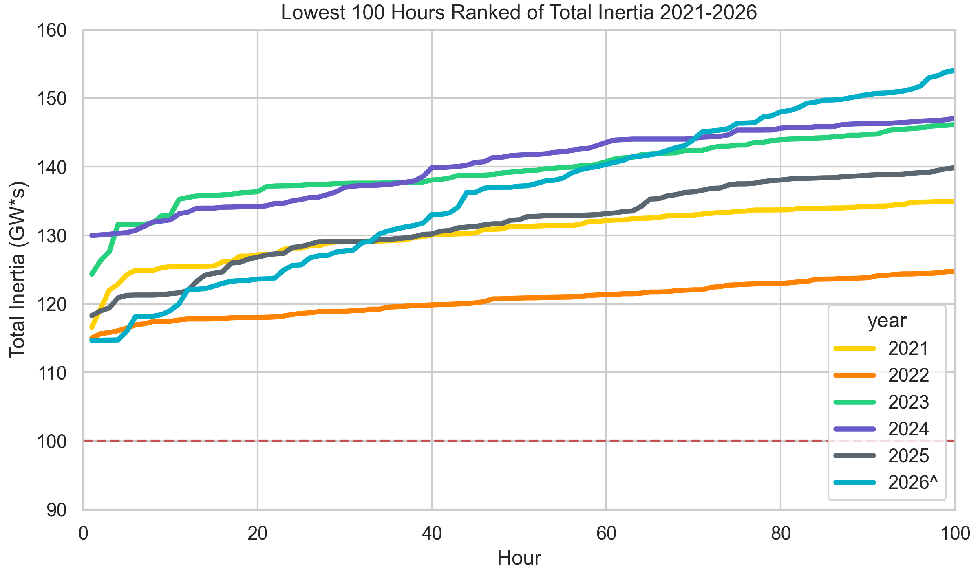
Lowest 100 Hours of Inertia 2021-2026
Our new minimum system inertia happened 3/14/2026 12:00 PM
114.7 GW*s
430 FFR
87 GW*s – Critical Inertia
This year as of April 1st, 2026, we have experienced 87 hours under 150 GW*s of Inertia. All hours happened in March.
2025: 203
2024: 120
2023: 165
2022: 492
2021: 417

Slide 31
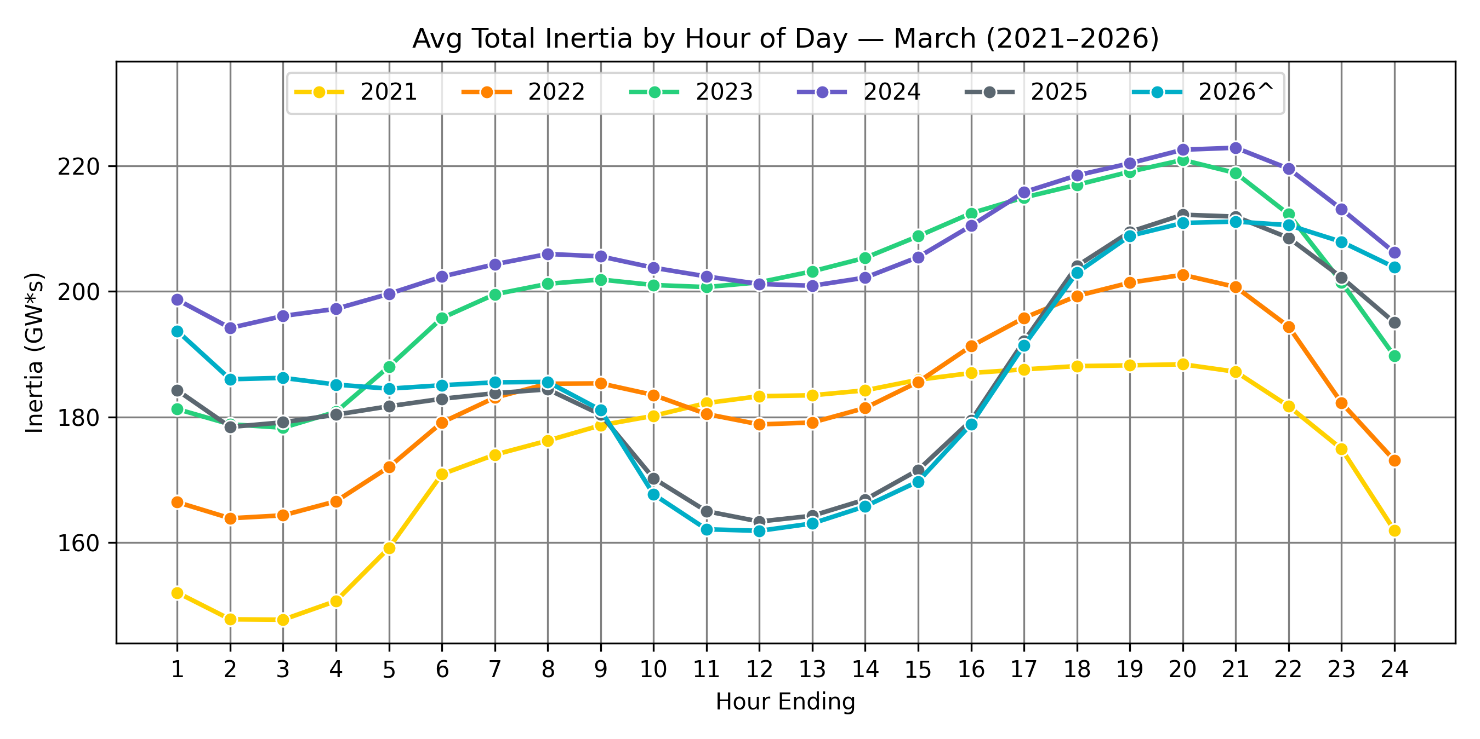
Average Total Inertia by Hour March 2021-2026
Average Inertia by Hour for March 2026 saw similar behavior patterns to 2025.

Slide 32
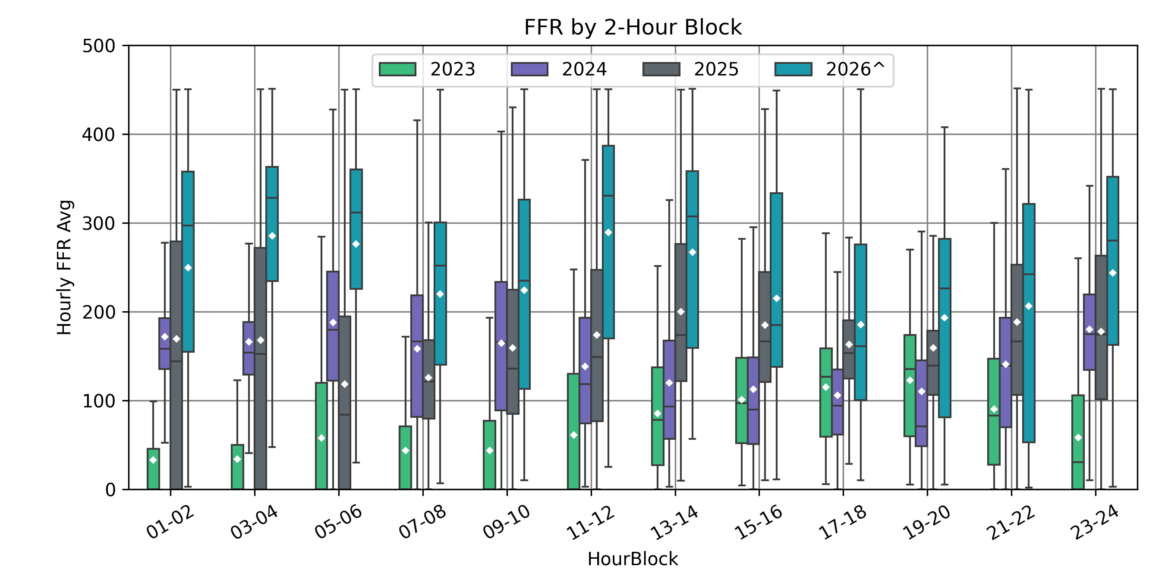
FFR by 2 Hour Blocks 2023-2026^
In 2025 and 2026, we are statistically carrying more FFR during the day hours compared to recent years.
Due to the influence of FFR on Critical Inertia, the resulting Critical Inertia levels are lower during the day hours.
Diamonds indicate Average

Slide 33
Summary
Lowest system inertia in 2025 was 118.3 GW*s on March 18th 12:00 PM, there was 298 MW FFR available.
Overall Increase in IRR Penetration in the Spring and Summer months .
In 2025, the median inertia decreased or experienced minimal change in the months of May – September and increased slightly in the months of October – December and increased in the months of January and February.
Combined Cycles Inertia during January 2025 saw an overall increase like 2024 but saw more volatility, on the other hand the summer months saw lower and more stable inertia when compared to its previous years.
Our lowest hours of inertia have moved from the night hours to the middle of the day.
High growth in solar generation
Overall, we are statistically carrying more FFR during the day hours compared to recent years and due to the influence of FFR on Critical Inertia, the resulting Critical Inertia levels are lower during the day hours.
Our new minimum system inertia of 114.7 GW*s happened March 14th 2026 12:00 PM, there was 430 MW FFR available.

Slide 34

Thank you!
Questions

Slide 35
Appendix

Slide 36
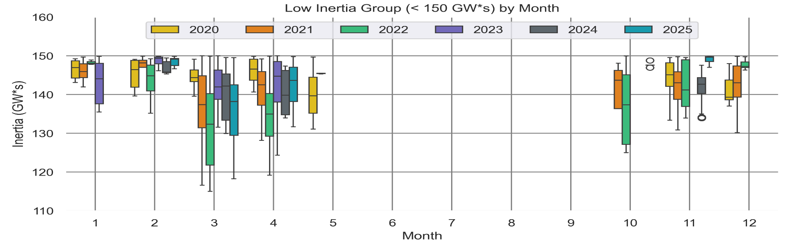
Low Inertia Group (< 150 GW*s) by Month 2020-2025

Slide 37
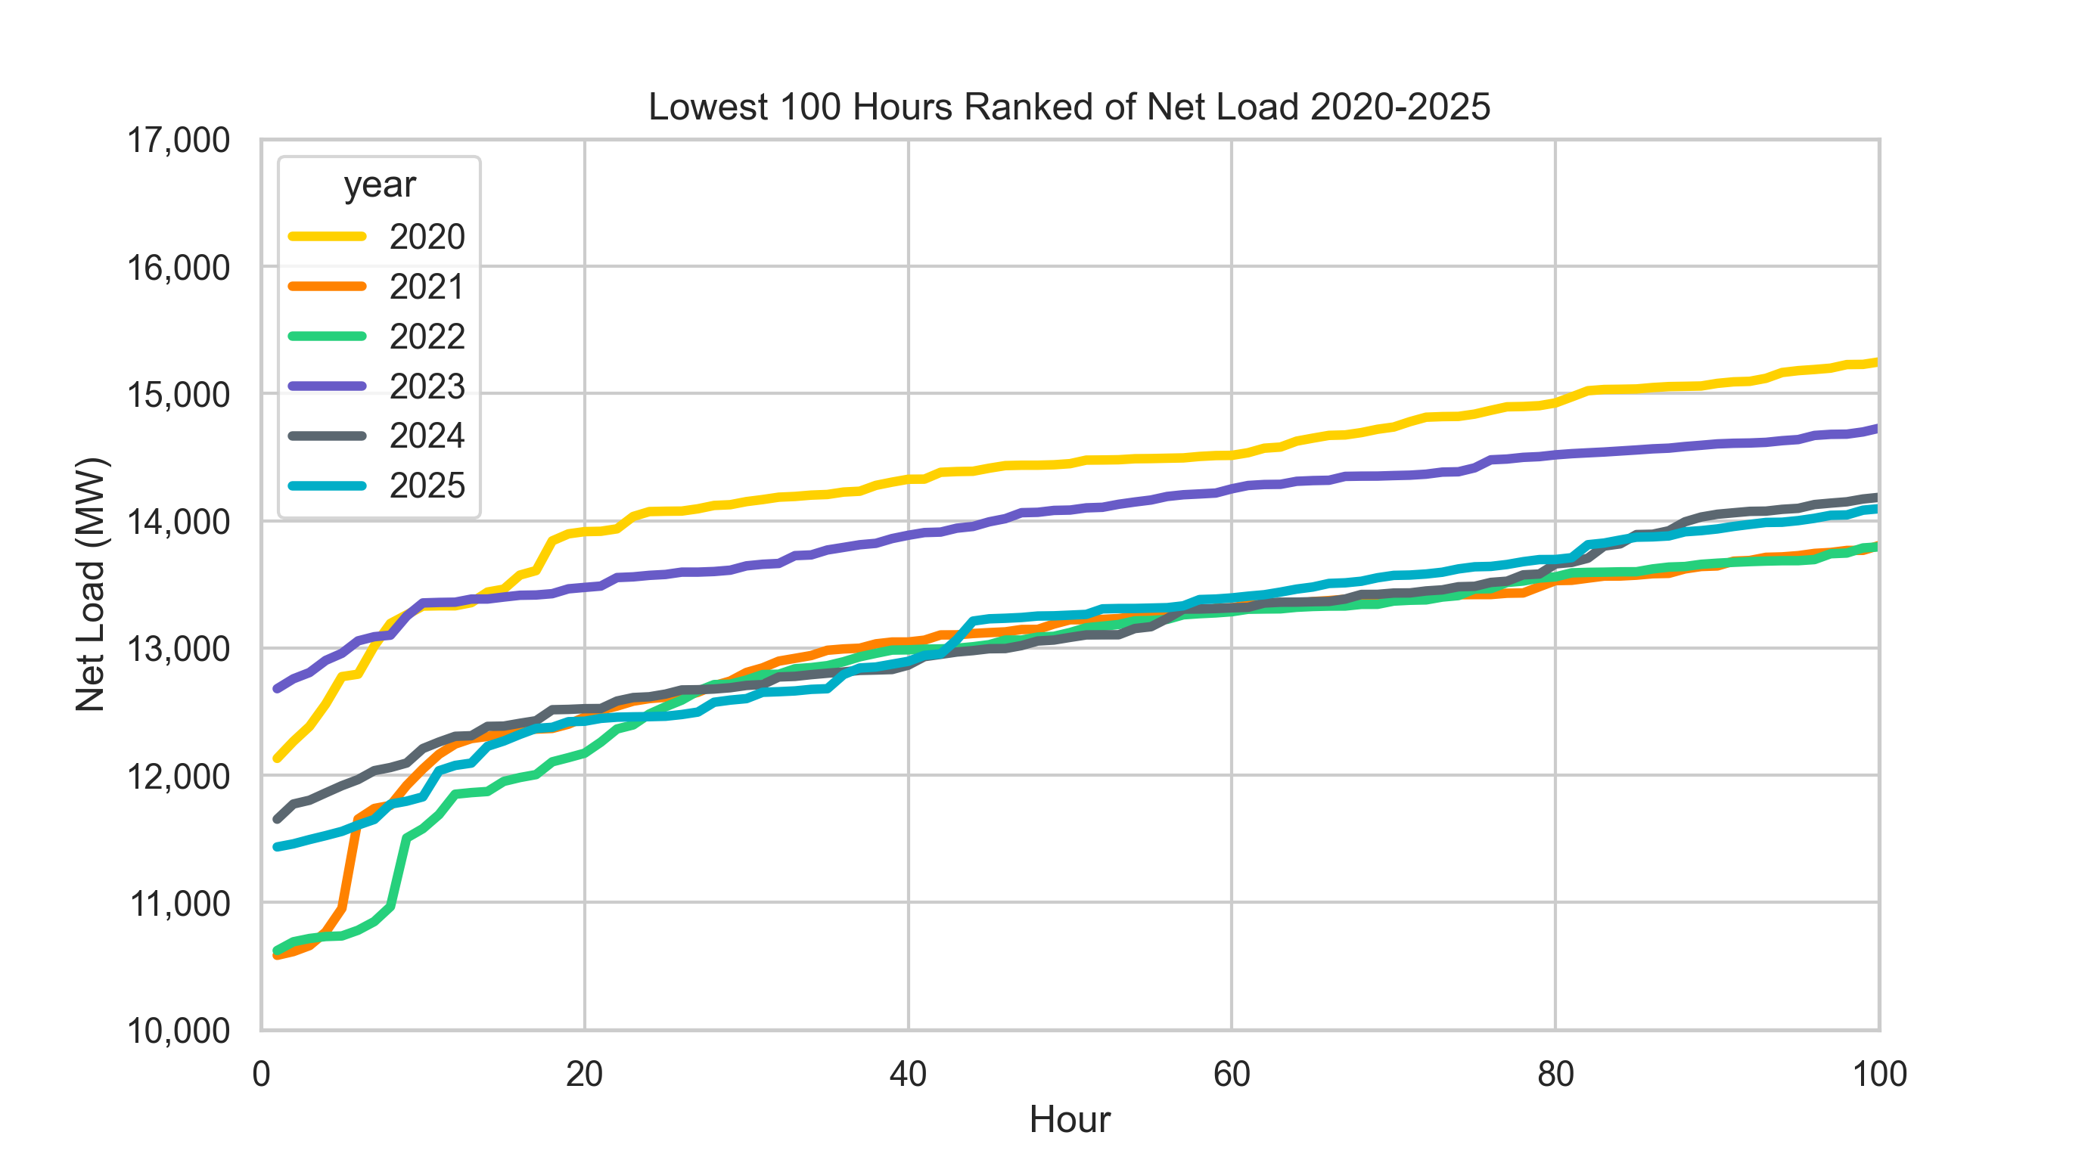
Lowest 100 Net Load Ranked Hours 2020-2025

Slide 38
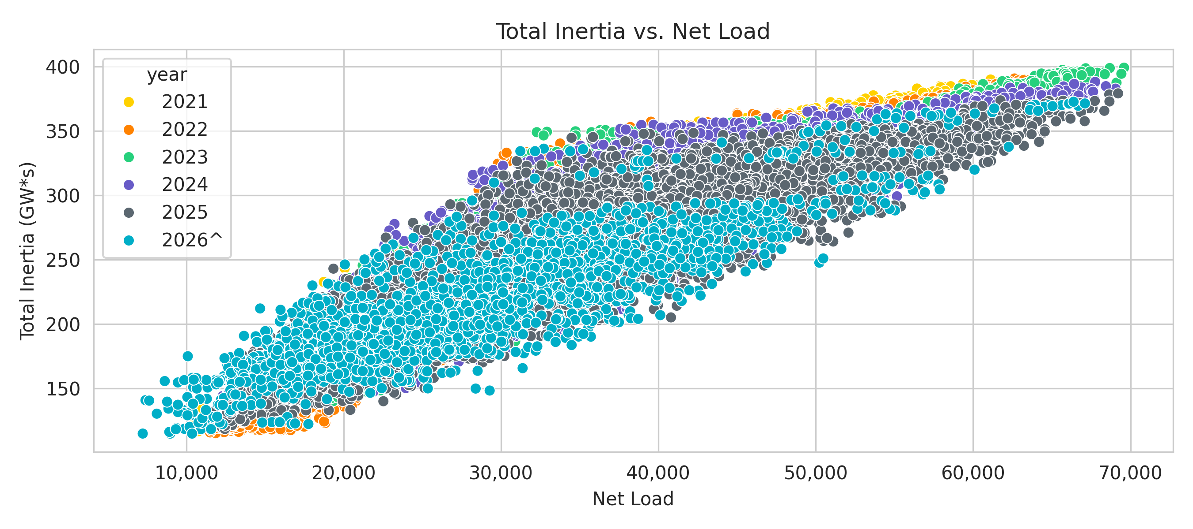
Correlation between Inertia and Net Load 2021 – 2026*
2026 only contains data up to 4/1/2026

Slide 39
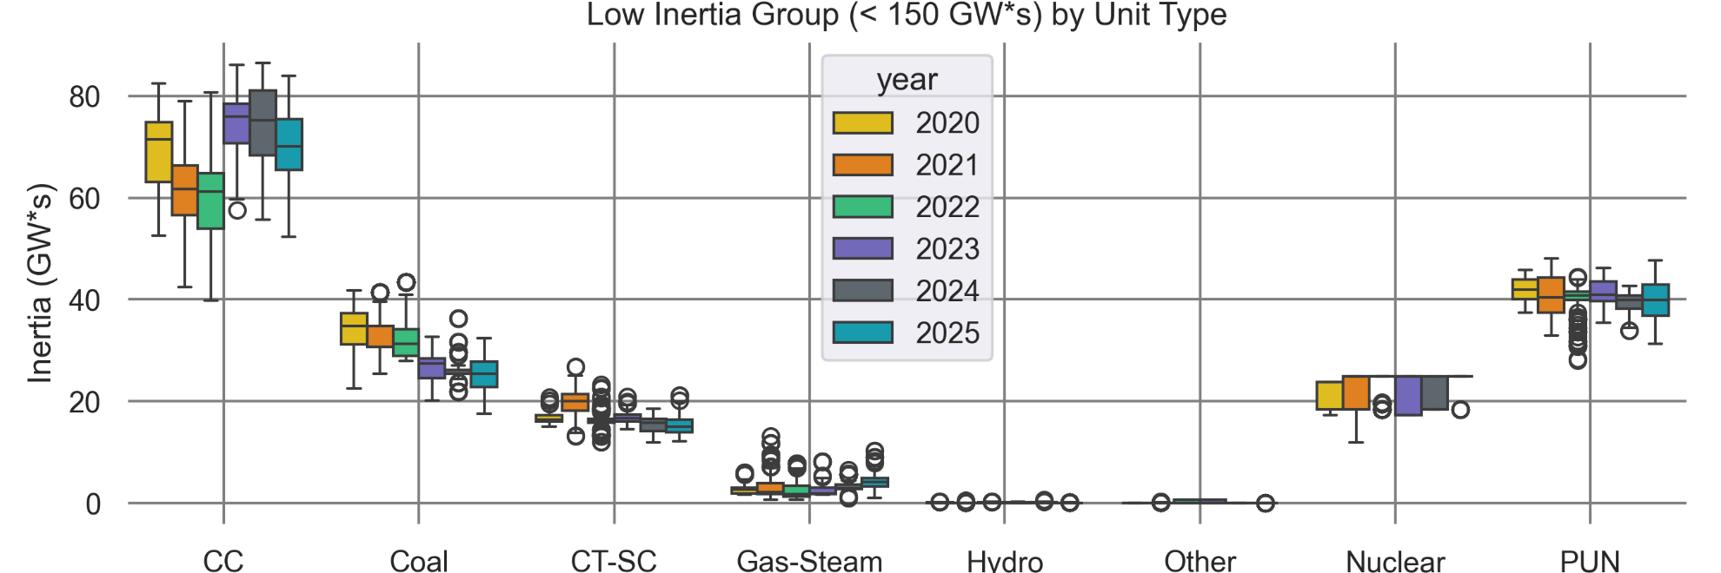
Total Inertia by Unit Type in Low Inertia Group (<150 GW*s) 2020-2025

Slide 40
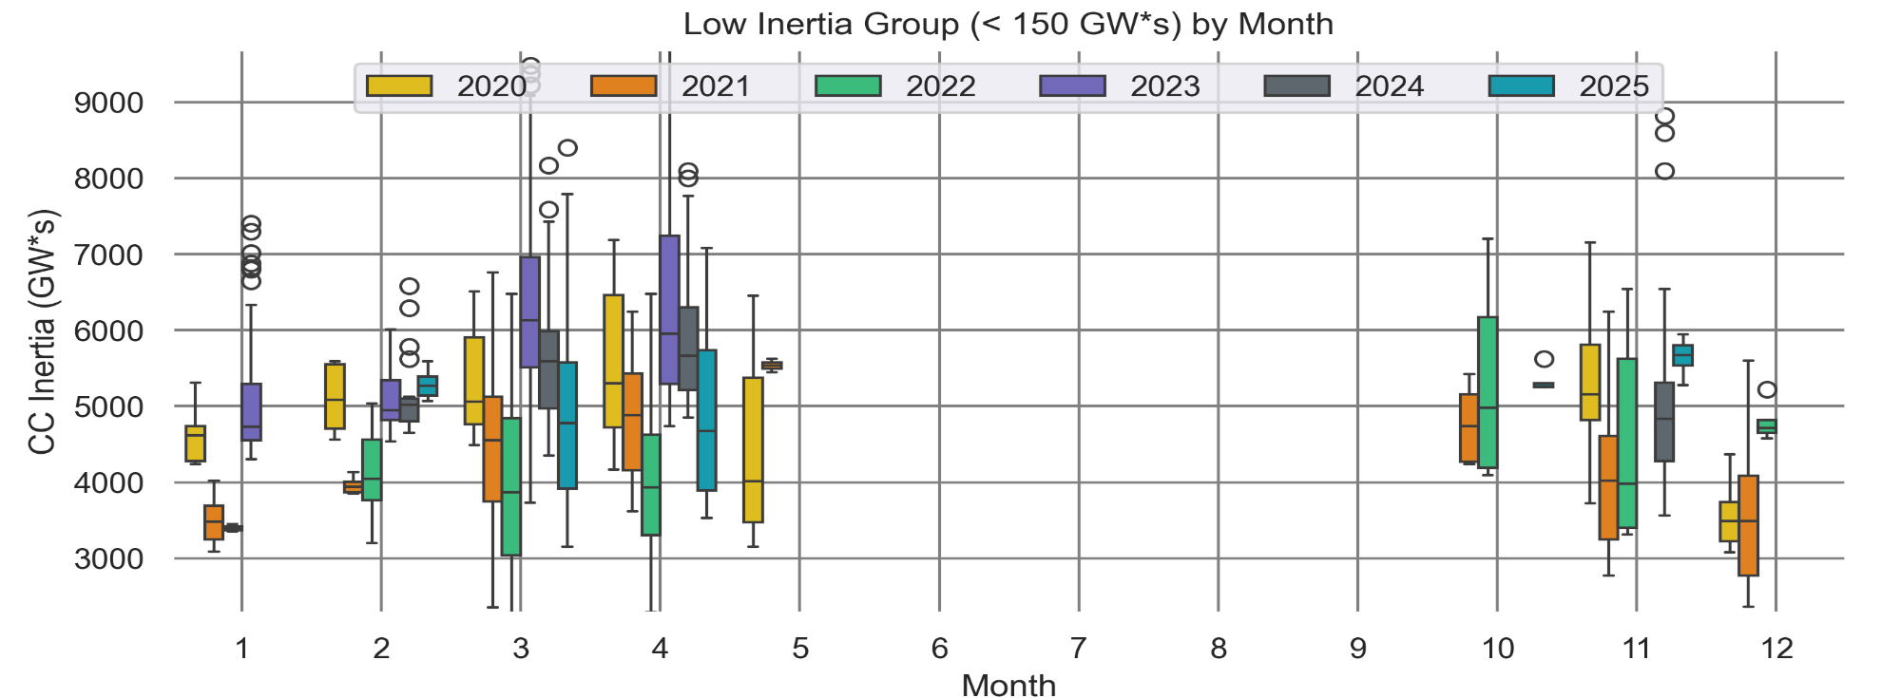
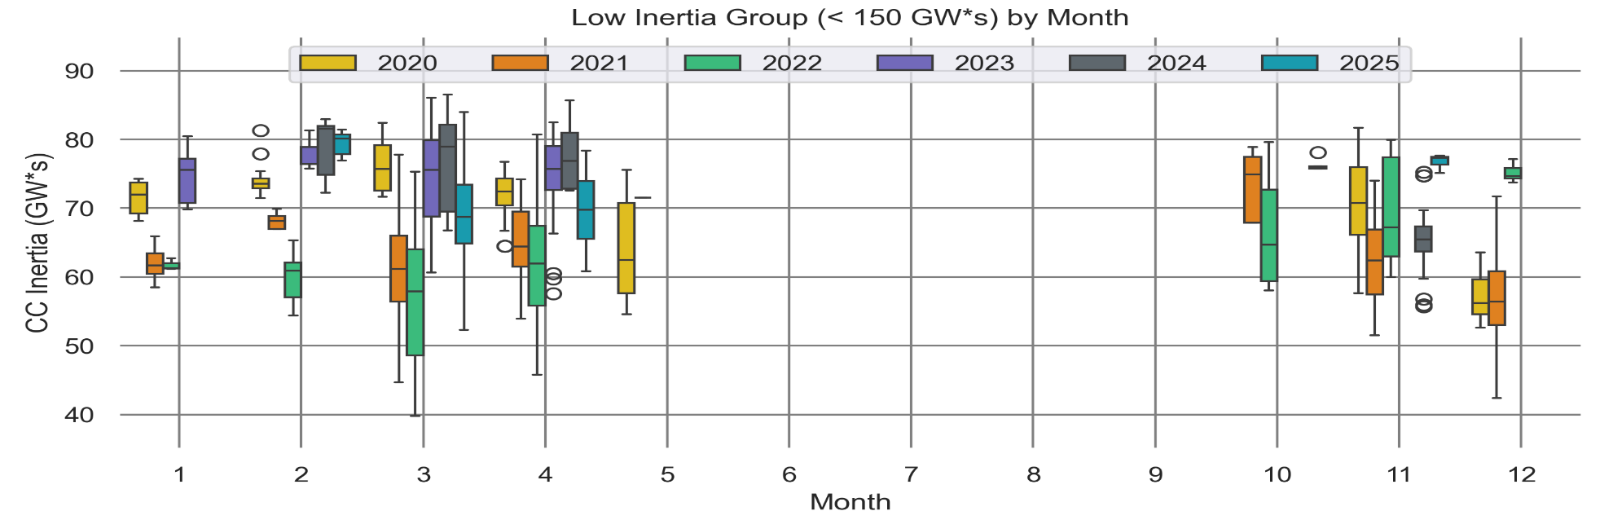
CC Gen and Inertia Low Inertia Period by Month 2020-2025

Slide 41
Natural Gas Prices Jan 2025 – Dec 2025
Source: Macrotrends (Natural Gas Prices)

