Slide 1
ERCOT Frequency Control Report
March 2026
PDCWG | April 15th , 2026
ERCOT
Operations Planning
April 14, 2026
Outline:
Frequency Control
  CPS1, BAAL, RMS1
Frequency Profile
Time Error
BAAL-003 Performance
ERCOT Energy Statistics
ERCOT System Inertia

Slide 2
Summary of March 2026
CPS1: 185.31%
Current CPS1 12-Month Rolling Average: 179.26%
0 BAAL Exceedance(s)
0 hourly CPS1 score below 100%
BAAL-003 Events have updated through 2024
2024 BAAL-003 FRM Performance: -1127.76
2026 RMS1 Statistics
  Mean: 11.46 mHz
  Min: 09.47 mHz
  Max 14.75 mHz
Energy Statistics
  Total Energy: 37,911,606 MWh
  Wind Energy: 13,331,081 MWh
  Percent Energy from Wind: 35.16%
  Solar Energy: 6,729,093 MWh
  Percent Energy from Solar: 17.75%
Minimum System Inertia
  Mean: 157,243 MW*s
  Max: 211,645 MW*s on March 8th
  Min: 114,642 MW*s on March 14th

Slide 3
Frequency Control
CPS1, BAAL, & RMS1

Slide 4
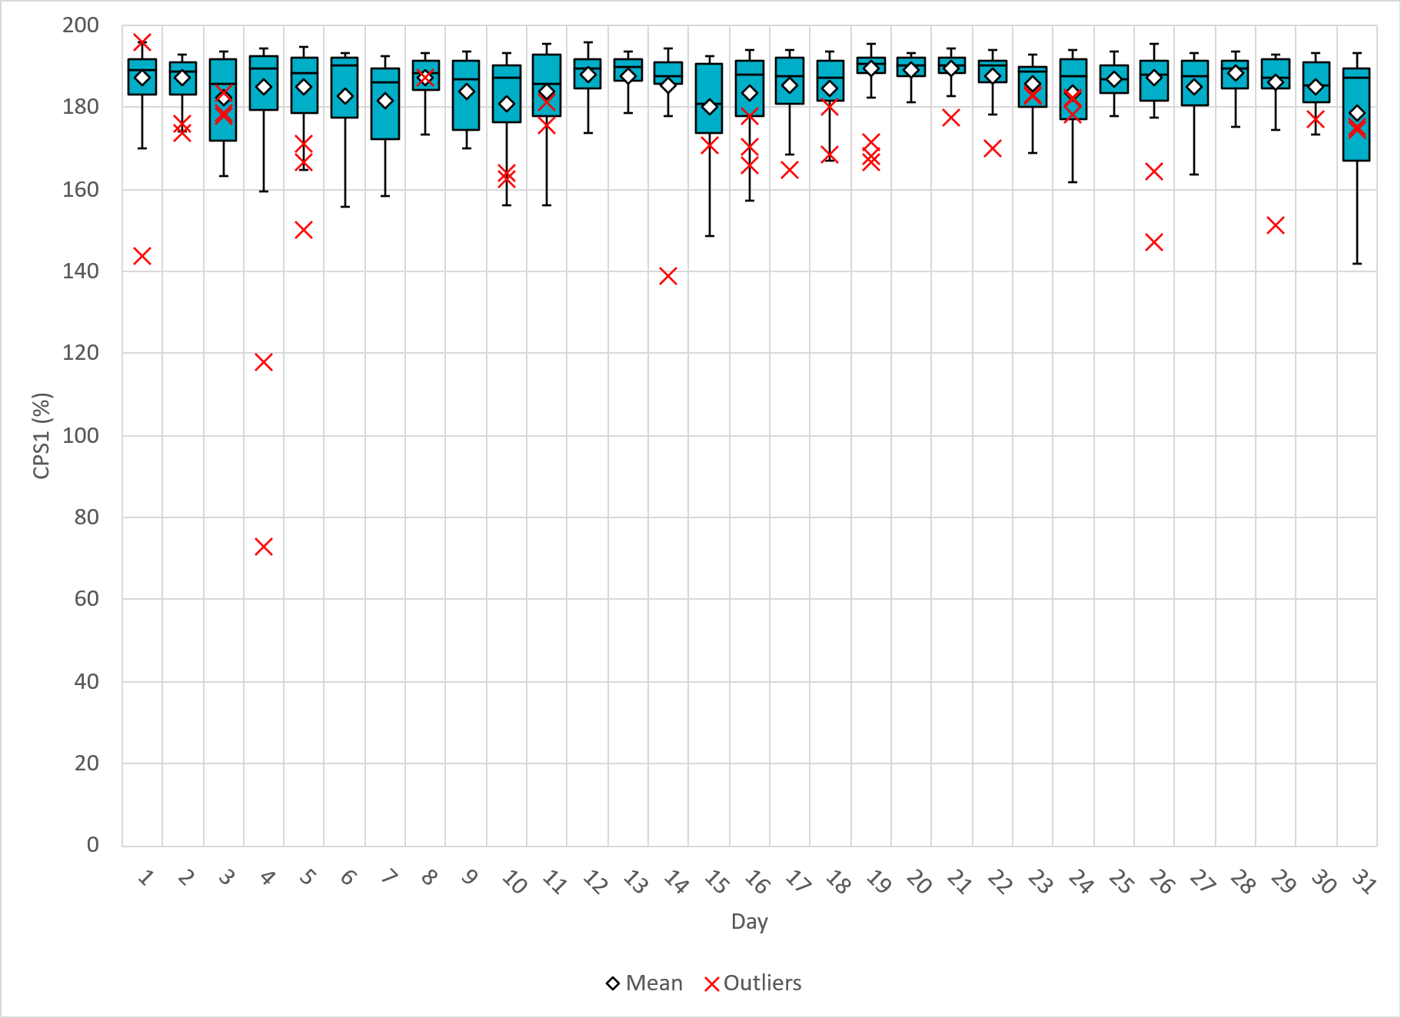
Hourly CPS1 by Day
Mar-26 CPS1 (%): 185.31
Notes:
CPS1 Score is 185.31%
Scores Below 100%: No instances of CPS1 Score under 100%

Slide 5
BAAL Exceedances & Violations
There were 0 BAAL exceedance(s) in March.

Slide 6
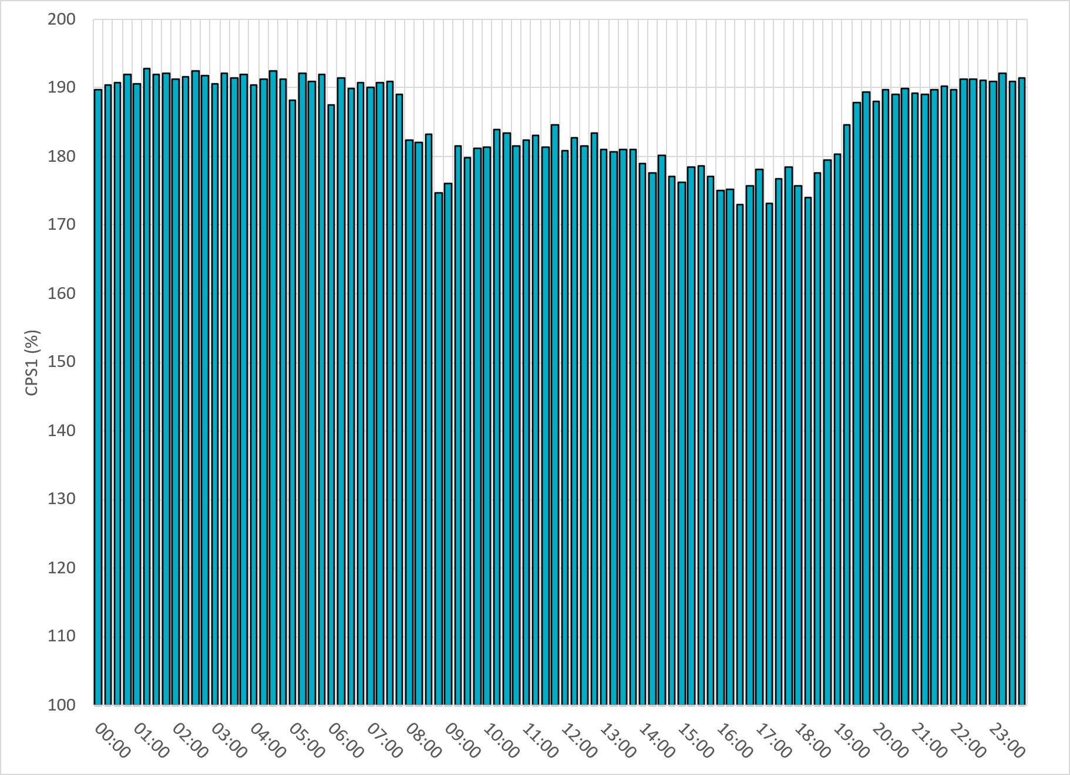
15-Minute Average CPS1%
Mar-26 CPS1 (%): 185.31
Notes:
CPS1 score is above 170% for all 15-minute intervals.

Slide 7
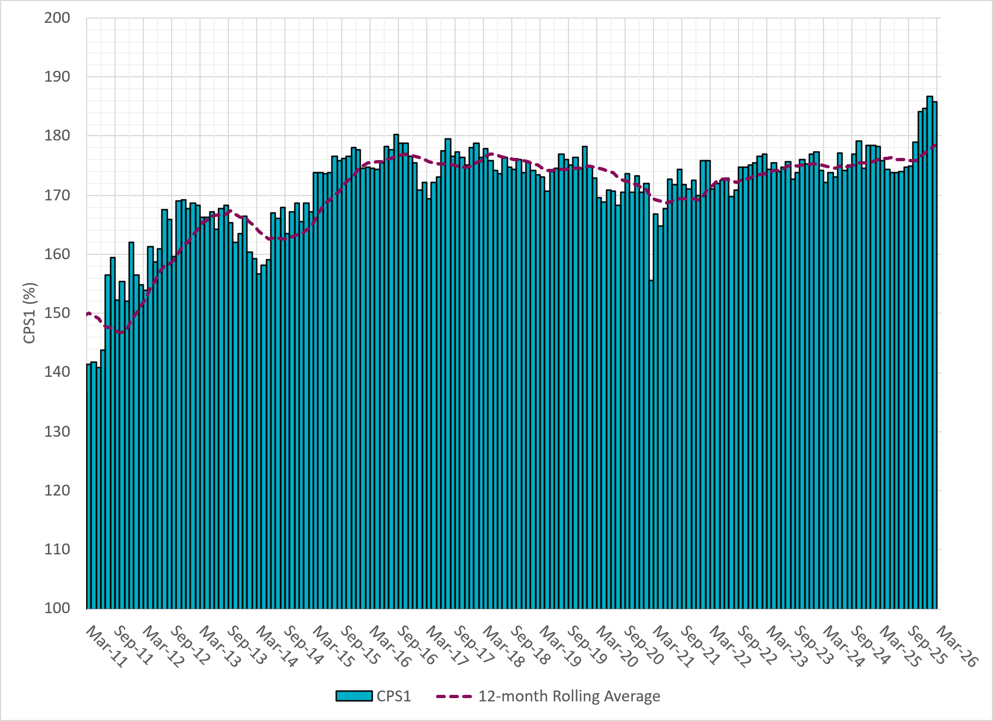
12-Month Rolling Average CPS1
Current 12-Month Rolling Average 179.26%
Notes:
12 month rolling average CPS1 score is 179.26 which is continuing the increasing trend of CPS1 scores.

Slide 8
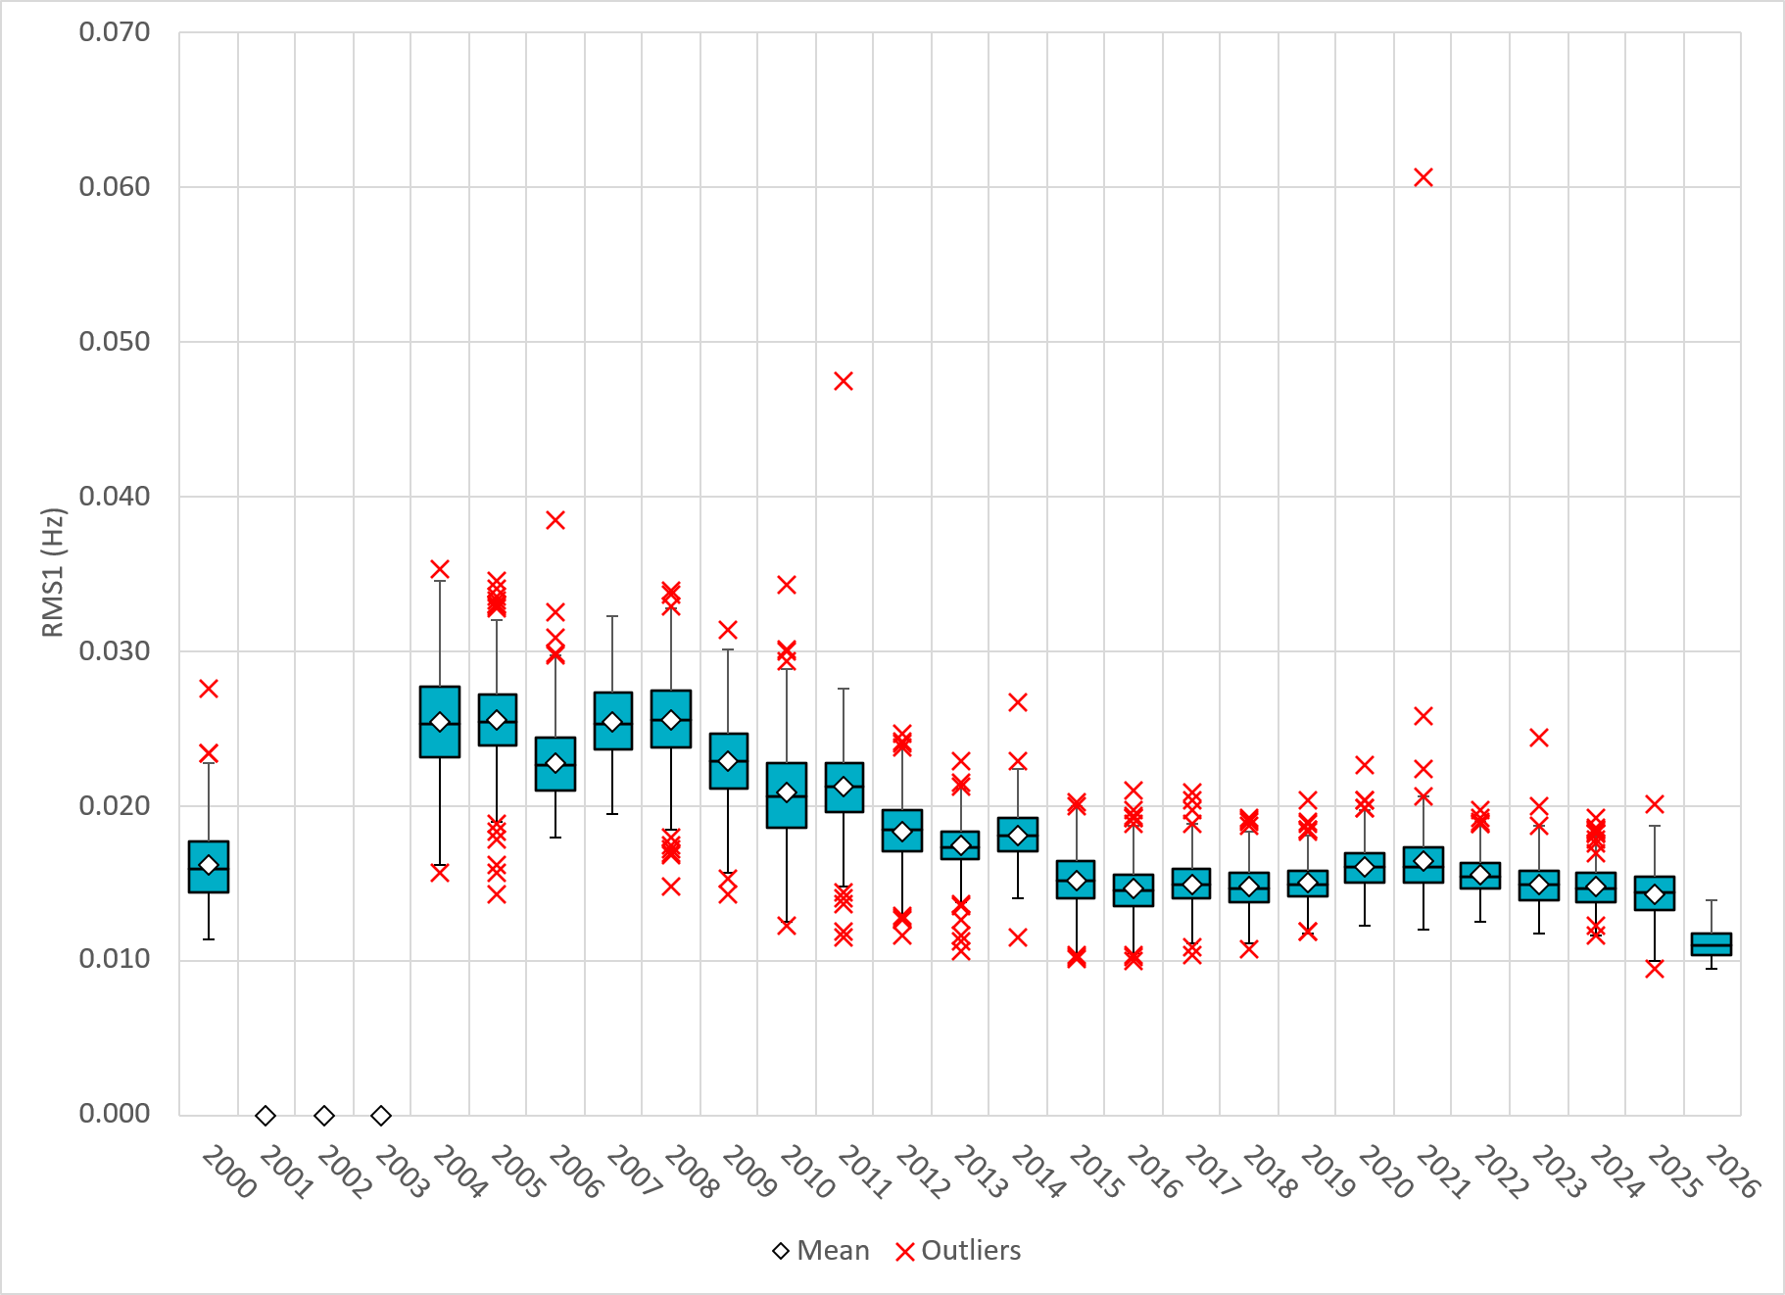
Daily RMS1 of ERCOT Frequency by Year
Notes:
Daily RMS1 frequency by year.
2026 RMS1 Statistics
Mean: 11.46 mHz
Min: 09.47 mHz
Max 14.75 mHz

Slide 9
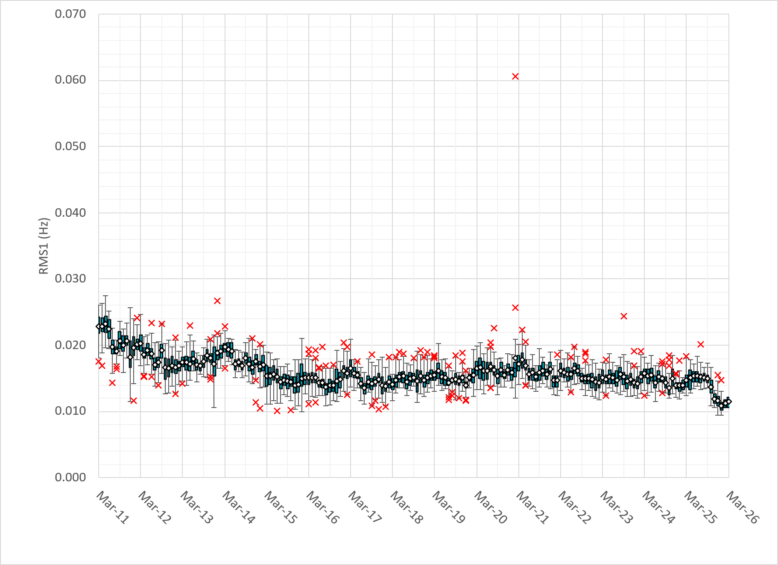
Daily RMS1 of ERCOT Frequency by Month
Notes:
A More granular look at last 15 years of RMS1 by month
11.46 mHz on avg for March 2026

Slide 10
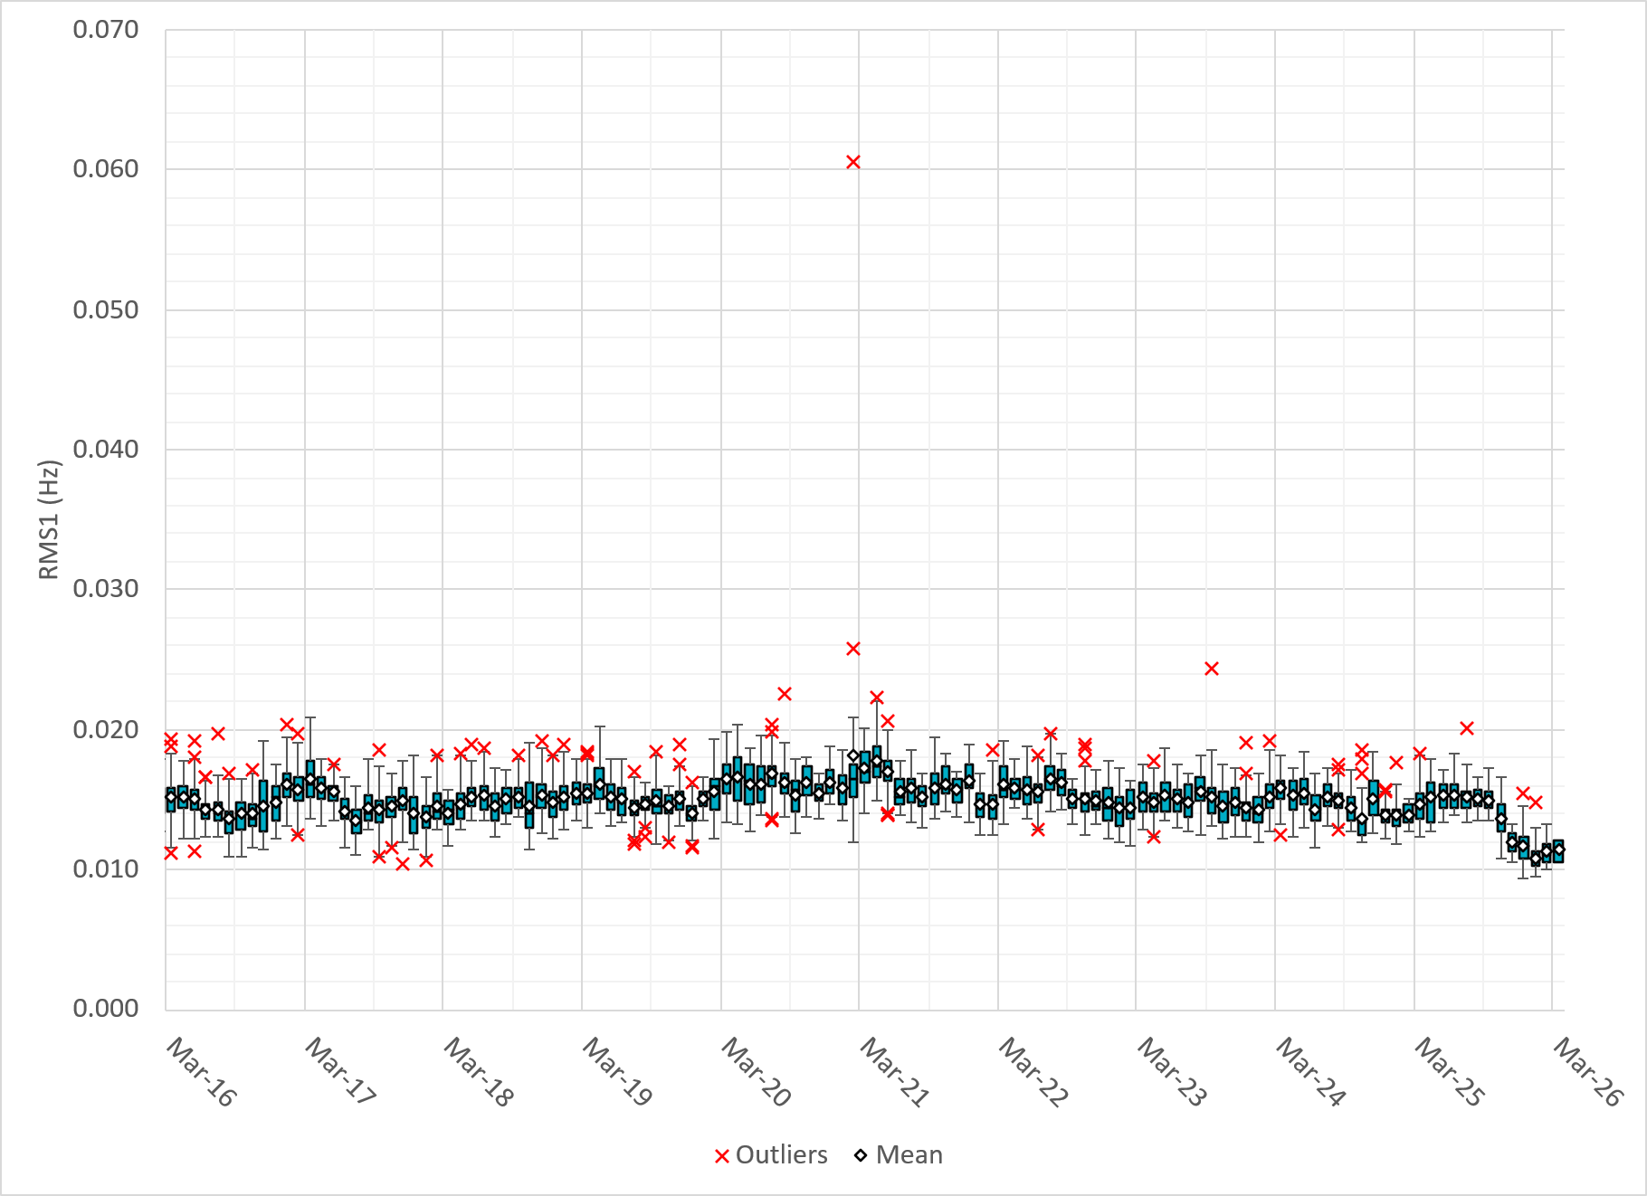
Daily RMS1 of ERCOT Frequency by Month
Notes:
Same data with 10 years shown instead of 15

Slide 11
Frequency Profile Comparison

Slide 12
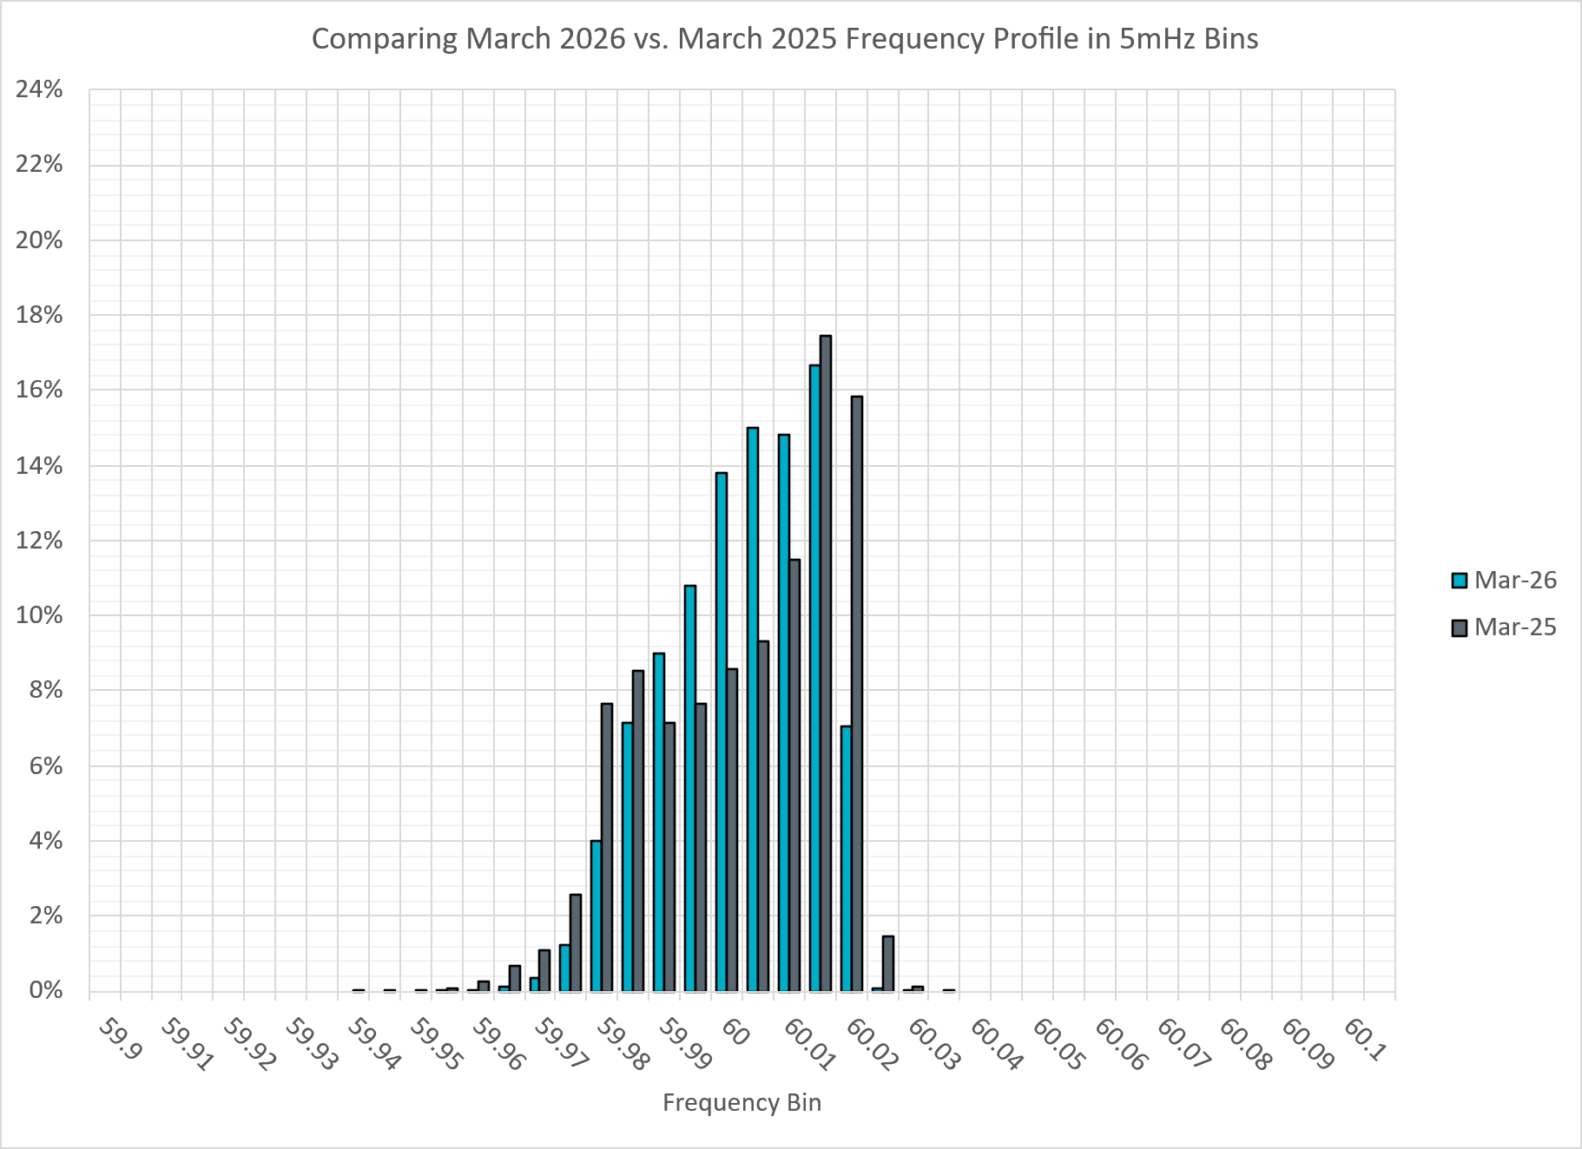
Frequency Profile Comparison
Notes:
Comparison of frequency profile between March 2025 and 2026. Compared to last year, there are slightly less instances of frequency hovering around the dead bands.

Slide 13
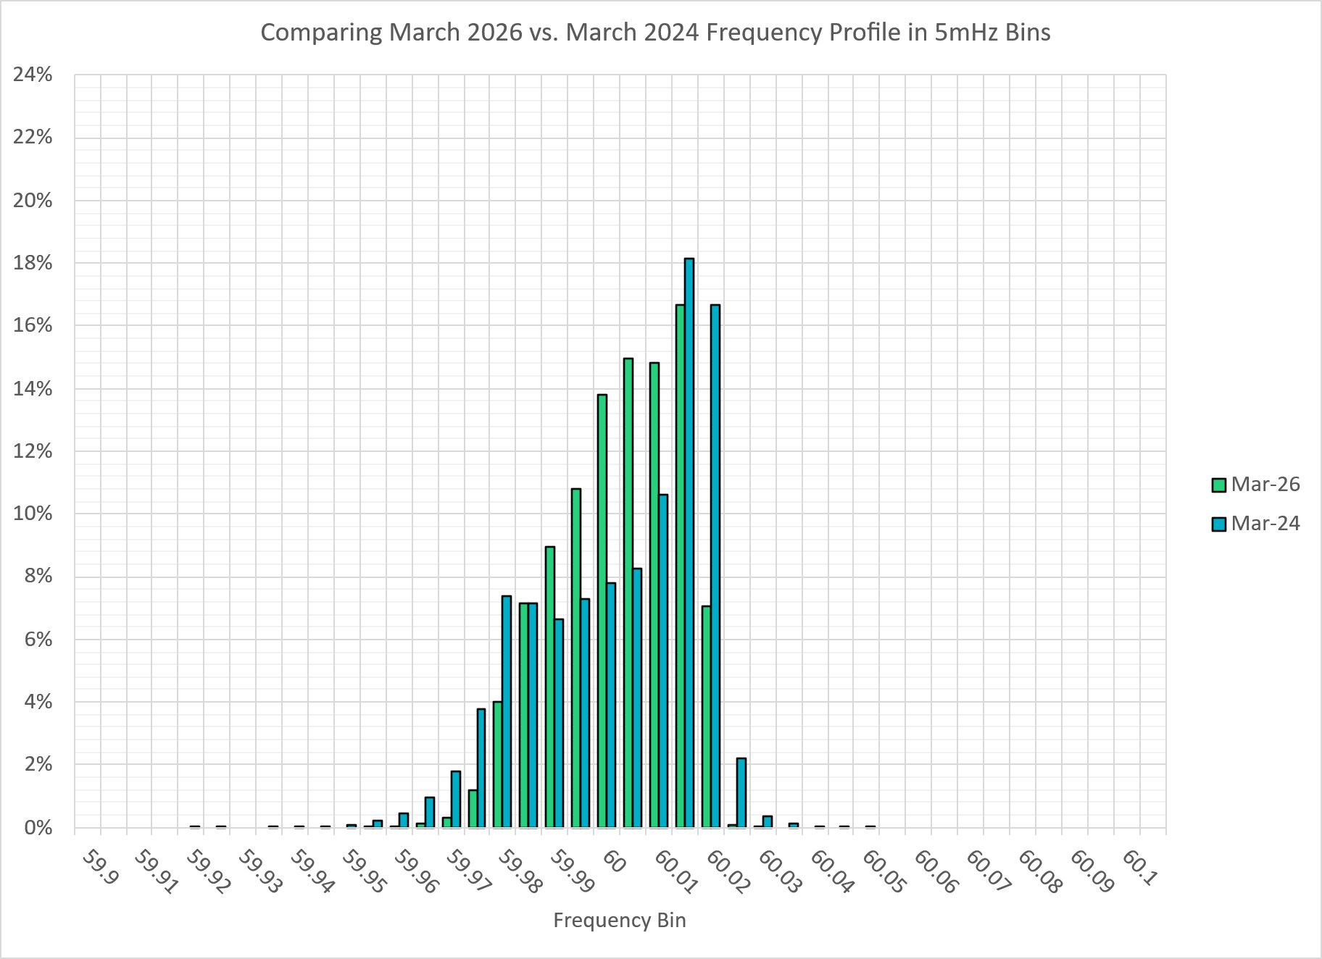
Frequency Profile Comparison
Notes:
Comparison of frequency profile between March 2024 and 2026. Like the previous slide, there are less instances of frequency hovering around the dead bands.

Slide 14
Time Error Correction

Slide 15
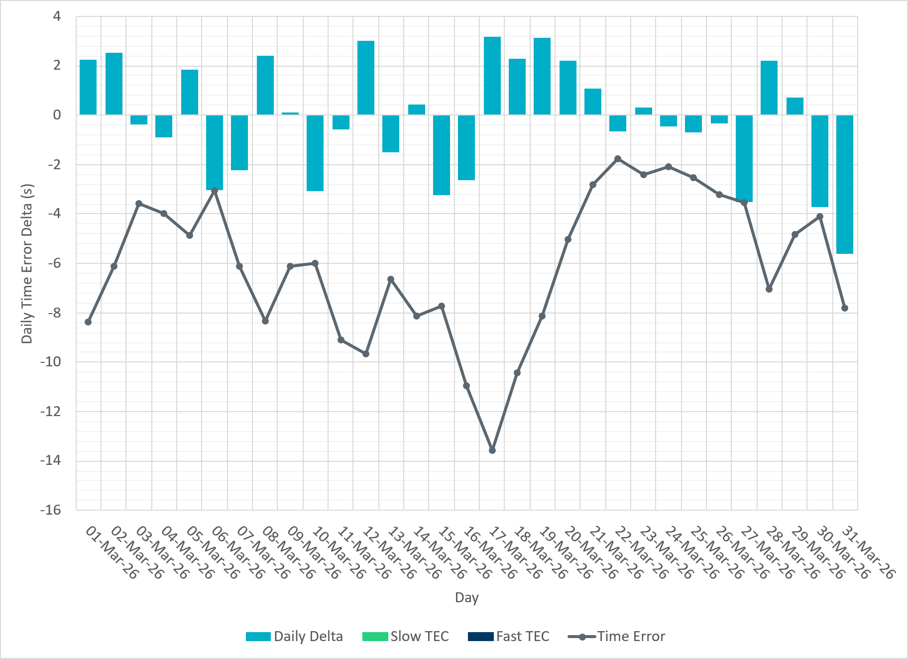
ERCOT Daily Time Error
Notes:
We see low time error accumulation throughout the month of March.

Slide 16
Time Error Corrections Log Summary
There have been no time error corrections since December 2016

Slide 17
BAL-003 Performance

Slide 18
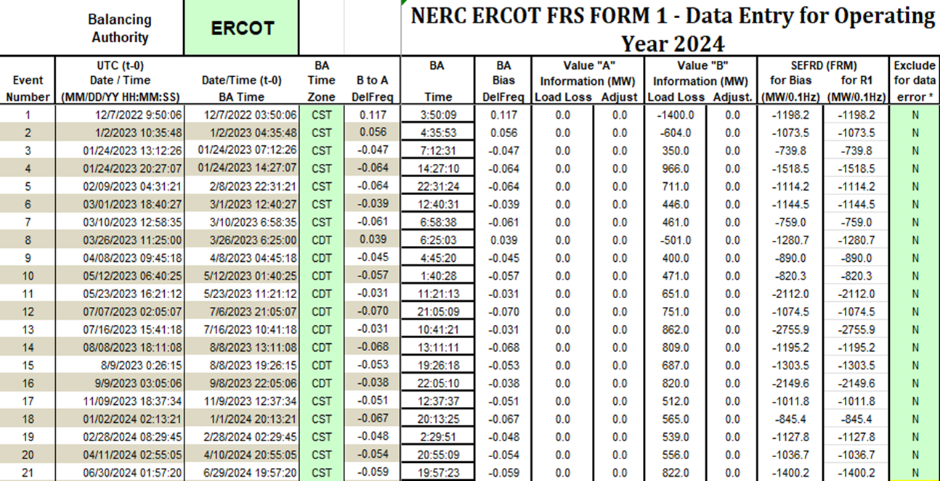
Op. Year 2024 BAL-003 Selected Events – Update
Notes:
BAL-003

Slide 19
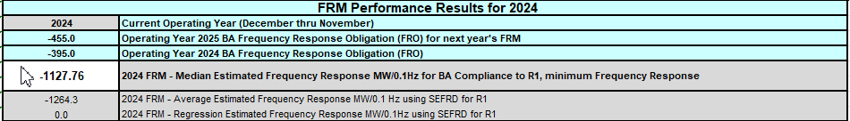
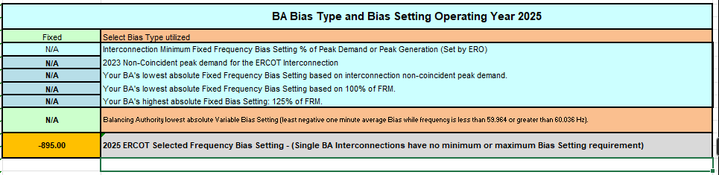
Op. Year 2024 BAL-003 FRM Performance - Update
Notes:
OP2018: FRO = -381.0, FRM_median = -843.17, FRM_average = -959.7
OP2019: FRO = -381.0, FRM_median = -811.14, FRM_average = -892.5
OP2020: FRO = -425.0, FRM median = -789.34, FRM average = -879.0
OP2021: FRO = -471.0, FRM median = -913.56, FRM average = -992.
OP2022: FRO = -412.0, FRM median = -1060.40, FRM average = -1153.4
OP2023: FRO = -463.0, FRM median = -1130.21, FRM average = -1302.7
OP2024: FRO = -395.0, FRM median = -1127.76, FRM average = -1264.3
OP2025: FRO = -455.0,

Slide 20
ERCOT Energy Statistics

Slide 21
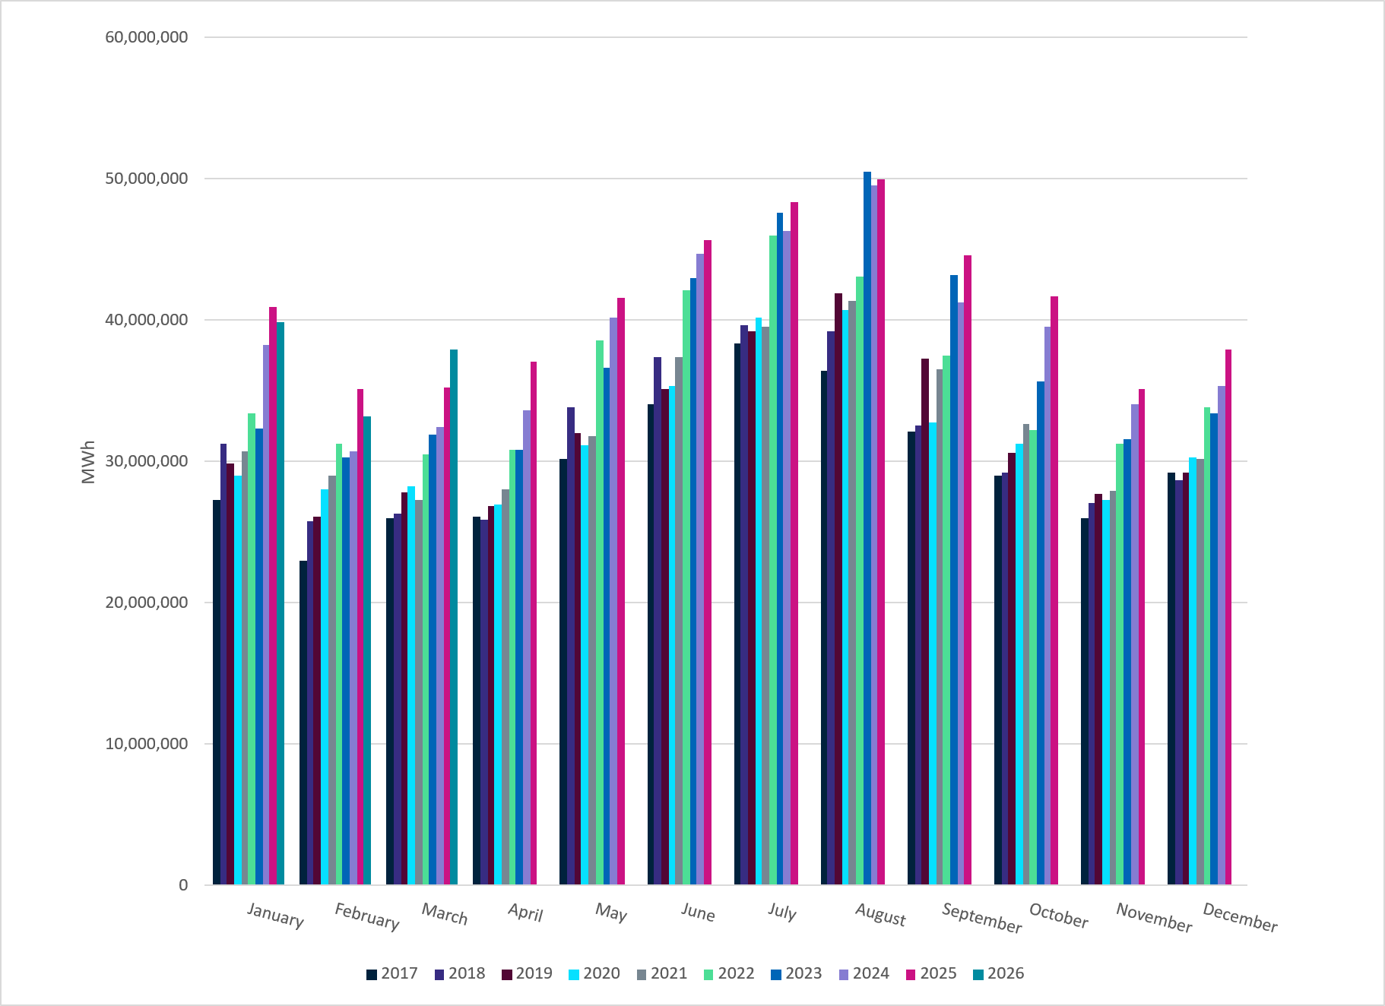
Total Energy
Notes:
37,911,606 MWh

Slide 22
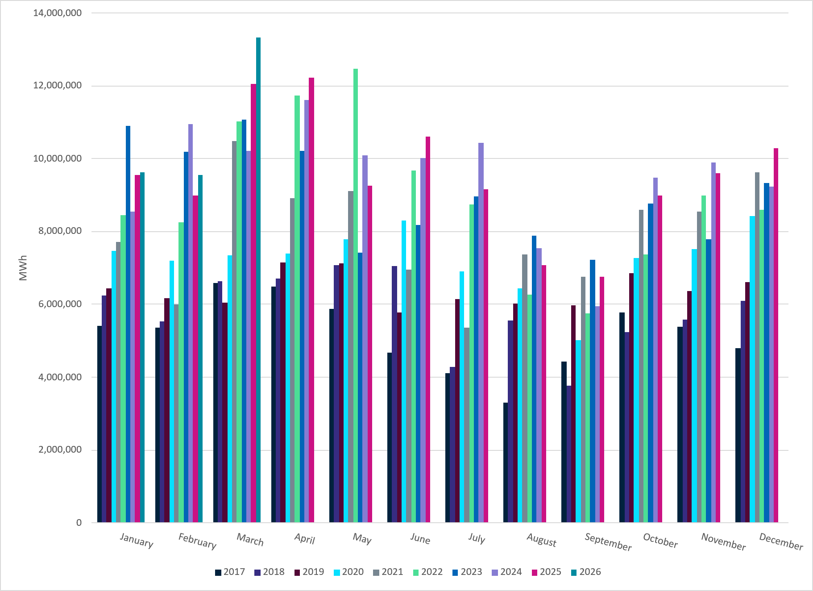
Total Energy from Wind Generation
Notes:
13,331,081 MWH

Slide 23
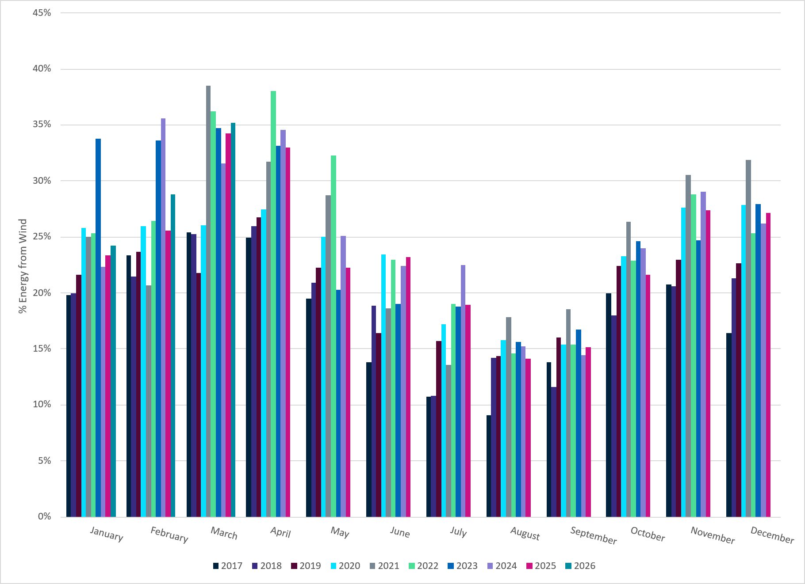
% Energy from Wind Generation
Notes:
35.16% of total energy was provided by wind generation

Slide 24
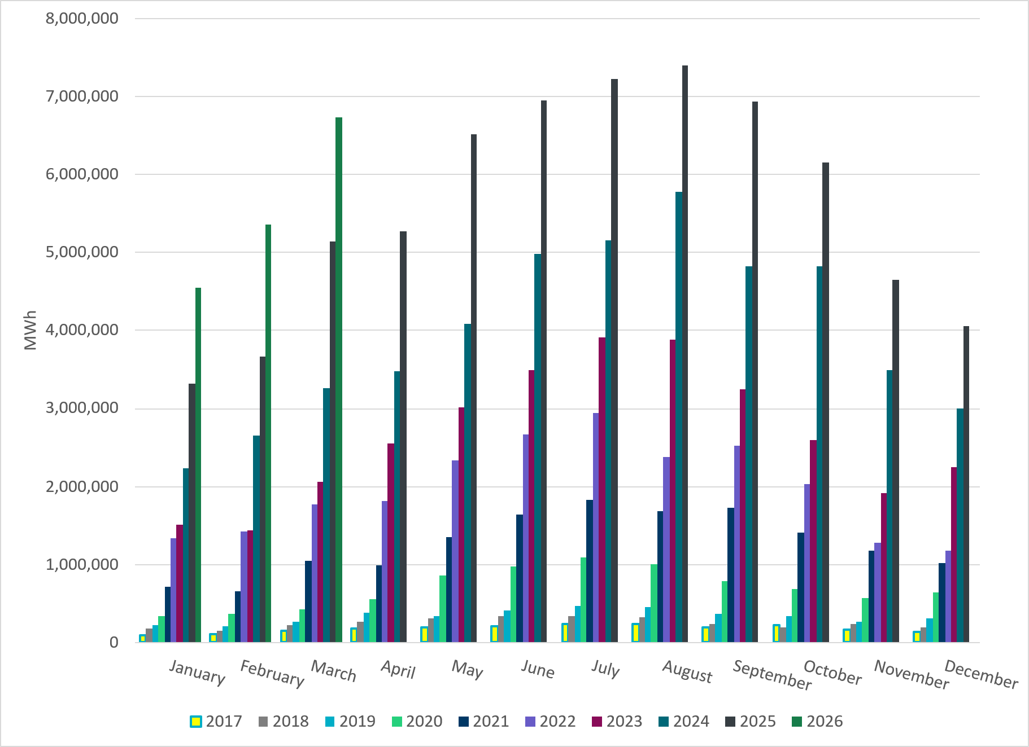
Total Energy From Solar Generation
Notes:
6,729,093 MWh

Slide 25
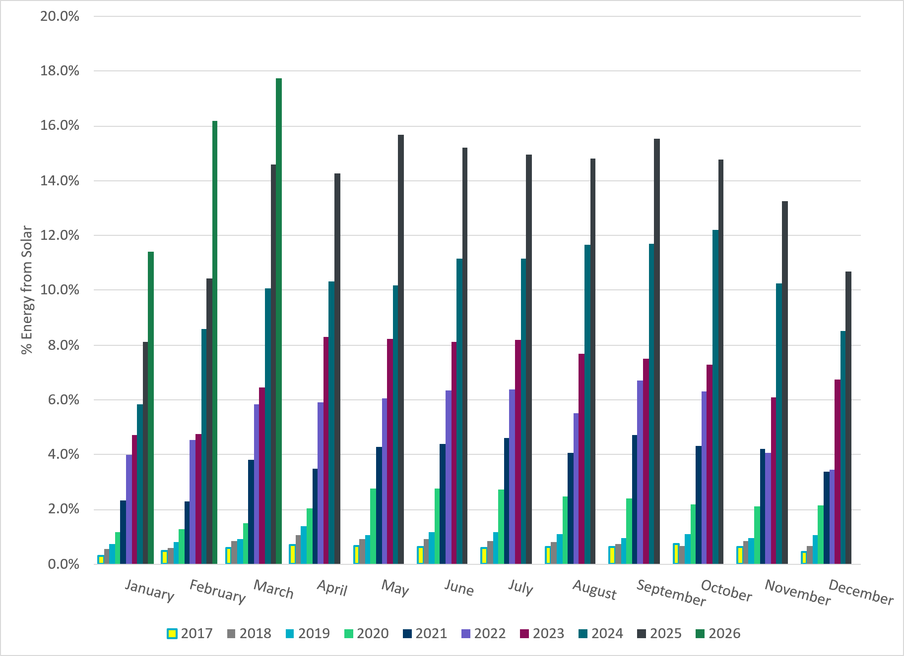
% Energy from Solar Generation
Notes:
17.75% of total energy was provided by solar generation

Slide 26
ERCOT System Inertia

Slide 27
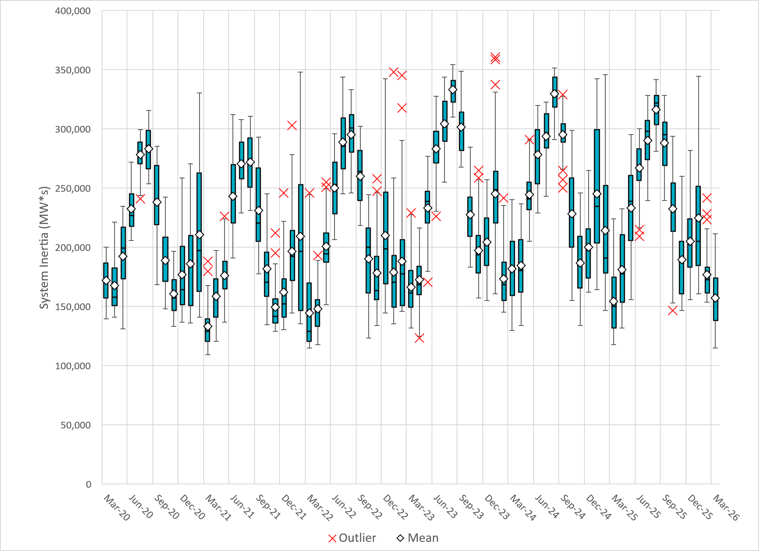
Daily Minimum System Inertia
Notes:
Minimum Inertia in March 2026 = 114,642 MW*s on March 14th
Historical Overall Minimum was 109,029 MW*s on 3/22/2021
March Data:
Mean: 157,243 MW*s
Max: 211,645 MW*s on March 8th
Min: 114,642 MW*s on March 14th

Slide 28
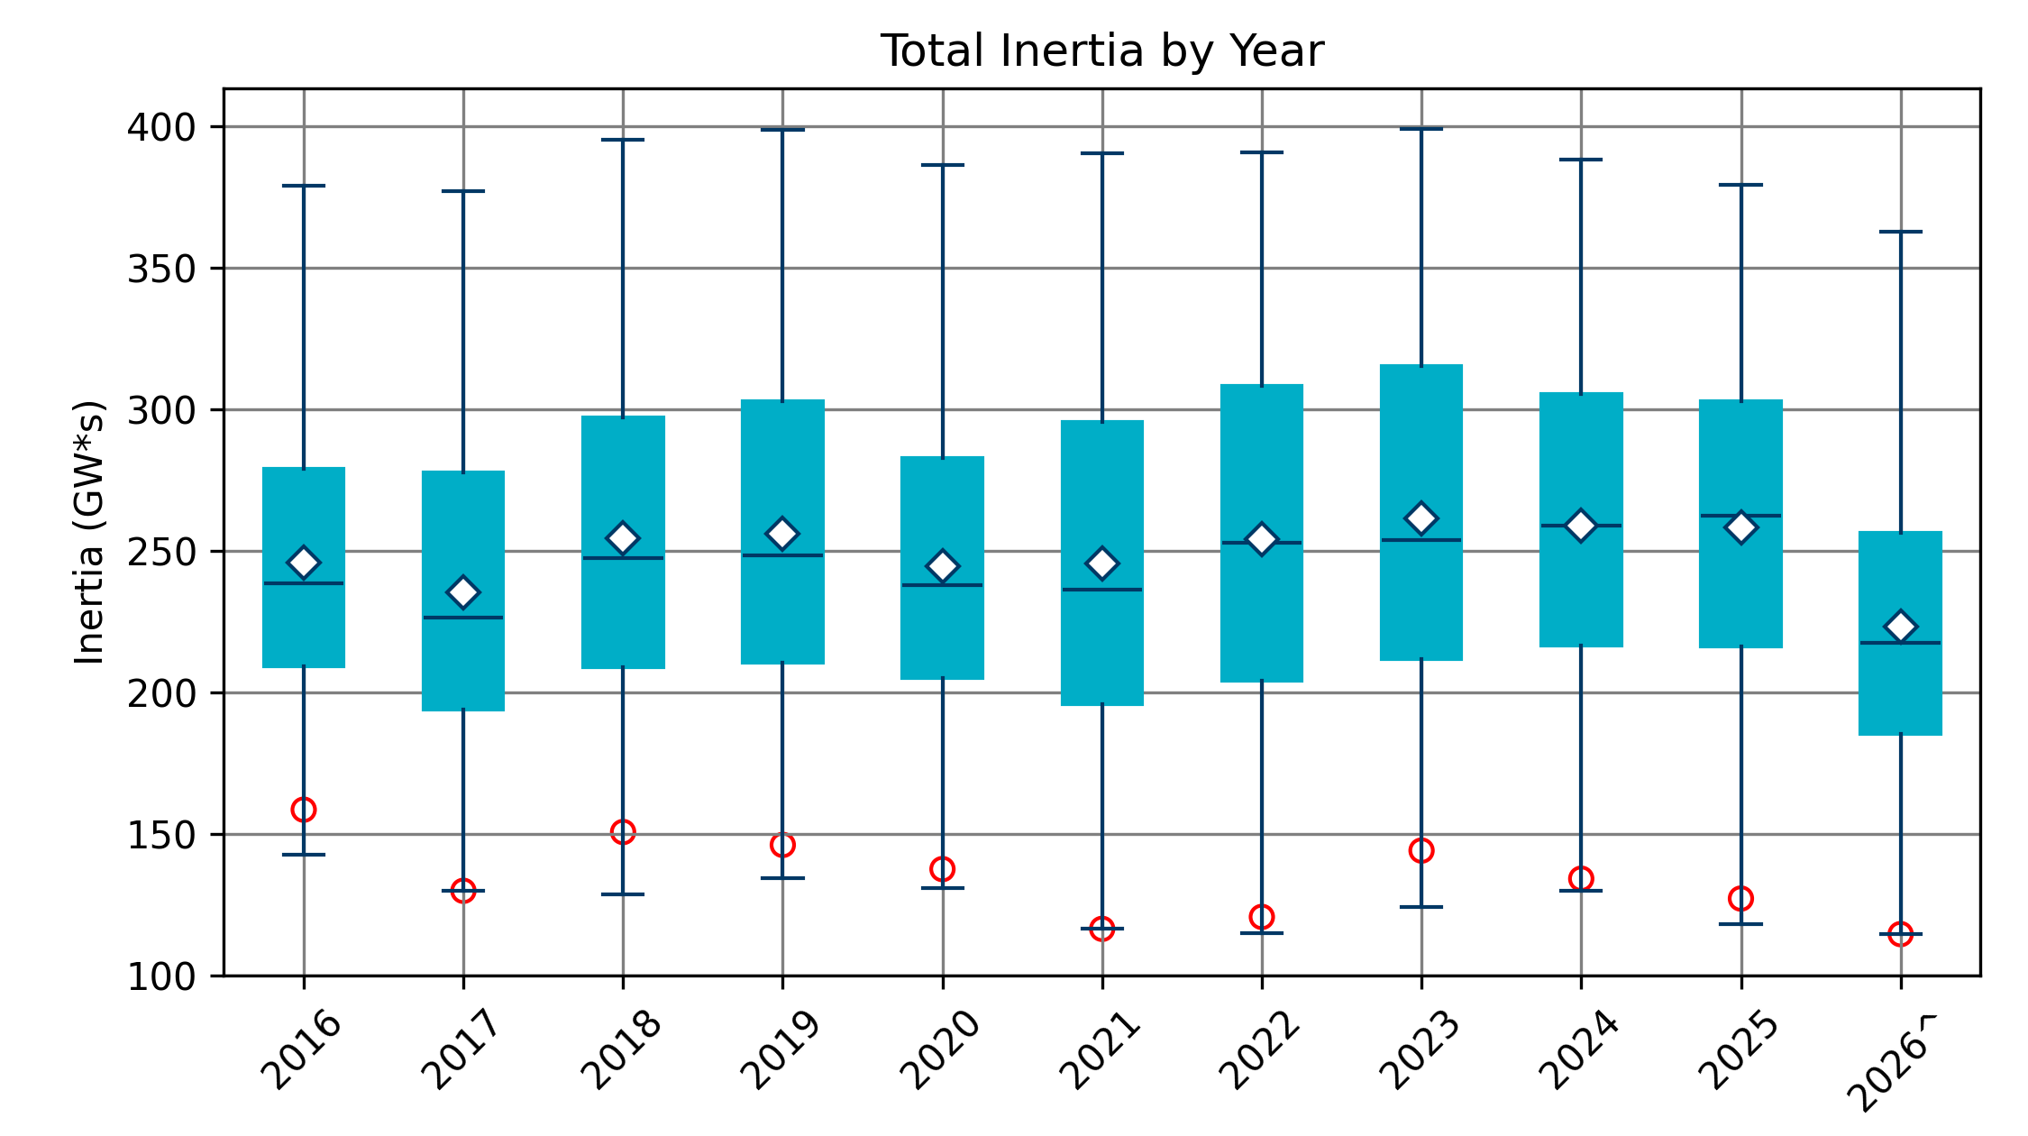
Total Inertia 2016-2026
Date and Time | 2016 4/10 2:00 AM | 2017 10/27 4:00 AM | 2018 11/03 3:30 AM | 2019 3/27 1:00 AM | 2020 05/01 2:00 AM | 2021 03/22 1:00 AM | 2022 03/21 2:00 AM | 2023 04/18 3:00 AM | 2024 03/29 4:00 AM | 2025 03/18 12:00 PM | 2026* 03/14 12:00 PM
Min synch. Inertia (GW*s) | 143 | 130 | 128.8 | 134.5 | 131.1 | 116.6 | 115.0 | 124.3 | 129.9 | 118.3 | 114.7
System load at minimum synch. Inertia (MW) | 27,831 | 28,425 | 28,397 | 29,883 | 30,679 | 31,767 | 33,784 | 35,578 | 37,039 | 49,130 | 48,013
Non-synch. Gen. in % of System Load | 47 | 54 | 53 | 50 | 57 | 66 | 65 | 61 | 68 | 74 | 81
FFR Award | N/A | N/A | N/A | N/A | 0 | 0 | 0 | 0 | 134 | 298 | 430
Critical Inertia (GW*s) | 100 | 100 | 100 | 100 | 100 | 100 | 100 | 100 | 93 | 92 | 87
Red circles denote inertia at max IRR penetration (= IRR Gen/Total Gen)

Slide 29
Questions/Comments?

