Slide 1
CRR Updates
CMWG
Samantha Findley
ERCOT CRR Market Operations
April 13, 2026
Outline:
  LTAS transactions and solution times
  CRR auction limits table – no changes
  Upcoming data removal from the CRR MUI (data > 7 years old)

Slide 2
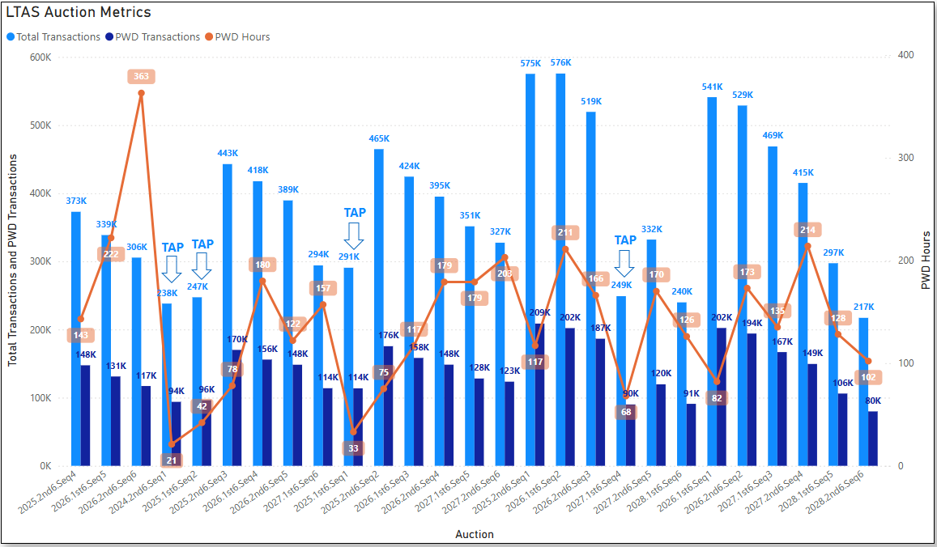
Historical LTAS transactions and solution times

Slide 3
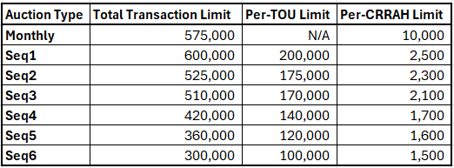
CRR auction transaction limits – no changes

Slide 4
Removal of historical data from the CRR system
The production database currently contains data from all markets back to Nodal go-live (~16 years of data).
CRR system performance is negatively impacted by containing this much data.
Historical data more than 7 years old will be removed from the CRR system on April 24, 2026, in alignment with ERCOT’s data retention policy. After the data is removed from production, it will no longer be available in the CRR Market User Interface.
Expired MIS reports containing CRR data will continue to be available by Historical Public Report Request at https://www.ercot.com/about/contact.
Market notices announcing the data removal will be sent prior to April 24, 2026 (30-days and 10-days ahead)

Slide 5
Questions/Comments?
ercotcrr@ercot.com

