Slide 1
DAM PTP Bid Fee NPRR Update ERCOT Staff April 13, 2026
Outline:
PTPs are a key contributor of long solution times
This NPRR will introduce a PTP bid fee
Structure of bid fee still under discussion
This presentation to clarify definition of uncompetitive threshold and provide examples

Slide 2
NPRR Background
PTP and PTPLO hourly bids are the most difficult products for the DAM engine to solve for. They slow solve times significantly.
The original NPRR language described at the last CMWG would assess a fee for all unawarded PTP bids.
ERCOT is considering WMS approval of changes to the bid fee or parameter(s).
We received feedback from stakeholders and the IMM that unawarded PTPs could deter nearly-awarded bids, which provide useful price signals even though not awarded.
At the last CMWG we discussed the two options we are considering at this time.
We appreciate the comments submitted and will consider during internal discussions.

Slide 3
Options Being Considered
Based on stakeholder and IMM feedback, we are now considering two options for the bid fee
The primary purpose of this presentation is to explain how “uncompetitive” is defined in option 2.
Option 1:
All PTPs are assessed a bid fee.
Option 2:
Only uncompetitive bids are assessed a bid fee.
The competitiveness of a PTP would be determined based on the clearing price of the path it is placed on.

Slide 4
Uncompetitive Definition
Uncompetitive PTP bids are defined as bids that are
Placed on de-energized settlement point(s)
Placed between electrically similar settlement points
Bids that have a not-to-exceed (bid) price below the uncompetitive threshold

Slide 5
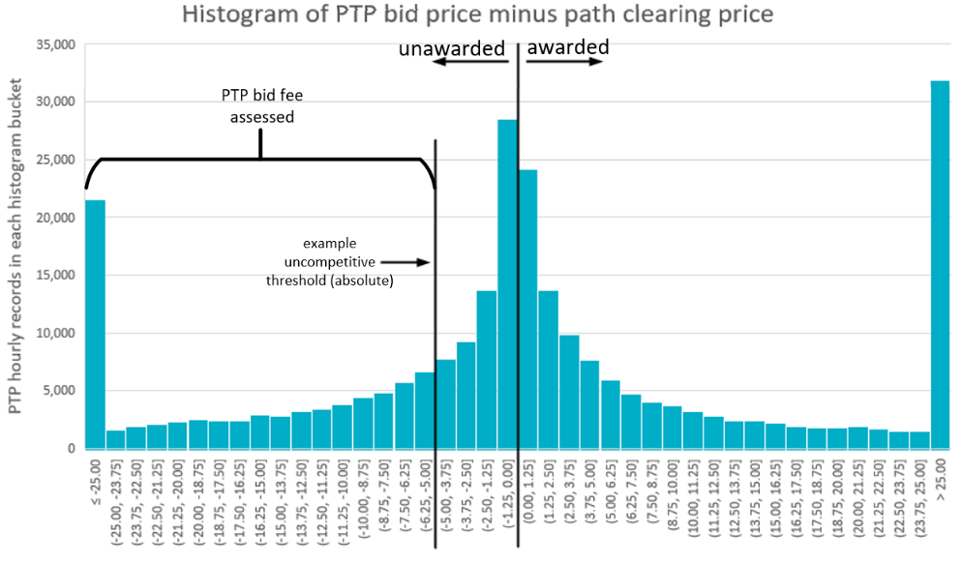
Uncompetitive Definition
PTP bid prices represent the clearing price (sink minus source) that the DAM engine should award if exceeded.
PTPs with bid prices above or not far below the path’s clearing price will not have a fee assessed.
The further a bid is away from being awarded, the more likely it is to be deemed uncompetitive, depending on the clearing and bid values.
Note that the first and last histogram buckets in the graph represent long “tails”
Key Takeaway: A subset of unawarded bids would be assessed a fee, targeting uncompetitive PTP bids, while having little impact on unawarded PTPs that contribute meaningful price signals.

Slide 6
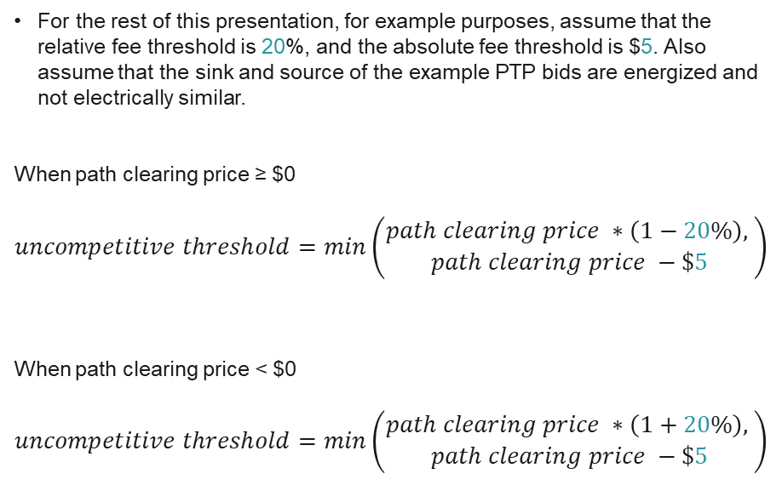
Uncompetitive Definition
Path Clearing Price ($) | Relative Threshold ($) | Absolute Threshold ($) | Minimum of abs or relative ($) | Abs or Relative used?
1000 | 800 | 995 | 800 | Relative
100 | 80 | 95 | 80 | Relative
10 | 8 | 5 | 5 | Absolute
1 | .8 | -4 | -4 | Absolute
0 | 0 | -5 | -5 | Absolute
-1 | -1.2 | -6 | -6 | Absolute
-10 | -12 | -15 | -15 | Absolute
-100 | -120 | -105 | -120 | Relative
-1000 | -1200 | -1005 | -1200 | Relative
For the rest of this presentation, for example purposes, assume that the relative fee threshold is 20%, and the absolute fee threshold is $5. Also assume that the sink and source of the example PTP bids are energized and not electrically similar.
When path clearing price ≥ $0
$$uncompetitive threshold=min\left(\begin{aligned}path clearing price ∗\left(1−20\%\right), \\ path clearing price −\$5\end{aligned}\right)$$
When path clearing price < $0
$$uncompetitive threshold=min\left(\begin{aligned}path clearing price ∗\left(1+20\%\right), \\ path clearing price −\$5\end{aligned}\right)$$

Slide 7
Worked Examples, single-hour PTP bids
Example # | Sink ($) | Source ($) | Clearing Price ($) | Absolute Threshold ($) | Relative Threshold | Uncompetitive Threshold ($) | Bid Price ($) | Awarded ? | Fee Assessed ?
1 | 11 | 2 | 9 | 9 – 5 = 4 | $9 x 0.8 = $7.2 | 4 (abs) | 10 | Yes | No
2 | 11 | 2 | 9 | 9 – 5 = 4 | $9 x 0.8 = $7.2 | 4 (abs) | 6 | No | No
3 | 11 | 2 | 9 | 9 – 5 = 4 | $9 x 0.8 = $7.2 | 4 (abs) | 2 | No | Yes
4 | 11 | 15 | -4 | -4 – 5 = -9 | $-4 x 1.2 = $-4.8 | -9 (abs) | -12 | No | Yes
5 | -50 | 300 | -350 | -350 – 5 = -355 | $-350 x 1.2 = $-420 | -420 (rel) | -400 | No | No
Key Takeaway: PTPs with a bid price less than the uncompetitive threshold will be assessed a fee.

Slide 8
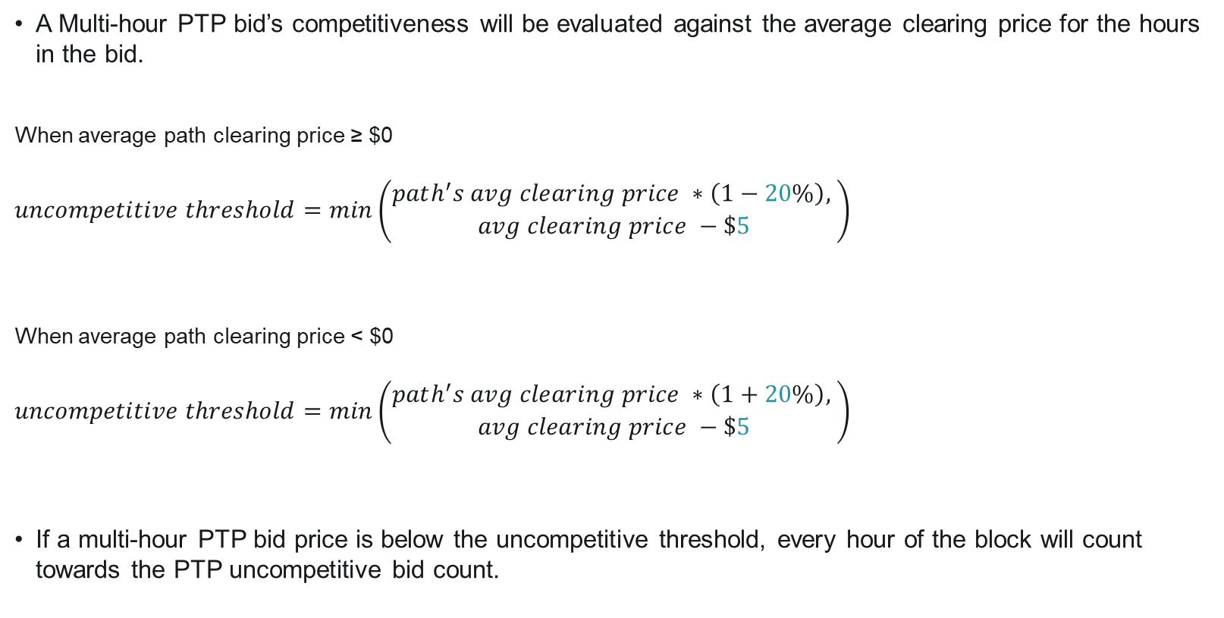
Multi-Hour PTP Bid Handling
A Multi-hour PTP bid’s competitiveness will be evaluated against the average clearing price for the hours in the bid.
When average path clearing price ≥ $0
$$uncompetitive threshold=min\left(\begin{aligned}path^{′}s avg clearing price ∗\left(1−20\%\right), \\ avg clearing price −\$5\end{aligned}\right)$$
When average path clearing price < $0
$$uncompetitive threshold=min\left(\begin{aligned}path^{′}s avg clearing price ∗\left(1+20\%\right), \\ avg clearing price −\$5\end{aligned}\right)$$
If a multi-hour PTP bid price is below the uncompetitive threshold, every hour of the block will count towards the PTP uncompetitive bid count.

Slide 9
Worked Examples, multi-hour PTP bids: Example 6
Block ID | Hour | Sink ($) | Source ($) | Avg Clearing Price ($) | Absolute Threshold ($) | Relative Threshold | Uncompetitive Threshold ($) | Bid Price ($) | Awarded ? | Fee Assessed ?
1 | 1 | 17 | 7 | 9 | 9 – 5 = 4 | $9 x 0.8 = $7.2 | 4 | 2 | No | Yes
1 | 2 | 16 | 7
1 | 3 | 15 | 7
2 | 4 | 50 | 16 | 41 | 41 – 5 = 36 | $41 x 0.8 = $32.8 | 32.8 | 33 | No | No
2 | 5 | 50 | 2
Key Takeaway: Multi-hour PTP bid’s uncompetitive thresholds are calculated similarly to single-hour, but average clearing prices are used.

Slide 10
Total Charge from Previous Examples
$$charge to QSE=PTP Fee Rate ∗PTP Uncompetitive bid count$$
Example # | Block | Fee Assessed? | Hours in block | Hours assessed a fee
1 | - | No | 1 | 0
2 | - | No | 1 | 0
3 | - | Yes | 1 | 1
4 | - | Yes | 1 | 1
5 | - | No | 1 | 0
6 | 1 | Yes | 3 | 3
 | 2 | No | 2 | 0
 |  |  | Total | 5
$$charge to QSE=\$0.50 ∗5=\$2.50$$
Assume a $0.50 fee rate per uncompetitive PTP.

Slide 11
Bid Fee Structure Comparison
Consideration | Option 1: Bid Fees for All PTPs Submitted | Option 2: Bid Fees for Only Uncompetitive PTPs
Number of parameters | 1 (fee rate) | 3 (fee rate, absolute uncompetitive threshold, and relative uncompetitive thresholds)
Fee rate | $ Lower | $$$ Higher
Complexity of analysis to determine parameter values | Low | High
Expected timeline to approve change in parameter values | Shorter | Longer
Expected impact to entities hedging real-time congestion | Medium | Low
Key Takeaway: Option 1 would be easier and less expensive to set up and maintain. However, Option 1 has a greater anticipated impact on real-time hedging and is less targeted towards the most computationally intensive submissions.

Slide 12
Questions/Comments?
Alfredo.Moreno@ercot.com

