Slide 1
ERCOT Batch Zero Financial Security Obligations primer
April 9th, 2026

Slide 2
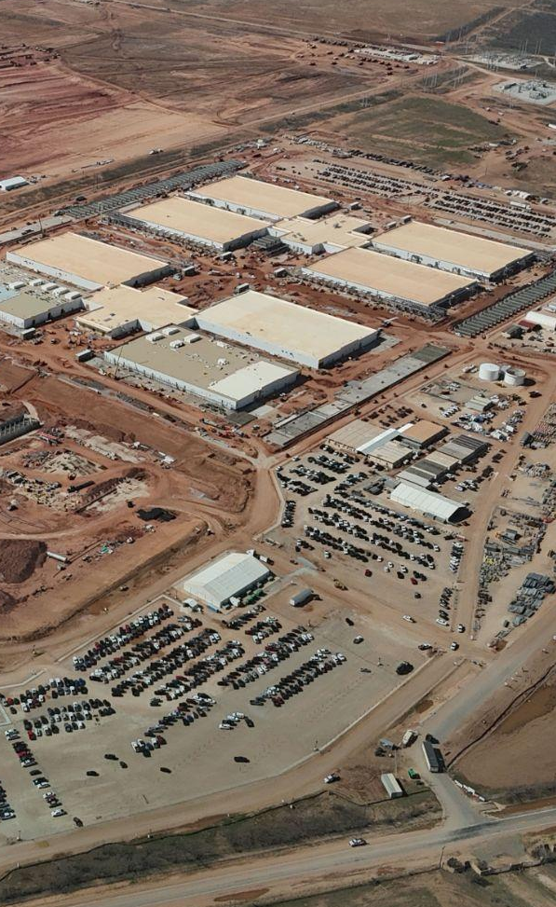
Executive summary
Objectives for today
Walk through the cash funding requirements for Interconnecting Large Load Entites (ILLEs) under the Batch 0/PGR 145 Draft language ( co-related with PUCT 58481 rule making)
Executive Summary
There are currently 3 proposed funding requirements for ILLEs
Partially refundable Financial Security of $50k/MW, due at Intermediate Agreement - July 2026
Non-refundable Contribution in Aid of Construction (CIAC) covering estimated interconnection facilities costs, due at Interconnection Agreement execution - Feb 2027
Partially refundable Upgrade Security covering transmission upgrade costs, due at Interconnection Agreement execution -Feb 2027
These funding pools represent separate, meaningful commitments from ILLEs to connect under the proposed rules

Slide 3
Proposed rules identify three funding requirements that ILLEs must post
Funding Pool | Timing | Amount | Refundability
Financial Security | Posted at Intermediate Agreement Signing | $50k/MW covering every MW in application | Partially refundable
Contribution in Aid of Construction (CIAC) | No later than (IA) Interconnection Agreement execution | Payment covering estimated costs for direct interconnection facilities soley built to serve ILLE | Non-refundable
Upgrade Security | Posted at execution of Interconnection Agreement | Payment covering transmission upgrades identified in Batch 0 study | Refundable under certain conditions
1
2
3

Slide 4
The Financial Security is $50k/MW posted at Intermediate Agreement signing
1
DSP / TSP draws payment at Interconnection Agreement signing to offset rate base costs
ILLE signs Interconnection Agreement
ILLE posts $50k/MW to TSP at Intermediate Agreement signing
Rule §25.194(f)(7)(A)
Rule §25.194(f)(7)(B)
OR
ILLE receives 20% ($10k/MW) refund within 60 days; TSP receives 80% to offset rate base costs
ILLE withdraws before signing Interconnection Agreement
Rule §25.194(d)(10)
Rule §25.194(g)(2)
Rule §25.194(g)(3)
Rule §25.194(g)(4)

Slide 5
CIAC is a non-refundable payment that offsets interconnection facilities built for the ILLE
2
Coverage
Cash-only payment covers:
All direct costs incurred for interconnection facilities built solely to serve ILLE
Costs that DSP / TSP cannot recover through regulated rates
Examples: radial transmission lines to from Substation to ILLE, substation upgrades, switchgear and protection relays, etc.
ILLEs must post a CIAC payment no later than the execution of an Interconnection Agreement; once posted it is nonrefundable
Rule §25.194(f)(9)(A)
Rule §25.194(f)(9)(B)
Rules
Key rules stipulate that:
Actual costs are settled up after completion via credit or surcharge
Construction cannot begin until CIAC is paid in full
Rule §25.194(f)(9)
Rule §25.194(g)(5)
Rule §25.194(h)(5)
Rule §25.194(f)(9)(C)

Slide 6
The Upgrade Security covers transmission upgrades with a standard deduction / refund process
3
Upgrade Security
-
Deductions for costs incurred
=
Refund Pool
Upgrade Securtity is posted by ILLE at signing of Interconnection Agreement and covers transmission upgrades identified in Batch Zero study
ILLE & DSP/TSP incur transmission upgrade costs across major categories:
General costs
Equipment costs
Construction costs
Cost of services
Costs incurred are deducted from Upgrade Security
Difference between Upgrade Security and cost deductions is refunded to ILLE via standard schedule:
20% refunded over time proportional to energization schedule
Remaining 80% refunded after 5 years of sustained operations
Rule §25.194(f)(10)
Rule §25.194(i))
Rule §25.194(i)(1)
Rule §25.194(i)(2)

Slide 7
Funding requirements for a hypothetical 1GW ILLE moving through the Batch 0 process
Intermediate agreement
Interconnection agreement
1
Financial security
CIAC
System upgrades
2
3
1GW ILLE enters Batch 0 process
Payment: ILLE submits $50M payment (e.g. $50k/MW for 1GW project)
Refund: If ILLE withdraws before signing IA; eligible for 20%, remaining 80% offsets rate base costs
Payment: ILLE submits $100M (assumed) to cover interconnection facility costs
Refund: No refunds under any circumstances
Payment: ILLE submits $100M (assumed) to cover system upgrades
Deductions: Eligible cost deductions are $90M (assumed)
Refund: $10M (e.g. $100-$90M); 20% recovered in tranches, 80% recovered in lump sum after 5 yrs sustained ops
Incremental posting | $50M | $100M (assumed) | $100M (assumed)
Cumulative posting | $50M | $150M | $250M
Refundable | $10M | $0 | $10M (assumes $90M in deductions)

Slide 8
Appendix

Slide 9
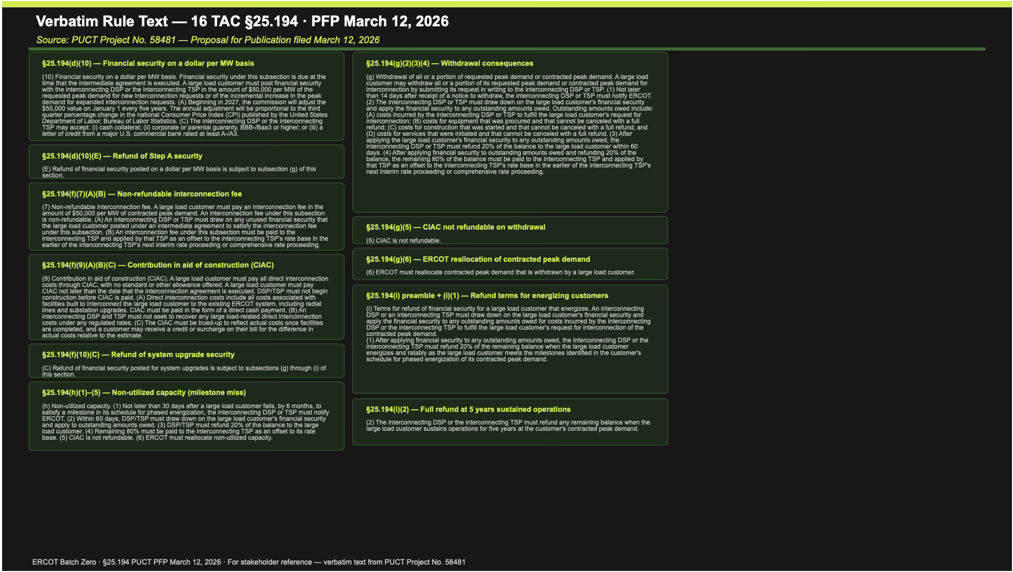
PUCT Project No. 58481 rule text filed on March 12, 2026 (I/IV)
 | Rule name | Rule Text
§25.194(d)(10) | Financial security on a dollar per MW basis | (10) Financial security on a dollar per MW basis. Financial security under this subsection is due at the time that the intermediate agreement is executed. A large load customer must post financial security with the interconnecting DSP or the interconnecting TSP in the amount of $50,000 per MW of the requested peak demand for new interconnection requests or of the incremental increase in the peak demand for expanded interconnection requests. (A) Beginning in 2027, the commission will adjust the $50,000 value on January 1 every five years. The annual adjustment will be proportional to the third quarter percentage change in the national Consumer Price Index (CPI) published by the United States Department of Labor, Bureau of Labor Statistics. (C) The interconnecting DSP or the interconnecting TSP may accept: (i) cash collateral; (ii) corporate or parental guaranty, BBB-/Baa3 or higher; or (iii) a letter of credit from a major U.S. commercial bank rated at least A-/A3.
§25.194(d)(10)(E) | Refund of Step A security | (E) Refund of financial security posted on a dollar per MW basis is subject to subsection (g) of this section.
§25.194(f)(7)(A)(B) | Non-refundable interconnection fee | (7) Non-refundable interconnection fee. A large load customer must pay an interconnection fee in the amount of $50,000 per MW of contracted peak demand. An interconnection fee under this subsection is non-refundable. (A) An interconnecting DSP or TSP must draw on any unused financial security that the large load customer posted under an intermediate agreement to satisfy the interconnection fee under this subsection. (B) An interconnection fee under this subsection must be paid to the interconnecting TSP and applied by that TSP as an offset to the interconnecting TSP's rate base in the earlier of the interconnecting TSP's next interim rate proceeding or comprehensive rate proceeding.

Slide 10
PUCT Project No. 58481 rule text filed on March 12, 2026 (II/IV)
 | Rule name | Rule Text
§25.194(f)(9)(A)(B)(C) | Contribution in aid of construction (CIAC) | (9) Contribution in aid of construction (CIAC). A large load customer must pay all direct interconnection costs through CIAC, with no standard or other allowance offered. A large load customer must pay CIAC not later than the date that the interconnection agreement is executed. DSP/TSP must not begin construction before CIAC is paid. (A) Direct interconnection costs include all costs associated with facilities built to interconnect the large load customer to the existing ERCOT system, including radial lines and substation upgrades. CIAC must be paid in the form of a direct cash payment. (B) An interconnecting DSP and TSP must not seek to recover any large load-related direct interconnection costs under any regulated rates. (C) The CIAC must be trued-up to reflect actual costs once facilities are completed, and a customer may receive a credit or surcharge on their bill for the difference in actual costs relative to the estimate.
§25.194(f)(10)(C) | Refund of system upgrade security | (C) Refund of financial security posted for system upgrades is subject to subsections (g) through (i) of this section.
§25.194(h)(1)–(5) | Non-utilized capacity (milestone miss) | (h) Non-utilized capacity. (1) Not later than 30 days after a large load customer fails, by 6 months, to satisfy a milestone in its schedule for phased energization, the interconnecting DSP or TSP must notify ERCOT. (2) Within 60 days, DSP/TSP must draw down on the large load customer's financial security and apply to outstanding amounts owed. (3) DSP/TSP must refund 20% of the balance to the large load customer. (4) Remaining 80% must be paid to the interconnecting TSP as an offset to its rate base. (5) CIAC is not refundable. (6) ERCOT must reallocate non-utilized capacity.

Slide 11
PUCT Project No. 58481 rule text filed on March 12, 2026 (III/IV)
 | Rule name | Rule Text
§25.194(g)(2)(3)(4) | Withdrawal consequences | (g) Withdrawal of all or a portion of requested peak demand or contracted peak demand. A large load customer may withdraw all or a portion of its requested peak demand or contracted peak demand for interconnection by submitting its request in writing to the interconnecting DSP or TSP. (1) Not later than 14 days after receipt of a notice to withdraw, the interconnecting DSP or TSP must notify ERCOT. (2) The interconnecting DSP or TSP must draw down on the large load customer's financial security and apply the financial security to any outstanding amounts owed. Outstanding amounts owed include: (A) costs incurred by the interconnecting DSP or TSP to fulfill the large load customer's request for interconnection; (B) costs for equipment that was procured and that cannot be canceled with a full refund; (C) costs for construction that was started and that cannot be canceled with a full refund; and (D) costs for services that were initiated and that cannot be canceled with a full refund. (3) After applying the large load customer's financial security to any outstanding amounts owed, the interconnecting DSP or TSP must refund 20% of the balance to the large load customer within 60 days. (4) After applying financial security to outstanding amounts owed and refunding 20% of the balance, the remaining 80% of the balance must be paid to the interconnecting TSP and applied by that TSP as an offset to the interconnecting TSP's rate base in the earlier of the interconnecting TSP's next interim rate proceeding or comprehensive rate proceeding.
§25.194(g)(5) | CIAC not refundable on withdrawal | (5) CIAC is not refundable.
§25.194(g)(6) | ERCOT reallocation of contracted peak demand | (6) ERCOT must reallocate contracted peak demand that is withdrawn by a large load customer.

Slide 12
PUCT Project No. 58481 rule text filed on March 12, 2026 (IV/IV)
 | Rule name | Rule Text
§25.194(i) preamble + (i)(1) | Refund terms for energizing customers | (i) Terms for refund of financial security for a large load customer that energizes. An interconnecting DSP or an interconnecting TSP must draw down on the large load customer's financial security and apply the financial security to any outstanding amounts owed for costs incurred by the interconnecting DSP or the interconnecting TSP to fulfill the large load customer's request for interconnection of the contracted peak demand. (1) After applying financial security to any outstanding amounts owed, the interconnecting DSP or the interconnecting TSP must refund 20% of the remaining balance when the large load customer energizes and ratably as the large load customer meets the milestones identified in the customer's schedule for phased energization of its contracted peak demand.
§25.194(i)(2) | Full refund at 5 years sustained operations | (2) The interconnecting DSP or the interconnecting TSP must refund any remaining balance when the large load customer sustains operations for five years at the customer's contracted peak demand.

Slide 13
Hypothetical example | An ILLE in Batch Zero proposes a 1GW project
 |  | Pool 1 - Financial security |  | Pool 2 - CIAC | Pool 3 - System upgrades
Initial payment | Amount | $50M |  | $100M (purely hypothetical) | $100M (purely hypothetical)
 | Calculation | $50k/MW x 1GW ($50k/MW x total load in application) |  | N/A - estimated in study | N/A - estimated in study
 | Timing | Paid at signing of Intermediate Agreement |  | Paid no later than execution of Interconnection Agreement | Paid when Interconnection Agreement is signed
ILLE decision |  | ILLE signs IA | ILLE withdraws
Refund | Amount | N/A - no refund | $10M | N/A - no refund in any circumstance | $10M (purely hypothetical; assumes $90M of cost deductions)
 |  |  |  |  | 20% tranche ($2M received in 4 tranches of $500k) | 80% tranche ($8M in lump sum)
 | Calculation | N/A | 20% x $50M (20% of Pool 1 payment) | N/A | ($100M - $90M) x 20% | ($100M - $90M) x 80%
 | Timing | N/A | Refunded within 60 days | N/A | Received in tranches as project reaches milestones | Received after 5 years of sustained operations

