Slide 1


TDTMS Update to RMS
April 2026
Leadership 2026
Chair - Sheri Wiegand, Vistra
Vice Chair – Monica Jones, CNP
Vice Chair - Rob Bevill, TNMP

Slide 2

TDTMS has met twice since the last RMS meeting in Feb.
          Feb 23
          March 23
          Today’s update covers both.

Slide 3
2026 Service Level Agreements
  Retail Market IT Systems – Met Jan & Feb
    Some users noted MT latency in March
      ERCOT researching for further discussion at TDTMS
      Submit ServiceNow tickets for performance issues
  ListServ IT Services - Met Jan & Feb
    TXSETLP listserv “hold” has been removed
      No impact to any other listservs
  Market Data Transparency - Met Jan & Feb
    The MDT SLA will remain under RMS purview
  SLA Documents: https://www.ercot.com/services/sla/

Slide 4
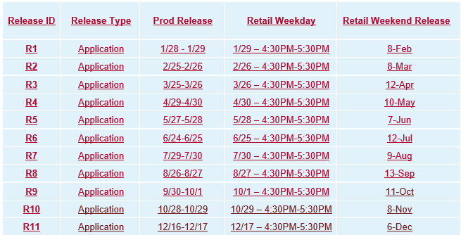
2026 Retail Release Schedule

Slide 5
ERCOT IT Projects
  Public Website Cipher Security Update
    Upgrading from TLS v1.2 to v1.3
    MPs should confirm with their IT dept.
    Market Notices will be sent
    Effective sometime this summer
  Multi-Factor Authentication
    Digital Certs being mostly retired
    Timeline is TBD
  MIS Retail API & GUI
    MIS application upgrade
    Go-live target in ~Q3-Q4 2027

Slide 6
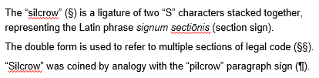
ERCOT Market
Performance Measures
  Revised PUCT Subst. Rule §25.88 became effective April 2, 2026
  ERCOT will no longer generate a Market Performance Measures Report unless performance fails to meet a minimum threshold.
  What is this symbol? §

Slide 7
Inadvertent Gain Analysis
2025 Q3-Q4 Data Review
  A TDTMS subgroup has scheduled a series of sessions to do a deep dive into the data over the next 4-6 weeks.
  A few REPs have an IAG rate double the market average (up to 3% annually)
  About 12 REPs are driving the majority of IAG issues (over 85%)
  TDTMS members asked ERCOT Client Services to consider outreach to REPs
  TDTMS is drafting a message to support Client Services outreach

Slide 8
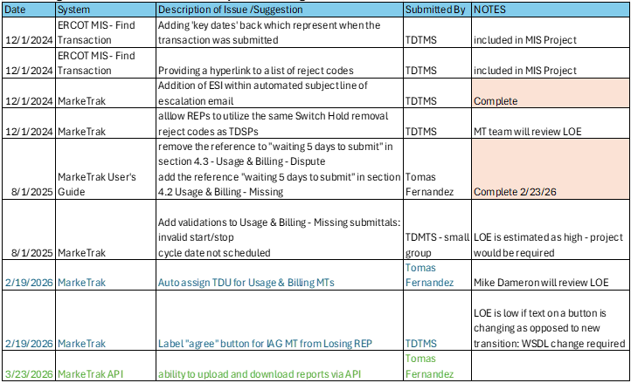
TDTMS Enhancement Wish List

Slide 9
Upcoming TDTMS Meetings
April – no meeting
May 4th – in person @ ERCOT Met Center
June 15th
July – no meeting
August 3rd
September 21st
October 19th
November 16th
December – no meeting
Only Q2 dates will be posted to the
ERCOT calendar for now.

Slide 10




Questions?

