Slide 1
Far West Texas Import GTCs Exit Strategies Priya Ramasubbu Grid Planning, ERCOT April 02, 2026

Slide 2
Introduction
ERCOT established the new North to Far West Texas Import (I_FW_N) and South to Far West Texas Import (I_FW_S) Generic Transmission Constraints (GTCs) to address cascading associated with large power imports from North to Far West Texas and South to Far West Texas, respectively, effective September 15, 2025.
Per Nodal Protocol Section 3.10.7.6 (7), ERCOT conducted a study and identified GTC exit strategies for the I_FW_N and I_FW_S GTC(s).
GTC Definition | Line
I_FW_N | Farmland – Wett_Long_Draw 345-kV line
I_FW_N | Scurry County South Switch – Wett_Long_Draw 345-kV line
I_FW_N | Scurry County South Switch – Wett_Faraday 345-kV line
I_FW_N | Farmland – Wett_Long_Draw 345-kV line
GTC Definition | Line
I_FW_S | Big Hill – Schneeman Draw #1 345-kV line
I_FW_S | Big Hill – Schneeman Draw #2 345-kV line
I_FW_S | Divide Switchyard – Wett_Sand_Bluff 345-kV line
I_FW_S | Cattleman Switch – Longshore Switch 345-kV line
I_FW_S | Morgan Creek SES – Longshore Switch #1 345-kV line
I_FW_S | Morgan Creek SES – Longshore Switch #2 345-kV line
I_FW_S | Morgan Creek SES – Consavvy Switch 345-kV line
I_FW_S | Ranger Camp Switch – Falcon Seaboard 345-kV line¹
I_FW_S | Ranger Camp Switch -- Falcon Seaboard
I_FW_S | Cattleman Switch – Prairieland Switch
I_FW_S | Ranger Camp Switch – Prong Moss Switch²
¹This interface will be obsolete once Prong Moss Switch is energized
²This interface will be used only after Prong Moss Switch is energized

Slide 3
Study Methodology
The following Texas Energy Fund (TEF) generators located in the Far West weather zone that have met the Planning Guide 6.9(1) requirements were included in the analysis.
The exit strategy developed based on the system conditions where the cascading risks were identified were further stress tested as follows to validate the effectiveness and robustness of the developed exit strategies.
Large Loads in the Far West weather zone substantiated by Interconnection Agreement and Officer Letters in the 2025 Regional Transmission Plan (RTP) were added.
All solar and battery units in the Far West weather zone were set at 0 MW output and only batteries were providing reactive power support.
All wind units in the Far West weather zone were dispatched at 15% and 10% of their respective maximum capacities
Index | TEF Generator | INR Number | Capacity (MW) | Projected COD
1 | Tolivar Power Plant (TEF- Due Diligence) | 27INR0297 | 225 | 5/6/2027
2 | Vast Sands Power I (TEF -Due Diligence) | 28INR0105 | 440 | 5/1/2028
3 | Vast Sands Power II (TEF-Due Diligence) | 28INR0109 | 440 | 6/30/2028
4 | BasRanch (TEF - Due Diligence) | 25INR0008 | 1,390 | 12/1/2028

Slide 4
I_FW_N GTC Exit Strategy
The study results indicated that implementing the following transmission upgrades is expected to help exit the I_FW_N GTC.
The I_FW_N GTC exit strategy has been incorporated into the GTC methodology documents and posted in the ERCOT MIS Secure Area.
ID | Description³ | Status | Expected In-Service Date
1 | Delaware Basin Stage 2 Project | Endorsed | 2026
2 | West Texas Synchronous Condenser Project | Endorsed | 2027
3 | Cattleman - Champion Creek/Bitter Creek - Sweetwater East 345-kV Double-Circuit Line Rebuild | Approved by the PUCT | 2028
4 | Delaware Basin Stage 5 Project | Endorsed | 2029
5 | Drill Hole to Sand Lake to Solstice 765-kV Line Project | Endorsed | 2030
6 | West Texas Infrastructure Project | Endorsed | 2030
7 | Permian Basin 765-kV Import Paths | Approved by the PUCT | 2030
8 | White River to Long Draw 345-kV Double Circuit Addition | Conceptual | N/A
³The projects may have individual components with staged expected in-service dates.

Slide 5
I_FW_S GTC Exit Strategy
The study results indicated that implementing the following transmission upgrades is expected to help exit the I_FW_S GTC.
The I_FW_S GTC exit strategy has been incorporated into the GTC methodology documents and posted in the ERCOT MIS Secure Area.
ID | Description | Status | Expected In-Service Date
1 | Delaware Basin Stage 2 Project | Endorsed | 2026
2 | West Texas Synchronous Condenser Project | Endorsed | 2027
3 | Delaware Basin Stage 5 Project | Endorsed | 2029
4 | Drill Hole to Sand Lake to Solstice 765-kV Line Project | Endorsed | 2030
5 | West Texas Infrastructure Project | Endorsed | 2030
6 | Permian Basin 765-kV Import Paths | Approved by the PUCT | 2030

Slide 6
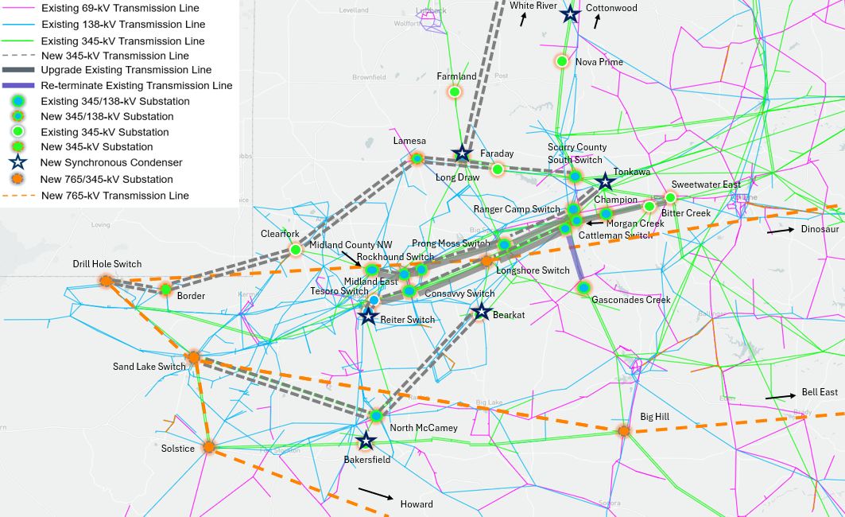
Locations of Projects – I_FW_N GTC Exit Strategy

Slide 7
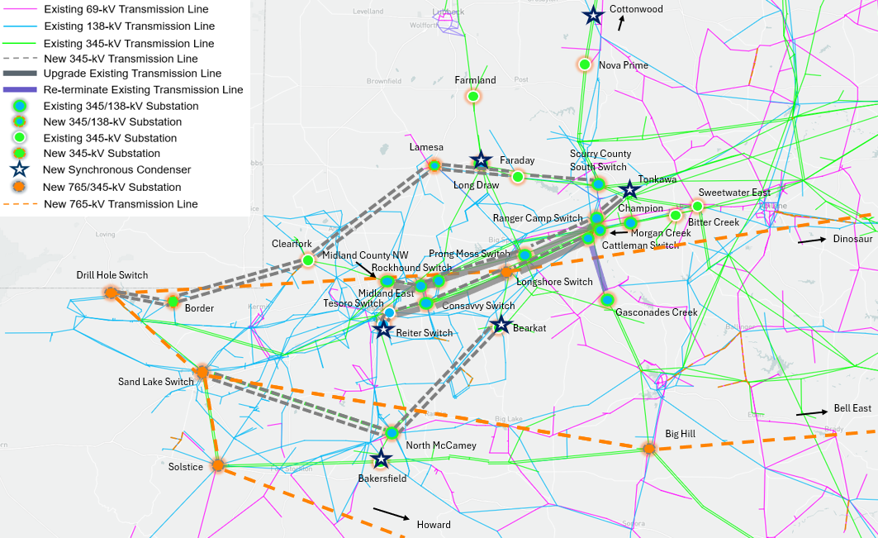
Locations of Projects – I_FW_S GTC Exit Strategy

Slide 8
Questions/Comments?
Priya.Ramasubbu@ercot.com
Ping.Yan@ercot.com

