Slide 1
Large Load Interconnection Status Update
Large Load Integration Team
March 26, 2026

Slide 2
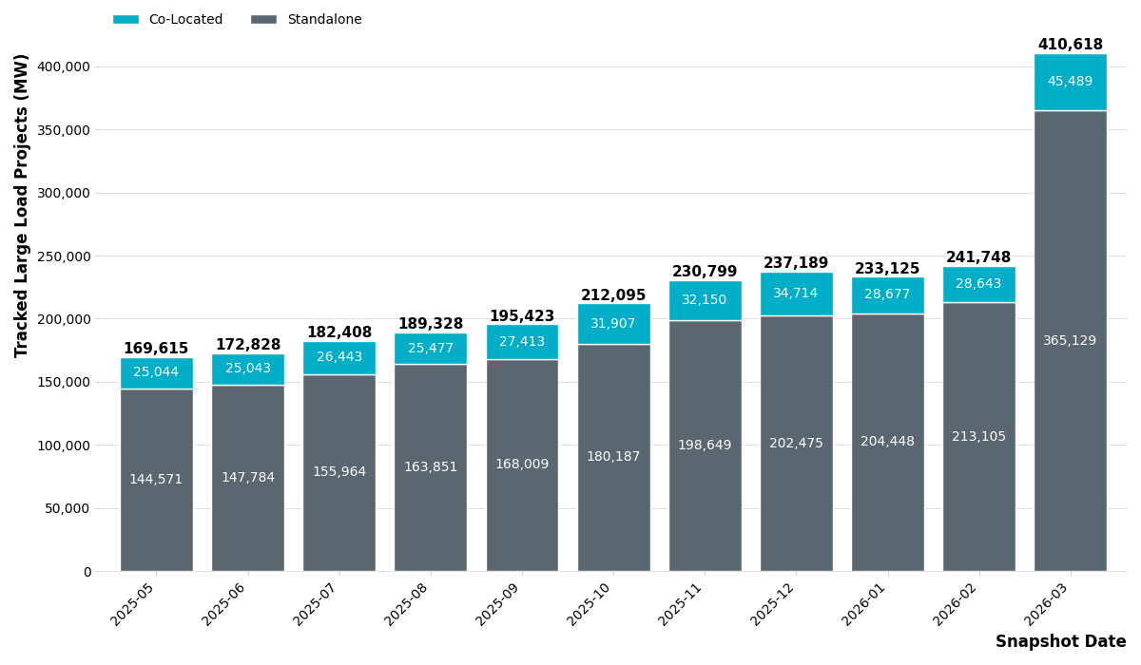
Large Load Queue – Past 12 Months

Slide 3
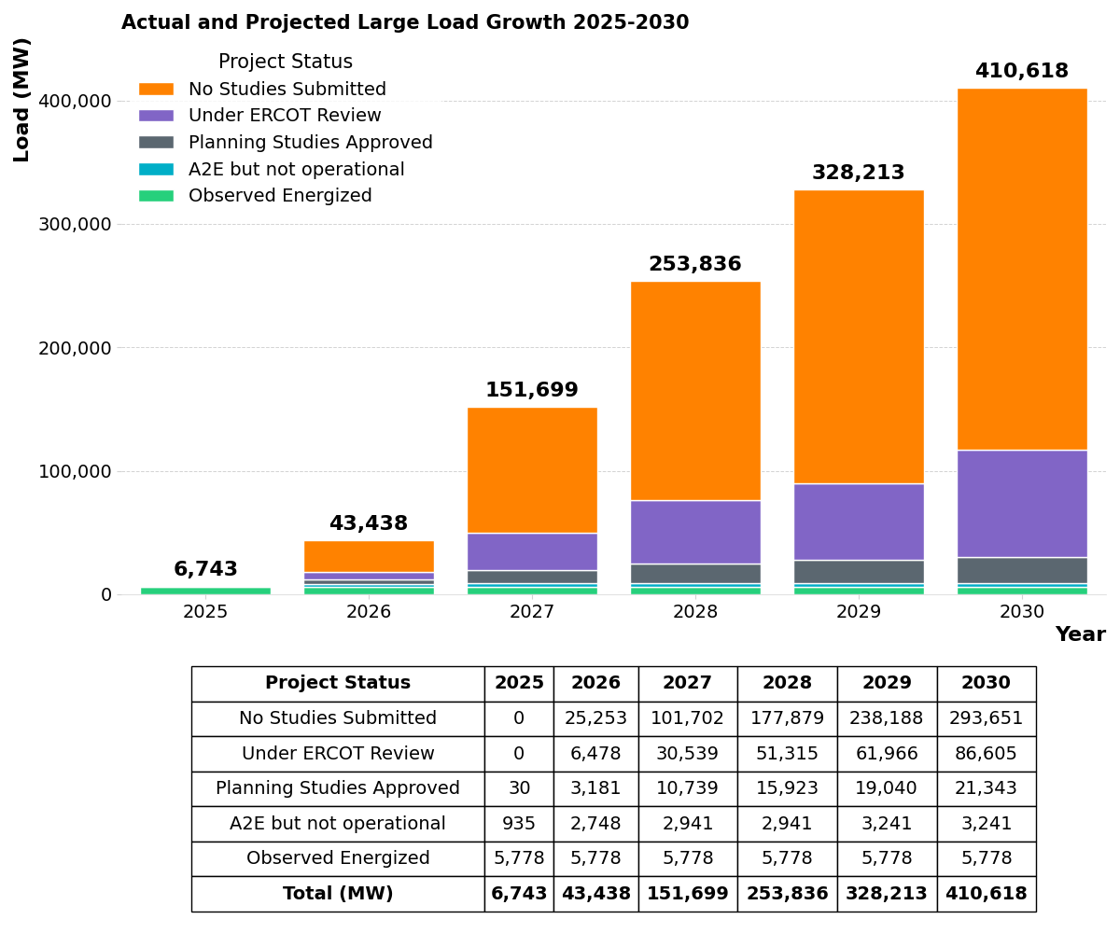
Current Large Load Interconnection Queue
Observed Energized – Projects that have received Approval to Energize from ERCOT Operations and are fully operational. Represented by all time non-simultaneous peak load consumption.
Approved to Energize (A2E) but Not Operational – Projects that have received Approval to Energize from ERCOT Operations but are not observed to be operational.
Planning Studies Approved – Projects that have received ERCOT approval of required interconnection studies. Any MWs that were not approved are reclassified as No Studies Submitted.
Under ERCOT Review – Projects that have studies under review by ERCOT.
No Studies Submitted – Projects that are tracked by ERCOT but that have not yet provided sufficient information for ERCOT to begin review. Additionally, MWs that were not approved by ERCOT after review of planning studies are included in this category until a path to interconnect these MWs is identified, or the customer cancels the interconnection request.

Slide 4
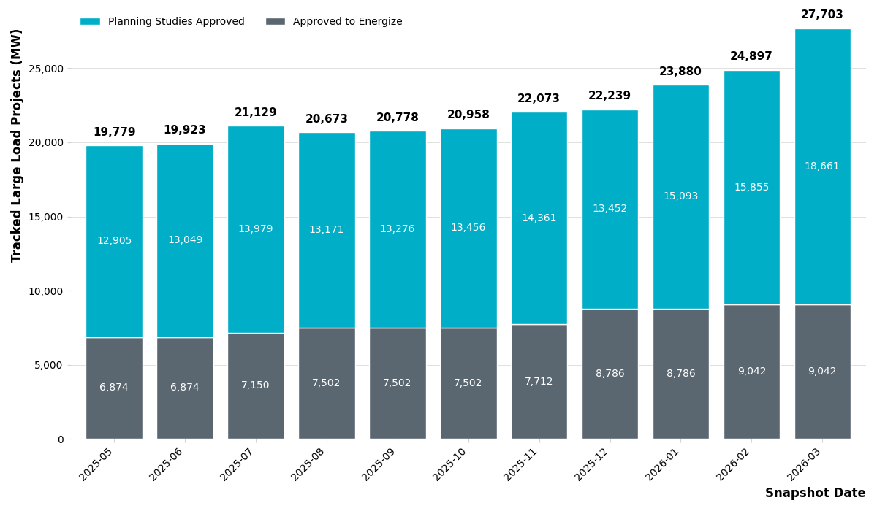
ERCOT Approvals – Past 12 Months

Slide 5
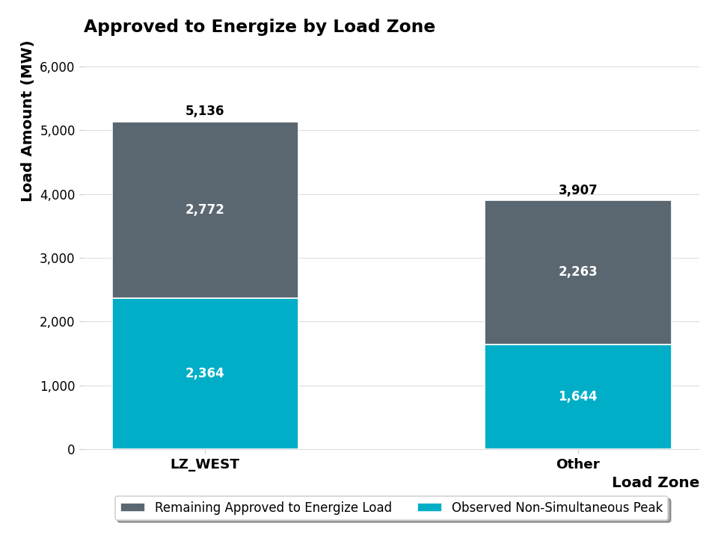
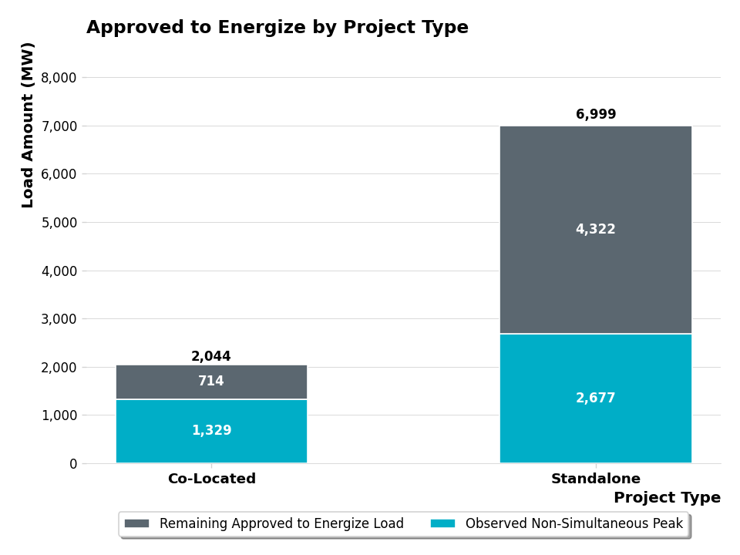
Loads Approved to Energize – By Zone & Project Type
*
*Other Includes LZ_NORTH, LZ_SOUTH, and LZ_HOUSTON

Slide 6
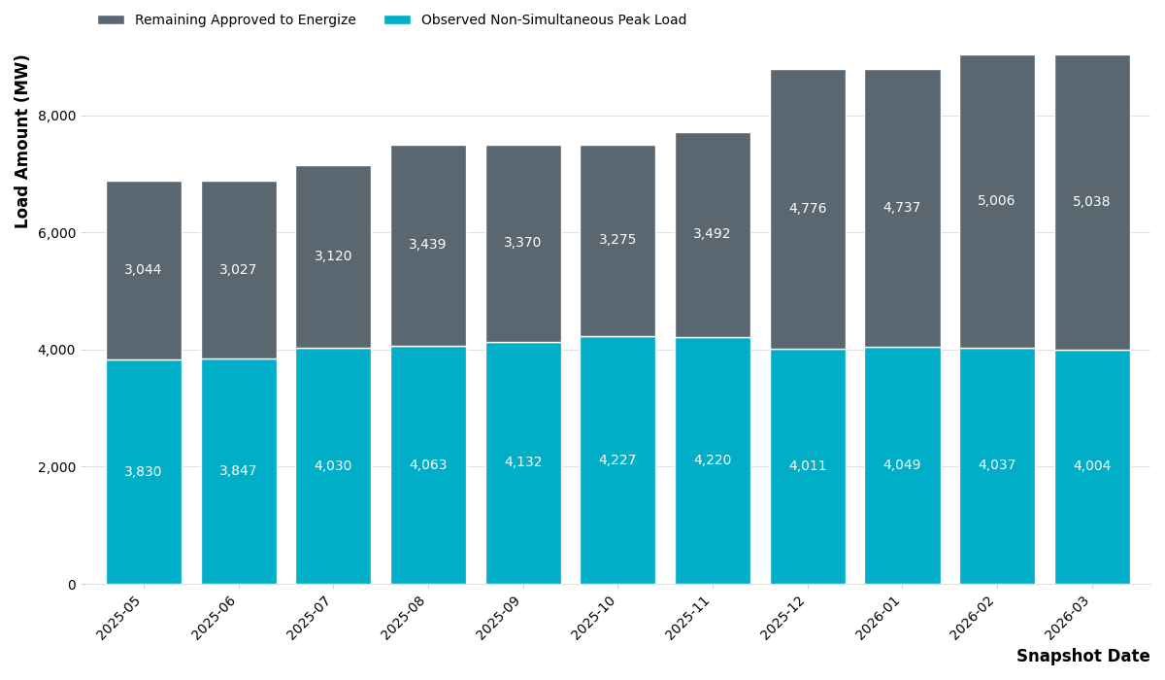
Loads Approved to Energize – Observations 1
Of the 9,042 MW that have received Approval to Energize, ERCOT has observed a non-simultaneous monthly peak consumption of 4,004 MW in March 2026 which is a slight decrease since February 2026.
  This is calculated as the sum of the maximum value for each individual load per month
  This value represents how much approved load ERCOT believes is now operational

Slide 7
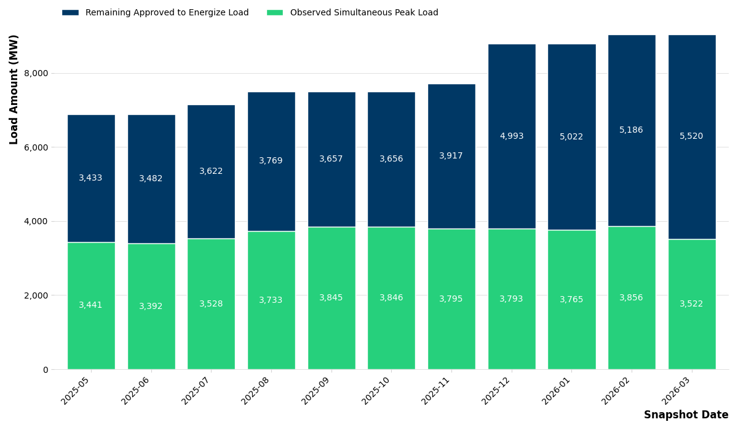
Loads Approved to Energize – Observations 2
ERCOT has observed a simultaneous monthly peak consumption of 3,522 MW in March 2026 which is a slight decrease since February 2026.
  This is the maximum value of the sum of all the individual loads per month
  This value is the maximum amount of large load that ERCOT has had to serve at a single point in time

Slide 8
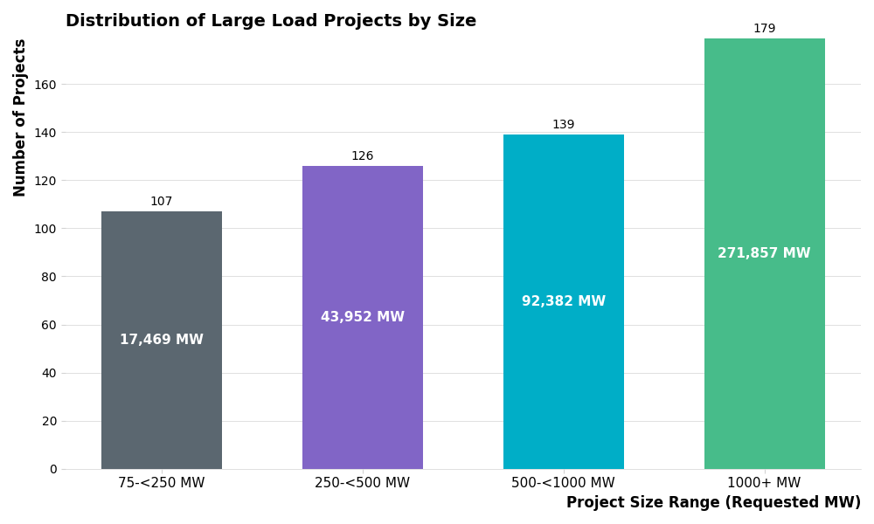
Large Load Project Distribution - Size

Slide 9
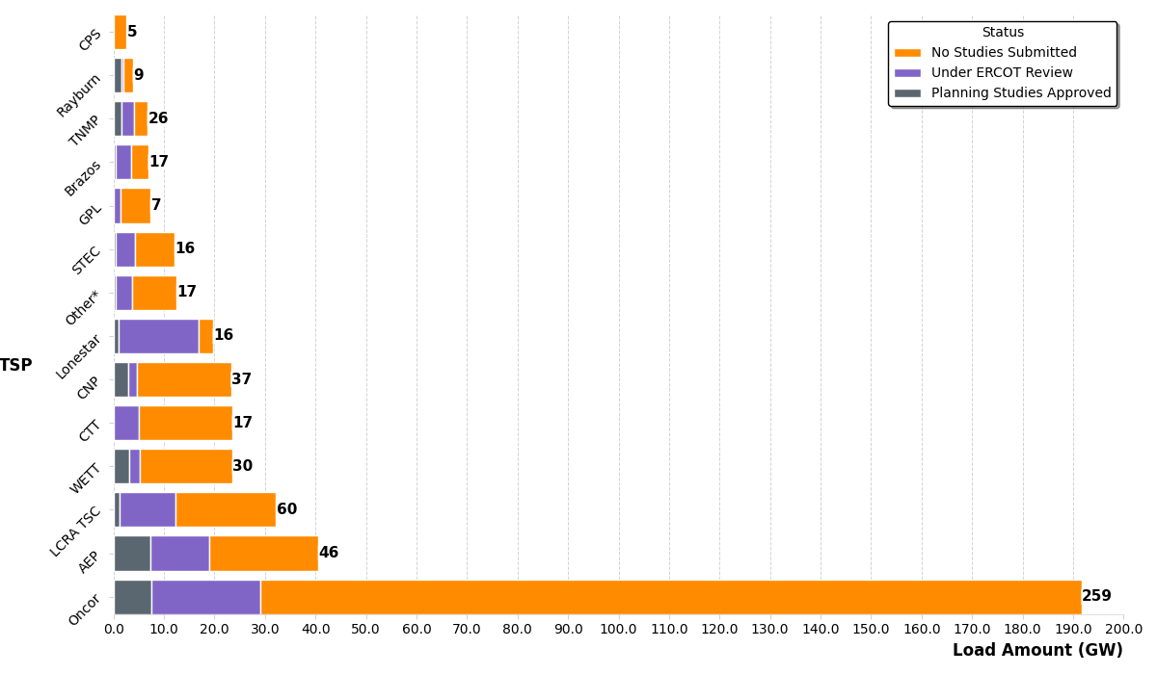
Large Load Project Distribution - TSP
  *The Other category includes categories in which there are less than five customers and is aggregated to protect Customer data

Slide 10
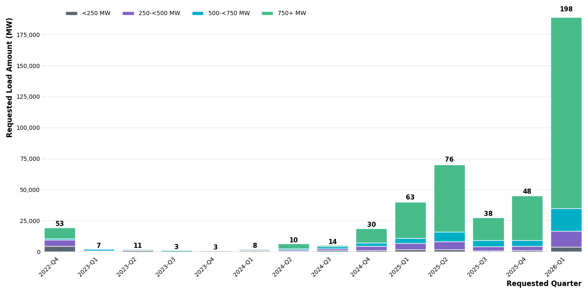
Large Load Project Submittal Date
LL totals before 2023-Q1

Slide 11
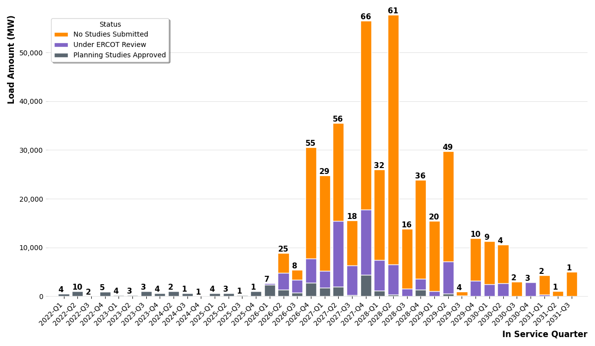
Large Load Project In Service Date

Slide 12
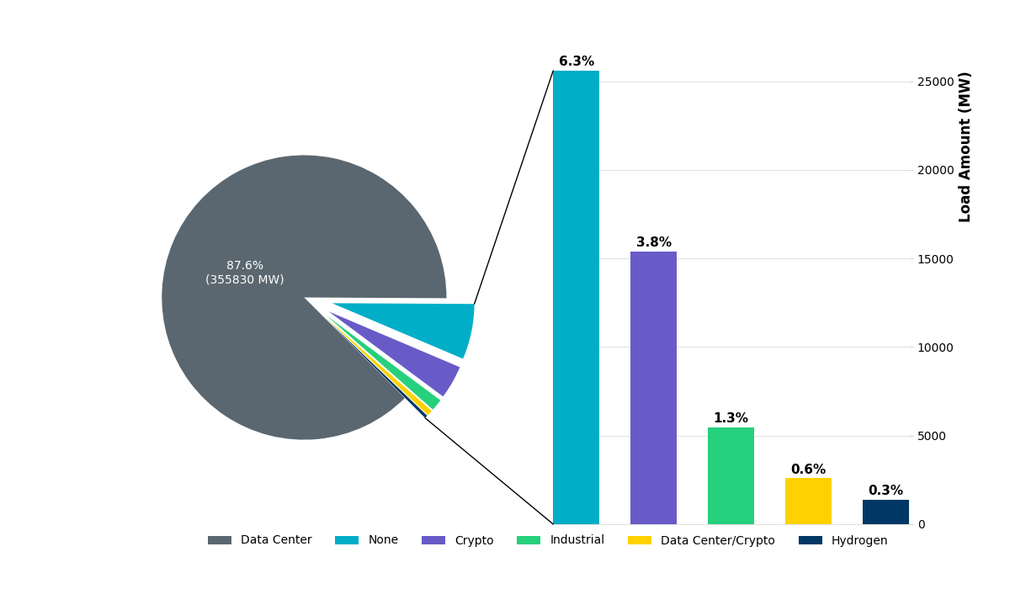
Large Load Project Distribution by Type

Slide 13
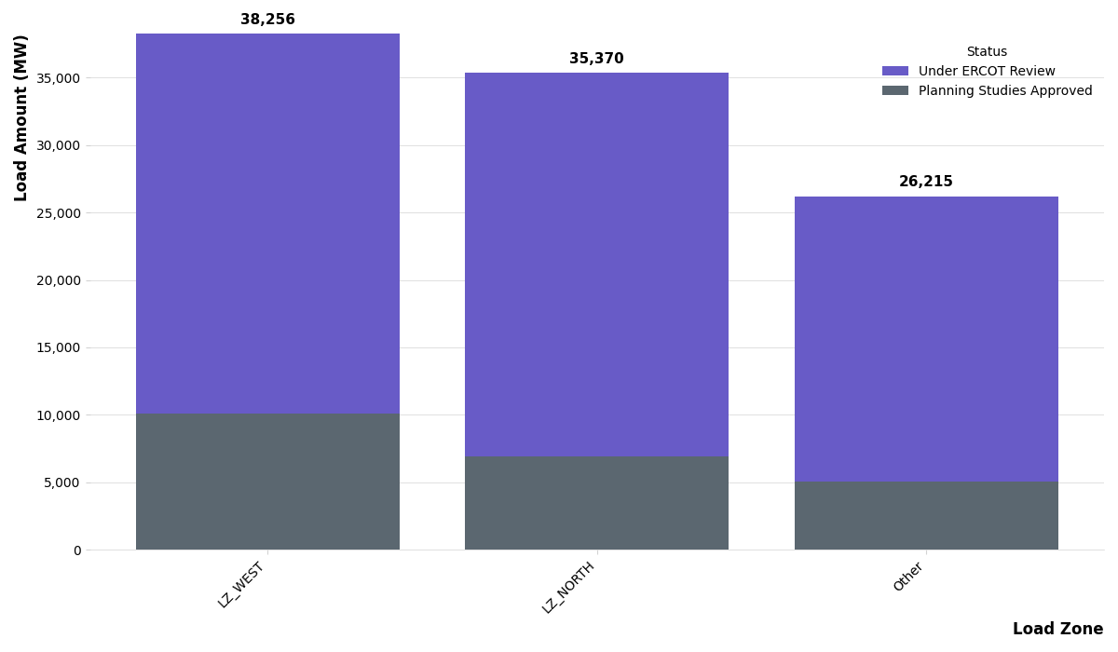
Large Load Project Distribution by Load Zone

Slide 14
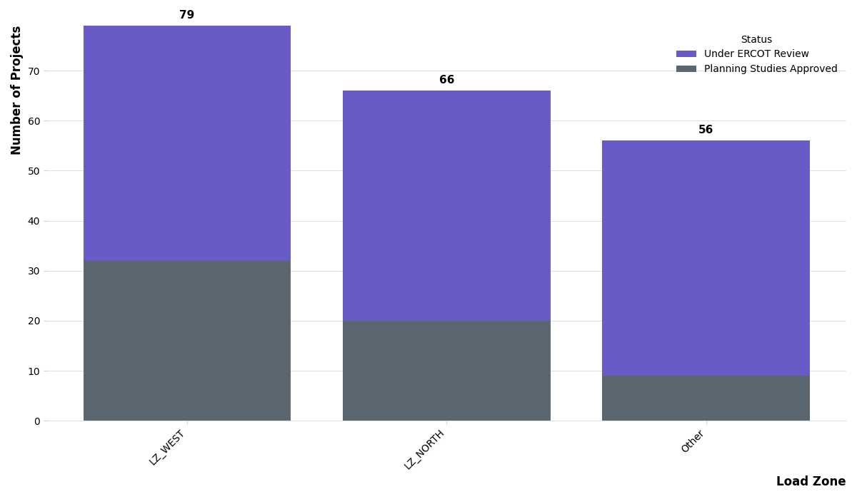
Large Load Project Distribution by Load Zone

Slide 15
Questions?
email: LargeloadInterconnection@ercot.com

