Slide 1
RIOO/GINR/REC Enhancements
Blake Halstead
Nick Jessett
March 26, 2026
Outline:
RIOO/GINR/REC Updated Authentication
RIOO/GINR/REC Enhancements
Key Takeaways
Enhancements made to the RIOO/GINR/REC login pages on March 17th/18th

Slide 2
Updated RIOO/GINR/REC Authentication
New User access Signup Page and Create Account
Download Authenticator app
(not for SMS)
Setup MFA app or choose SMS
Confirm Account was created
Complete login via MFA app or SMS
Verify Email address
Login with username and password
*Enabled CAPTCHA*
*Enabled CAPTCHA*
*SMS-Blocking High-Risk Countries*
*High-Risk Domains Prohibited*
*Enabled CAPTCHA for Sign Up, Login and Forgot Password
Key Take Aways: Enhancement to RIOO/GINR/REC Authentication

Slide 3
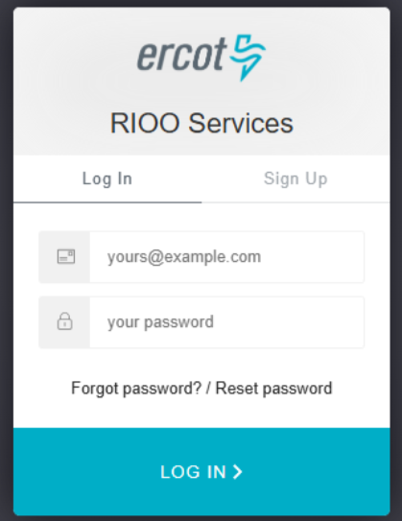
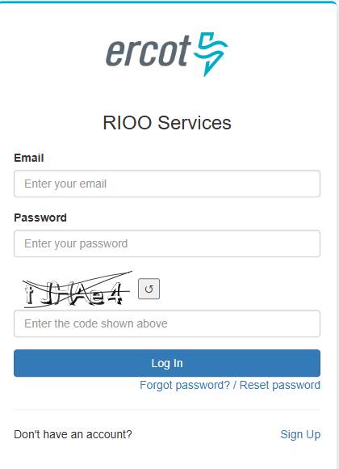
Updated RIOO/GINR/REC Authentication
Added CAPTCHA
Added SMS-blocking for known high-risk countries
Added blocking for high-risk domains for new registrations
Key Take Aways: CAPTCHA present on login pages

Slide 4

Next Steps
In addition to the minor enhancements, a refresh is right around the corner!
Key Take Aways: Refresh is coming!

Slide 5
Market Participant (B2B) Timeline
2026
  Q1: Deloitte selected as Implementation Partner and onboarded - completed
  Q1: IAM Modernization new B2B tooling vendor selection in progress
  Q2: ERCOT testing Market Participant Service Portal (MPSP) with B2B tooling, confirm release targets
  Q2: Target Board approval of Revision Requests
  Q3: Align new data with MPSP and NPRRs, stakeholder training
  Q4: Target Release in October with ongoing stabilization support and additional education
  Q4: Apply lessons into planning for additional forms (MPSP) & B2B tooling waves (other applications)
Data alignment with MPSP and NPRRs
Share initial plans for 2027/2028 B2B integration waves
Implementation Partner selected
IAM2 RFP for B2B Tooling
June Board Meeting
October Go-Live Check-Point
Targeted October Release
Q1 2026
Q2 2026
Q3 2026
Q4 2026
2027-2028
Stakeholder Education and Hands On Training
Stabilization Period
We are here
Internal ERCOT Planning for B2B tool integration with other market-facing applications
Updates will continue to be provided to TWG.

Slide 6

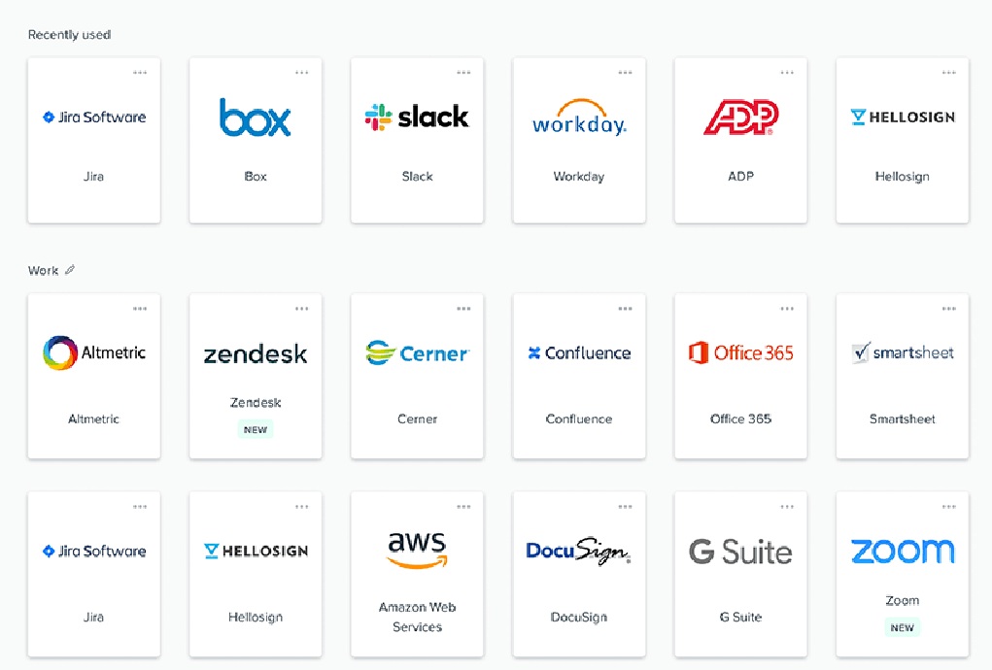
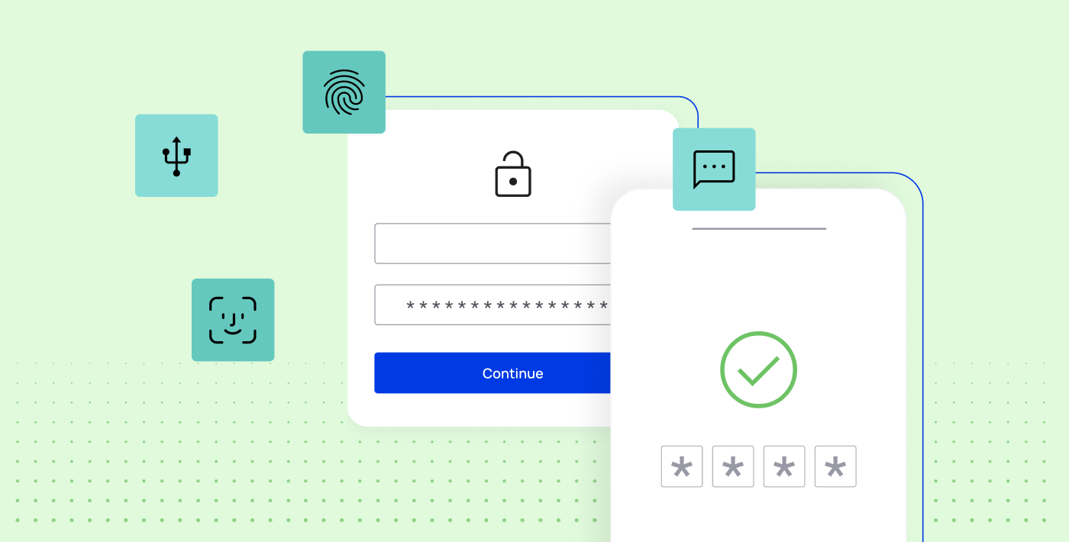
Future Ready Identity B2B Logon Process
ERCOT Market Participant and Entity Landing Page with All Applications
One ERCOT branded logon or registration page
Your choice of a strong MFA
Notes:
Splash Page – Begin Logon – Complete Logon w/MFA – Access Portal with Tiles

Slide 7
Market Participant B2B Plan
B2B Tooling Starts with MPSP, followed by implementation waves starting in 2027
Client certificates with SAML token (i.e. current Weatherization portal)
Auth0 MFA via SSL proxy per individual application, i.e. RIOO, GINR, REC, FlighTrak
Custom MFA (Client Certificate + password) GridGeo
Digital Certificates
NEW B2B TOOLING
Share Wave Plan
2027: Begin waves to transition applications to new B2B tooling
We are here
MPSP Go-Live (Oct 2026)
First use of new B2B tooling
2027/2028
Full adoption of new B2B tooling
Key Takeaway: The MPSP is the only application that will implement the new B2B tooling in 2026.

Slide 8
Thank you!

