Slide 1
NOGRR282 and NPRR1308 Updates Patrick Gravois Principal Operations Engineer ROS Meeting April 2, 2026

Slide 2
NOGRR282 and NPRR1308 Timeline
ROS target vote - April 2
ERCOT 3/27/2026 comments in response to DCC 3/12/2026 comments
PRS target vote - April 15 (NPRR 1308 only)
Only comments received on NPRR1308 were DCC comments; no proposed revisions to definition itself
TAC provides update to BOD - April 20-21
Part of Board Priority Revision Request Process
TAC target vote - April 29
Target June BOD vote
ROS Vote
April 2
PRS Vote
April 15
BOD Update
April 20-21
TAC Vote
April 29
BOD Vote
June 1-2

Slide 3
NOGRR282 Comments Received
AEP 12/5/2025 Comments
Discussed at DWG
ERCOT responded on 3/11/2026
Tesla 12/18/2025 Comments
ERCOT responded on 1/30/2026
Onward Energy 1/23/2026 Comments
ERCOT responded on 2/16/2026
Data Center Coalition 2/9/2026 Comments
ERCOT responded on 3/11/2026
Texas Blockchain Council 2/18/2026 Comments
Data Center Coalition 3/12/2026 Comments
ERCOT responded on 3/27/2026
Schaper Energy Consulting 3/18/2026 Comments
Texas Blockchain Council 3/18/2026 Comments
TIEC 3/25/2026 Comments
NOGRR282 Comment Page

Slide 4
ERCOT Comments – 1/30/2026
ERCOT submitted comments regarding NOGRR282 on 1/30/2026 to address the following items:
Renumber Section 2.14, Voltage Ride-Through Requirements for Large Electronic Loads, to Section 2.15 since Section 2.14 is now used for advanced grid support requirements for inverter-based Energy Storage Resources (ESRs), implemented in NOGRR272, Advanced Grid Support Requirements for Inverter-Based ESRs.
Revise frequency and voltage ride-through requirement exemption language in paragraph (1) of Section 2.6.4 and Section 2.15.
Respond to Tesla comments submitted on 12/18/2025. Added language to Section 2.15(6) and Section 2.15(3)(e) to explicitly allow LEL to implement load-transfer scheme to meet ride-through requirements.
Revise the active power recovery time for post-disturbance Large Electronic Load (LEL) consumption from one second to two seconds.

Slide 5
Onward Energy’s Comments – 1/23/2026
Onward Energy’s comments expressed concern that NOGRR282 is not clear which requirements apply when an LEL and Generation Resource are connected behind the same POI (co-located), and how ERCOT would determine which NOG requirements apply when an LEL and/or Generation Resource trip during an event
ERCOT responded on 2/16/2026
ERCOT will be able to determine if an LEL or Generation Resource/ESR tripped (or reduced consumption/output) during a frequency or voltage disturbance event
Telemetry is required on LELs and Generation Resources/ESRs
ERCOT also has telemetry from POI of co-located facilities
ERCOT may request disturbance monitoring data from TSPs, REs, and QSEs
ERCOT could send out RFIs to aid in its analysis
After initial investigation of the event:
If LEL tripped or reduced consumption following system disturbance, ERCOT would verify if non-exempt LEL complied with NOG sections 2.6.4 and 2.15
If Generation Resource/ESR tripped or reduced output following a system disturbance, ERCOT would verify if GR/ESR complied with NOG sections 2.6.2 and 2.9
Applicability clearly defined in appropriate NOG sections, so no language revisions needed

Slide 6
ERCOT 3/11/2026 Comments – AEP/DWG Feedback
DWG discussed NOGRR282 on 2/12/2026 and presented feedback to ROS on 3/5/2026
AEP’s 12/5/2025 comments were addressed at DWG
ERCOT submitted comments on 3/11/2026 in response:
ERCOT and DWG agreed to increase high frequency ride-through threshold in Table A in Section 2.6.4(3) from 61.8 Hz to 63.0 Hz; as per AEP’s comments
LEL developer feedback indicates high frequency is not a ride-through concern
Increased high frequency threshold improves system reliability during events
Revised FRT Conditions
Frequency (f) in (Hz) | Minimum Ride-Through Time (seconds)
f > 61.863.0 | May ride-through or trip
61.2 < f ≤ 61.863.0 | 299
58.8 ≤ f ≤ 61.2 | continuous
57.0≤ f < 58.8 | 299
f < 57.0 | May ride-through or trip

Slide 7
ERCOT 3/11/2026 Comments – AEP/DWG Feedback
DWG members wanted clarifying language for Section 2.15(3)(d)
Paragraph defines allowable overcurrent of 125% during voltage disturbance
ERCOT Comments included the following added sentence:
The allowable overcurrent up to 125% shall only persist during the voltage transient with a duration not to exceed 0.5 seconds.
Additional AEP feedback not addressed in ERCOT comments
AEP comments suggested increasing low frequency thresholds from 57.0 Hz to 58.2 Hz
ERCOT and DWG members agreed to keep the criteria as currently written so LELs would not trip on underfrequency events unless they are performing in accordance with UFLS or Ancillary Service obligations
AEP comments suggested additional requirement that LELs shall return to pre-disturbance consumption within 2 seconds when voltage conditions exceed “must ride-through” curve
ERCOT decided not to include additional requirement since it could lead to the unintended consequence of LELs choosing to trip rather than riding through these conditions
However, ERCOT agrees this should be the desired performance

Slide 8
ERCOT Response to DCC 2/9/2026 Comments
DCC comments propose the following revisions:
Replace Large Electronic Load with Large Load in all of NOGRR282
Change exemption date from 11/14/2025 to 1/1/2027
Apply VRT requirements to only 50% of the Demand at the facility
ERCOT response does not agree with these revisions
LELs pose a more imminent risk to ERCOT System reliability than other LLs
LELs are more sensitive to voltage disturbances than traditional LLs
LELs are >80% of the projected Demand growth in ERCOT
Additional requirements on other LLs may still be needed (VFDs, hydrogen, etc.)
Many operational and approved LELs will be exempt from RT requirements
Extending the exemption date would worsen existing reliability risk
Applying VRT requirements to only 50% of the load would not mitigate risk
ERCOT provided additional supporting evidence in response to DCC comments
Referenced multiple LLWG and LL workshop presentations showing need for LEL RT requirements
ERCOT continues to examine transmission and market solutions to help mitigate risks; but maintain these solutions alone cannot mitigate risk without improved LEL RT capability

Slide 9
DCC 3/12/2026 Comments
DCC 3/12/2026 comments provide the following suggested requirement revisions for ERCOT to consider:
Consideration for mechanical/cooling load
Align ERCOT low frequency ride-through requirements with PRC-024
Revise low VRT threshold
Remove reference to positive sequence voltage in VRT requirements
Decrease overvoltage VRT threshold and allow for 2% tolerance
Allow short-duration (0.5 sec or less) post fault active power recovery
Increase allowable overcurrent during voltage transient from 125% to 150%
Request for allowing load-transfer schemes that coordinate with transmission events/TDSP reclosing schemes
Change date for meeting the exemption criteria from 11/14/2025 to 6/30/2026
ERCOT submitted response on 3/27/2026

Slide 10
ERCOT 3/27/2026 Comments – Response to DCC Comments
List of DCC recommended revisions accepted as is by ERCOT
Align ERCOT low frequency ride-through requirements with PRC-024: (57.0 → 57.5) ✓
57.5 Hz well below last UFLS trigger
LELs tripping at 57.5 Hz could help with frequency recovery
Remove reference to positive sequence voltage in VRT requirements ✓
LEL facilities do not monitor positive sequence; protection schemes based on single-phase voltage
Slightly higher potential for LELs to trip on unbalanced faults but minimal additional reliability risk
Increase allowable overcurrent during voltage transient from 125% to 150% ✓
Verified with SPWG and DWG that this is not a concern
Allows LELs to ride through down to 0.7 p.u. without any temporary load transfer needed

Slide 11
ERCOT 3/27/2026 Comments – Response to DCC Comments
Consideration for mechanical/cooling load
DCC comments request either of the following:
VRT requirements should only apply to power electronic or computational portion of the load
VRT requirements should only apply to 70% of the load at the LEL facility
ERCOT cannot accept the above proposed revisions
Cooling load is a considerable portion of the load and needs to ride-through to its maximum capability
Adds additional reliability risk if cooling load is completely exempted
ERCOT is amenable to allowing exemptions for deep voltage sags
Proposed language allows cooling load to trip for voltage <0.35 p.u.
Cooling load often driven by VFDs which have difficultly riding through deep voltage sags
Limits cooling load loss to smaller area
ERCOT open to revisiting VRT requirements for cooling load once more data is available

Slide 12
ERCOT 3/27/2026 Comments – Response to DCC Comments
DCC request to revise low VRT threshold
DCC propose revising the low VRT threshold from 0.20 pu for 0.15 sec to 0.35 pu for 0.02 sec
Claim that only 3-phase faults directly outside LEL facility would cause voltage this low
ERCOT must plan for worst-case scenarios; 3-phase faults do occur and are credible NERC defined contingencies in TPL standards
3-phase fault near area with congested data center load could cause load loss exceeding stability limits
ERCOT agrees to increase voltage magnitude threshold to 0.35 pu but duration remains 0.15 sec
DCC request for allowing load-transfer schemes that coordinate with transmission events/TDSP reclosing schemes ✓
Section 2.15(3)(7) prohibits load-transfer or trip schemes that count number of voltage sags/swells
Major contributor to data center load loss during Dominion events
DCC requests exemptions for such schemes that are coordinated with TDSP reclosing schemes
ERCOT proposes such a scheme may be implemented but LEL must remain connected for a minimum of 6 voltage sags/swells within a period of 90 seconds
Outside the range of reclosing schemes in ERCOT

Slide 13
ERCOT 3/27/2026 Comments – Response to DCC Comments
DCC request to decrease overvoltage VRT threshold and allow for 2% tolerance
DCC request change of 1.10 < V ≤ 1.20 voltage range to be reduced from 2 seconds to 0.5 seconds
Also request a 2% tolerance may be applied to overvoltage settings
ERCOT has the following concerns with these changes:
Load loss events can lead to overvoltage in the area once fault is cleared
LELs that rode-through low voltage event may end up tripping on overvoltage; increasing event magnitude
ERCOT proposes the following:
Duration of the 1.10 < V ≤ 1.20 voltage range be reduced from 2.0 seconds to 1.0 second
NOGRR282 provides grace period until 1/1/2028 such that LEL may trip for overvoltage >1.08 pu after 5 seconds
After 1/1/2028 LEL must be able to operate continuously up to 1.1 p.u.
Additional considerations:
VRT requirements are based at the Service Delivery Point or POIB; voltage would typically be lower within the LEL facility
Dynamic and static reactive devices should be used to alleviate overvoltage concerns within the LEL facility

Slide 14
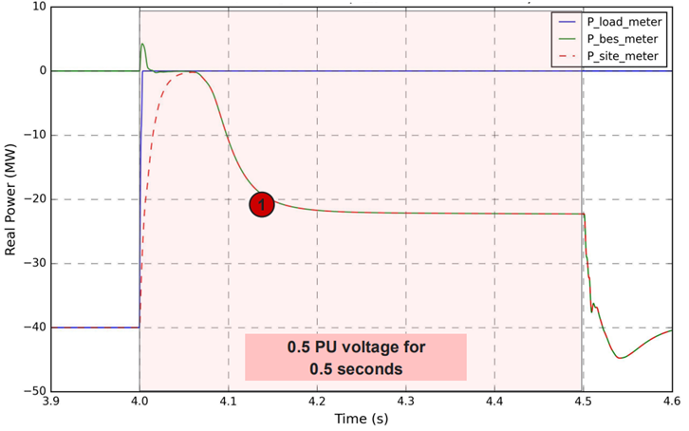
ERCOT 3/27/2026 Comments – Response to DCC Comments
DCC request to allow short-duration (0.5 sec or less) post fault active power recovery ✓
Section 2.15(3)(c)(ii) requires LELs to continue consuming power from grid during voltage condition between 0.5 and 0.8 pu at the POIB, after 1/1/2028
Section 2.15(3)(e) allows for a load transfer scheme for voltages below 0.8 p.u.
No requirement for this scheme to continue consuming power
Active power does fall to 0 MW temporarily
DCC proposes the following:
Allow similar performance for voltage conditions below 0.8 pu after 1/1/2028
Active power recovery would be 0.5 sec or less
ERCOT response:
Although preferable to continue consuming power during shallow voltage sags, this performance is acceptable
Revised Section 2.15(3)(e) such that LEL shall begin returning to grid within 0.25 sec and shall return to at least 90% of pre-disturbance consumption within 0.5 seconds of voltage recovery
**Plot is an example of LEL load transfer scheme from Tesla presentation from Jan. 22, 2026, LLWG meeting

Slide 15
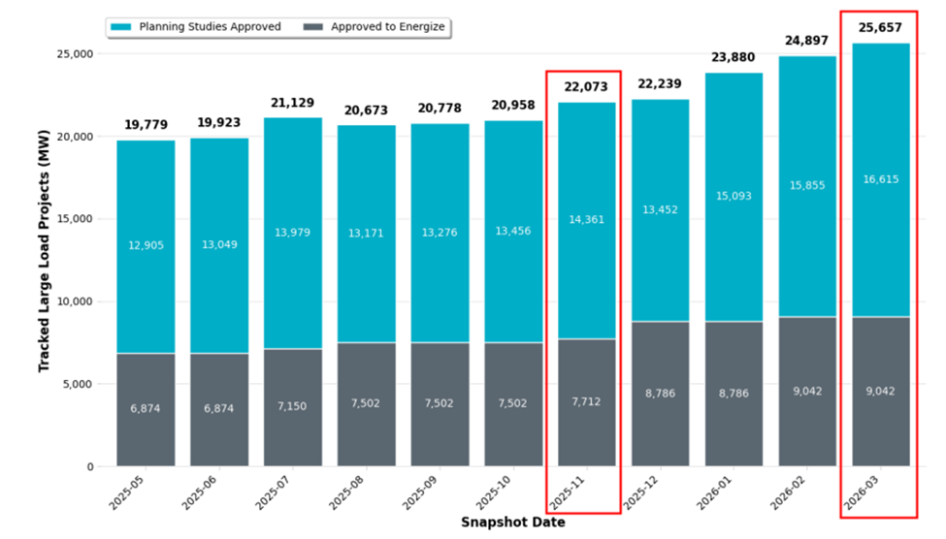
ERCOT 3/27/2026 Comments – Response to DCC Comments
Change date for meeting the exemption criteria from 11/14/2025 to 6/30/2026
ERCOT cannot support changing this date
NOGRR282 as written allows the following exemptions
All LELs operational or approved to energize prior to 11/14/2025
All LELs with LLIS approved and meet PG Section 9.5 criteria before 11/14/2025
LELs submitted through RPG process with energization before 1/1/2027
Extending the exemption date would lead to even more LELs without ride-through capability
Additional LELs that may be subject to System Operating Limits needed to prevent potential frequency and voltage instability from excessive load loss
An additional ~3,600 MW of LELs have had LLIS approved since November 2025

Slide 16
Texas Blockchain Council and Schaper Energy Consulting Comments
TBC 2/18/2026 comments
TBC discussed their 2/18 comments at 3/13 LLWG
Cryptocurrency facilities can meet frequency ride-through requirements in NOGRR282 but cannot meet voltage ride-through requirements for V<0.8 pu at POIB
Comments claim VRT solutions (BESS, UPS, etc.) are neither practical nor economical at scale
Exploring potential pilot project with existing BESS to provide RT
TBC 3/18/2026 and Schaper Energy Consulting 3/18/2026 comments
Under ERCOT review
No proposed revisions to NOGRR282 language or requirements

Slide 17
NPRR1308 Comments Received
DCC 2/9/2026 comments
Express concern that ride-through requirements only apply to data centers and cryptocurrency mining facilities
No proposed revisions to protocol language/ LEL definition
ERCOT response to DCC’s 2/9/2026 comments applies to NPRR1308 comments
No additional comments/feedback received on LEL definition from comments or Working Groups

Slide 18
Questions/Comments?

