Slide 1
NERC EMTWG Updates
ERCOT IBRWG Meeting, March 2026
Aung Thant
Principal Engineer
IRPS, EMTWG
March 27, 2026

Slide 2
NERC-Industry Collaboration
Long-term
Medium
Short
NERC EMTWG
EMT Modeling Working Group
Best Practices
Guidelines
NERC-ORNL-DOE-Industry
Efficiency
Accuracy
Expertise
Outreach

Slide 3
NERC EMT Modeling Working Group (EMTWG)
Support and accelerate industry adoption of EMT modeling and simulation in the interconnection and planning studies
Best Practices Guidance
White Papers
Technical Reference Documents
Recommended Practices
Reliability Guidelines
Resources
Suggested Reading List
Technical Presentations
Outreach and Education
Workshops
Webinars

Slide 4
EMTWG Work Items
Work Item #3
In Progress
EMT Modeling Resources Repository
Work Item #6
In Progress
Uniform User Interface and Internal Structure for IBR Plant Models
Work Item #8
In Progress
IBR Plant Model Benchmarking – PSPD vs. EMT
Work Item #9
In Progress
EMT Model Portability and Interoperability
Work Item #10
In Progress
EMT Methods for Disturbance Ride Through Performance Evaluation
Work Item #12
Not Yet Started
EMT Modeling Considerations for Large Loads
Collaboration with LLWG
Training & Resources
Standardizing EMT Modeling Practices
Early Model Verification and Coordination
EMT Adoption Survey Findings

Slide 5

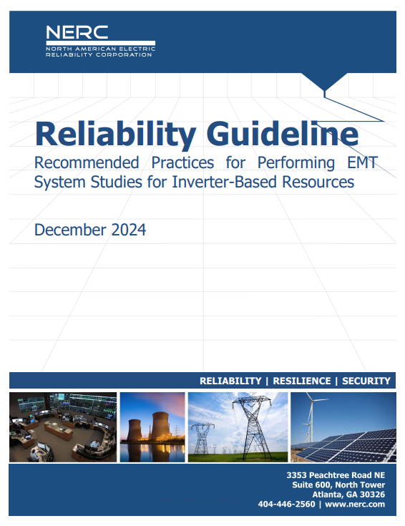
Reliability Guidelines on EMT Modeling
Work Item #11: Revision to this guideline

Slide 6
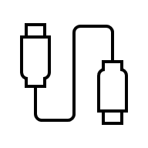
DRAFT White Paper – Uniform User Interface and Internal Structure for IBR Plant Models
Improve transparency, consistency, efficiency and portability
Streamline automated testing and integration into network models for system studies
POI
Plant Model Under Test
Automated Tester
Uniform Test Harness
- Inputs
- Outputs
- Mode
- Initialization

Slide 7
Uniform User Interface and Internal Structure for IBR Plant Models
POI
Plant Model Under Test
Automated Tester
- P_{ref}
- V_{ref}
- P_{mode}
- Q_{mode}
…
Inputs
Table 2.1: Inputs for the Uniform Test Harness
Inputs | Description | Unit
Pref_plant | Active power reference(s) for the PPC | MW or p.u.
Fref_plant | Frequency reference for the PPC | Hz
Qref_plant | Reactive power reference for the PPC | MVAr or p.u.
Vref_plant | Voltage reference for the PPC if it works on voltage control mode | kV or p.u.
PFref_plant | Power factor reference for the PPC if it works on PF control mode | MW or p.u.
MVA_Base | Base for p.u. power | MVA
Voltage_Base | Base for p.u. voltage | kV

Slide 8
Uniform User Interface and Internal Structure for IBR Plant Models
- V,P,Q _{POM}
- V,P,Q _{terminal}
- P,Q _{PPC commands}
- Status Flags
- Debug Signals
…
Outputs
POI
Plant Model Under Test
Automated Tester

Slide 9
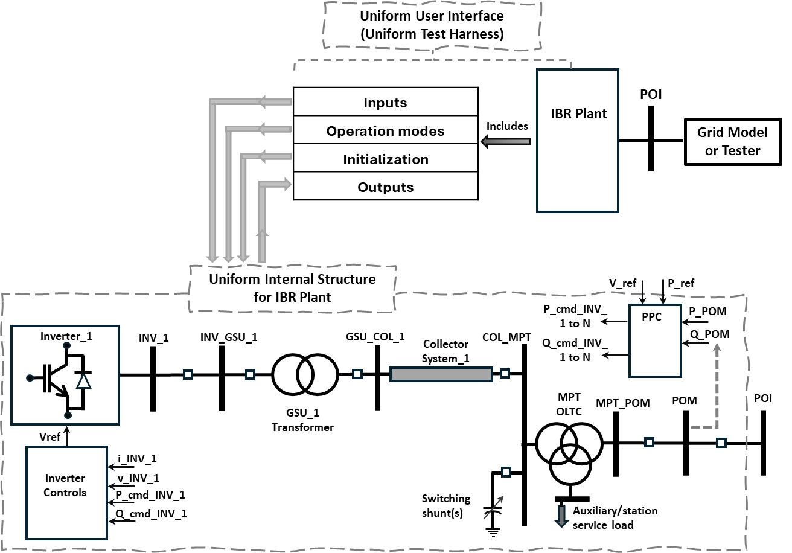
Uniform User Interface and Internal Structure for IBR Plant Models

Slide 10
Uniform User Interface and Internal Structure for IBR Plant Models
Status:
Out for IRPS and EMTWG comments
Next steps:
In April IRPS meeting, seek IRPS and EMTWG consensus to request RSTC review of the paper

Slide 11
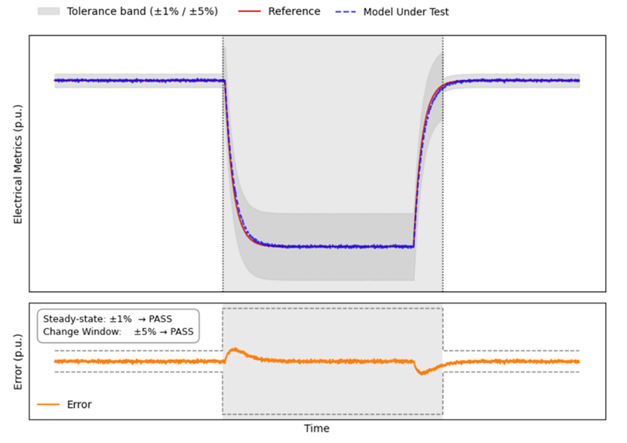
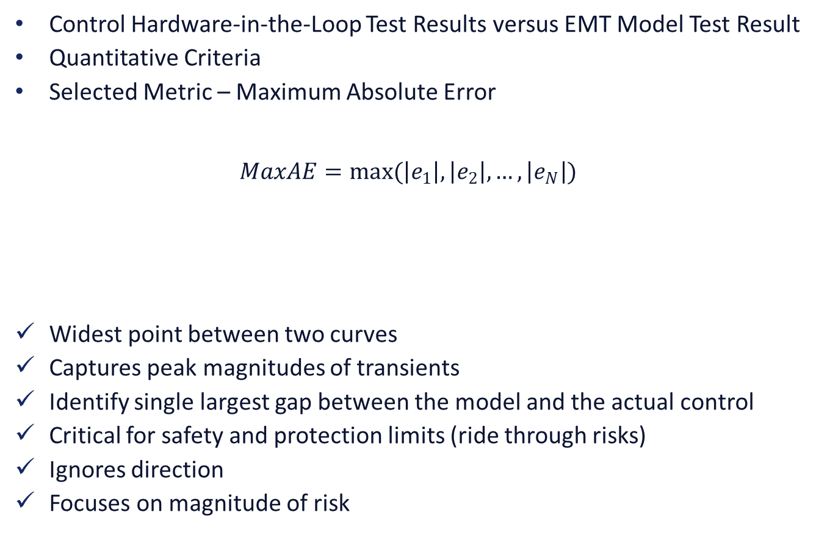
DRAFT IRPS White Paper – Equipment Model Validation
Control Hardware-in-the-Loop Test Results versus EMT Model Test Result
Quantitative Criteria
Selected Metric – Maximum Absolute Error
$$MaxAE=max(\left|e_{1}\right|,\left|e_{2}\right|,…,\left|e_{N}\right|)$$
Widest point between two curves
Captures peak magnitudes of transients
Identify single largest gap between the model and the actual control
Critical for safety and protection limits (ride through risks)
Ignores direction
Focuses on magnitude of risk

Slide 12
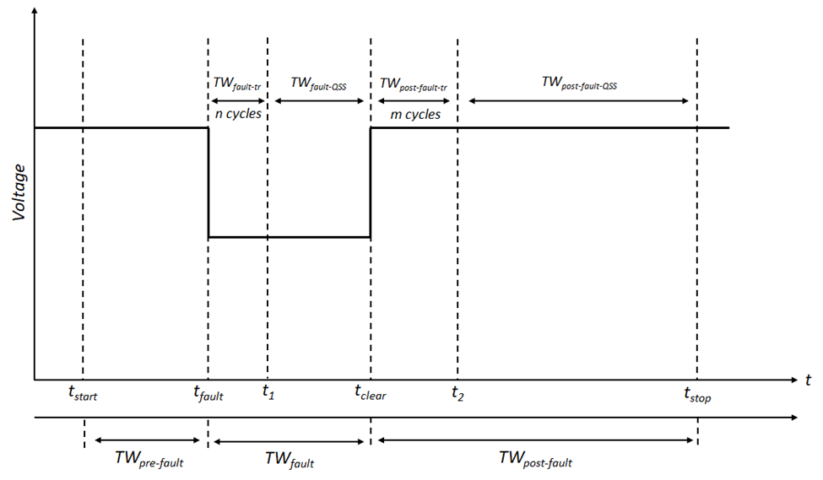
DRAFT IRPS White Paper – Equipment Model Validation
Table: Recommended MaxAE tolerances for Fault Event Windows
Quantities (Positive and negative sequence, if applicable)
Time Windows | Voltage* | Active Current | Reactive Current
Pre-fault | 2% | 2% | 2%
Fault Transient | 10% | 10% | 10%
Fault QS | 5% | 5% | 5%
Post-fault Transient | 10% | 10% | 10%
Post-fault QS | 5% | 5% | 5%
Applicable to cases 3a,3b,4c,3d,2c from Table 2.1
*Should always be within 1% error if voltage playback is being used (across all time windows)

Slide 13
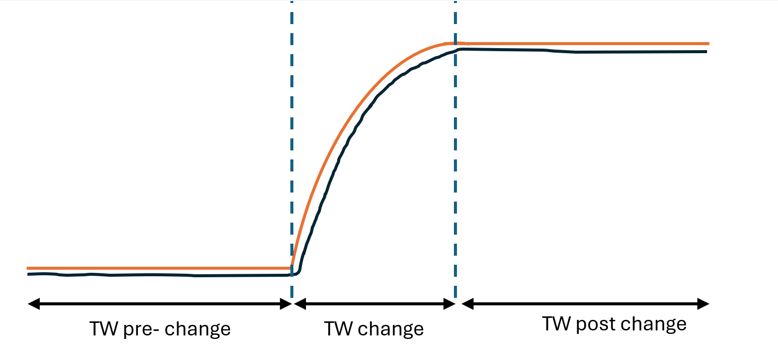
DRAFT IRPS White Paper – Equipment Model Validation
Table: Recommended MaxAE tolerances for Non-Fault Events
Quantities (positive sequence only)
Time Windows | Voltage | Active Power | Reactive Power
Pre-change | 2% | 2% | 2%
Change | 5% | 5% | 5%
Post Change | 2% | 2% | 2%
Applicable to cases 2a,2b,2d from Table 2.1
*Should always be within 1% error if voltage playback is being used (across all time windows)

