Slide 1
SSWG Report to ROS
April 2, 2026
Chair: Chris Ramirez (cramirez@wettllc.com)
Vice Chair: Weiwei Hu (weiwei.hu@austinenergy.com)

Slide 2
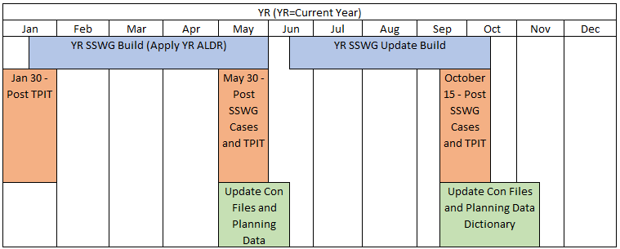
SSWG Report
Key Updates
26SSWG Case Build #1
Currently Ongoing
Load Data / Topology Deadline: March 27th
In-Person Post-Dispatch Tuning Meeting
April 27th – 29th
Target Posting: May 22nd
SSWG Procedure Manual Revisions
Specifying that ESRs are online in off-peak cases for VAR support
A rework of extraordinary dispatch for PGRR127
Language updates to be presented for May ROS combo ballot
SSWG Report to ROS External

