Slide 1
Base Power Company - ADER overview

Slide 2
Outline
ADER resource overview
Introduction to Base and residential battery configuration
ADER resource sizing and general location
ADER connectivity to SCED and resource bidding
Outstanding questions for ADER NPRR
CIM location of ADER assets
Single nodal aggregations
Details of the Aggregation (DoTA) form concerns

Slide 3
ADER resource overview

Slide 4




Base is building distributed storage to make the grid more affordable & reliable
Base delivers exactly what the grid and homeowners need today…
…enabled by vertical integration…
…across two, growing business units
Hardware
Designed and built for the purpose
Adding 200 MWh to the grid in 2025
1
The fastest way to add
dispatchable capacity to the grid
~20MW/mo.
Regulated
utility segment
(most of U.S.)
Deregulated, retail energy segment
(most of Texas)
Software
Built in-house across the full stack
Vertically Integrated Across the Stack
The lowest-cost backup power for homeowners anywhere 20x less than the competition
Go-to-Market
Led by our holistic growth engine
2
Utility buys or tolls the batteries from Base to control the battery fleet
Base is a ‘Gentailer’ using its batteries in direct wholesale market operations
Deployments
Sale to install to service, all by Base

Slide 5


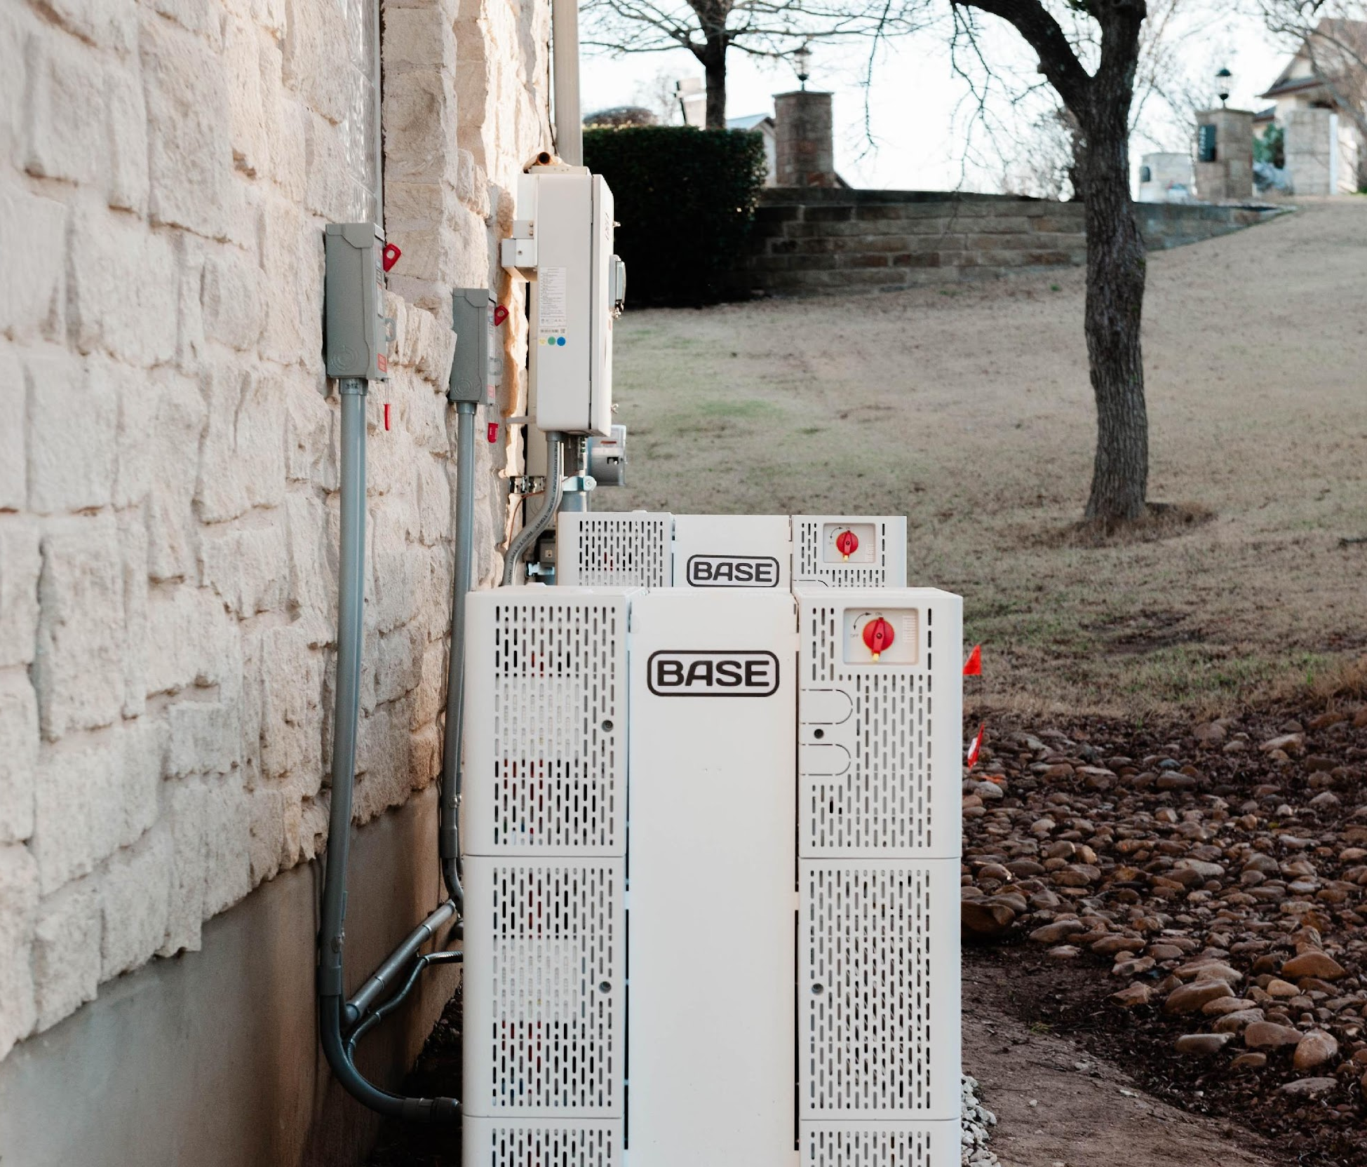

Base designs, deploys, and networks residential batteries to deliver utility-scale capacity
Physical
Digital
Cloud platform
Power supply operator
Purpose-built hardware…
…deployed efficiently at scale…
…and dispatched to meet grid needs
Owned by Base or the utility so it’s affordable to homeowners and available to the grid
Every stage can introduce cost, time, and technical issues, which is why Base supports every step

Slide 6
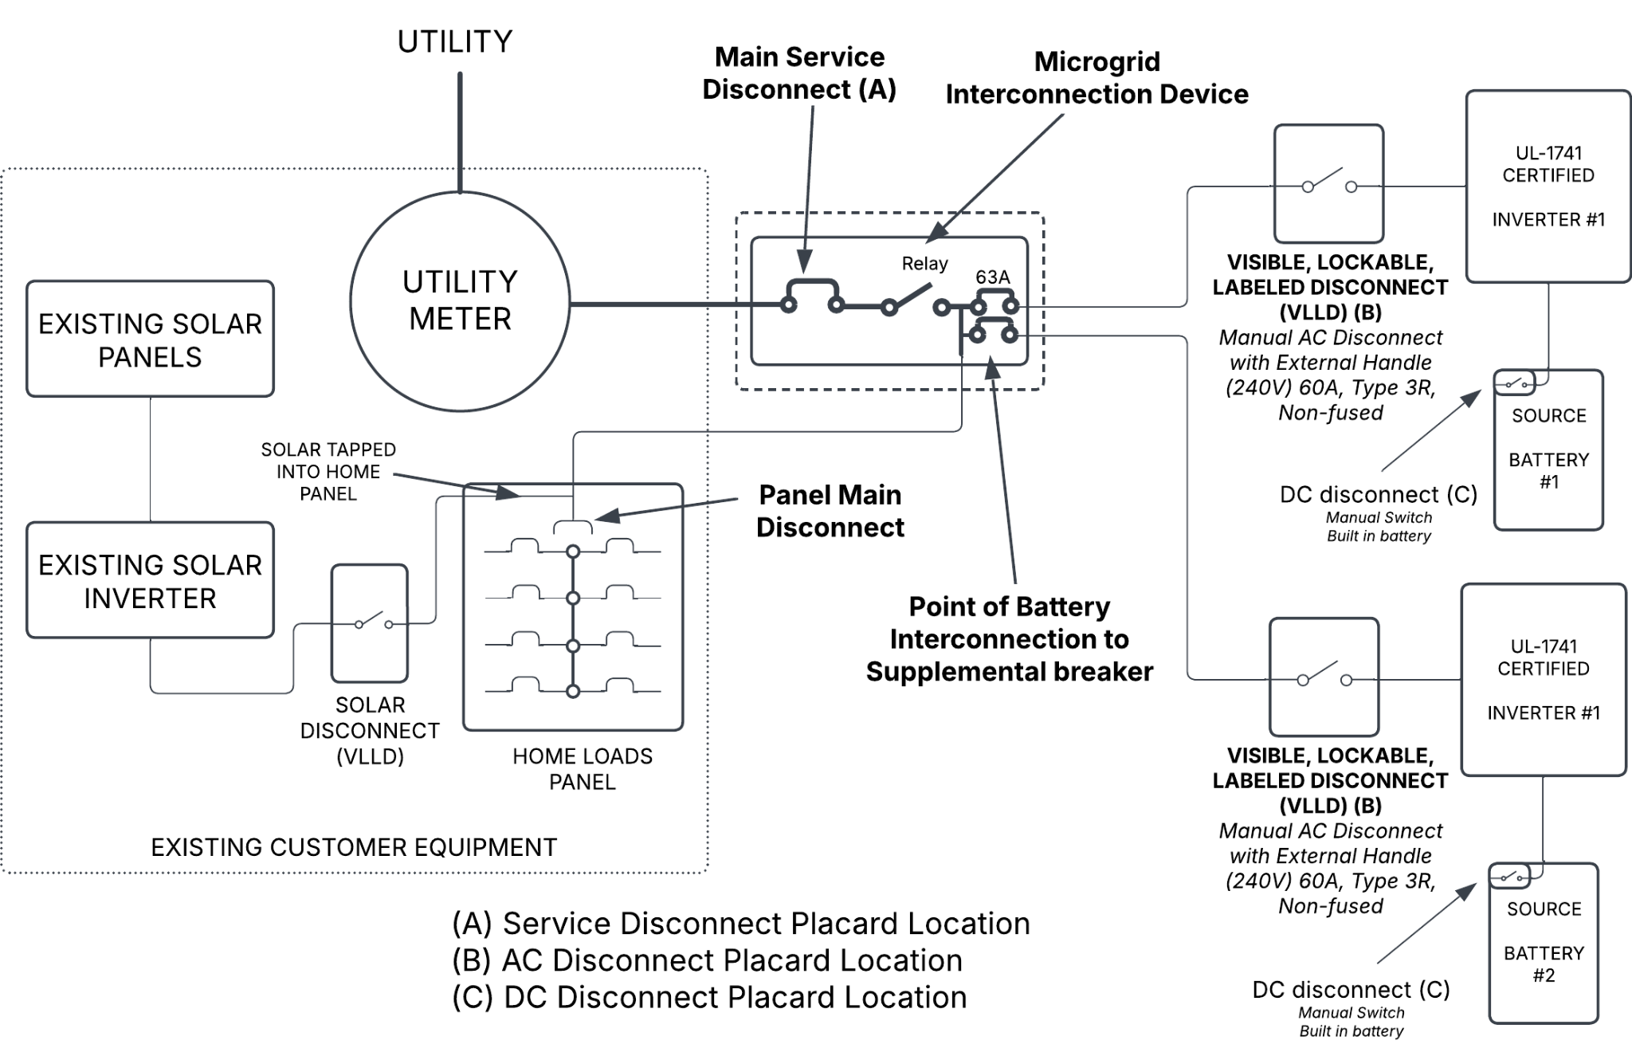
One-line diagram of Base connection
Simplified representation
Transmision-level transformer
Low-voltage feeder
Utility transformer
The distribution utility transformer would step the power up onto the local distribution system, which then flows upstream through the utility’s distribution network, and ultimately connects with ERCOT’s transmission-level grid.
Solar panels are not sold by Base, but customers with existing solar can be configured into the Base operating system

Slide 7
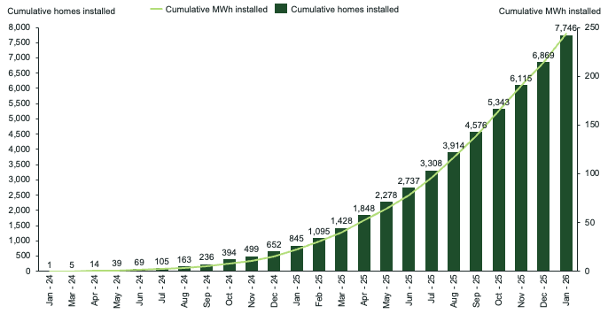
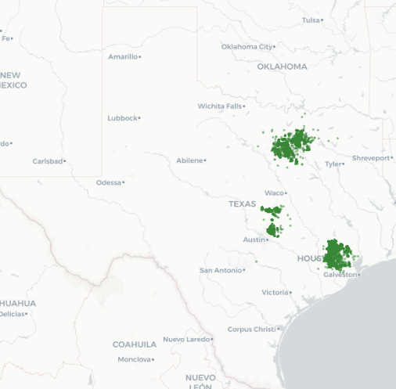
Total Base Installed Fleet in Texas
Concluded January at 245MWh installed across 7.7K homes
Installed fleet as of 1/31/26

Slide 8
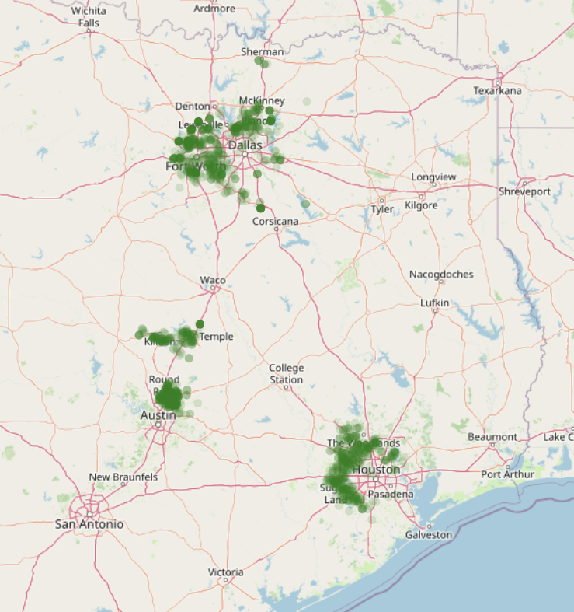
Base ADER Resources
All resources are qualified for ECRS and Nonspin
In-market 24/7 with RTC+B transition
As of Feb 26, larger than all other participants combined
Location of Individual Base ADER devices
Resource | Volume (injection capability)
LZ North | 23MW (current)
LZ South | 7.5MW (current)
LZ Houston | 24MW (current), 56MW (in review)

Slide 9

Base ADER connectivity for SCED operations
Legend
Communication protocol
Control flows
Communication flows
Base
ERCOT
Utility
QSE4
ERCOT
MQTT
Private backhaul connection
Private Cloud
WAN Site
ICCP
Bastrop
WAN/Firewall
Taylor
Base API
Base QSE
MIS
Base 24/7 on-call

Slide 10
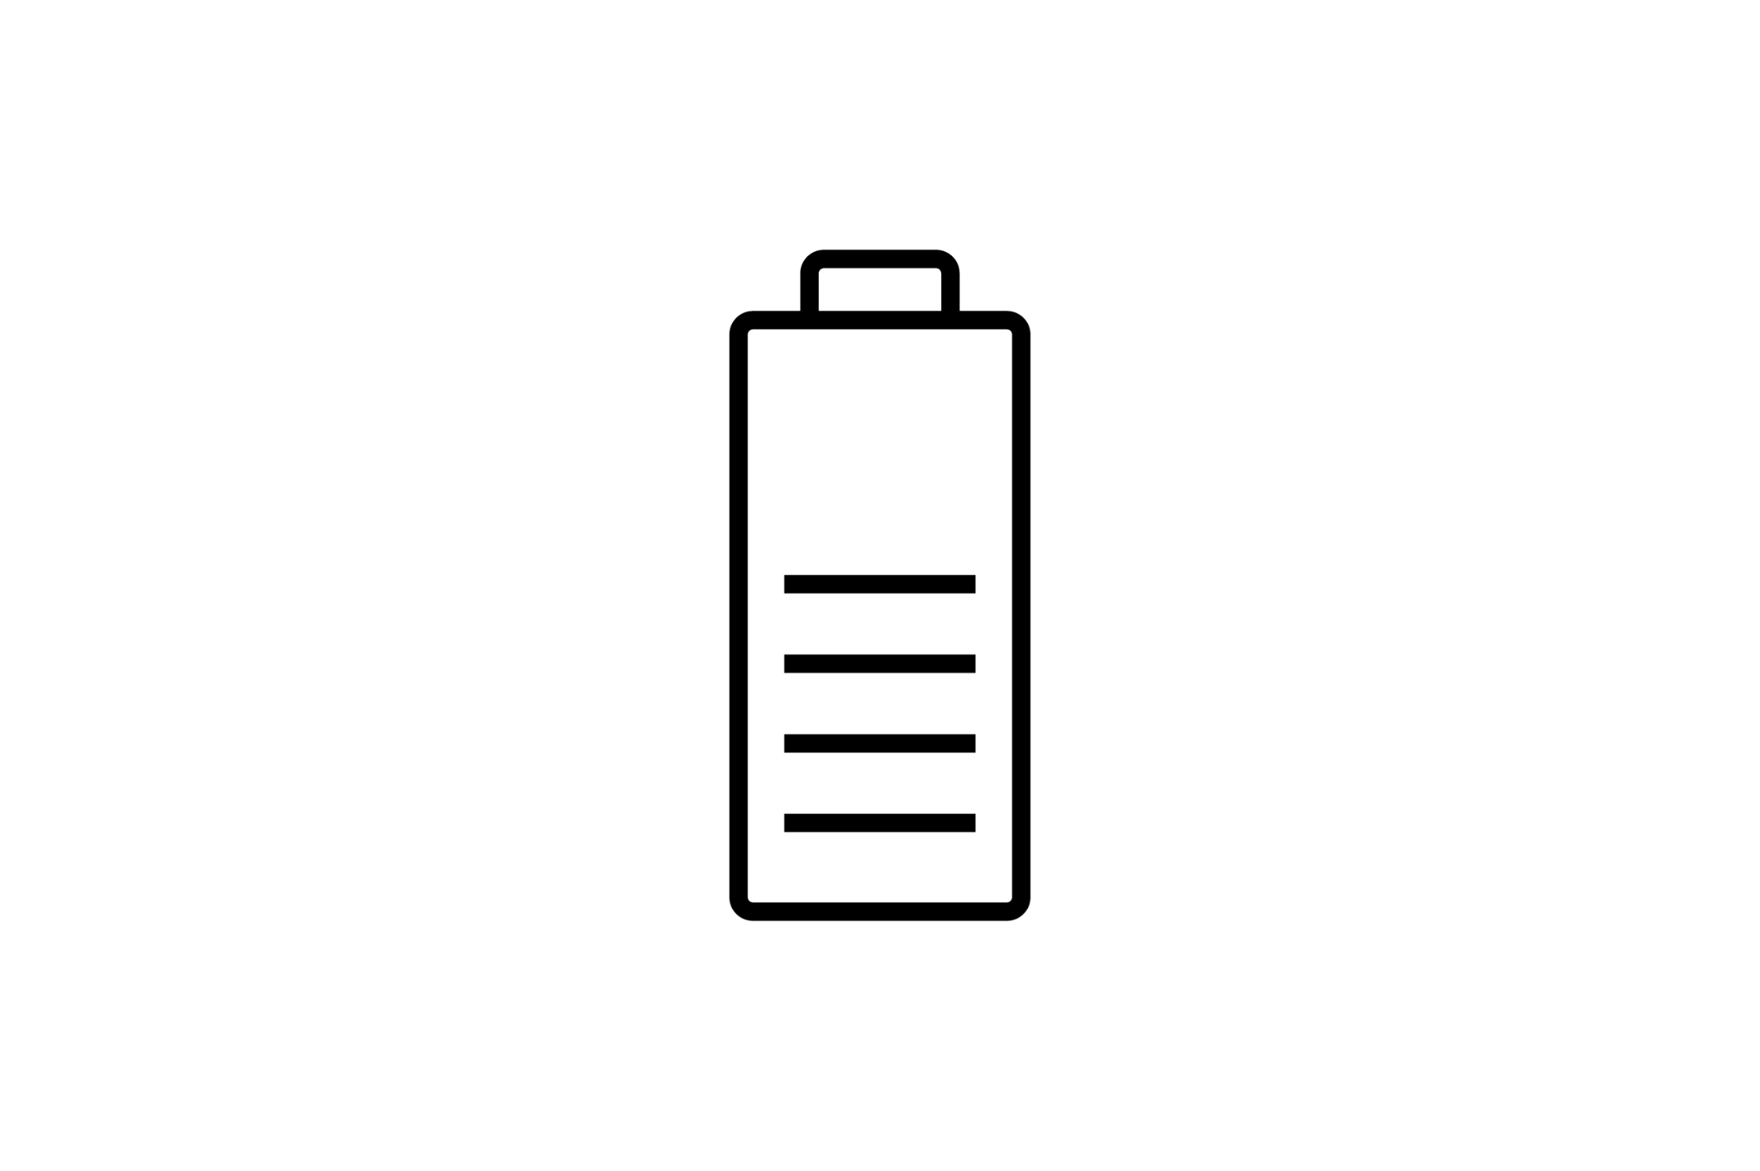
SCED dispatch aggregation methodology
Step 1: Determine aggregate parameters
Step 2: Submit resource offers to SCED
Step 3: Receive award and disaggregate
7kW available
7kW dispatch
Energy capability: 310kW
ECRS: 310kW
Non-spin:150kW
Total available:
310kW
10kW available
10kW dispatch
Real-Time SCED engine
Real-Time Award:
310kW energy
14kW available
Energy: 310kW @$-250/MW
ECRS: 310kW @$25/MW
Non-spin: 150kW @$50/MW
14kW dispatch
…
…
With these parameters, we can treat the aggregation as one large resource available to offer into the ECRS, Non-spin, and energy (at load zone price) markets
Currently, all ADER devices are modelled as CLRs, and resource offers are reflected in this designation
Each battery has parameters aggregated up into an aggregate value for the entire set of devices
Total capabilities respect individual device limits, meaning the aggregate parameters don’t exceed what devices can physically provide
After receiving awards for the resource, the aggregate award is assigned to devices based on their individual capability
Disaggregation is performed to keep devices at similar capabilities for the next dispatch interval

Slide 11
Outstanding questions for ADER NPRR

Slide 12
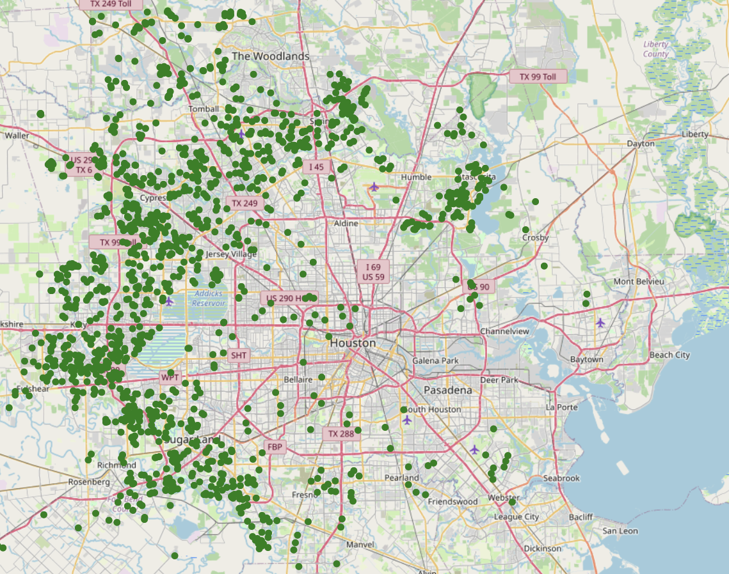
CIM-assigned locations of ADER assets
CIM “location” of Poweryall (LZ Houston) ADER resource and Base premises enrolled in the aggregation
Currently the Houston load zone aggregation is 24MW (56MW in review)
The MW injection is modelled using the load zone shift factor as the load-weighted average of the shift factors at all electrical buses assigned to that Load Zone.
However, only 101 / 553 LZ Houston substations actually have Base ADER capacity behind them, 73% of which is behind only 20 substations
As ADER aggregations grow, nodal dispatch becomes increasingly important for grid stability and efficient SCED dispatch
The MW response of an ADER is represented based on the Load Zone Shift Factor of the Load Zone. ERCOT calculates the Load Zone Shift Factor as the Load-weighted average of the Shift Factors at all Electrical Buses assigned to that Load Zone. The Load-weighting must be determined using the Load, if any, from the State Estimator at each Electrical Bus.
Base proposal: Introduce nodal dispatch and settlement for ADER resources, newly aggregated by substation
OBrien substation (dummy placeholder location of resource in CIM)
Base premise enrolled in ADER

Slide 13
Single nodal ADER aggregations
Base proposal: Introduce nodal dispatch and settlement for ADER resources, newly aggregated by substation
Single-nodal ADER aggregation framework
ADER aggregation defined at the ERCOT substation POI level
ADER single-node aggregations allow for coherent nodal dispatch and modelling injection at a single POI consistent with reality
Nodal settlement can be considered in conjunction to fully align pricing incentives with dispatch outcomes due to all injection/load reduction to the ERCOT grid occurring at the same substation
Base prefers the single nodal ADER aggregation proposal due to simplicity and expediency of using existing protocol language and market design over complete overhaul of the ADER program and applicable market foundations

Slide 14
ADER DoTA form submission concerns
Current process
Removed devices need to be categorized and resubmitted in another batch to DSP
High chance of cyclical study-> reject-> resubmit -> restudy
Observed timelines
1-5 months
~1 month
2-3 months
Aggregator submits DoTA excel sheet to DSP
DSP returns excel sheet with approve/reject per premise
Aggregator removes rejected devices and submits to ERCOT
ERCOT approves/rejects updated DoTA form and issues new resource limits
Aggregator submits new limits in RIOO for implementation in next Production Load Schedule model update
Key concerns:
Manual data entry into single excel document allows significant opportunity for clerical errors
Restudy cycles lead to long wait times before DoTA form reaches ERCOT
Premise-level rejections at any point in the process require manual removal of premise and resubmission in a different form submission
“Snapshot” nature of submission creates long lead times to capacity additions from device installation and large step changes in resource sizing
Base Proposal: Implement a web app to streamline ADER premise and aggregation management. Additionally, ensure ERCOT's current resource limits include a buffer for near-term growth, ensuring continuous updates to ADER premises.

Slide 15
ADER DoTA form proposed solution
Base Proposal: Implement a web app to streamline ADER premise and aggregation management. Additionally, ERCOT's current resource limits can include a buffer for near-term growth, ensuring continuous updates to ADER premises.
How it works
Aggregator uploads premise information to web app, with ERCOT, DSP, and aggregator read/edit access
Both TSP and ERCOT can perform checks and issue comments on premises, with the aggregator able to react and add information or updates
As devices are approved by both ERCOT and DSP, they can immediately begin operation in the ADER aggregation if the resource in aggregate remains under the “offset” resource limits defined by ERCOT through the last Production Load Schedule model update
Key concern mitigation:
Manual data entry into single excel document allows significant opportunity for clerical errors -> Electronic submissions automate and streamline process
Restudy cycles lead to long wait times before DoTA form reaches ERCOT -> Aggregator, DSP and ERCOT all have access to tooling simultaneously
Premise-level rejections at any point in the process require manual removal of premise and resubmission in a different form submission -> Native web hosting of premise information allows for easy resolution and resubmission of premises
“Snapshot” nature of submission creates long lead times to capacity additions from device installation and large step changes in resource sizing -> Web app allows for continuous updating of approved premise list for updating of resource parameters within new buffer limits set by ERCOT

