Slide 1

WMWG update to wms
April 1, 2026
Amanda Frazier, WMWG Chair

Slide 2

AGENDA
NPRRS ready for WMS vote:
  None
NPRRs Still with WMWG
  NPRR1278 - Establishing Advanced Grid Support Service as an Ancillary Service
Other Business
  OBDRR055 - Revisions to NSRS Deployment and Recall Procedure
  Winter Storm Fern - Load Forecasts
  RTCBTF Work Plan Assignments

Slide 3
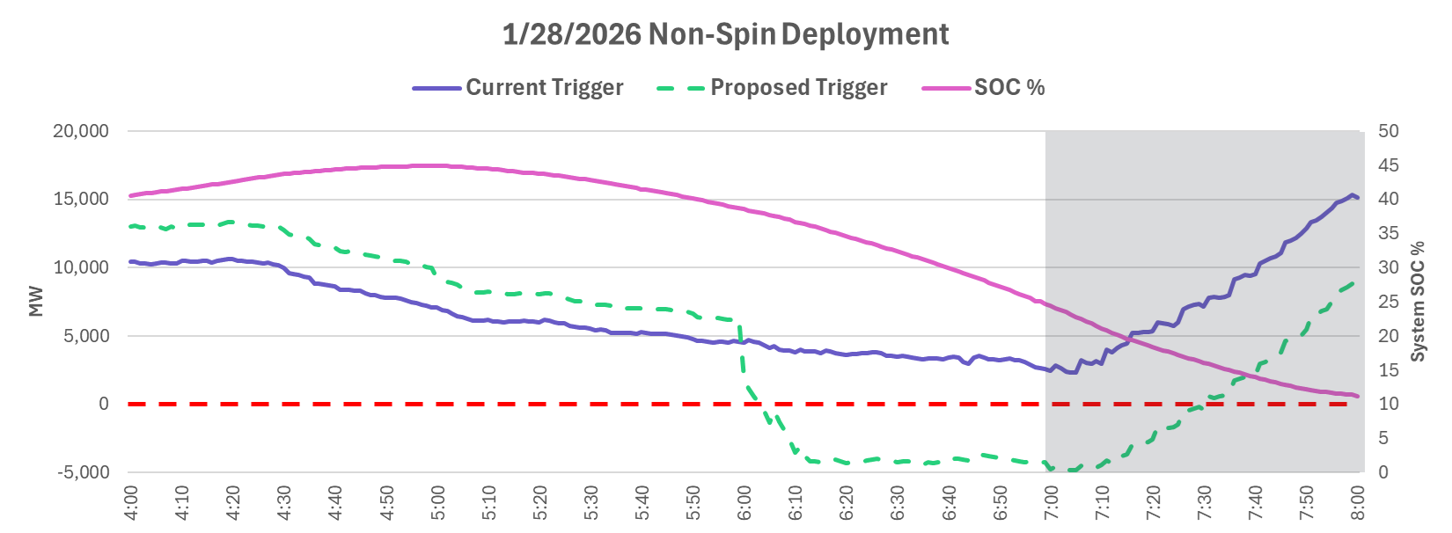
Discussion of Revision Requests
  NPRR1278 - Establishing Advanced Grid Support Service as an Ancillary Service – Discussion on hold
  OBDRR055 - Revisions to NSRS Deployment and Recall Procedure – Approved by 3/25 TAC
  ERCOT reviewed a newly proposed Non-Spin deployment procedure which incorporates changes from RTC and accounts for system-wide state of charge in evaluating the system’s capability to meet the 30-minute forecasted Load
  ERCOT presented an analysis from operating day 1/28 comparing the new deployment procedure to the previous deployment trigger methodology.

Slide 4
Other Business
  Winter Storm Fern – Load Forecast Discussion
  ERCOT provided follow-up analysis of load forecasting challenges from Winter Storm Fern noting the following contributions to a ~9 GW forecast error:
    ~4.2 GW multi-day reduction of Oil and Gas load
    ~4.1 GW persistent reduction from crypto facilities (winter price response less predictable)
    ~2.3 GW from unexpected school and business closures (difficult to quantify)
    ~0.5 GW reduction from steel mills and data centers
  ERCOT continuously iterates on internal load forecasting methodology based upon operational history. Following Winter Storm Fern, ERCOT will explore modeling improvements for winter crypto response and to account for weather responsiveness of less-than-large loads.

Slide 5
Other Business
  WMWG members reviewed the RTCBTF work plan assignments from WMS.
Item | Recommended Priority and Timing | Notes and WMWG Discussion
1A) General performance of ASDC curves and impacts on prices | Priority: High Timing: Pause for Reliability Standard Assessment. Review events as needed | ERCOT will likely include analysis as part of the 2026 biennial "ORDC" report and will bring event analysis of ASDC performance to WMWG upon request. Discussion also expected during Reliability Standard Assessment.
1B) Evaluating the impacts of the ASDC floors | Priority: High Timing: Pause for Reliability Standard Assessment. Review events as needed
2) Evaluating the impacts of the Ancillary Service proxy offer floors | Priority: High Timing: Review events as needed
4) Analyzing the Real-Time Ancillary Service duration parameters | Priority: High Timing: Discuss with 2027 AS Methodology | Re-evaluate after DRRS approval and through annual Ancillary Service Methodology discussions.
5) Evaluate impacts of capping System Lambda and potential alternatives to what is included in NPRR1290 | Priority: Medium Timing: Pause until 2027. Review events as needed | PUCT has opened a new project 59550 to review system-wide offer cap.
8) Investigate the impact of not having an indifference payment for the post-RTC, pre-1214 RDPA process | Priority: Medium Timing: Later part of 2026 | investigate the Winter Storm Fern impacts of not having an indifference payment for the post-RTC, pre-1214 RDPA process.
10) Update to the Off-Line Non-Spin Deployment procedures | Priority: Medium Timing: Review events as needed. | OBDRR055 presented to 3/23 WMWG and approved by 3/25 TAC.
11) Identify potential gaps in reporting post-RTC+B implementation | Priority: Medium Timing: On-going. | Stakeholders that identify reporting gaps may submit revision requests.

Slide 6

THANK YOU

