Slide 1
Operations Working Group
Chair- Rickey Floyd
Vice-Chair- Tyler Springer
4/02/2026

Slide 2
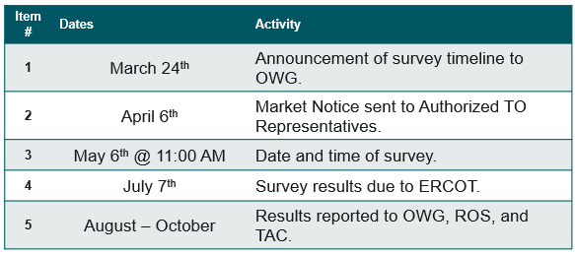
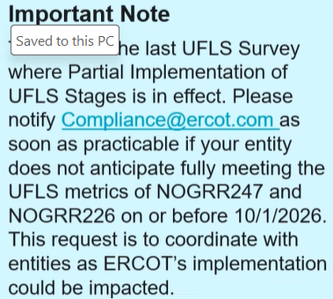
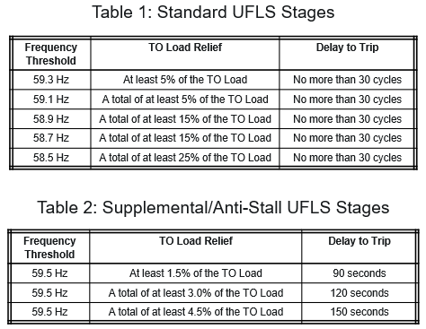
2026 Annual UFLS Survey

