Slide 1
Project Update
March 11, 2026
Troy Anderson
ERCOT Portfolio Management

Slide 2
Project Update Agenda
Recent / Upcoming Project Highlights
2026 Release Targets
Other Project Updates
Revision Request Additional FTEs
Priority/Rank Recommendations for Revision Requests with Impacts
NPRR1323 – Correction to Inadvertent Removal of Real-Time MCPC Capping for NPRR1290 Phase 2
Technology Working Group (TWG)
Next meeting is 3/26/2026
Prioritization Update
2026 Project Planning
Reports at Upcoming PRS Meetings
March
FTE Impacts of Revision Requests Report
April
Impact Analysis Accuracy Report
June
Aging Revision Request Prioritization
Location of Revision Request Project Information: http://www.ercot.com/services/projects

Slide 3
Recent / Upcoming Project Highlights
2026 February Off-Cycle Release – 2/1/2026 Complete
NPRR1285 – Improve Self-Commitment within RUC Opt Out Window
2026 February Release – R2 – 2/26/2026 Complete
NPRR1299 – Clarifications to Emergency Response Service (ERS)
2026 February Off-Cycle Release – 3/1/2026 Complete
NPRR1266 – Opt-Out Status Held by a Transmission-Voltage Customer Cannot be Transferred
2026 February Off-Cycle Release – 3/2/2026 Complete
NPRR1277 – Revisions to EAL Formula
2026 March Release – 3/25/2026-3/26/2026 In Flight
NPRR1287 – Revision to Outage Coordination
10 data products added to ERCOT Data Portal for public API access
See 3/6/2026 market notice for details
Additional market-facing changes will be delivered over the remaining releases in 2026
Note: Projected Go-Live dates are subject to change. Please watch for market notices as the effective dates approach.
3

Slide 4
2026 Release Targets – Approved NPRRs / SCRs / xGRRs
R1
R3
R5
January 1/28-1/29 | February 2/25-2/26 | March 3/25-3/26 | April 4/29-4/30 | May 5/27-5/28 | June 6/24-6/25
NPRR1234(c) PGRR131 NPRR1283 NPRR1285 NPRR1299 | NPRR1266 NPRR1277 | NPRR1287 Add’l Public Data Products in ERCOT Data Portal |  |  | SCR820
R2
R4
R6
ü
ü
ü
ü
ü
E
E
E
1/1
3/1
ü
ü
2/1
3/2
SCR820 TO/QSE Testing (see 2/19/2026 TWG)
Cipher Security Upgrades (see 2/19/2026 TWG)
RTC+B Stabilization
July 7/29-7/30 | August 8/26-8/27 | September 9/30-10/1 | October 10/28-10/29 |  | December 12/16-12/17
DPC Automation |  | NPRR1198 NPRR1303 | NPRR1281
R7
R8
R9
R10
R11
E
NS
E
P
Go-live dates can differ from Protocol effective dates – Please refer to market notices for more details
APPENDIX
Red Text: New additions and target release changes
Strike-Through Text: Previous target release
(a), (b), etc.: Multiple phase release
Project Status Codes
NS = Not Started
I = Initiation
P = Planning
E = Execution
H = On Hold
NPRR1234(c) – RIOO changes for End-Use
Industry Classification to Loads
Release targets are subject to change

Slide 5
Other Project Updates
NPRR1290 Phase 2 – Gap Resolutions and Clarifications for RTC+B
The team was ready to kick this off as part of RTC+B stabilization
Discovered an issue with the language – ERCOT will file an urgent NPRR to resolve
Path forward is now TBD – may require a stand-alone project
NPRR1198 – Congestion Mitigation Using Topology Reconfigurations
Targeting April 2026 start – expecting late Q3 / early Q4 go-live
This is one of the “high priority” items identified in last year’s prioritization workshop
NPRR1201 – Limitations on Resettlement Timeline & Default Uplift Exposure Adjustments
Targeting July 2026 start with go-live in late 2026
NPRR1238 – Voluntary Registration of Loads with Curtailable Load Capabilities
Part of Large Load Curtailment Manager project (Initiated in February 2026)
Targeting partial implementation by summer 2026 with full scope delivered by end of 2026
ERCOT expecting to file an NPRR to codify SB6-related curtailments in the Protocols
Targeting June 2026 for the next prioritization discussion at PRS
Plans for 2026 will largely be in place (and in motion) by that time
5

Slide 6
Revision Request Additional FTEs page 1 of 3
RR | RR Title | Approval | Dept | FTEs | Status
PGRR082 | Revise Section 5 and Establish Small Generation Interconnection Process | 12/8/2020 | Resource Integration | 3 | Added in 2023
NPRR1007 | RTC – NP 3: Management Activities for the ERCOT System | 12/8/2020 | EMMS Production Support | 2 | IA noted ERCOT “may” need 2 FTEs – staffing increase in GMS has been driven by other factors
NPRR1073 | Market Participant Application Changes | 8/19/2021 | General Counsel | 1 | 2024/2025 budget
NPRR1108 | ERCOT Shall Approve or Deny All Resource Outage Requests | 5/12/2022 | Outage Coordination | 2 | Added in 2022
PGRR098 | Consideration of Load Shed in Transmission Planning Criteria | 5/12/2022 | Transmission Planning | 1 | 2024/2025 budget
NOGRR215 | Limit Use of Remedial Action Schemes | 10/12/2023 | Operations Stability Analysis | 1 | Candidate for 2028/2029 budget
NPRR1198 | Congestion Mitigation Using Topology Reconfigurations | 7/25/2024 | Grid Analysis | 1 | 2026/2027 budget request
NOGRR245 | Inverter-Based Resource (IBR) Ride-Through Requirements | 9/26/2024 | Dynamic Studies | 3 | 2 FTEs included in 2026/2027 budget request
 |  |  | Resource Integration | 1 | 2026/2027 budget request
 |  |  | Event Analysis | 1-2 | 1 FTE for new team
 |  |  | Operations IBR Performance Evaluation | 2-4 | 3 FTEs in 2026/2027 budget request

Slide 7
Revision Request Additional FTEs page 2 of 3
RR | RR Title | Approval | Dept | FTEs | Status
NPRR1180 | Inclusion of Forecasted Load in Planning Analyses | 1/16/2025 | Dynamic Studies | 2 | 2026/2027 budget
 |  |  | Regional Planning | 4 | 2026/2027 budget
 |  |  | Regional Transmission Planning | 4 | 2026/2027 budget
 |  |  | Load Forecasting & Analysis | 1 | 2026/2027 budget
NPRR1247 | Incorporation of Congestion Cost Savings Test in Economic Evaluation of Transmission Projects | 1/16/2025 | Economic Analysis & Long-Term Studies | 2 | Added in 2024/2025
PGRR117 | Addition of Resiliency Assessment and Criteria to Reflect PUCT Rule Changes | 3/13/2025 | Regional Transmission Planning | 2 | Added in 2024/2025
NPRR1234 | Interconnection Requirements for Large Loads and Modeling Standards for Loads 25 MW or Greater | 5/15/2025 | Resource Integration | 1
PGRR122 | Reliability Performance Criteria for Loss of Load | Pending | Dynamic Studies | 2 | Pending at ROS
 |  |  | Regional Planning | 2
 |  |  | Regional Transmission Planning | 1

Slide 8
Revision Request Additional FTEs page 3 of 3
RR | RR Title | Approval | Dept | FTEs | Status
NPRR1296 | Residential Demand Response Program | Pending | Demand Integration | 2 | Pending at PRS
NPRR1279 | Reinstate Enhancements to the Exceptional Fuel Cost Process | 11/6/2025 | Settlements | 0 | Potential for 1-2 FTEs depending quantity and complexity of Exceptional Fuel Cost Submissions
NOGRR282 NPRR1308 | Large Load Ride-Through Requirements | 1/16/2025 | Event Analysis | 2 | Pending at ROS
 |  |  | Dynamic Studies | 1
PGRR144 | Dynamic Model Submission and Review Requirements for Large Loads including Large Electronic Loads | Pending | Dynamic Studies | 1 | Pending at ROS
PGRR145 NPRR1325 | Batch Zero Process for Large Load Interconnections | Pending | Large Load Integration | TBD | PGRR/NPRR posted on 3/4/2026 IA revision expected as language progresses through stakeholder process
 |  |  | Planning Model Admin. | TBD
 |  |  | Dynamic Studies | TBD

Slide 9
Priority / Rank Recommendations for Revision Requests with Impacts
Recommendations for…
Revision Request | Description | Priority | Rank | Comments
NPRR1323 | Correction to Inadvertent Removal of Real-Time MCPC Capping for NPRR1290 Phase 2 | 2026 | 4800 | If urgency is approved: $25k-$45k, 3-5 months Impacted Systems: Reporting, Integration If approved, ERCOT intends to combine with NPRR1290 Phase 2 Efficiencies expected by bundling with NPRR1290 Phase 2 ($75k-$100k effort)
PPL Rank Information
Next 2025 Rank in Business Strategy = 4580 Next 2028 Rank in Business Strategy = 5110
Next 2026 Rank in Business Strategy = 4820 Next 2029 Rank in Business Strategy = 5300
Next 2027 Rank in Business Strategy = 4910 Next Rank in Regulatory = 430

Slide 10
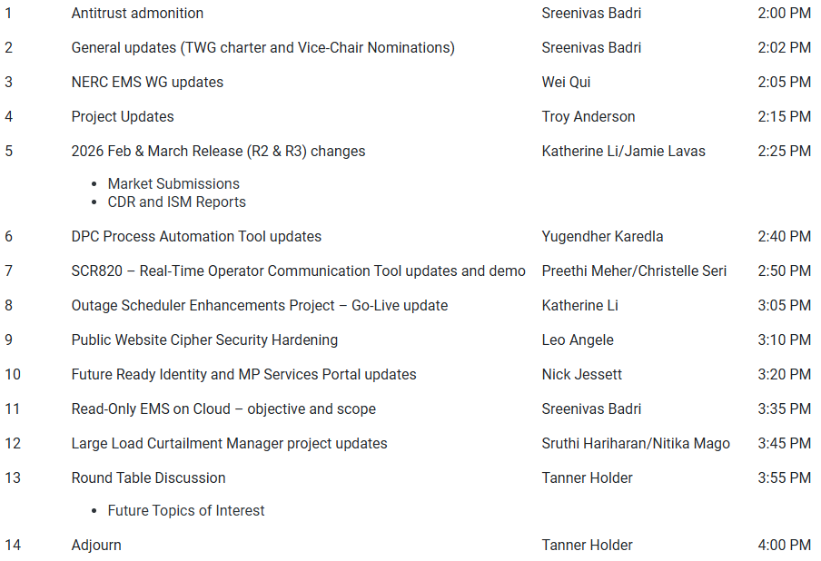
Technology Working Group (TWG)
Agenda for TWG meeting held on 2/19/2026:
Next TWG scheduled for 3/26/2026

Slide 11
2026 Project Planning
ERCOT understands that Market Participants need lead time to implement changes in their systems for many Revision Requests
Approved Revision Request Project Starts
NPRR936 – CRR Account Holder Limits
NPRR1188 – Implement Nodal Dispatch and Energy Settlement for Controllable Load Resources
NPRR1198 – Congestion Mitigation Using Topology Reconfigurations
NPRR1201 – Limitations on Resettlement Timeline & Default Uplift Exposure Adj
NPRR1238 – Voluntary Registration of Loads with Curtailable Load Capabilities
NPRR1244 – Clarification of CLR Primary Frequency Response Responsibilities
NPRR1277 – Revisions to EAL Formula
NPRR1281 – Improvements to Alternate FFSS Resource Designation
NPRR1288 – Remove Multiple Month Transactions in CRR Auctions
NPRR1290 Phase 2 – Gap Resolutions and Clarifications for RTC+B
SCR818 Phase 2 – Changes to Incorporate GIC Modeling Data into Existing Modeling Applications
SCR831 – Short Circuit Model Integration
Revision Request Projects with Potential for 2026 Implementation
SCR829 – API for the NDCRC Application
Other priority Review Request projects may start in 2026 with a future year Go-Live
DRRS (NPRR1309, NPRR1310), Residential Demand (NPRR1296), Firming
Green Text: Deemed “High Priority” at 2025 Prioritization Workshop

