Slide 1
Incident Review –
Voltage-Sensitive Crypto Load Reductions
ERCOT TWG
Wei Qiu
Lead Engineer, NERC
March 26, 2026

Slide 2
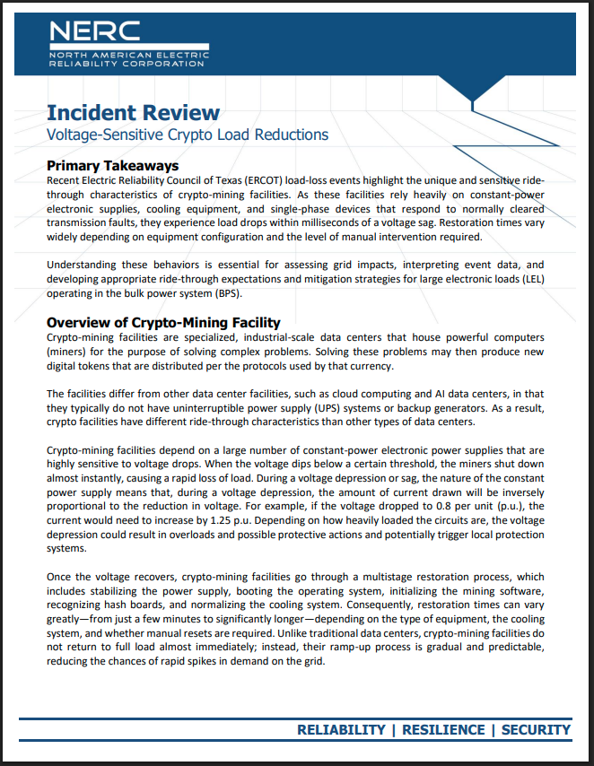

Incident Review: Voltage-Sensitive Crypto Load Reductions
A follow-on/companion on the incident review – “Considering Simultaneous Voltage-Sensitive Load Reductions” published in January 2025
Focusing on unique and sensitive ride through characteristics of crypto-mining facilities

Slide 3
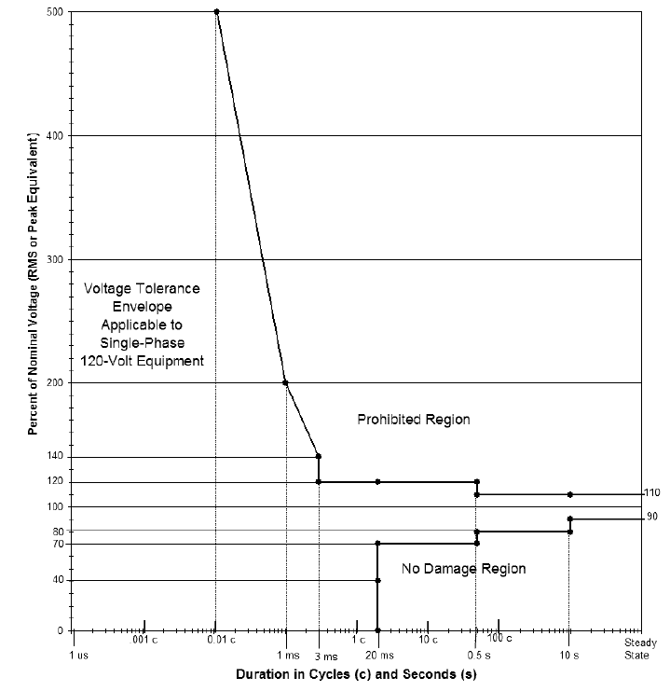
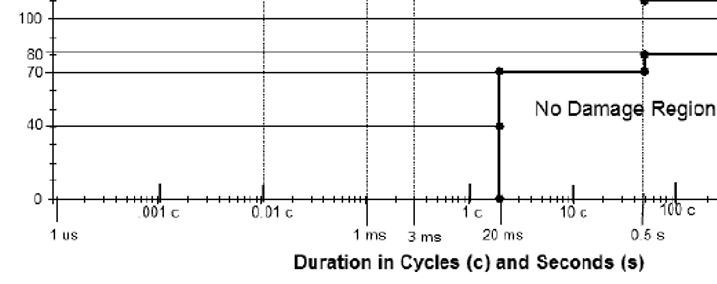
Crypto-mining Facility
Powerful computers for the purpose of solving complex problems – currency
No UPS – Direct exposure to POI voltage
Highly voltage sensitive loads
  Single phase devices
  Constant-power electronic supplies
  Cooling equipment
Restoration times vary, but it is a gradual ramp-up
70

Slide 4
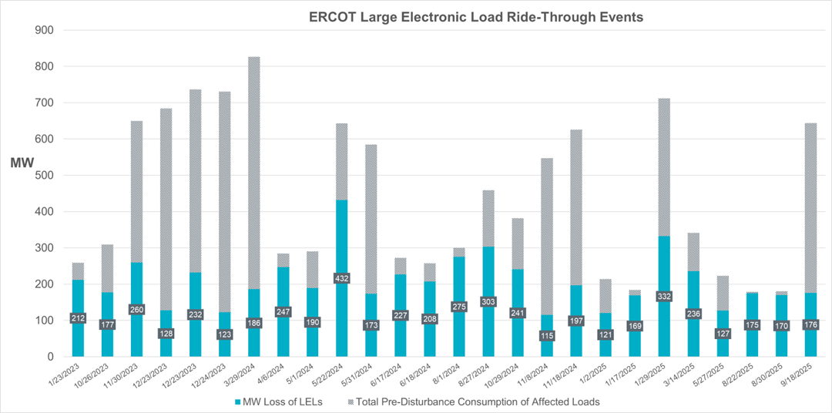
Incident Data: Highly Voltage Sensitive
26
26 distinct events (>100 MW loss)
in ERCOT (Jan’23 – Sep’25)
Load Reduction: 17% to 95%
Trigger: normally cleared transmission faults – e.g. a shallow single-phase voltage dip (0.844 p.u.)

Slide 5



Technical Observation & Mitigation Strategy
Protection
Transformer Winding Configuration
Cooling System
Grid Modeling
Phase unbalanced currents vs. True ground fault
Switch from Neutral Overcurrent to Ground overcurrent
Promote Delta-Wye Configuration
Leverage 30-degree phase shift to buffer single-phase faults
Adjust variable frequency drive (VFD) undervoltage setting – 0.96 is too high
Implement UPS support specifically for control circuits and drives
Update models to reflect “Constant Power” physics
Ensure simulations capture current spikes during voltage sags

Slide 6
Future Considerations
Load Evolution: Facilities are transitioning toward hybrid crypto/AI/Cloud workloads
Deep faults will still cause drops - multi-phase fault conditions
New requirements for submitting facility data and models
  Voltage and frequency ride-through requirements – ERCOT NOGRR282
  Study on worst-case LEL losses in large concentration areas, focusing on existing voltage and frequency ride-through limits

