Slide 1
SCR820 – Real-Time Operator Communication System (RTOC)
Preethi Meher & Christelle Seri
Mar 26, 2026

Slide 2
SCR820
Agenda
Status updates
Project timeline overview
Testing Updates
Primary Contacts

Slide 3
Status Updates
Project updates
ERCOT internal operator logging feature went live in Dec 2025
Messaging feature deployed and under testing in staging
MIS proxy setup to enable external user access
EMS data interface development is complete
Communication template creation screens are developed and testing is in progress
Development updates
Admin screens for internal use in progress
SOL Exceedance data displays are being developed
Default dashboard development will begin

Slide 4
SCR820 – Project Timelines
Project Timeline
Phase | Milestone | Target Date
Planning | Requirements & Design Finalized | Complete
Development | Development & Internal ERCOT Testing | Apr 2026
Testing | TOs/QSEs Testing | Mar 2026 – May 2026
Parallel Ops | Dual Operation Phase | June 2026
Go Live | Full Launch | July 2026
Market Notice: M-A032326-01 Access and familiarization of the Real- Time Operation Communications (RTOC) tool

Slide 5
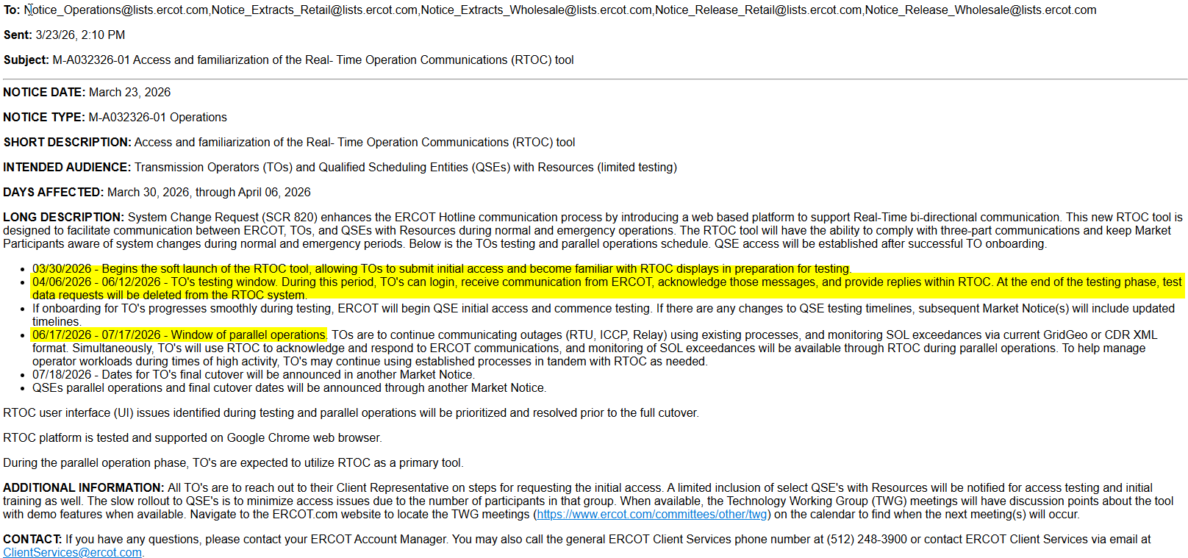
Testing and Parallel Operations Timelines
Market Notice sent out on 03/23/2026:
M-A032326-01 Access and familiarization of the Real- Time Operation Communications (RTOC) tool

Slide 6
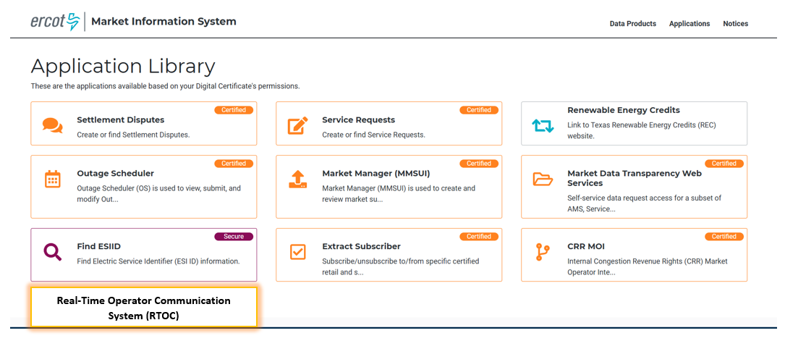
Tool Access
Access control
Application access will be granted via digital certificates
New roles must be added to the certificate for authorization
Operator (RTOC_M_OPERATOR)
ReadOnly (RTOC_M_VIEW)
Link will be available on mis.ercot.com application library (It will be enabled after the completion of testing)
Available to request

Slide 7
Provide Primary Contact Information
We need your help to streamline communication for RTOC Market Testing.
Please share the following details for your organization:
Primary Contact Name
Email Address
Role/Designation
Why?
To provide testing-related communications
Share application URL, updates, and instructions promptly
How to Submit:
Email your details to: Preethi.MeherMalla@ercot.com, Sreenivas.Badri@ercot.com

Slide 8
Key Highlights
What messages will RTOC handle?
Anything that requires a hotline call today
Examples include:
Operational alerts
Outage notifications
System conditions
These same communications will now be delivered through RTOC for centralized access
How will notifications work?
Audible alerts for critical messages when logged in.
Visual notifications for operational updates.
API integration is under consideration
How Will RTOC Handle QSE Relationships?
Main QSE will have access to the tool
Main QSE should communicate on behalf of sub-QSEs

Slide 9
SCR820
Thank you

