Slide 1
Outage Scheduler (OS) Enhancements Project Updates
Katherine Li
March 26, 2026

Slide 2
Outage Scheduler (OS) Enhancements Project
OS Enhancement introduces following changes
Provide new warning messages when proposed resource planned outage(s) exceeding MSRPOC
Overlapping resource outages with zero HSL are not allowed
Overlapping resource outages with same LSL and/or HSL are allowed
For M2 outages, entering a Planned Start less than 1 day before the start is not allowed
For M3 outages, entering a Planned Start less than 3 days before the start is not allowed
If an Outage has a Nature of Work (NofW) of (“Other” or “Unknown”), it is required that
either change the NofW, If applicable, or a note must be added to the Supporting Notes section before the outage can be COMPLETED
If an Outage has a Nature of Work(NofW) that is not (“Other” or “Unknown”), it may only be changed to a different NofW that is not (“Other” or “Unknown”)
The only time we expect a NofW of (“Other” or “Unknown”) is when an outage is created.
There are no XSD changes.
These changes are available in MOTE for Market Participants testing from the week of February 2, 2026.
OS Enhancement Project is planned for Go-Live in March (R3) release on 03/26/2026.

Slide 3
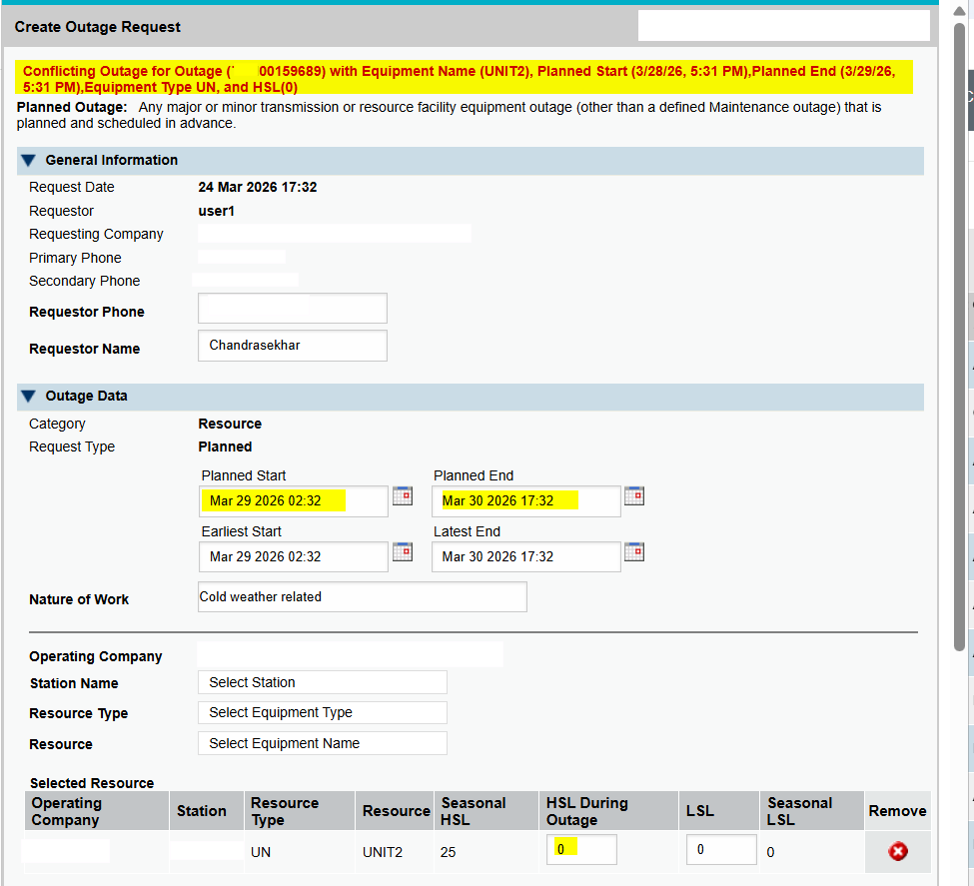
Sample 1 - Overlapping Resource Outages With Zero HSL
Overlapping resource outages with Zero HSL are not allowed.
Existing Outage:

Slide 4
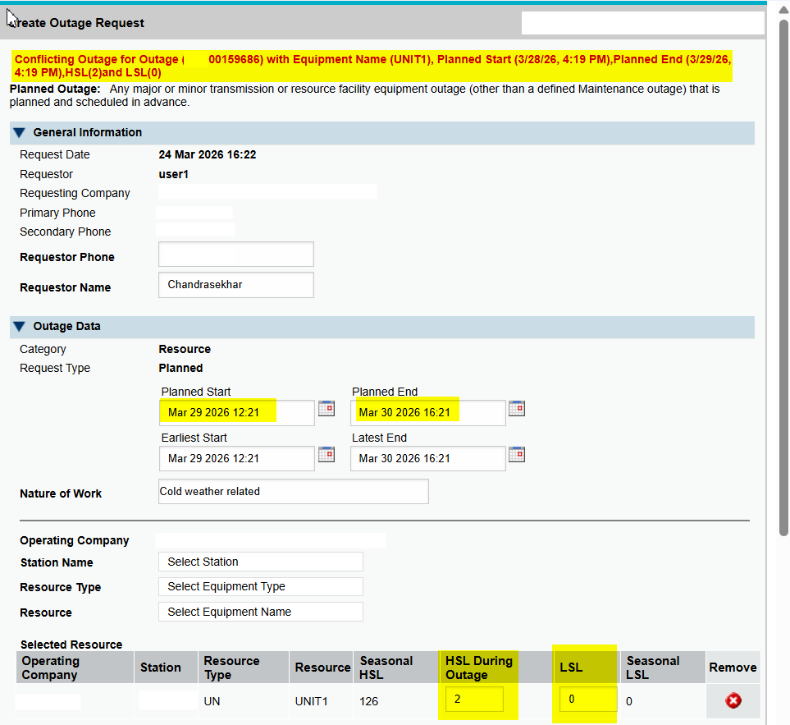
Sample 2 - Overlapping Resource Outages with Same LSL & HSL
Overlapping resource outages with same LSL & HSL are not allowed.
Existing Outage:

Slide 5
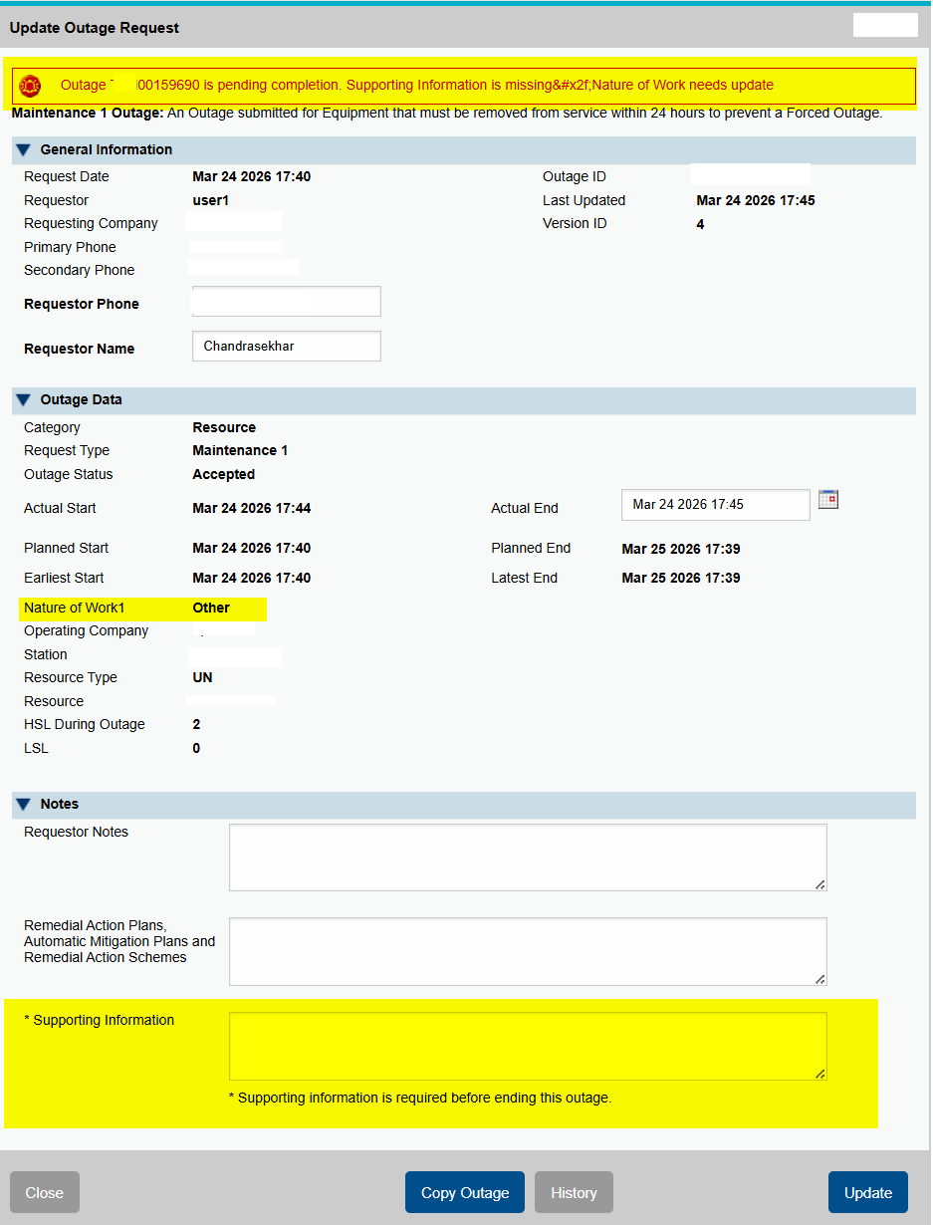
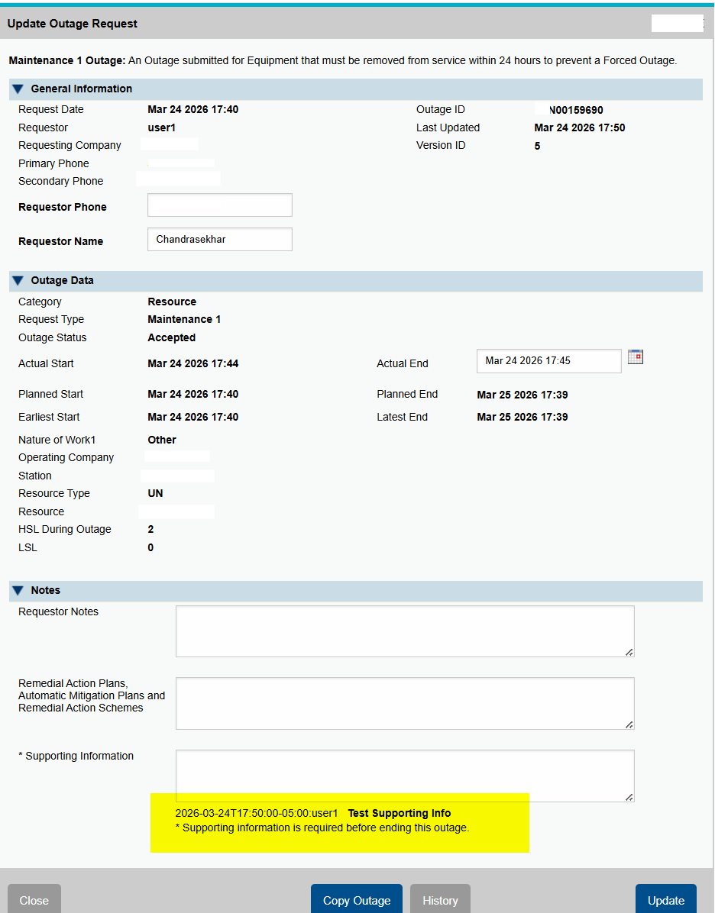
Sample 3 – Outages with Nature of Work of Other or Unknown
A warning would be displayed for an outage with Nature of Work as Others or Unknown if Supporting Information is NOT provided and the outage would be in pending complete.
- Support Information is needed when ending an outage - Outage is ended successfully with Supporting Information provided.

Slide 6
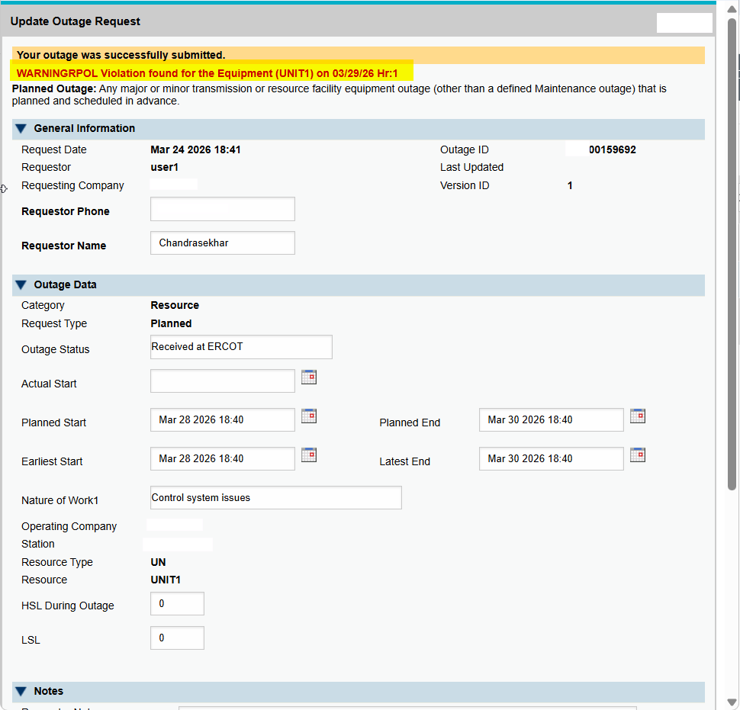
Sample 4 – Resource Planned Outage Limits Warning
A new warning messages is provided when a proposed resource planned outage exceeding RPOL (Resource Planned Outage Limit).

Slide 7
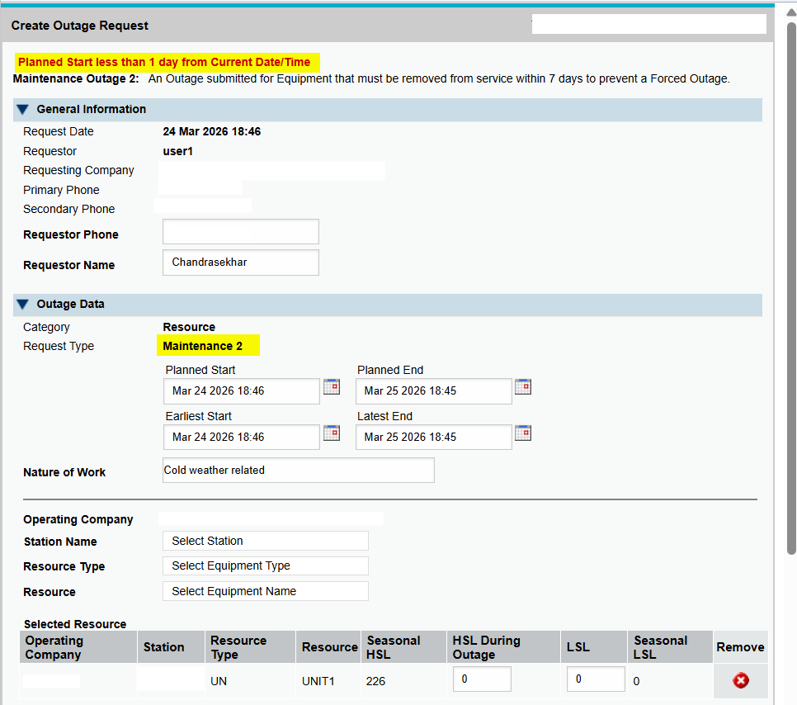
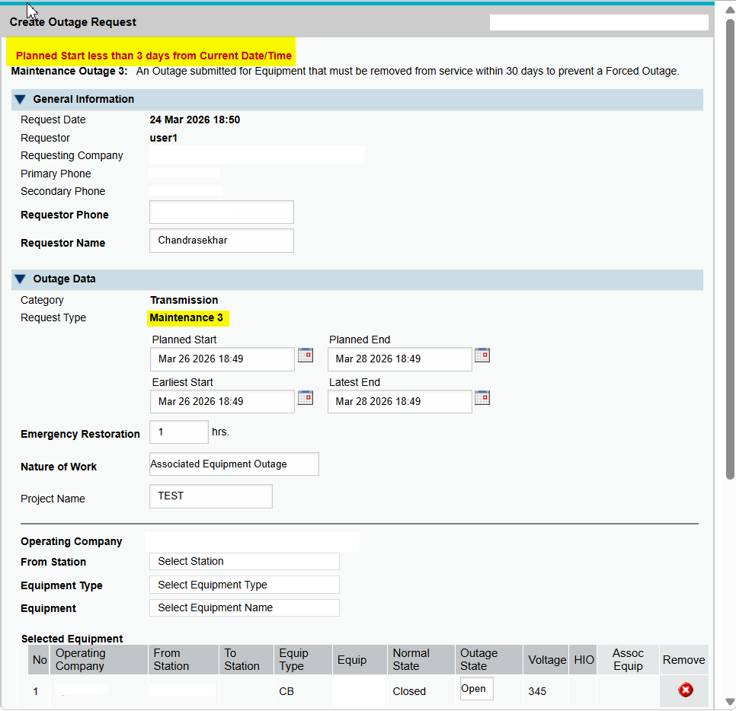
Sample 5 – Maintenance 2 and Maintenance 3 Outage Planned Start
- Maintenance 2 Planned Start < one day - Maintenance 3 Planned Start < three days

Slide 8
Questions?
You can reach following contacts for any questions and feedback
Katherine.Li@ercot.com
or
Sreenivas.Badri@ercot.com

