Slide 1
ERCOT Technology Working Group (TWG) Sreenivas Badri March 26, 2026
Outline:
Antitrust Admonition
Agenda
Sequence of discussion Items

Slide 2
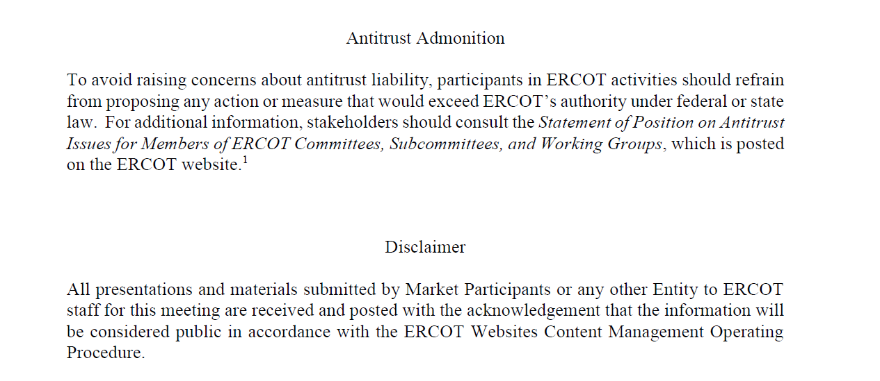
ERCOT TWG

Slide 3
Agenda
Item # | Item Description | Presenter | Start Time
1 | Antitrust admonition | Sreenivas Badri | 2:00 PM
2 | General updates Vice-Chair Selection | Sreenivas Badri | 2:02 PM
3 | NERC EMS WG updates | Wei Qui | 2:10 PM
4 | Project Updates | Troy Anderson | 2:20 PM
5 | 2026 March & April Release (R3 & R4) changes Market Submissions Outage Scheduler Enhancements Project – Go-Live CDR and ISM Reports | Katherine Li/Jamie Lavas | 2:30 PM
6 | DPC Process Automation Tool updates and demo | Yugendher Karedla/Yong Ma | 2:45 PM
7 | SCR820 – Real-Time Operator Communication Tool updates | Preethi Meher/Christelle Seri | 3:05 PM
8 | Public Website Cipher Security Hardening Reminder Legacy Dashboard URL Redirect Removal on ERCOT.com Website TLS Certificate Lifetime Reduction – Implementation details | Leo Angele | 3:20 PM
9 | Enhancements to RIOO and REC applications sign up process | Blake Halstead/Nick Jessett | 3:35 PM
10 | Large Load Curtailment Manager project updates | Sruthi Hariharan/Nitika Mago | 3:45 PM
11 | NPRR1188 (Implement Nodal Dispatch and Energy Settlement for Controllable Load Resources) – Market Applications and API/XSD changes overview | Xiangjun Xu/Susan Jinright | 3:55 PM
12 | Round Table Discussion Future Topics of Interest | Tanner Holder | 4:10 PM
13 | Adjourn | Tanner Holder | 4:20 PM

Slide 4
TWG
General updates – Sreenivas Badri/TWG
Vice-Chair Selection

Slide 5
NERC EMSWG Updates
NERC EMSWG updates – Wei Qui

Slide 6
Project Updates
Project updates – Troy Anderson

Slide 7
2026 March and April (R3 & R4) Release changes
Market Submissions – Katherine Li
Outage Scheduler Enhancements Project – Go-Live – Katherine Li
CDR and ISM Reports – Jamie Lavas

Slide 8
DPC Process Automation updates and Demo
DPC Process Automation Tool updates and Demo –
Yugendher Karedla/Yong Ma

Slide 9
SCR820 – Real-Time Operator Communication Tool updates
SCR820 – Real-Time Operator Communication Tool updates –
Preethi Meher/Christelle Seri

Slide 10
Public Website Cipher Security Hardening, ERCOT.COM and TLS Certificates Lifetime Reduction updates
Public Website Cipher Security Hardening – Leo Angele
Legacy Dashboard URL Redirect Removal on ERCOT.com Website - Leo Angele
TLS Certificate Lifetime Reduction – Implementation details - Leo Angele

Slide 11
Enhancements to RIOO and REC applications sign up process
Enhancements to RIOO and REC applications sign up process –
Blake Halstead/Matthew Price

Slide 12
Large Load Curtailment Manager (LLCM)
Large Load Curtailment Manager (LLCM) Project updates -
Sruthi Hariharan/Nitika Mago

Slide 13
NPRR1188 – Market Applications and API/XSD changes
NPRR1188 (Implement Nodal Dispatch and Energy Settlement for Controllable Load Resources) – Market Applications and API/XSD changes overview –
Xiangjun Xu/Susan Jinright

Slide 14
ERCOT TWG – Round Table Discussion
ERCOT TWG – Round Table Discussion
Future Topics of Interest
Topics and presentations from TWG members

Slide 15
Thank You Questions/Comments/Feedback?
You can reach Sreenivas at
Sreenivas.Badri@ercot.com and Tanner at tholder@tnsk.com

