Slide 1

PGRR 145 Analysis & Comments
March 24, 2026

Slide 2
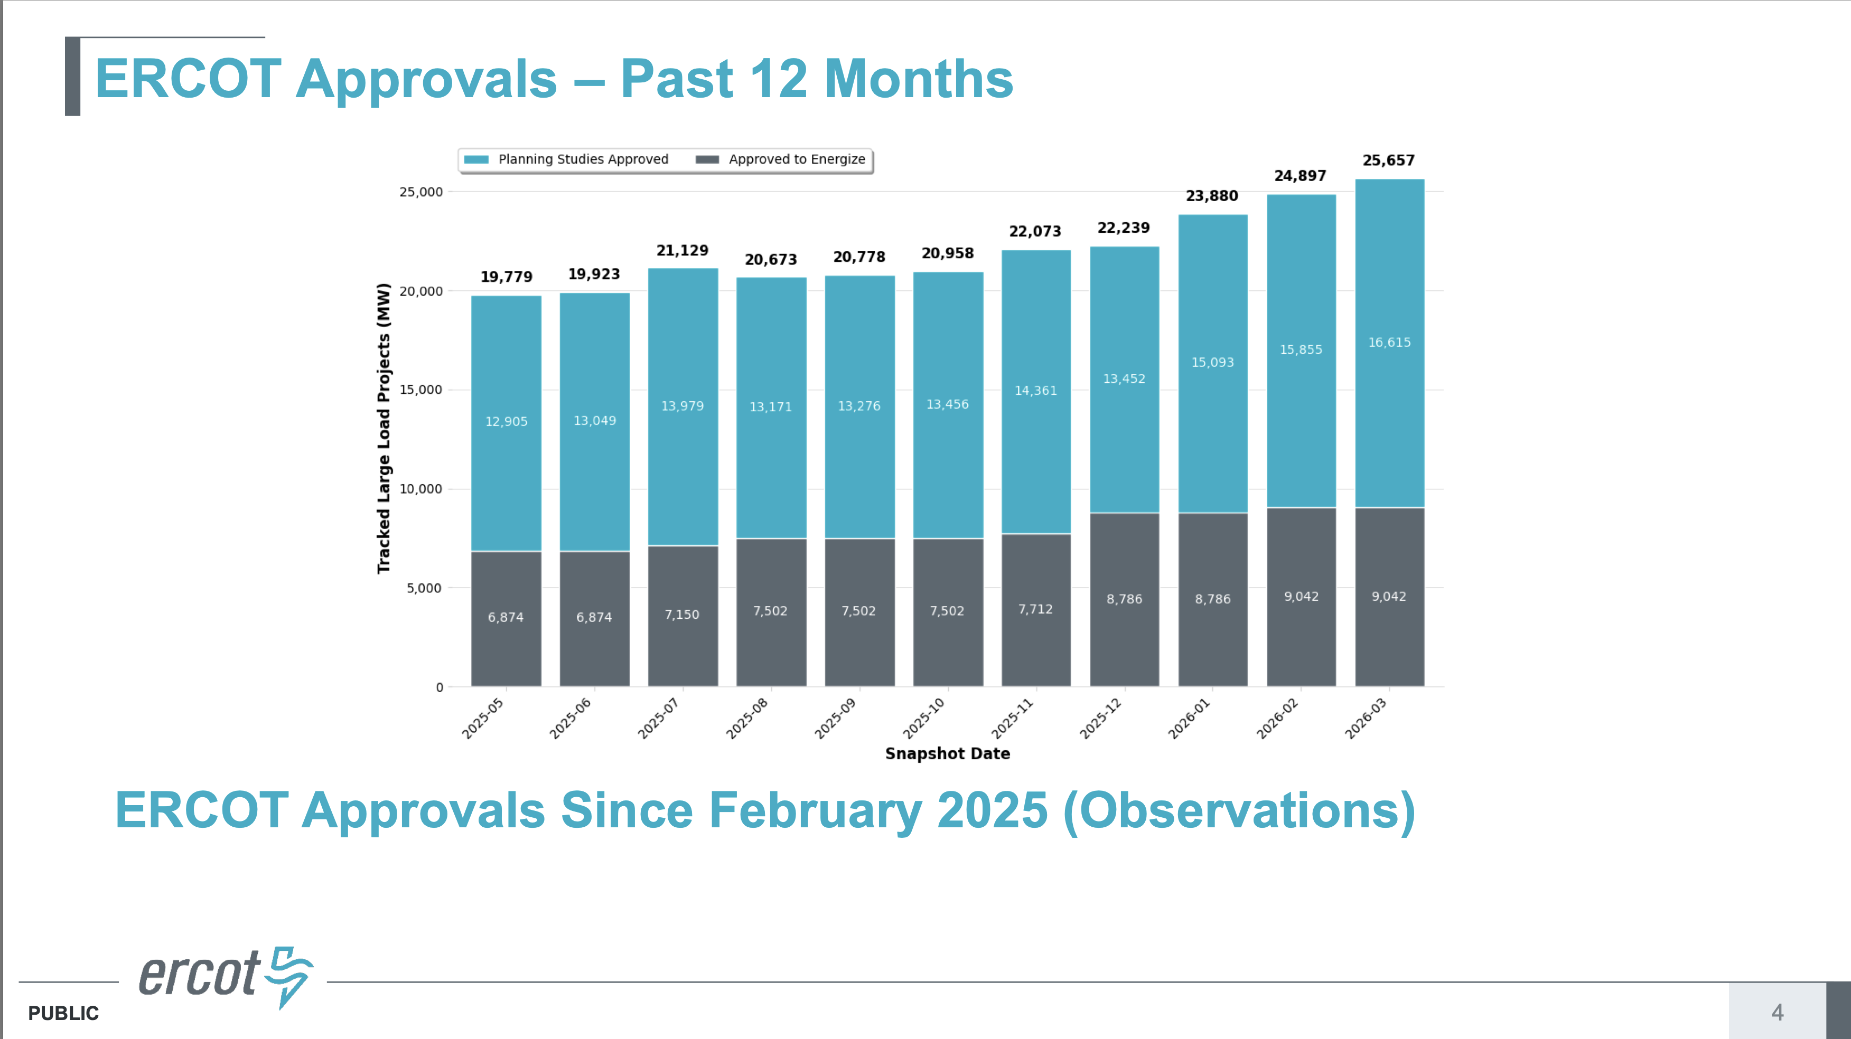
Dimensionalizing The Scope of the Concern
Planning Studies Approved
Only 3,710 MW were approved over the past 11 months (avg. 337 MW/mo)
3,710 MW = 16,615 MW – 12,905 MW
Approved to Energize
Only 2,168 MW were approved over the past 11 months (avg. 197 MW/mo)
2,168 MW = 9,042 MW – 6,874 MW
This slide illustrates how woefully ineffective that the current PGRR115 process has been in getting Large Loads approved
Source: March TAC Report
Notes:
@2Datacenter

Slide 3
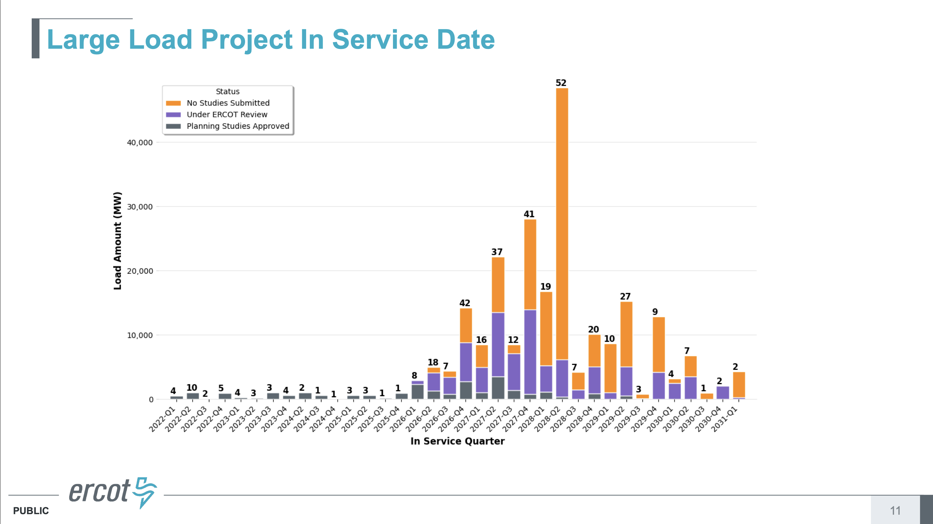
Dimensionalizing The Scope of the Concern
Graph Only Includes PGRR115 Review
Notice all the “No Studies Submitted”
~6 GW in 2026
~27 GW in 2027
~60 GW in 2028
~27 GW in 2029
~4 GW in 2030
~124 GW Total for ‘26 thru ‘30
How many are included in LL RPG projects instead of PGRR115 studies?
For any ’26 & ’27 and many of the ‘28 LL RPG projects, will be excluded from Baseload by the current PGRR145 language
Source: March TAC Report
Notes:
@2Datacenter

Slide 4
High Level Qualitative Review of Excluded LL RPGs
CPS Energy
25RPG020 – 2,000 MW of Large Loads, ERCOT published 6/25/25, NO EIR completed yet
Denton Municipal Electric
26RPG005 – 575 MW of Large Loads, ERCOT published 2/12/26, NO EIR completed yet
STEC
25RPG016 – 1,150 MW of Large Loads, ERCOT Independent Review completed 3/19/26
25RPG039 – 250 MW of Large Loads, ERCOT published 11/17/25
LCRA
26RPG001 – 2,500 MW of Large Loads, ERCOT published 1/29/26
AEP
26RPG004, 008, & 009 – 26,396 MW of Large Loads, ERCOT published between 2/12/26 and 2/25/26
Oncor
25RPG004 – 4,046 MW of Large Loads, ERCOT Independent Review completed 3/19/26
25RPG038, 040, 041, 042, 043 – 14,000 MW of Large Loads, ERCOT published between 11/4/25 and 11/17/25
6 TSPs have 14 RPGs→ ~50,900 MW of Large Load Excluded by PGRR145
Note: it is entirely possible that some small portion (<3,710 MW) of this 50,917 MW total may already be included in the ERCOT Planning Studies Approved on the prior slides
Notes:
@2Datacenter

Slide 5
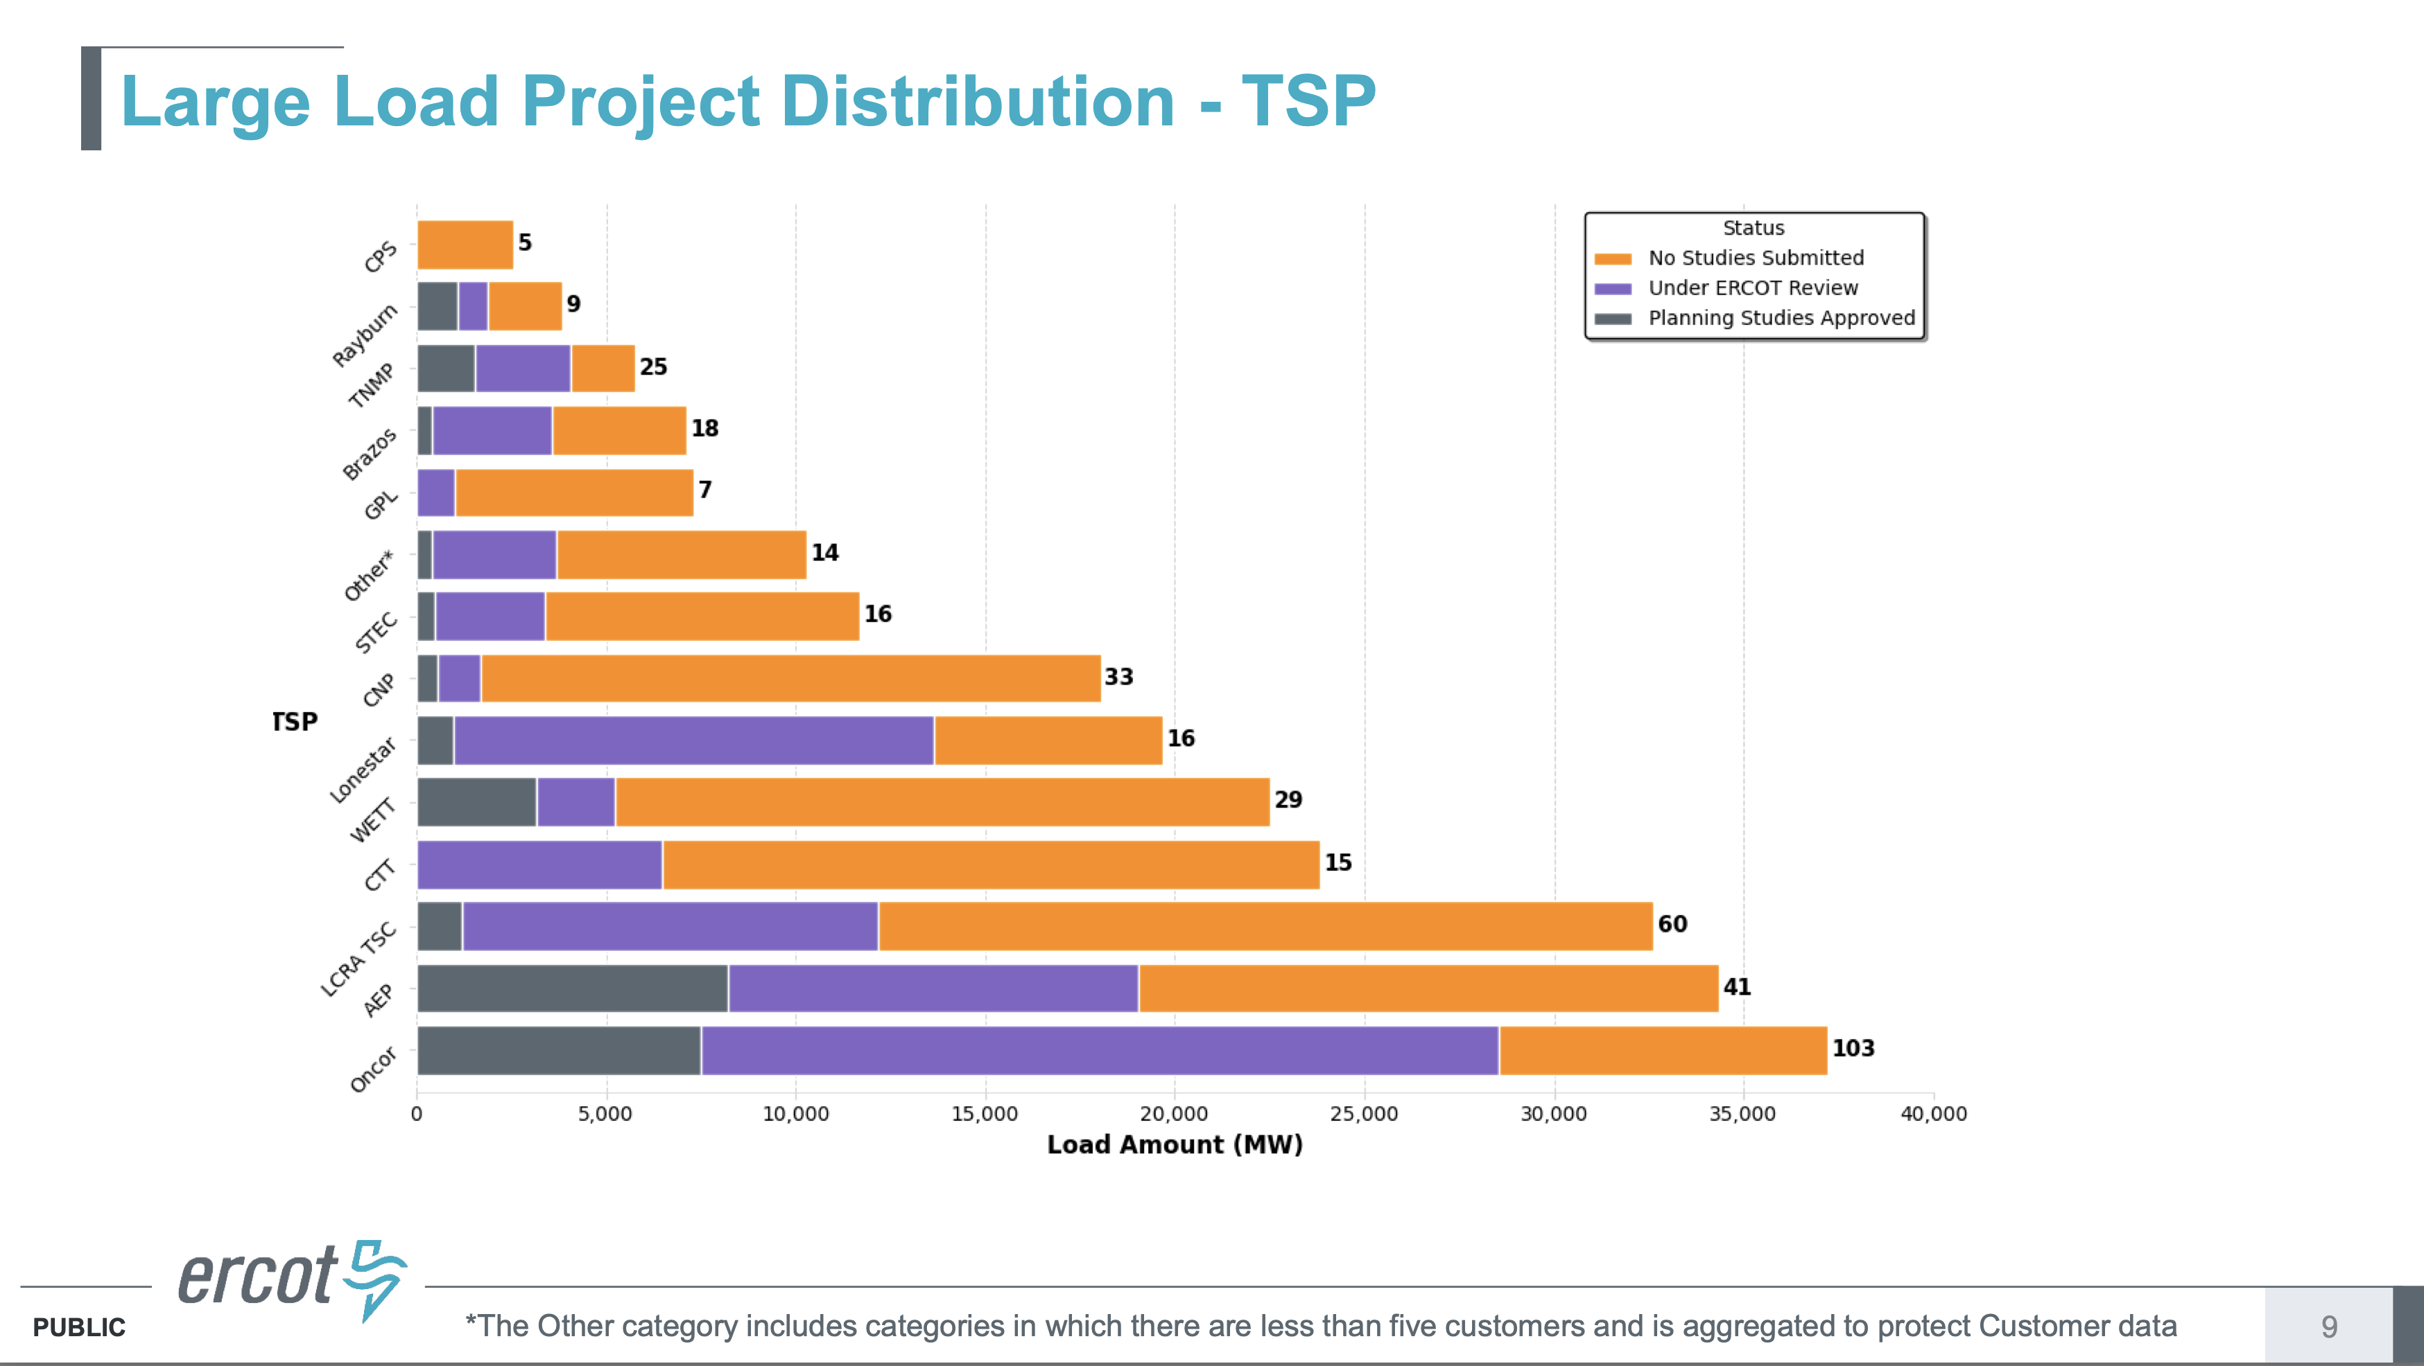
Comparing LL RPGs to Respective TSP Totals
CPS Energy – 2,000 MW
DME – 575 MW
STEC – 1,400 MW
LCRA – 2,500 MW
AEP – 26,400 MW
Oncor – 18,050 MW
Total – 50,925 MW
← ~2.5 GW
~3 GW
~6.5 GW
~3 GW
~9 GW
~11 GW
~15 GW
~22 GW
~6 GW
CPS, AEP, & Oncor it represents 91% of the ~50.9 GW total and ~82% of their “No Studies Submitted” and “Under ERCOT Review” categories
Notes:
@2Datacenter

Slide 6
PGRR145 - Eolic Development Partners Comments
Concern #1 - it is extremely important to respect and leverage the tremendous amount of work that TSPs have invested into developing RPG proposals for Large Load Integration
Most of these RPG proposals were being worked on by TSPs well before ERCOT’s announcement of PGRR115’s effective date or the initiation of the batch process
Each of the TSPs who commented, suggested key edits to Section 9.2.1.4:
Center Point Energy – replaced “ERCOT’s sole discretion” statement, with one that emphasized ERCOT collaborating with the Interconnecting TSP and/or Interconnecting DSP
Oncor – extended the window of ERCOT RPG Acceptance and ERCOT Endorsement out to July 10, 2026
AEP – emphasized ERCOT collaboration with the Interconnecting TSP and/or Interconnecting DSP and extending the window for RPG submission out to July 10, 2026
For this reason, for inclusion as Base Load in Section 9.2.1.4, Eolic suggested edits that included all Regional Planning Group (RPG) proposals which were submitted prior to March 4, 2026, where:
A Large Load contributed to establishing the reliability need for the RPG project, and
The Large Load was also included in the ERCOT 2026 RTP (meant to respects the PUCT 58480 rule)
Proprietary & Confidential
Notes:
@2Datacenter

Slide 7
PGRR145 - Eolic Development Partners Comments
Concern #2 – it is highly beneficial to leverage the upcoming 2026 ERCOT RTP as a way to accelerate the integration of Large Loads that contribute to establishing the reliability need for the RTP project
All Large Loads included in the 2026 RTP, meet the higher standard of the PUCT 58480 rule
The 2026 ERCOT RTP is calendared sufficiently in front of Batch Zero that it will identify all needed transmission upgrades required to serve the PUCT 58480 compliant Large Loads
For any Legacy Interconnection Agreement that have met the Requirements of Section 9.10 and was included in the 2026 ERCOT RTP, there should be no reason not to also include it as baseload in Batch Zero
ERCOT previously recognized the value of utilizing RTP for this in their 2/3/26 presentation
For this reason, for inclusion as Base Load in Section 9.2.1.4, Eolic suggested edits that include all Large Loads which:
Meet the requirements of Section 9.10 (Legacy Interconnection Agreement & Responsibilities), and
The Large Load was also included in the ERCOT 2026 RTP (meant to respects the PUCT 58480 rule)
Proprietary & Confidential
Notes:
@2Datacenter

Slide 8
Concluding Ask - Addressing ERCOT Concerns
ERCOT Feedback In Prior Discussions
Concern that LL RPG proposals determine a “End State” load serving capability, but not all the intermediate Quarter / Year load serving capability
Said differently, there is still a need for a “Load Commissioning Plan” for these LL RPGs
TSP Feedback in these PGRR145 Comments
TSP Comments have requested that ERCOT collaborate with them on these RPGs
TSP Comments have requested that ERCOT extend the date beyond 3/4/26 for LL RPGs for Batch Zero baseload
Concluding Ask → Proposed Solution path to a “Load Commissioning Plan” for LL RPGs
ERCOT should extend the backend date for LL RPGs to early July 2026
ERCOT should collaborate with affected TSPs between now and early July 2026, to develop an agreed upon “Load Commissioning Plan” for these LL RPGs
To the degree that a collaborative ERCOT / TSP LL RPG “Load Commissioning Plan” can be developed by early July 2026, then include these LL RPGs as baseload in Section 9.2.1.4
If ERCOT will collaborate with TSPs as they are requesting, then all the hard work of their LL RPGs will be respected, and ~10X the number of LL MWs can be included as Baseload in Batch Zero
Note: the 10X figure assumes that approximately another 1.35 GW will be processed through the PGRR115 process between now and then, which when added to the 3,710 MW that have already made it through the Planning Studies Approved status, this equates to approximately 5.1 GW, which is almost exactly 1/10th of the quantity of LL RPGs
Notes:
@2Datacenter

Slide 9
For Additional Information Contact: Shannon Caraway Eolic Development Partners, LLC shannon.caraway@eolic.us
Proprietary & Confidential
Notes:
@1AllAudiences
@2Datacenter
@3FullDetail
@4Offtaker
@6InvestorNDA
@7DatacenterInvestor

