Slide 1
Monthly Review of Reliability Unit Commitment Market Impacts – January 2026
Wholesale Market Working Group
ERCOT Market Analysis

Slide 2
RUC Resource-Hours
* The difference between “Instructed” and “Effective” values is a result of Resources starting up, shutting down, receiving partial hour instructions, or otherwise not being dispatchable by SCED.

Slide 3
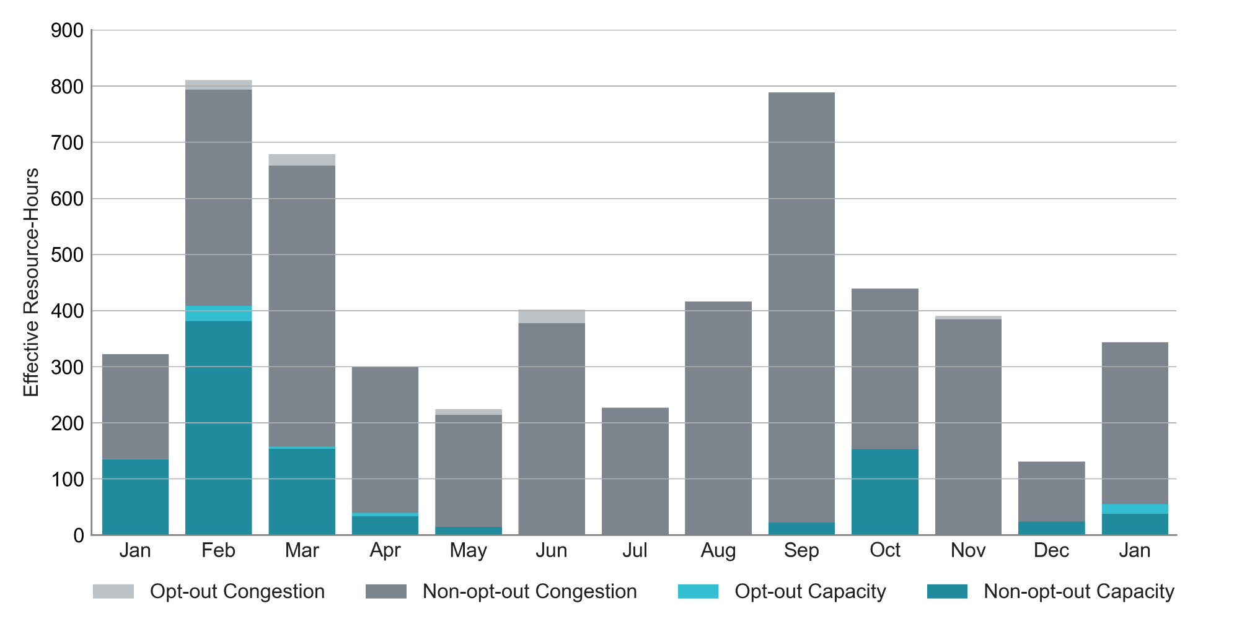
RUC Instruction Reasons: Last 13 Months
84% of RUC effective hours in January 2026 were nominally attributed to congestion.
For January 2026, 72% of non-opt-out RUC activity (233.0 effective hours) was RMR for congestion (primarily E_PASP) during Winter Storm Fern (1/24 to 1/27) including:
  Life Cycle Units (167.3 effective hours)

Slide 4
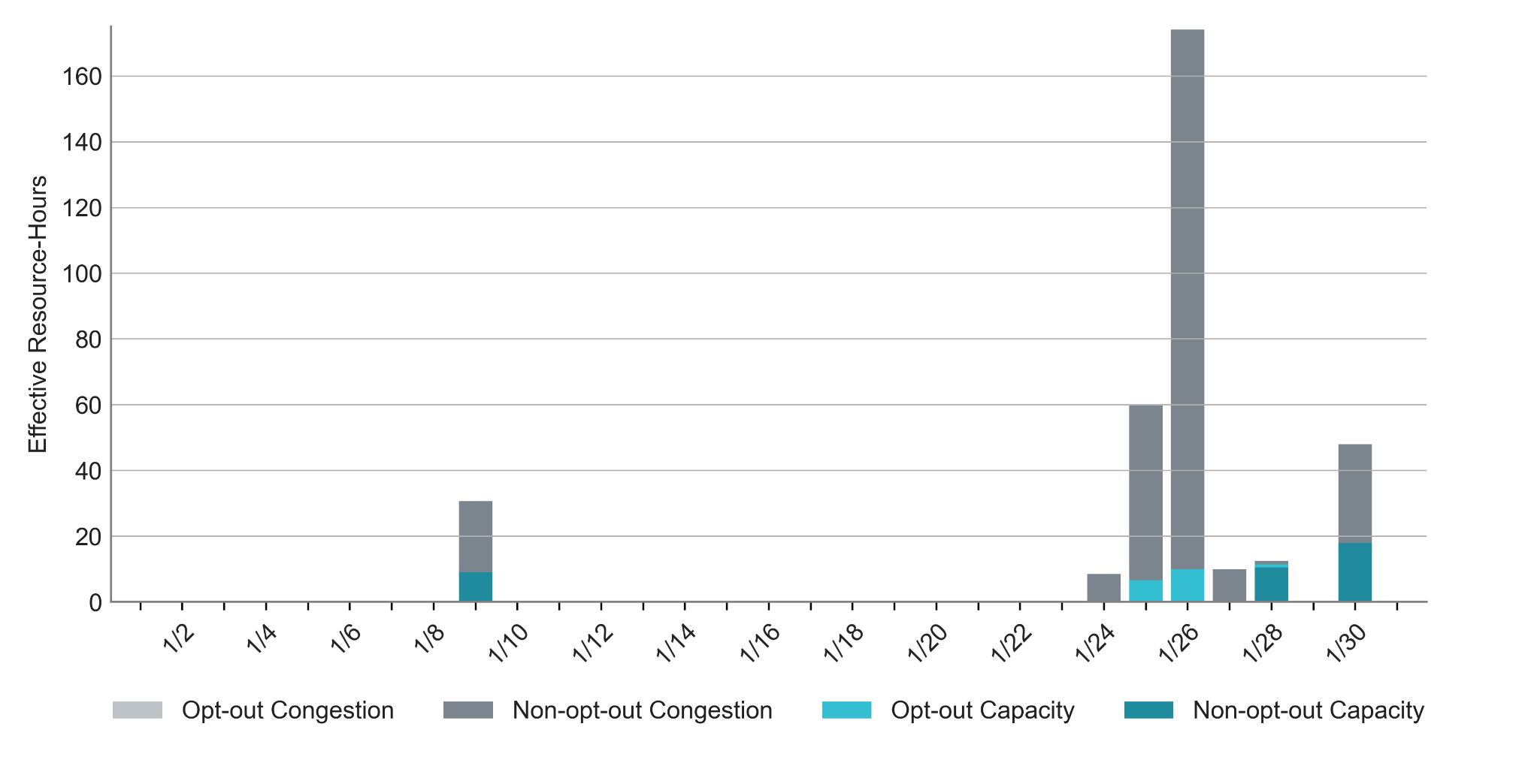
RUC Instruction Reasons in January 2026
340.4 RUC effective Resource-hours:
  285.7 hours (84%) for congestion

Slide 5
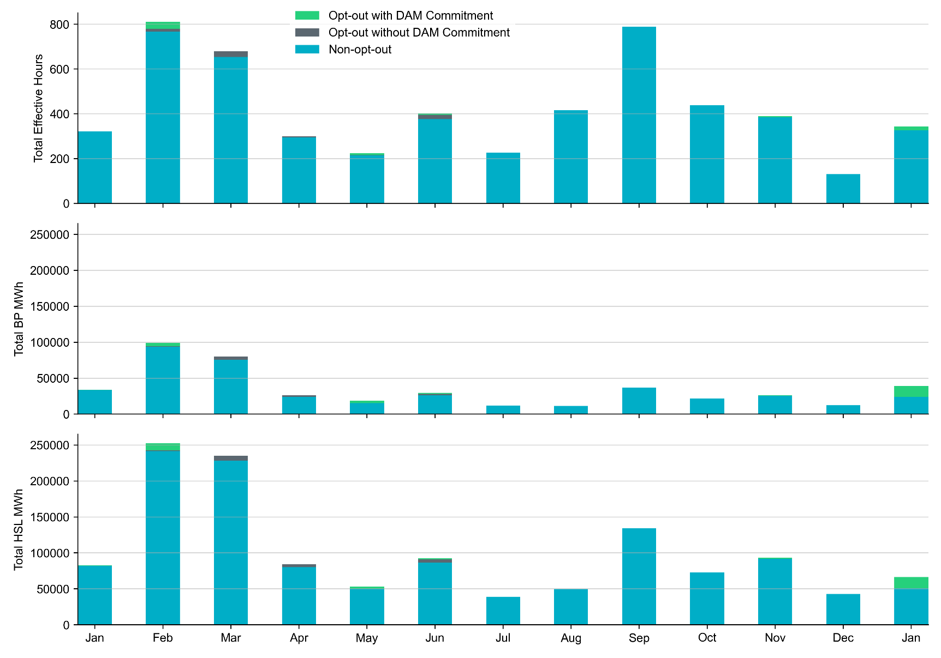
Non-opt-out and Opt-out Totals: Last 13 Months
January 2026 had a total of 323.1 non-opt-out effective resource-hours (95%) and 17.3 opt-out effective resource-hours (5%).

Slide 6
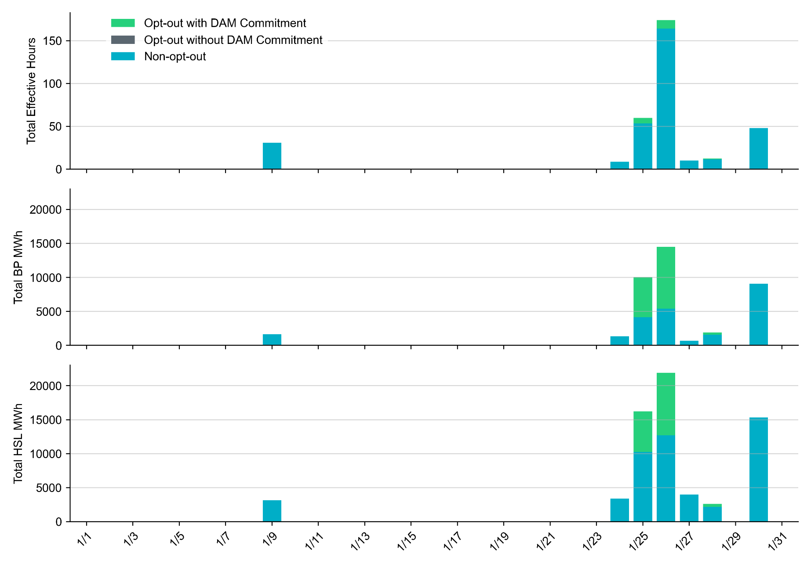
Non-opt-out and Opt-out Totals: January 2026

Slide 7
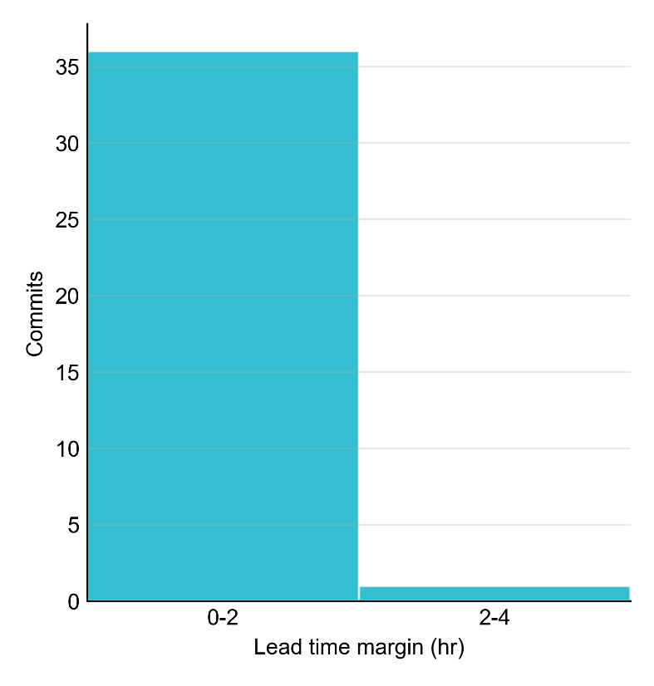
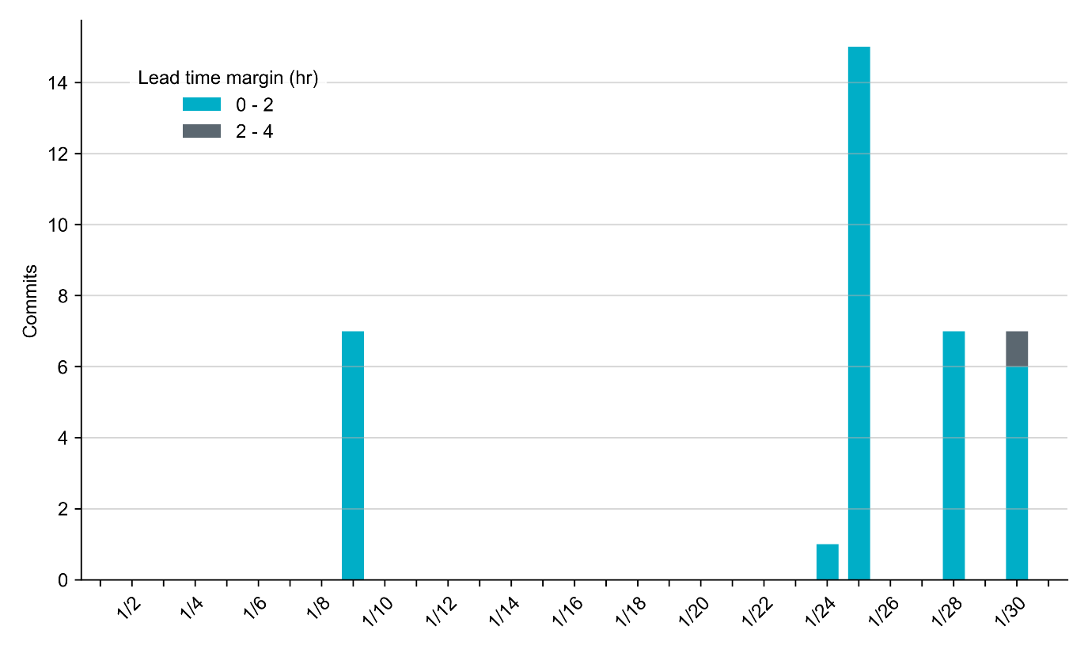
RUC Lead Time Margin: January 2026
Most RUC commitment windows (97%) had a lead time margin of 2 hours or less.
Lead time refers to the length of time between a RUC instruction and the start of the commitment window.
Lead time margin is the difference between lead time and the Resource’s startup time.
  In cases where a Resource is committed for multiple back-to-back time blocks, lead time margin is calculated from the first instruction.

Slide 8
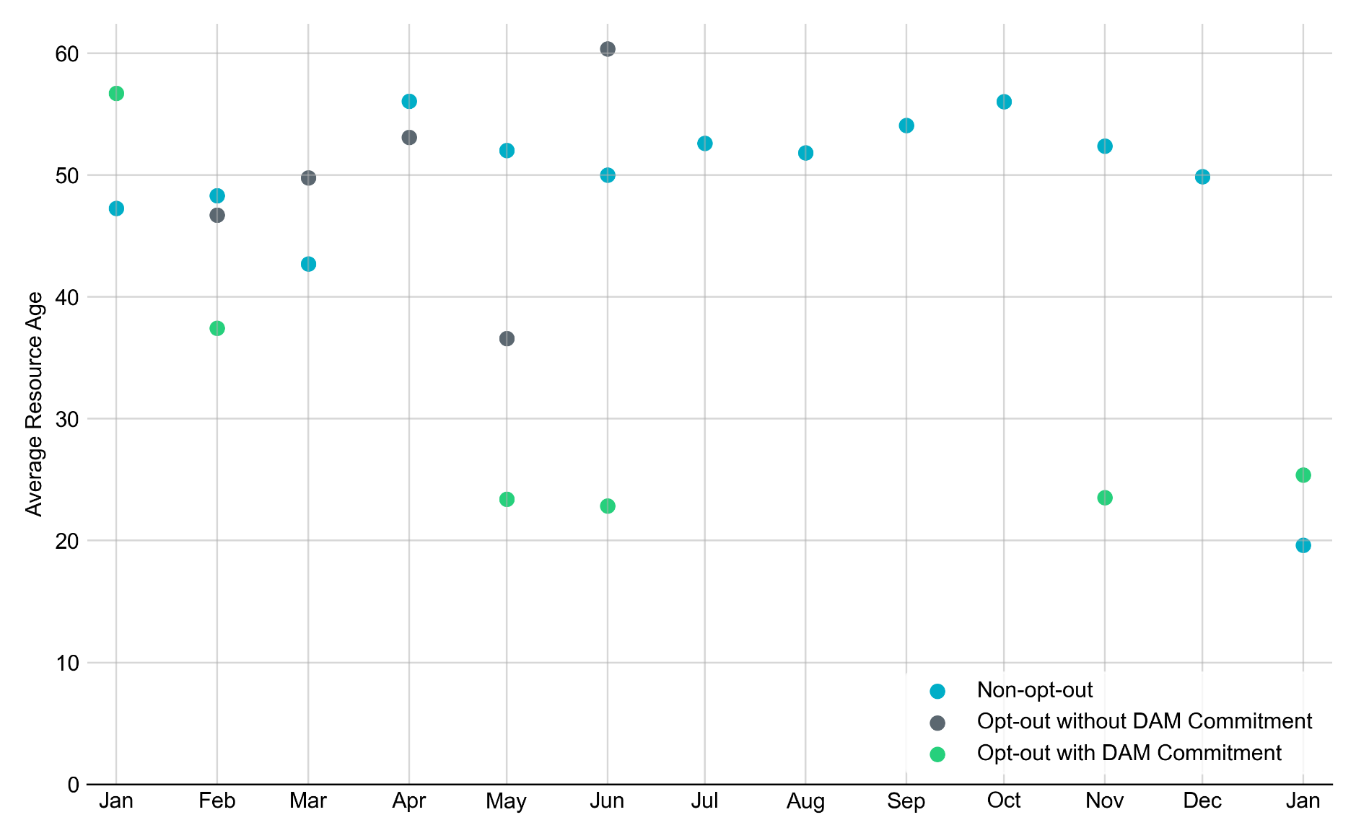
Average Resource Age: Last 13 Months
In January 2026, the average age of RUC-committed Resources was 19.6 years for Non-opt-out Resource-hours.
Note: For Resource configurations with multiple physical generators, the age of the oldest generator is used.

Slide 9
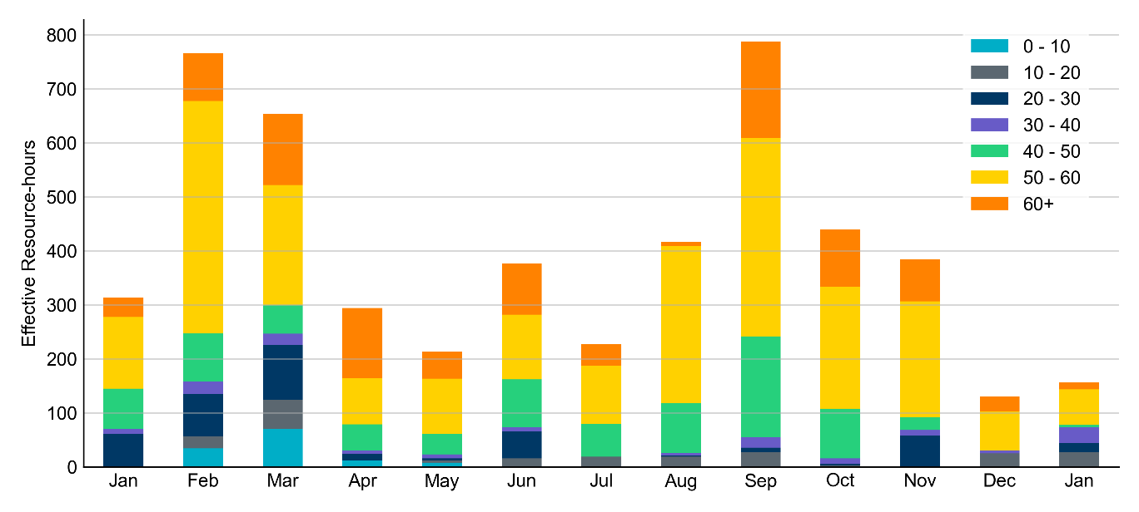
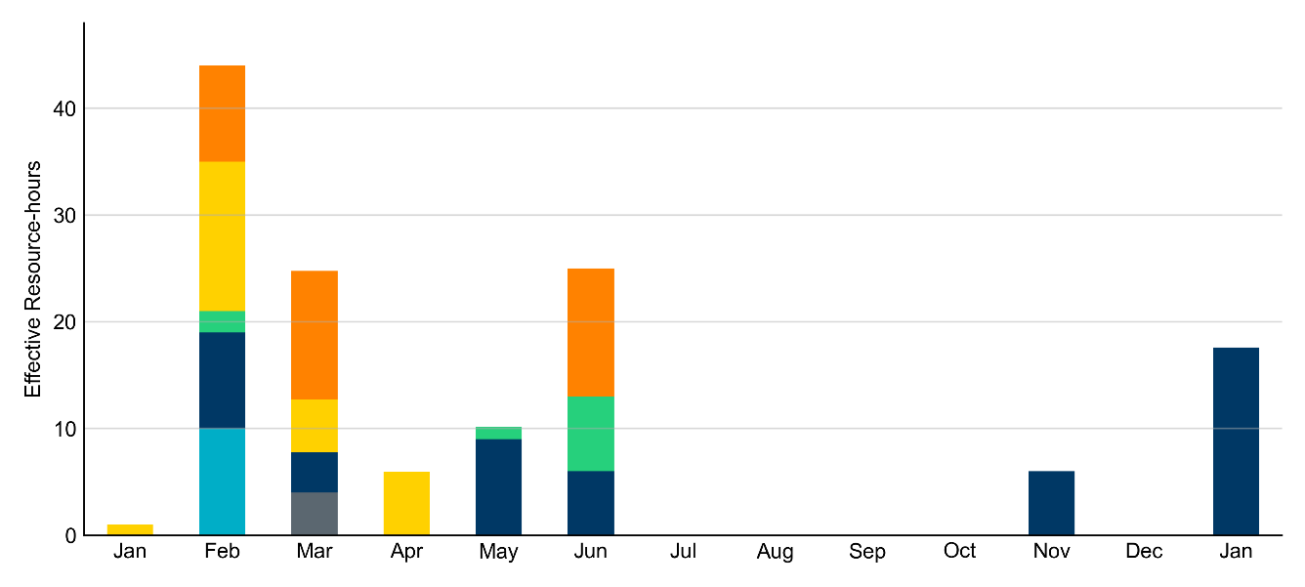
Age Category: Last 13 Months
In January 2026, 50% of RUC Effective Resource-Hours were provided by resources that were at least 50 years old.
Non-opt-out
Opt-out

Slide 10
RUC-Instructed Resource Dispatch above Low Dispatch Limit (LDL) in Non-Opt-Out Hours
Out of all 323.1 non-opt-out Effective Resource-hours, RUC-instructed Resources were dispatched above their LDL for 20.6 Resource-hours.
  In 15.6 of these Resource-hours, the Locational Marginal Price (LMP) for the RUC-instructed Resource exceeded the RUC offer floor.
  In 5.0 of these Resource-hours, the LMP for the RUC-instructed Resource fell below the RUC offer floor.
    All 5.0 Resource-hours saw the RUC-instructed Resource being mitigated.
There were no Exceptional Fuel Cost submissions for any Resources committed by RUC.

Slide 11
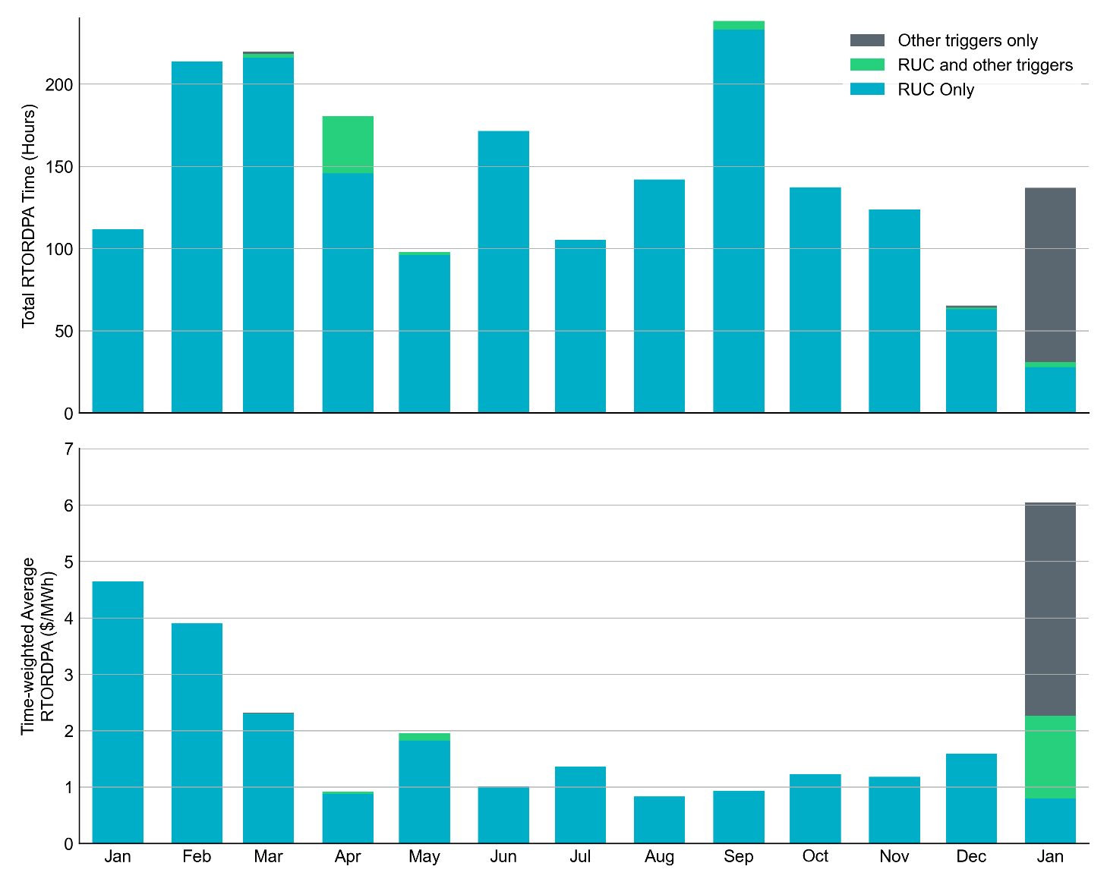
Reliability Deployment Price Adder: Last 13 Months
January 2026 had a total of 136.9 RTORDPA hours with a time-weighted average value of $6.05/MWh.
These graphs show RTORDPA instances by reliability action: 'RUC Only' for instances triggered solely by Reliability Unit Commitment, 'RUC and other triggers' for instances with RUC and additional triggers, and 'Other triggers only' for instances with non-RUC triggers. The daily average RTORDPA is calculated using the total duration across all categories. See ERCOT protocol section 6.5.7.3.1 for details.

Slide 12
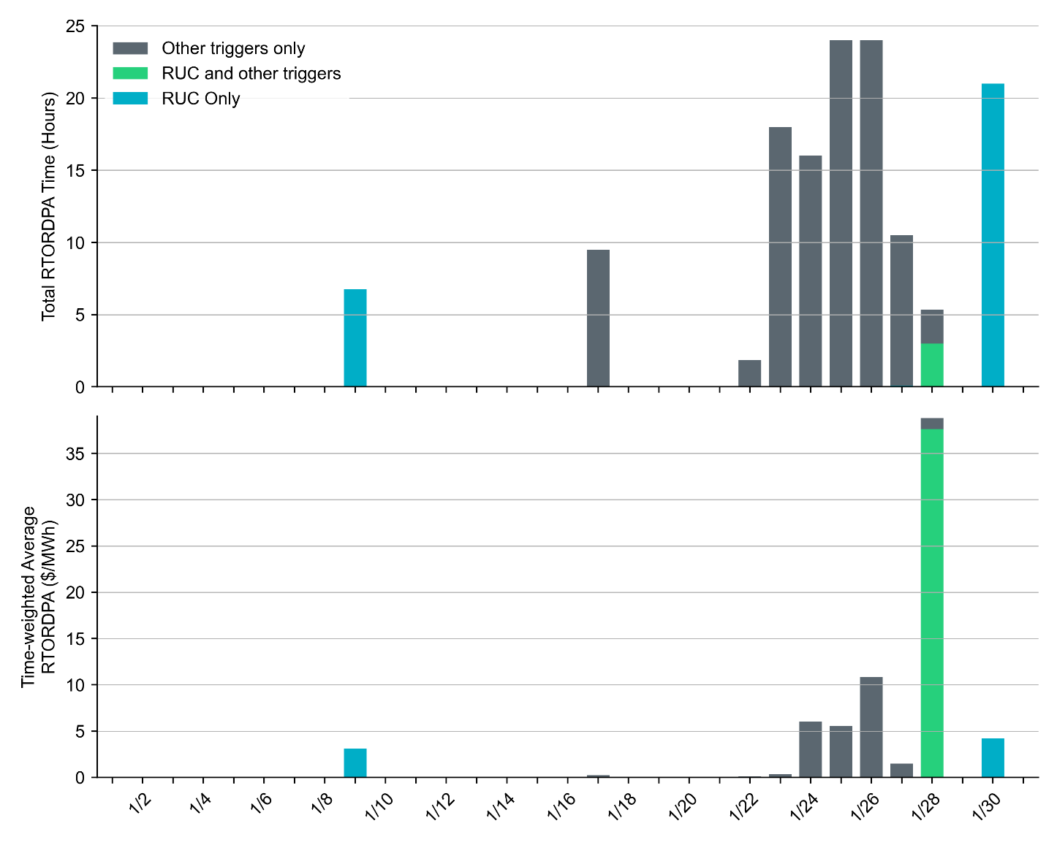
Reliability Deployment Price Adder for Energy: January 2026
OD 1/28 had the highest daily time-weighted average RTORDPA of $38.79/MWh.
These graphs show RTORDPA instances by reliability action: 'RUC Only' for instances triggered solely by Reliability Unit Commitment, 'RUC and other triggers' for instances with RUC and additional triggers, and 'Other triggers only' for instances with non-RUC triggers. The daily average RTORDPA is calculated using the total duration across all categories. See ERCOT protocol section 6.5.7.3.1 for more details.

Slide 13
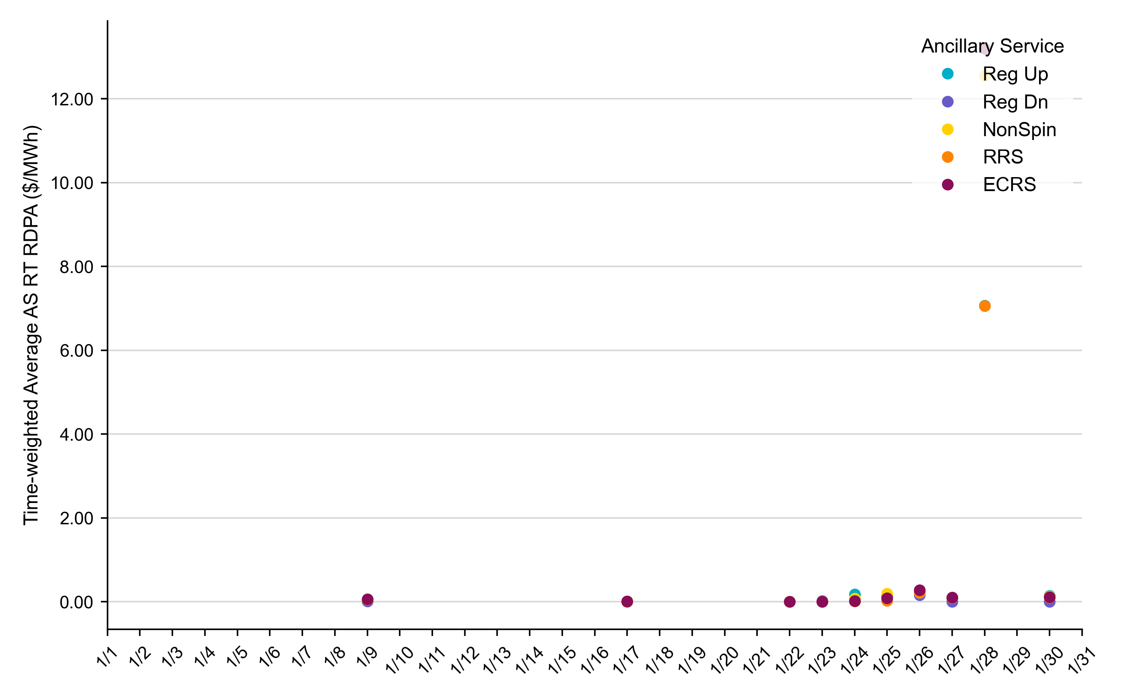
Reliability Deployment Price Adder for Ancillary Services: January 2026
OD 1/28 had the highest daily time-weighted average RT RDPA for Ancillary Services.
The daily average values are calculated as time-weighted average Real-Time Reliability Deployment Price Adders for each Ancillary Service during SCED intervals with RDPA active for any reliability event trigger.
For details on the triggers for reliability price adders, please refer to the previous slide titled “Reliability Deployment Price Adder for Energy: January 2026”

Slide 14
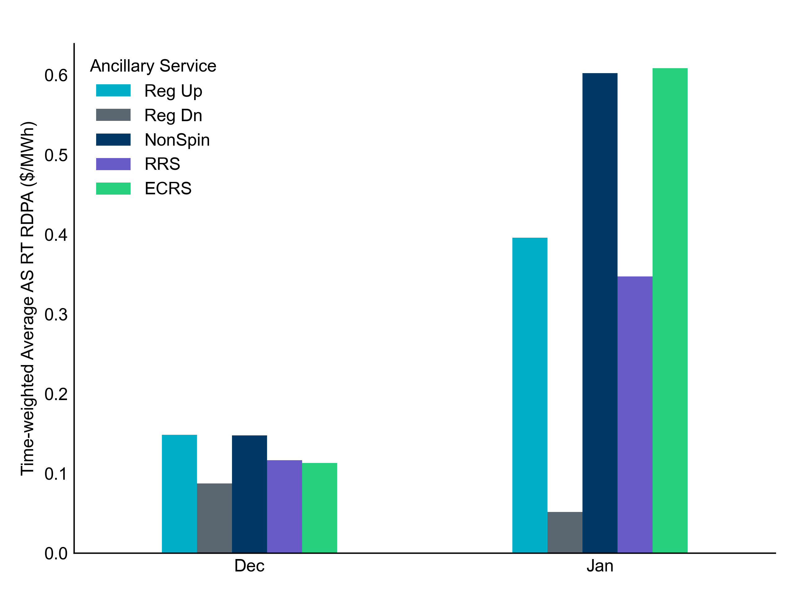
Reliability Deployment Price Adder for Ancillary Services: January 2026
OD 1/28 had the highest daily time-weighted average RT RDPA for Ancillary Services.
RDPA | Monthly Time Weighted Average ($/MWh)*
Regulation Up (Reg-Up) | 0.40
Regulation Down (Reg-Down) | 0.05
Non-Spinning Reserves (Non-Spin) | 0.60
Responsive Reserve Service (RRS) | 0.35
ERCOT Contingency Reserve Service (ECRS) | 0.61
* RDPAs for Ancillary Services are only available after RTC+B implementation on December 5, 2025
The average values are calculated as time-weighted average Real-Time Reliability Deployment Price Adders for each Ancillary Service during SCED intervals with RDPA active for any reliability event trigger.

Slide 15
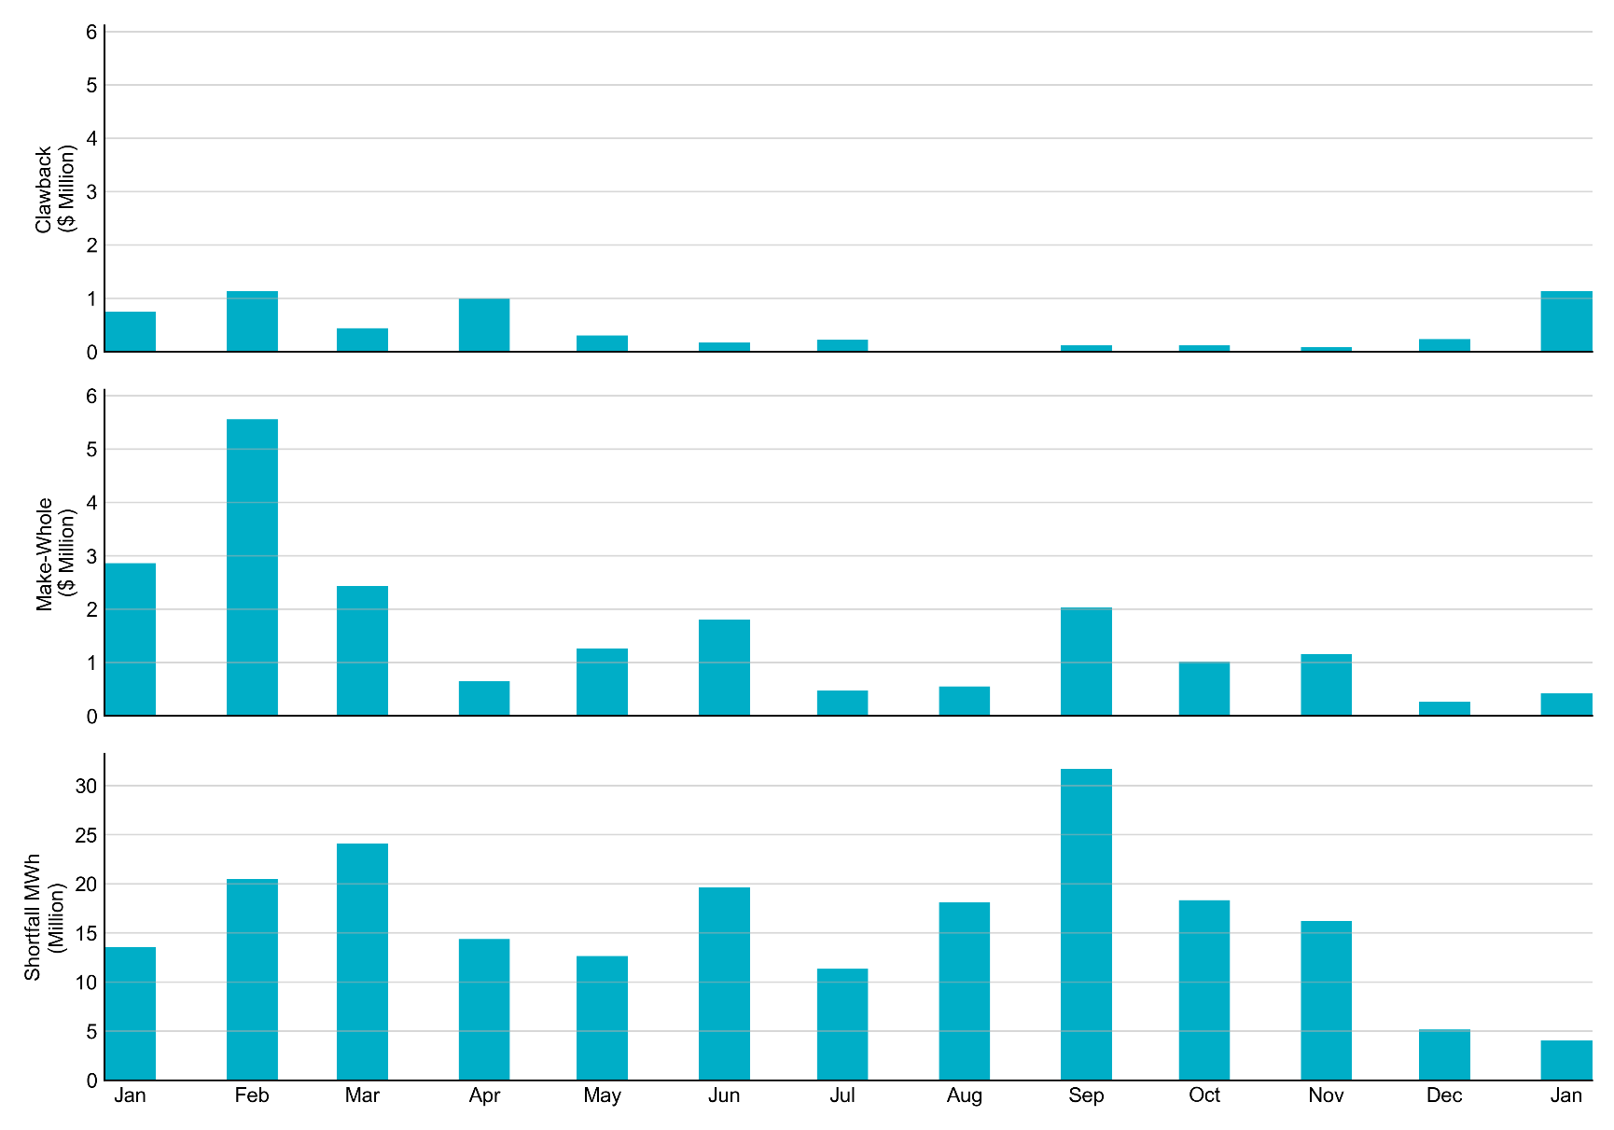
RUC Clawback, Make-Whole, and Shortfall
For January 2026, the total Clawback Charge was $1,130,396. The total Make-Whole Payment was $431,895.
Of the $431,895 in Make-Whole Payments made in January 2026, $0.51 was uplifted to load due to rounding.
The remaining amount was collected through Capacity-Short Charges.
Data as of January 9th, 2026

Slide 16
RUC Clawback by Settlement Type
Month | Initial Settlement ($) | Final Settlement Change ($) | True-up Settlement Change ($) | Net as of Jan 4, 2026 ($)
Jan ‘25 | 1,037,717 | 0 | -294,094 | 743,623
Feb ‘25 | 3,272,312 | 0 | -2,138,639 | 1,133,673
Mar ‘25 | 545,642 | 0 | -87,084 | 458,558
Apr ‘25 | 993,341 | 119 | -418,816 | 574,643
May ‘25 | 574,643 | 0 | - | -
Jun ‘25 | 173,176 | 0 | - | -
Jul ‘25 | 246,345 | 134 | - | -
Aug ‘25 | 12,319 | 0 | - | -
Sep ‘25 | 122,634 | - | - | -
Oct ‘25 | 128,343 | - | - | -
Nov ‘25 | 61,933 | - | - | -
Dec ‘25 | 233,499 | - | - | -
Jan ‘26 | 1,130,396 | - | - | -
Negative dollars represent a payment from ERCOT to a market participant
“-” indicates settlement has yet to be completed.
Net figures may differ slightly due to rounding.

Slide 17
RUC Make-Whole by Settlement Type
Month | Initial Settlement ($) | Final Settlement Change ($) | True-up Settlement Change ($) | Net as of Jan 4, 2026 ($)
Jan ‘25 | -834,867 | -80,530 | -1,947,157 | -2,862,554
Feb ‘25 | -1,198,579 | -17,762 | -4,344,131 | -5,560,472
Mar ‘25 | -1,701,707 | 0 | -111,462 | -1,813,169
Apr ‘25 | -594,864 | -3,693 | 104,830 | -493,728
May ‘25 | -493,728 | 0 | - | -
Jun ‘25 | -1,285,661 | 0 | - | -
Jul ‘25 | -382,594 | -294 | - | -
Aug ‘25 | -487,773 | 0 | - | -
Sep ‘25 | -2,035,251 | - | - | -
Oct ‘25 | -1,016,193 | - | - | -
Nov ‘25 | -1,119,452 | - | - | -
Dec ‘25 | -271,995 | - | - | -
Jan ‘26 | -431,895 | - | - | -
Negative dollars represent a payment from ERCOT to a market participant
“-” indicates settlement has yet to be completed.
Net figures may differ slightly due to rounding.

