Slide 1
Monthly Review of Reliability Unit Commitment Market Impacts – February 2026
Wholesale Market Working Group
ERCOT Market Analysis

Slide 2
RUC Resource-Hours There were no RUC effective hours in February 2026
* The difference between “Instructed” and “Effective” values is a result of Resources starting up, shutting down, receiving partial hour instructions, or otherwise not being dispatchable by SCED.

Slide 3
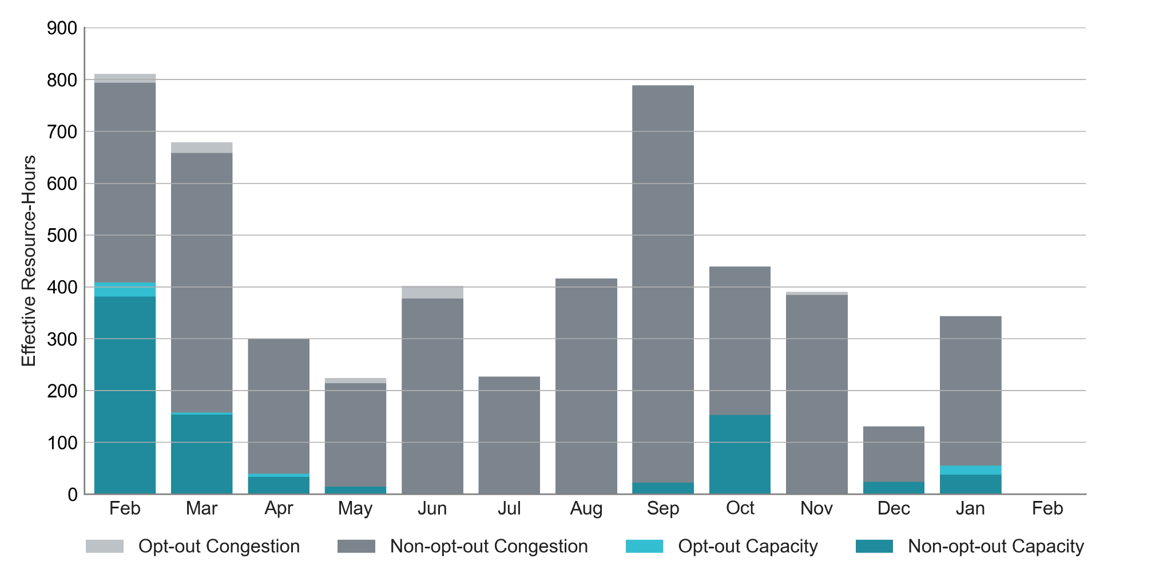
RUC Instruction Reasons: Last 13 Months There were no RUC effective hours in February 2026

Slide 4
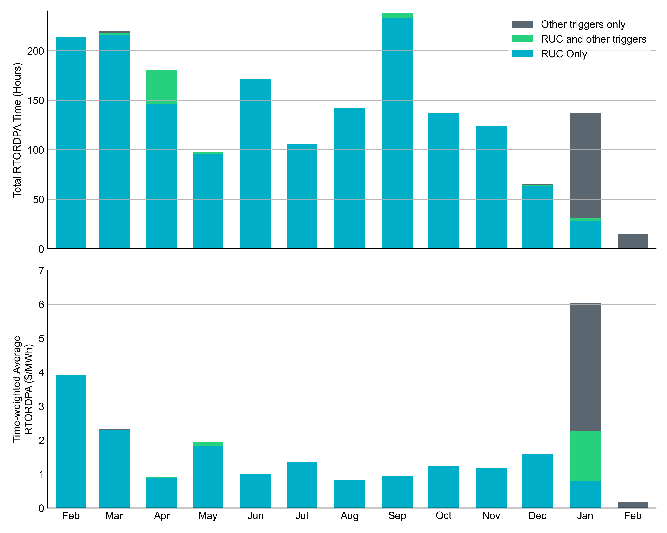
Reliability Deployment Price Adder: Last 13 Months February 2026 had a total of 17.5 RTORDPA hours with a time-weighted average value of $0.20/MWh.
These graphs show RTORDPA instances by reliability action: 'RUC Only' for instances triggered solely by Reliability Unit Commitment, 'RUC and other triggers' for instances with RUC and additional triggers, and 'Other triggers only' for instances with non-RUC triggers. The daily average RTORDPA is calculated using the total duration across all categories. See ERCOT protocol section 6.5.7.3.1 for details.

Slide 5
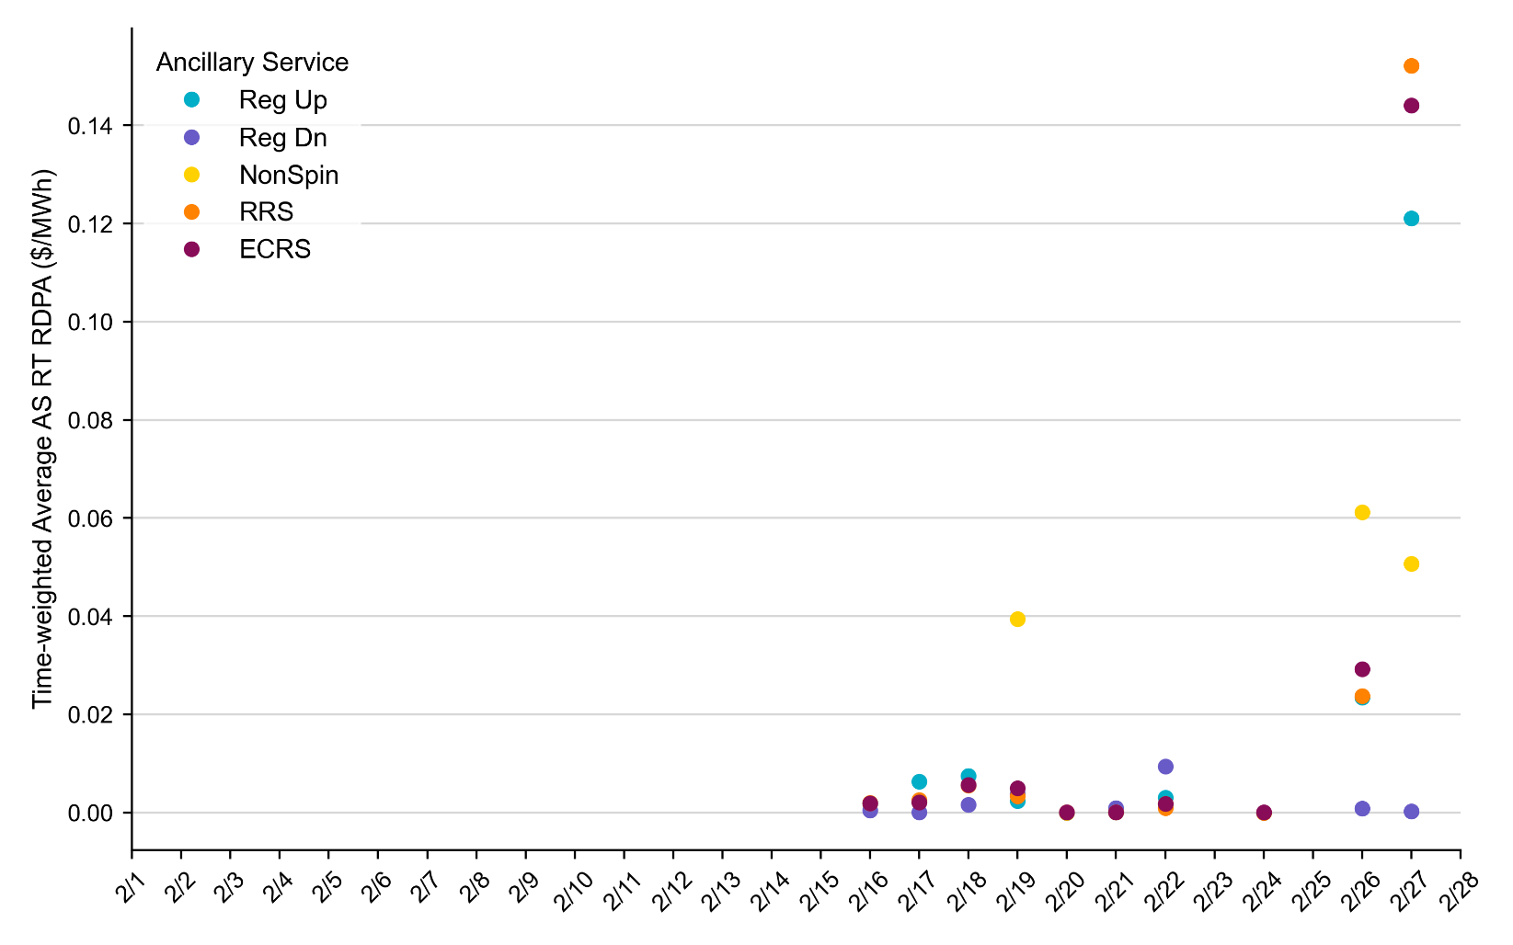
Reliability Deployment Price Adder for Ancillary Services: February 2026 OD 2/27 had the highest daily time-weighted average RT RDPA for Ancillary Services.
The daily average values are calculated as time-weighted average Real-Time Reliability Deployment Price Adders for each Ancillary Service during SCED intervals with RDPA active for any reliability event trigger.
For details on the triggers for reliability price adders, please refer to the previous slide titled “Reliability Deployment Price Adder for Energy: February 2026”

Slide 6
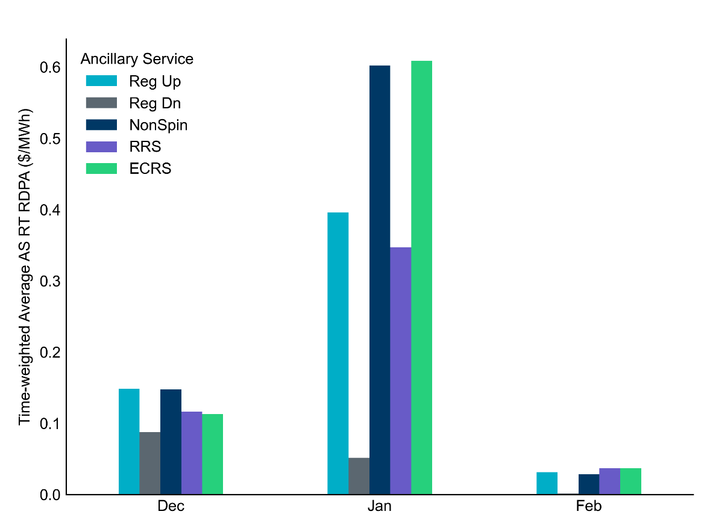
Reliability Deployment Price Adder for Ancillary Services: February 2026 OD 2/27 had the highest daily time-weighted average RT RDPA for Ancillary Services.
RDPA | Monthly Time Weighted Average ($/MWh)*
Regulation Up (Reg-Up) | 0.03
Regulation Down (Reg-Down) | 0.00
Non-Spinning Reserves (Non-Spin) | 0.03
Responsive Reserve Service (RRS) | 0.04
ERCOT Contingency Reserve Service (ECRS) | 0.04
* RDPAs for Ancillary Services are only available after RTC+B implementation on December 5, 2025
The average values are calculated as time-weighted average Real-Time Reliability Deployment Price Adders for each Ancillary Service during SCED intervals with RDPA active for any reliability event trigger.

Slide 7
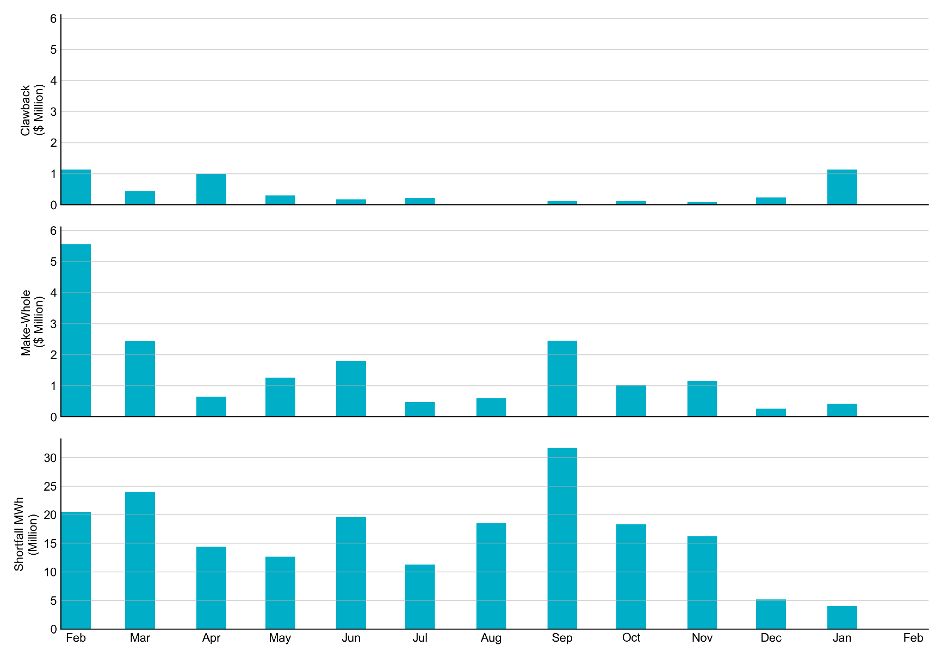
RUC Clawback, Make-Whole, and Shortfall There were no RUC effective hours in February 2026
Data as of March 9th, 2026

Slide 8
RUC Clawback by Settlement Type
Month | Initial Settlement ($) | Final Settlement Change ($) | True-up Settlement Change ($) | Net as of Jan 4, 2026 ($)
Feb ‘25 | 3,272,312 | 0 | -2,138,639 | 1,133,673
Mar ‘25 | 545,642 | 0 | -87,084 | 458,558
Apr ‘25 | 993,341 | 119 | -418,816 | 574,643
May ‘25 | 574,643 | 0 | - | -
Jun ‘25 | 173,176 | 0 | - | -
Jul ‘25 | 246,345 | 134 | - | -
Aug ‘25 | 12,319 | 0 | - | -
Sep ‘25 | 122,634 | - | - | -
Oct ‘25 | 128,343 | - | - | -
Nov ‘25 | 61,933 | - | - | -
Dec ‘25 | 233,499 | - | - | -
Jan ‘26 | 1,130,396 | - | - | -
Feb ‘26 | 0 | - | - | -
Negative dollars represent a payment from ERCOT to a market participant
“-” indicates settlement has yet to be completed.
Net figures may differ slightly due to rounding.

Slide 9
RUC Make-Whole by Settlement Type
Month | Initial Settlement ($) | Final Settlement Change ($) | True-up Settlement Change ($) | Net as of Jan 4, 2026 ($)
Feb ‘25 | -1,198,579 | -17,762 | -4,344,131 | -5,560,472
Mar ‘25 | -1,701,707 | 0 | -111,462 | -1,813,169
Apr ‘25 | -594,864 | -3,693 | 104,830 | -493,728
May ‘25 | -493,728 | 0 | - | -
Jun ‘25 | -1,285,661 | 0 | - | -
Jul ‘25 | -382,594 | -294 | - | -
Aug ‘25 | -487,773 | 0 | - | -
Sep ‘25 | -2,035,251 | - | - | -
Oct ‘25 | -1,016,193 | - | - | -
Nov ‘25 | -1,119,452 | - | - | -
Dec ‘25 | -271,995 | - | - | -
Jan ‘26 | -431,895 | - | - | -
Feb ‘26 | 0 | - | - | -
Negative dollars represent a payment from ERCOT to a market participant
“-” indicates settlement has yet to be completed.
Net figures may differ slightly due to rounding.

