Slide 1
Item 4: OBDRR055 - Revisions to Non-Spinning Reserve Deployment and Recall Procedure for RTC+B Luis Hinojosa Manager, Ancillary Services & Operations Analytics WMWG March 23, 2026
Purpose
Provide an update on OBDRR055 and previous discussions
Review key changes to the procedure
Discuss additional market feedback
Key Takeaways
The OBDRR aligns the procedure with ERCOT market rules with implementation of RTC+B and enhances the trigger for offline Non-Spin
The OBDRR055 is up for a possible vote at the upcoming March 25th, 2026 TAC meeting
ERCOT intends to have this OBDRR approved for Summer 2026

Slide 2
OBDRR055 Overview
ERCOT has submitted OBDRR055 to reflect these key changes:
Remove outdated references of Ancillary Service Responsibility and Schedules, telemetered schedule performance monitoring, HASL calculation, Non-Spin deployment grouping, online Generation Resource sand Controllable Load Resources
Add in references for RTC+B AS Awards
Enhance the offline Non-Spin deployment trigger
ERCOT previously presented at RTCBTF on 12/15/2025, and 1/20/2025, PDCWG on 2/18/2026, and TAC on 2/25/2026. TAC tabled to allow additional discussion with WMS on 03/04/2026 and WMWG in March. Proposed changes were needed to align the procedure with ERCOT market rules that are now effective post implementation of RTC+B. This OBDRR also enhances the trigger calculation that is used to recommend deployment of offline Non-Spin such that it takes the available energy into account when assessing capability to meet the 30-minute out forecasted Load.
At WMS, ERCOT discussed stakeholder feedback and ERCOT agreed to make those changes, and we filed comments on 03/11/2026.
ERCOT has shared and discussed the OBDRR and changes needed with the market and has worked to incorporate market feedback.

Slide 3
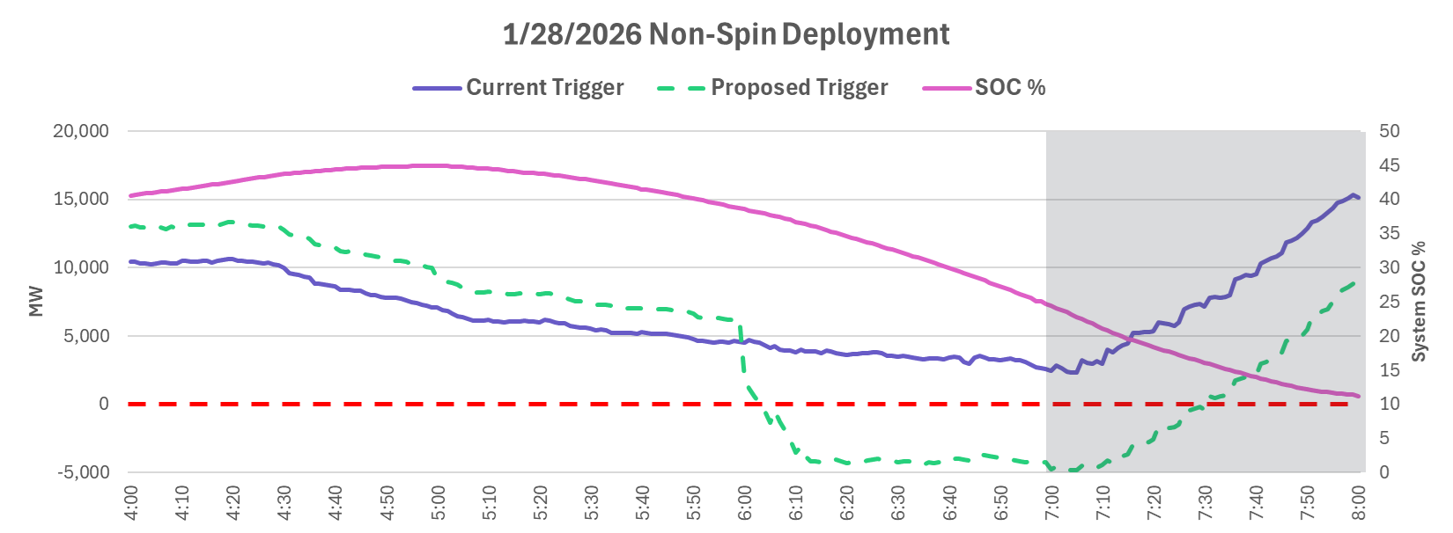
Impact on offline Non-Spin Deployment for 1/28/2026
The trigger for deploying offline NSRS used on 1/28 (purple) did not indicate a need to deploy offline Non-spin.
ERCOT Operators, using awareness of tight system conditions, deployed offline Non-Spin at 06:58. Maximum of 3,410 MW deployed during this period.
ERCOT has recognized this trigger needs to be modified to account for RTCB going short on the AS plan and to be SOC (pink) aware.
ERCOT has submitted OBDRR055 to update the Non-Spinning Reserve Deployment and Recall Procedure to align with RTCB and propose trigger (green) enhancements. The proposed trigger suggests a deployment at ~06:00 due to AS Plan shortfall, dwindling ESR capability, and increased Non-Spin not covered by thermal Resources.
Shaded area represents offline Non-Spin Deployment

Slide 4
Summary and Next Steps
ERCOT’s requests that OBDRR055 be put on a timeline so that it can be approved for Summer 2026 (endorsement at Mar TAC will help achieve this).
ERCOT has submitted comments on March 11, 2026 to update the trigger in OBDRR055 based on pervious market discussions.
ERCOT requests that any further feedback or comments be shared with JoseLuis.Hinojosa@ercot.com or filed as soon as practicable so that we can continue moving this OBDRR forward.

Slide 5
Questions?

