Slide 1
Regulation Bias Analysis Post RTC
February 2026
ERCOT
Operations Planning
PDCWG | March 16th, 2026

Slide 2
Discussion Points
PDCWG Regulation Report post RTC
Current GTBD Parameters & References
Metric to measure Regulation bias and performance
Wind and Solar Ramp Rate MAE
Regulation Deployed Comparison (yearly/monthly)
Regulation bias for consecutive 5-min SCED intervals
Time Error and Accumulation
Profiles
Questions

Slide 3
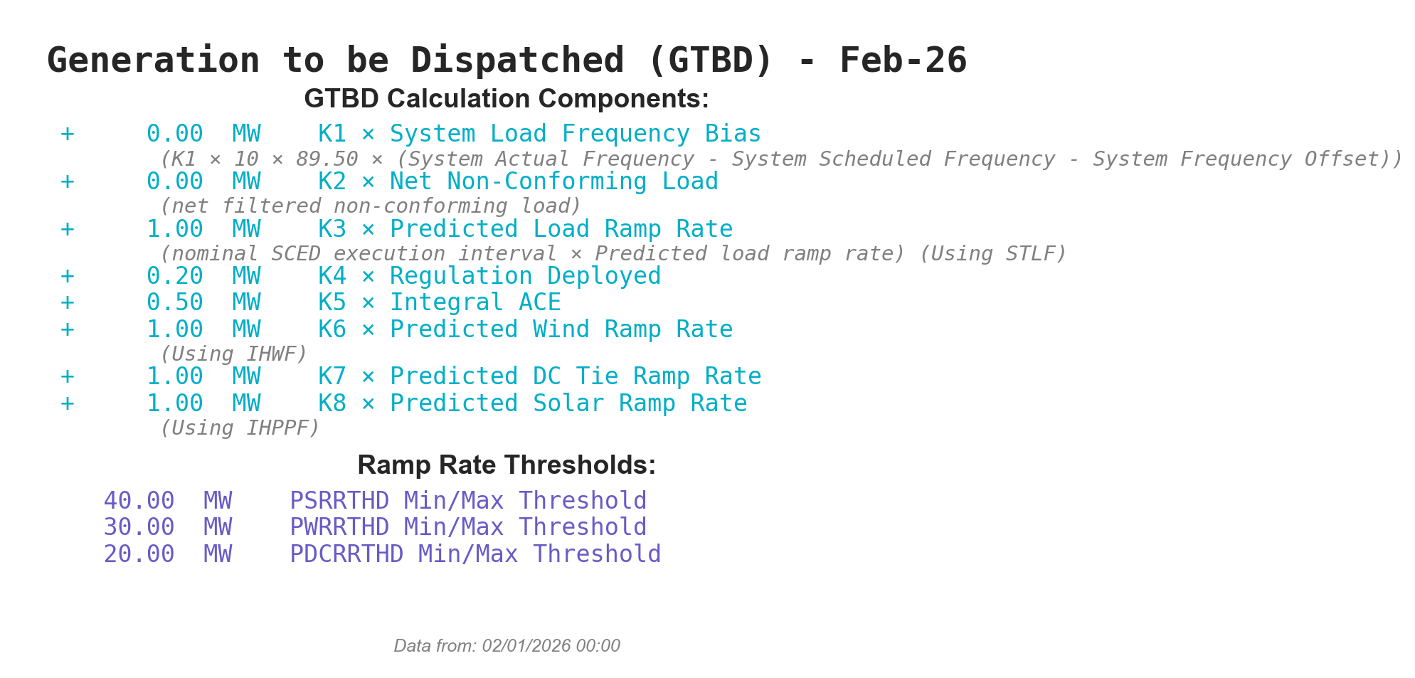
Current GTBD Parameters
Notes:
3/12/18 – Integral ACE Time Constant Changed from 60 min to 45 min
5/17/18 – K4 Changed from 0.3 to 0.2 and K5 Changed from 0.4 to 0.5
12/4/18 – 10:05 AM – K6 Changed from 0 to 0.5
2/12/19 – 2:15 PM – K6 changed from 0.5 to 1.0
3/12/19 – 2:10 PM – PWRR Threshold from 10 to 15 MW/min
3/19/19 – 2:15 PM – PWRR Threshold from 15 to 20 MW/min
4/01/19 – 10:00 AM – K5 changed from 0.5 to 0.4 and Max. Integral ACE Feedback changed from 250 to 150
4/24/19 – 1:15 PM – Max. Integral ACE Feedback changed from 150 to 160. PWRR Threshold changed from 20 to 25.
5/22/19 – 1:10 PM – K5 changed from 0.4 to 0.5, Max Integral ACE feedback changed from 160 to 200, PWRR Threshold changed from 25 to 30
6/17/20 – 10 AM - PWRR Calculation method changed from Direct to Interpolated
9/1/20 – 11 AM - Max Integral ACE Feedback changed from 200 to 250
9/3/20 – 3 PM - Max Integral ACE Feedback changed from 250 to 300
9/4/20 – 3 PM - Max Integral ACE Feedback changed from 300 to 250
6/1/21 – 10:00 AM – K8 Changed from 0 to 0.5, PSRR Threshold changed to 10
6/2/21 – 10:00 AM – PSRR Threshold changed from 10 to 20
6/3/21 – 10:00 AM – K8 Changed from 0.5 to 0.75
6/4/21 – 10:00 AM – K8 Changed from 0.75 to 1
9/2/21 – 10:00 AM – PSRR Threshold changed to 30
6/7/22 – 10:30 AM – K7 Changed from 0 to 0.5, PDCTRR Min/Max Threshold changed to 10 MW/min
6/8/22 – 10:30 AM – PDCTRR Min/Max Threshold changed from 10 to 20 MW/min
6/9/22 – 10:30 AM – K7 Changed from 0.5 to 0.75
6/10/22 – 10:30 AM – K7 Changed from 0.07 to 1.0
7/21/22 – 10:00 AM–Max Integral ACE Feedback changed from 250 to 350
7/21/22 – 05:10 PM – K5 Changed from 0.5 to 1
7/22/22 – 09:40 PM – K5 Changed from 1 to 0.5
7/27/22 – 08:40 AM – PSRR Threshold changed to 40 MW/min
6/12/23 - PSRR dynamic threshold enabled. The Max PSSR started at 80 MW/min for sunrise and sunset hours
6/15/23 – The Max PSRR threshold increased to 100 MW/min for sunrise and sunset hours
10/26/23 – Max Integral ACE Feedback changed from 350 to 250
3/7/24 – PSRR threshold increased from 100 MW/Min to 120 MW/Min
05/30/24 – Max Integral ACE Feedback changed from 250 MW to 350 MW
8/28/24 – PSS Dynamic Threshold changed from 120 MW/Min – 180 MW/Min
10/31/24– K5 changed to 0.5 to 1 to correct the time error
11/1/24 - K5 changed from 1 to 0.75
11/5/24 – K5 changed from 0.75 to 0.5
11/18/24 – K5 changed from 0.5 to 0.75
11/22/24 – K5 changed from 0.75 to 0.5
3/5/25 – K5 changed from 0.5 to 0.75
3/6/25 – K5 changed from 0.75 to 1
3/7/25 – Max Ace Integral Feedback changed from 350 MW to 400 MW
3/7/25 – PSRR Dynamic Threshold for sunrise and sunset changed from 180 MW/Min to 225 MW/Min
3/11/25 – Max Ace Integral Feedback changed from 400 MW to 350 MW
3/12/25 – K5 changed from 1 to 0.5
6/6/25 – K5 changed from 0.5 to 0.75
6/13/25 – K5 changes from 0.75 to 0.5

Slide 4
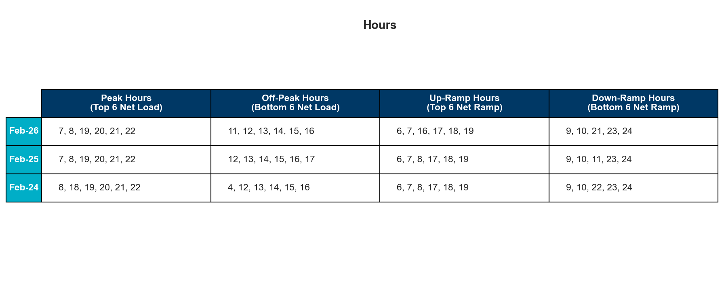
References
Notes:
Reference Hours

Slide 5
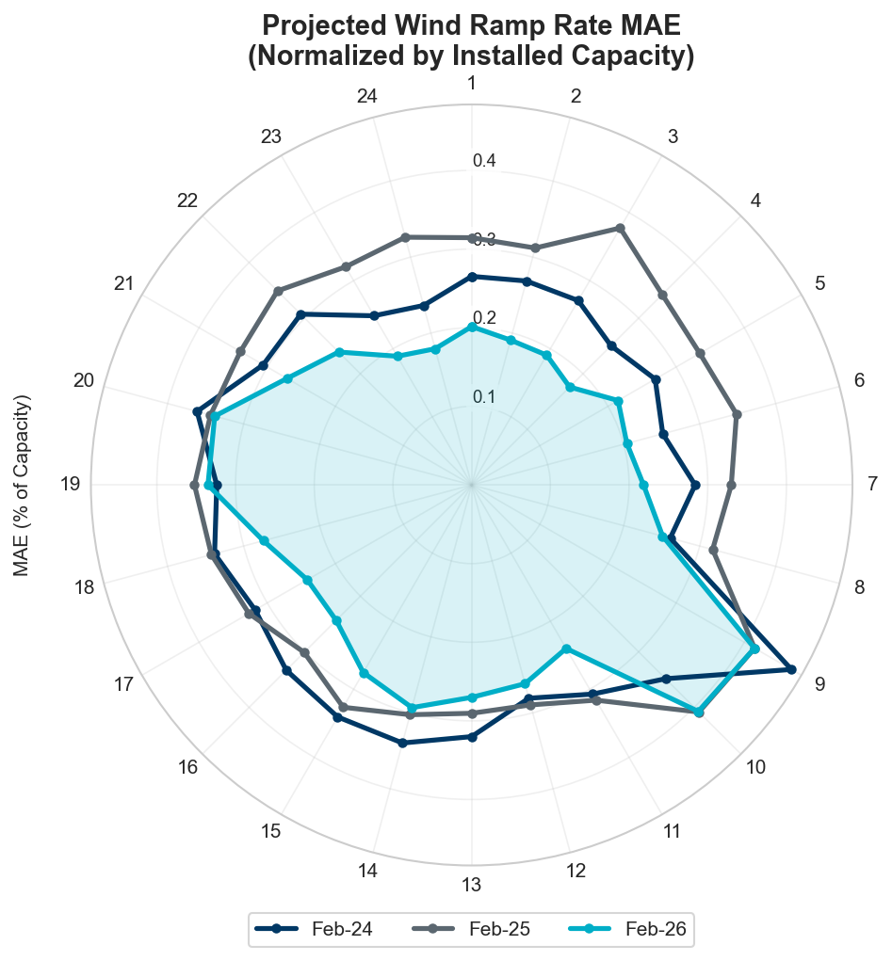
Projected Wind Ramp Rate MAE
Notes:
For intra-hour wind ramp forecast, SCED PWRR MAE is smaller than the Persistence forecast with more errors occur during ramping hours.

Slide 6
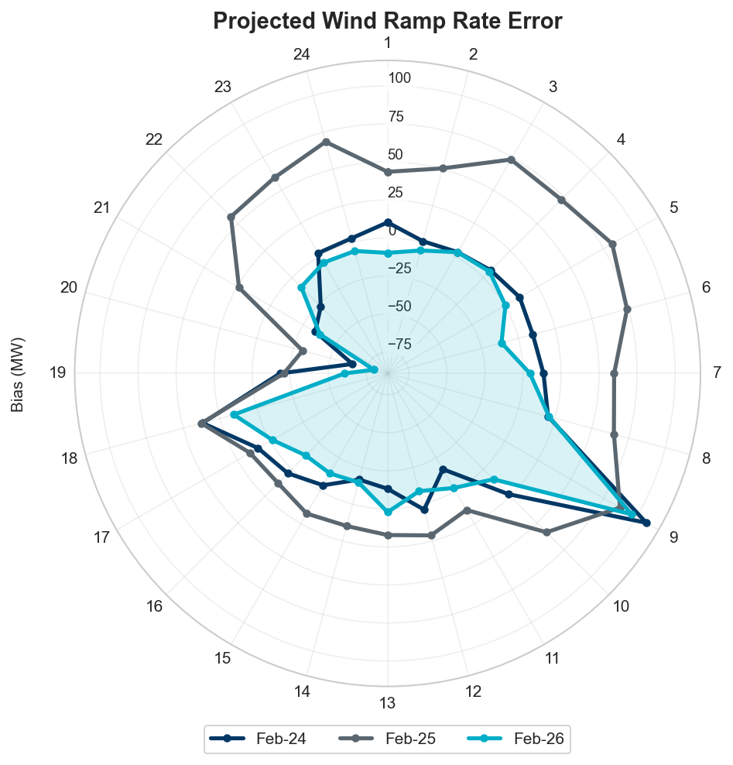
Projected Wind Ramp Rate Error
Notes:
More errors during ramping hours

Slide 7
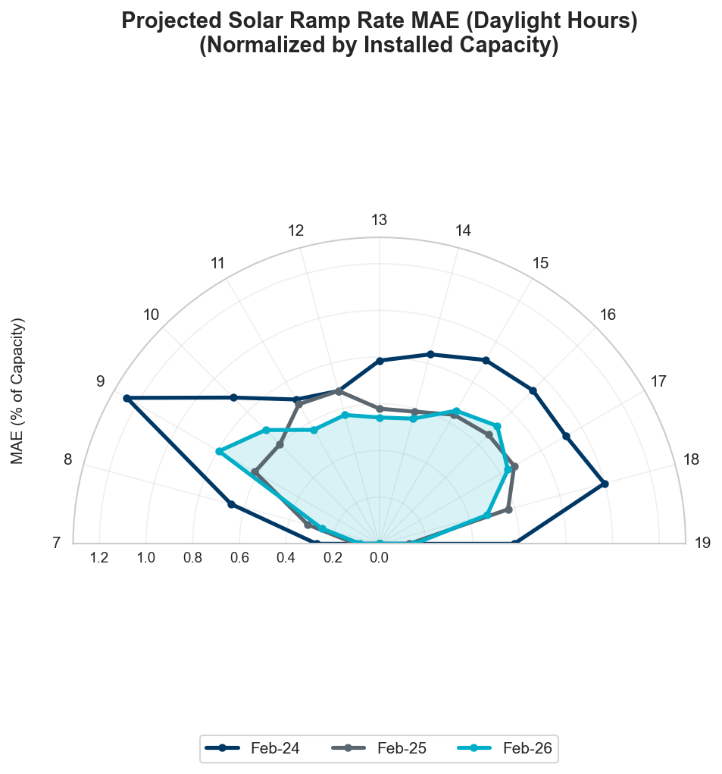
Projected Solar Ramp Rate MAE
Notes:
For intra-hour solar ramp forecast, SCED PSRR is generally performing better when compared to the persistence forecast, particularly during the most significant solar ramp hours.

Slide 8
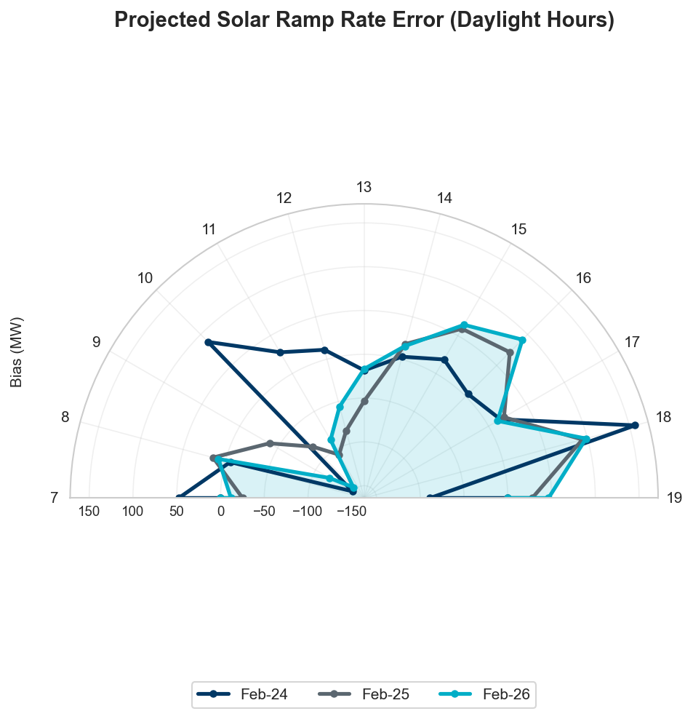
Projected Solar Ramp Rate Error
Notes:
Similar to wind, generally we see greater forecast errors during ramping periods.

Slide 9
Total Regulation Deployed Comparisons

Slide 10
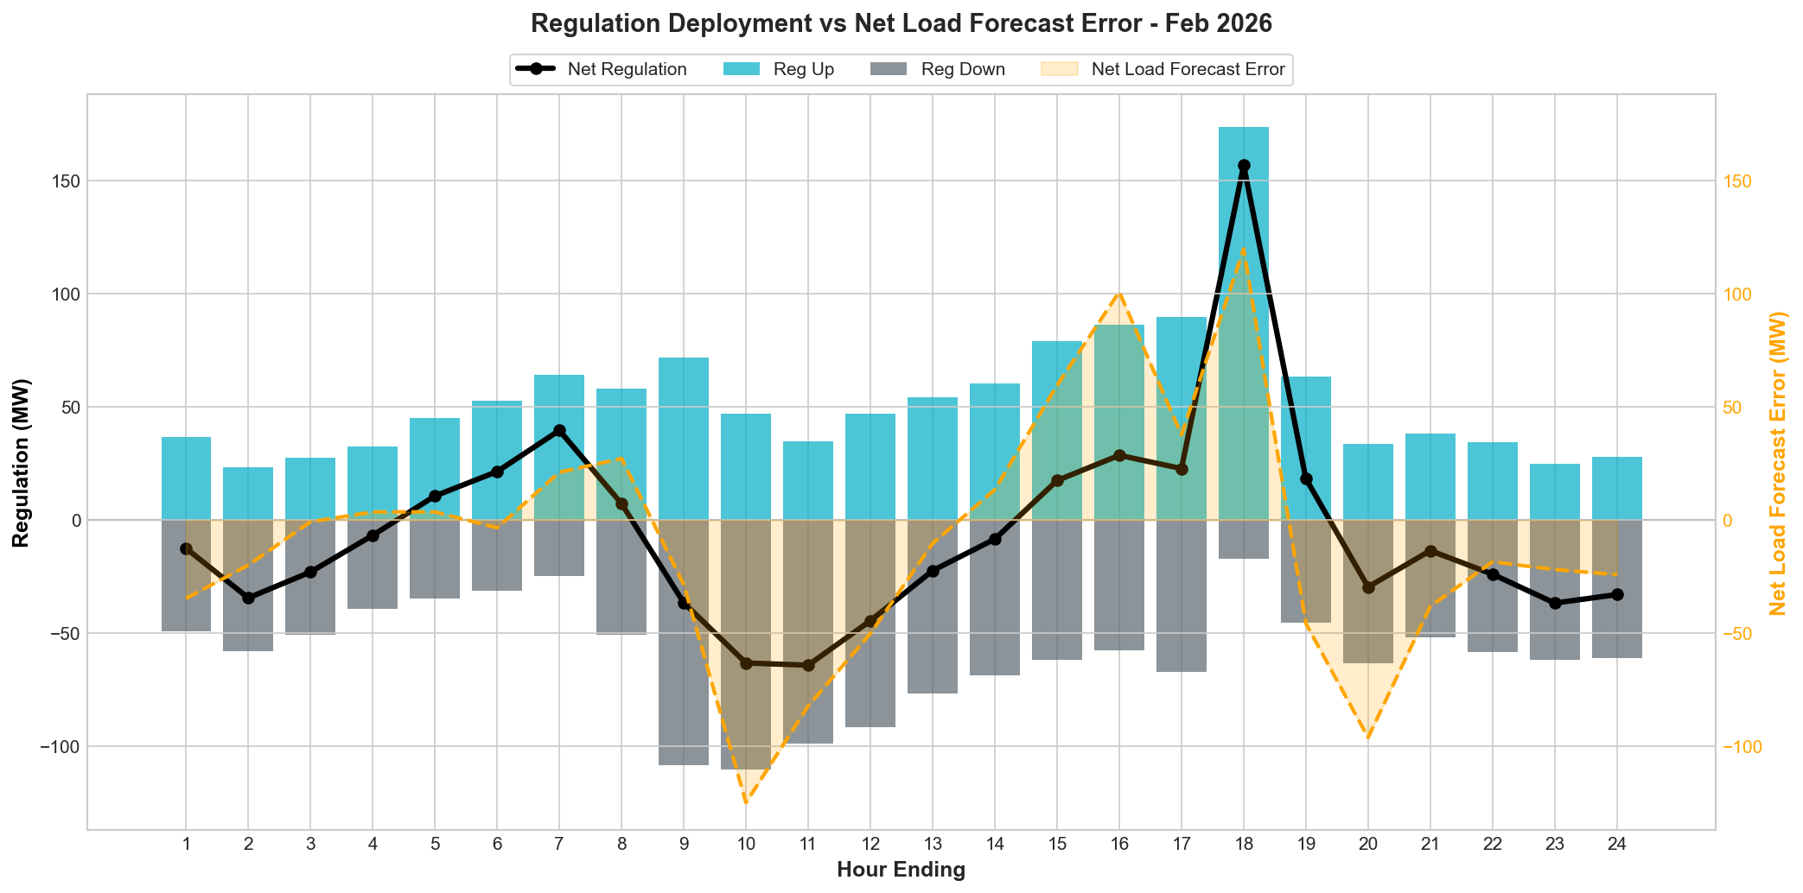
Total Regulation Deployed Comparison
Notes:
Total regulation deployed compared with the previous two years.

Slide 11
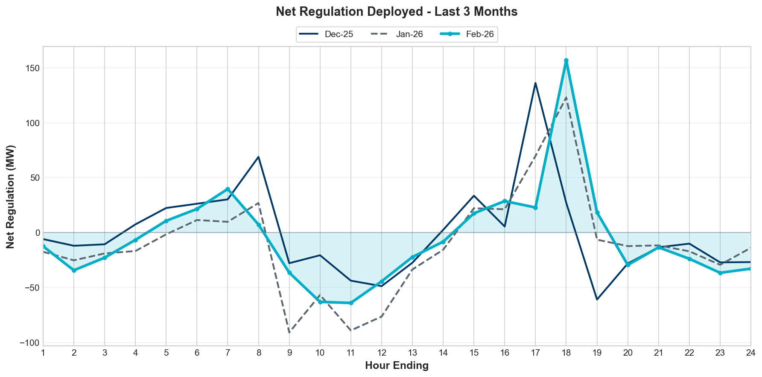
Regulation Deployed Comparison - Monthly
Notes:
Total regulation deployed compared with the previous two years.

Slide 12
REG Bias for Consecutive 5-min Intervals

Slide 13
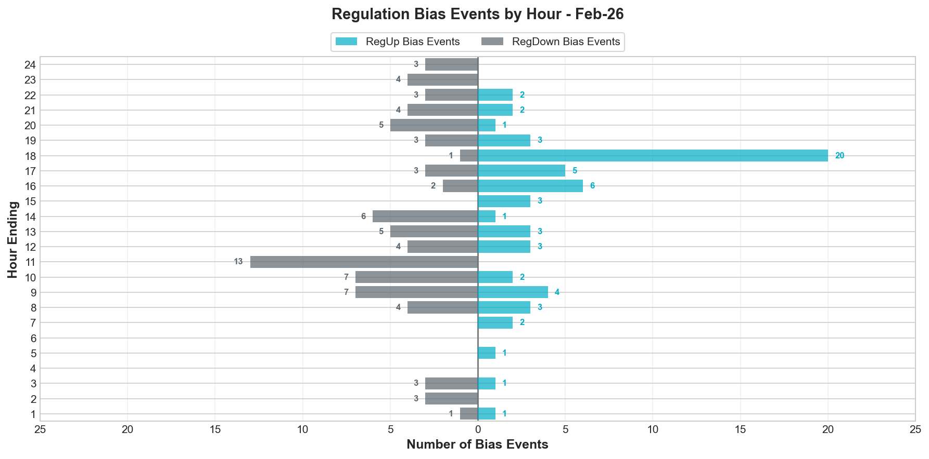

Regulation Bias for Consecutive SCED Intervals
Notes:
Regulation up bias occurrence for consecutive SCED intervals for all hours is 136 and peak hours is 48.

Slide 14
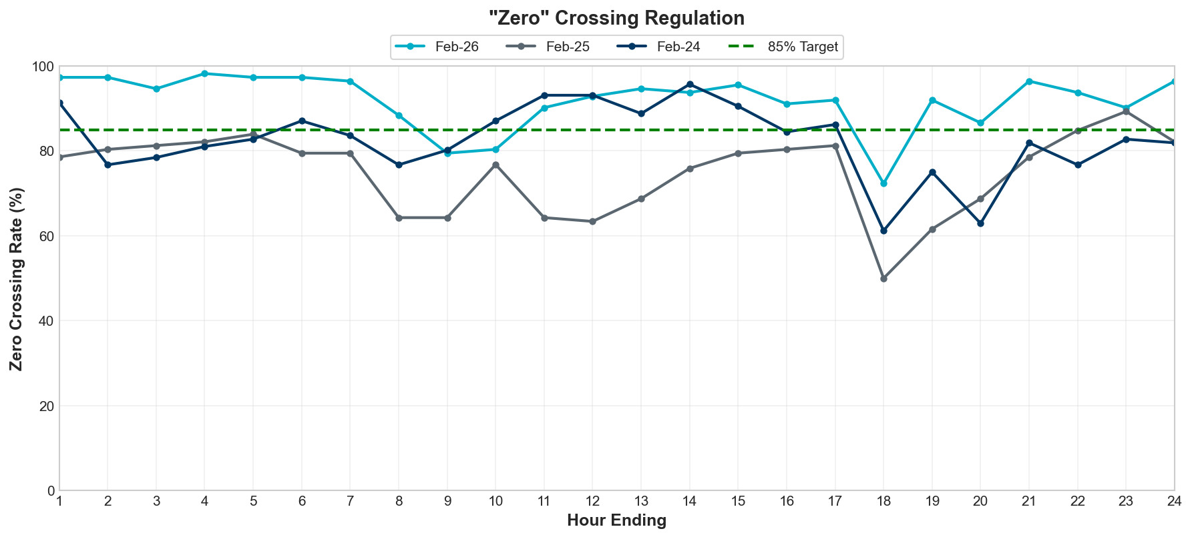
Zero-Crossing

Slide 15
Time Error and Contributing Factors
Accumulated Time Error, Load, Wind Ramp, Solar Ramp, Start-Up/Shut-Down Hours, STLF Error and NSLL Ramping.

Slide 16
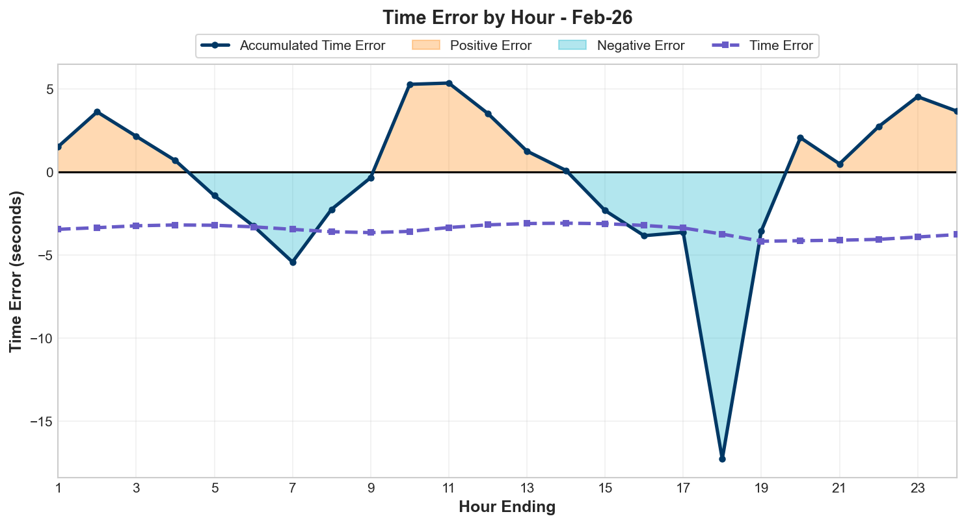
Time Error Accumulation

Slide 17
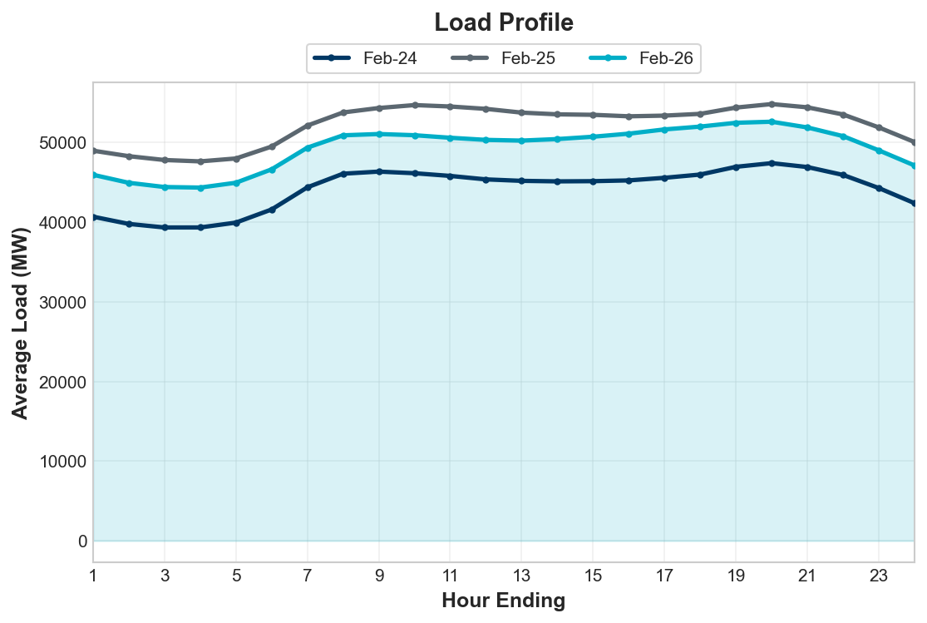
Load Profile
Notes:
Load is seeing an overall increase compared to the last two years.

Slide 18
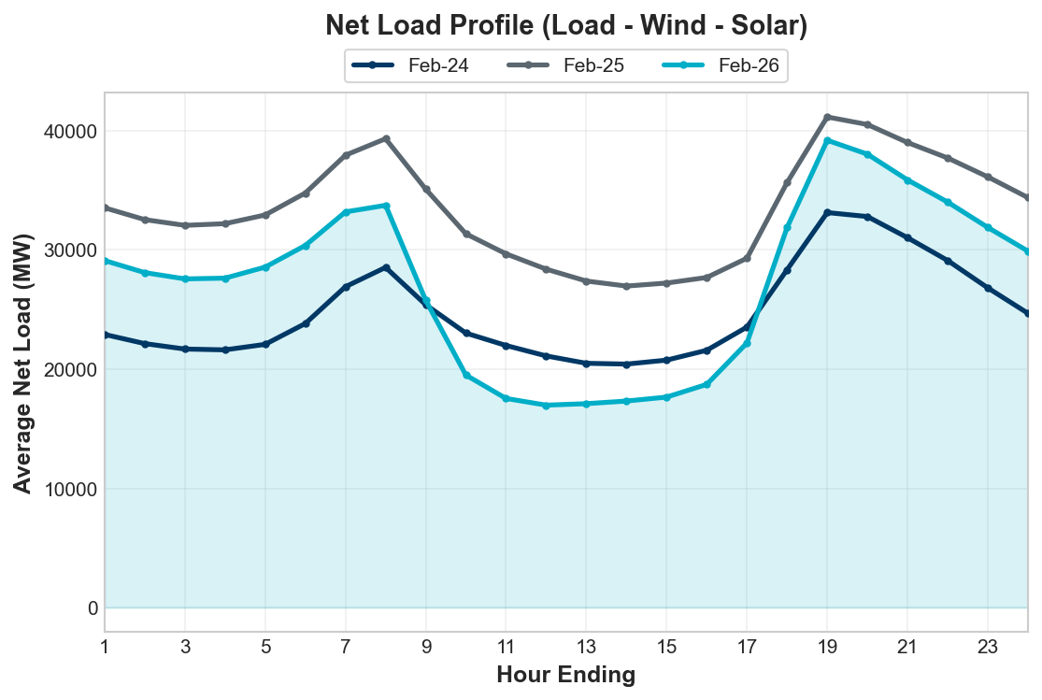
Net Load Profile
Notes:
The total load is more than the last year.
More Net Load during Up ramp hours.
Net Load: dashed line.

Slide 19
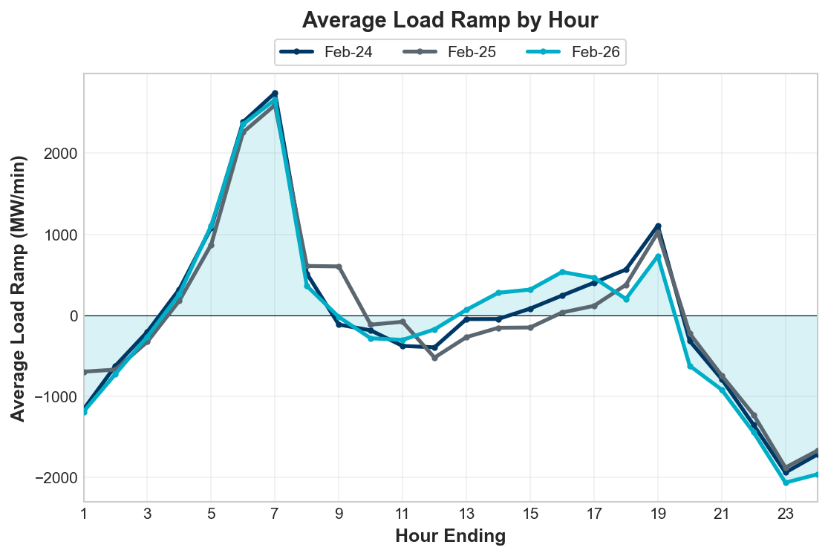
Load Ramp
Notes:
Overall hourly load ramp trend remained similar compared to the last couple of years.

Slide 20
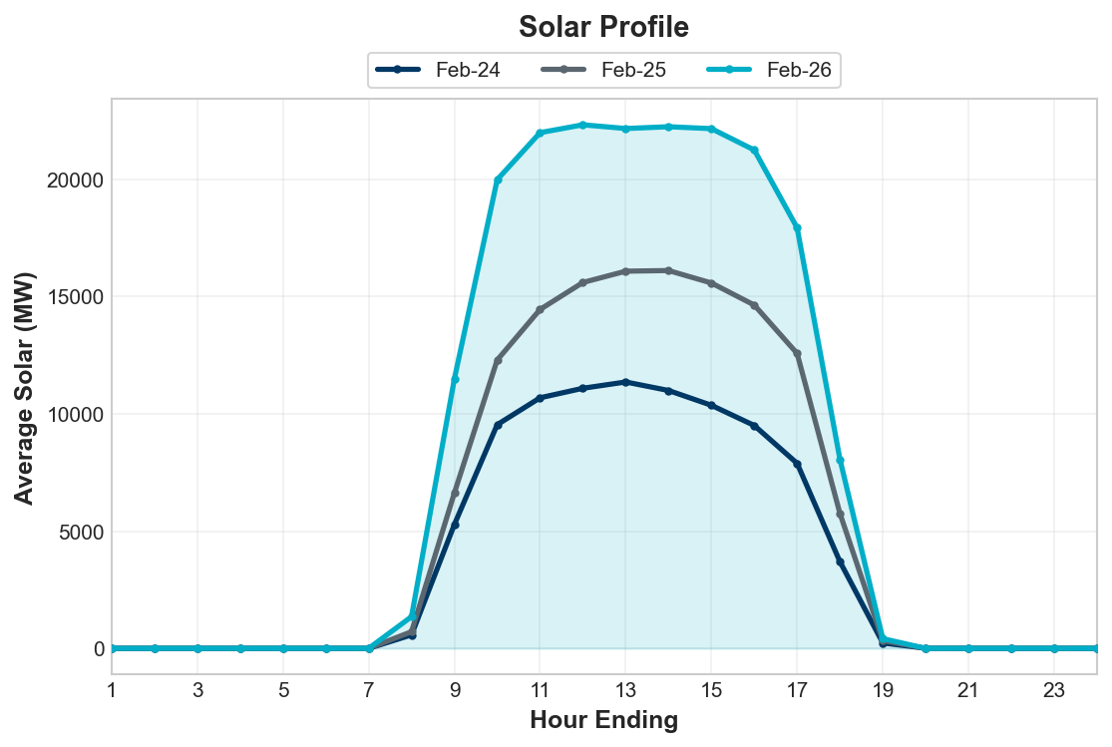
Solar Profile
Notes:
Wind generation is slightly lower than last year

Slide 21
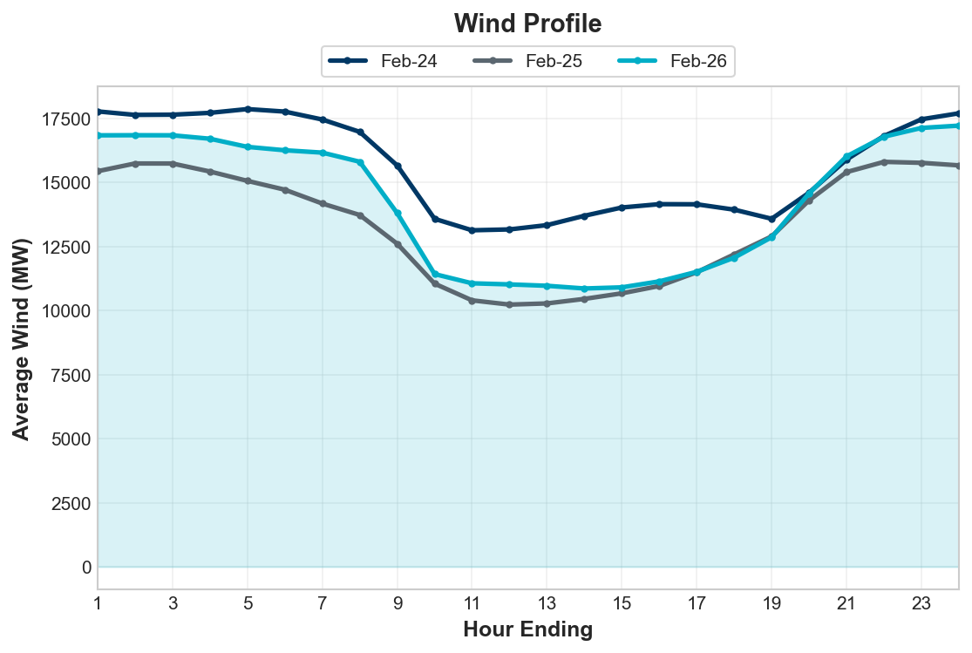
Wind Profile
Notes:
Wind generation is slightly lower than last year

Slide 22
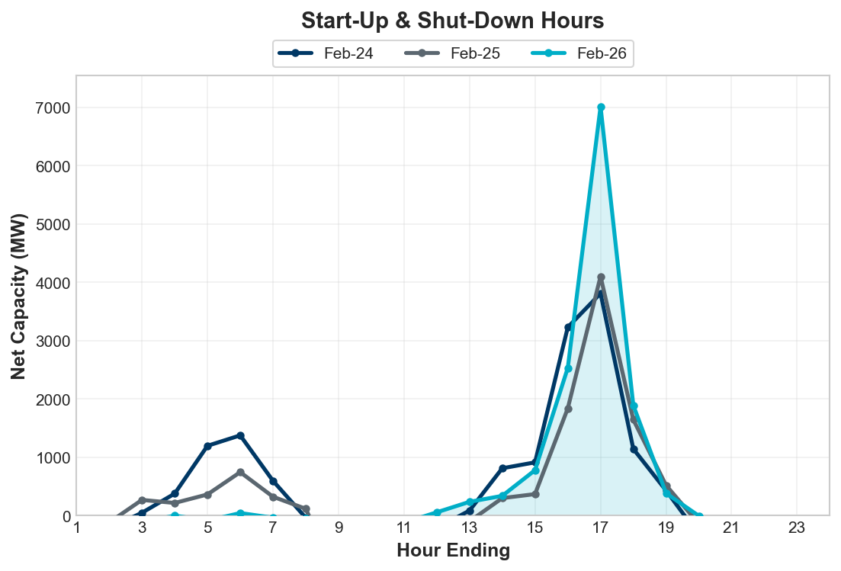
Start-Up & Shut-Down Hours
Notes:
Net Capacity on Start-Up/ShutDown are generally following the trends of the last two years. More capacity during sunset hours

Slide 23
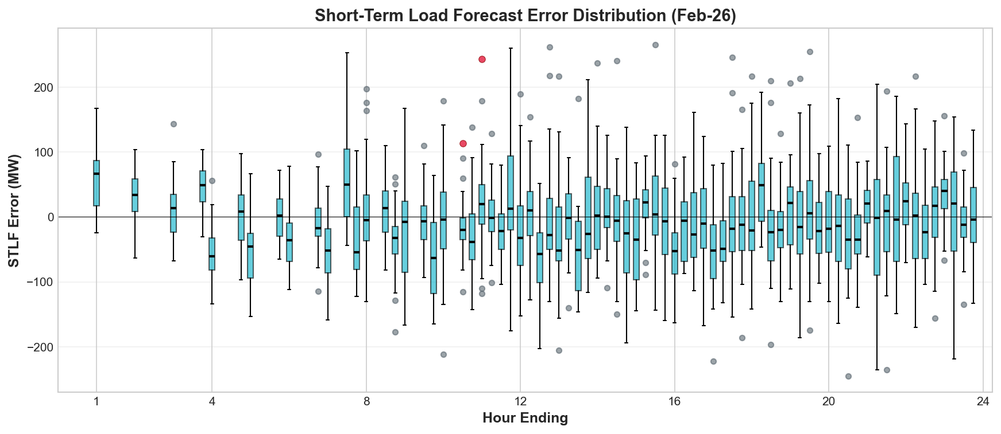
STLF Error Chart
Notes:
Error = Forecast – Actual
Min, Max, 10th, 90th percentile
15-minute intervals
Max Positive Forecast Error:
10/2025 HE10 -> 495 MW
Max Negative Forecast Error:
10/2025 HE9 -> -625 MW

Slide 24
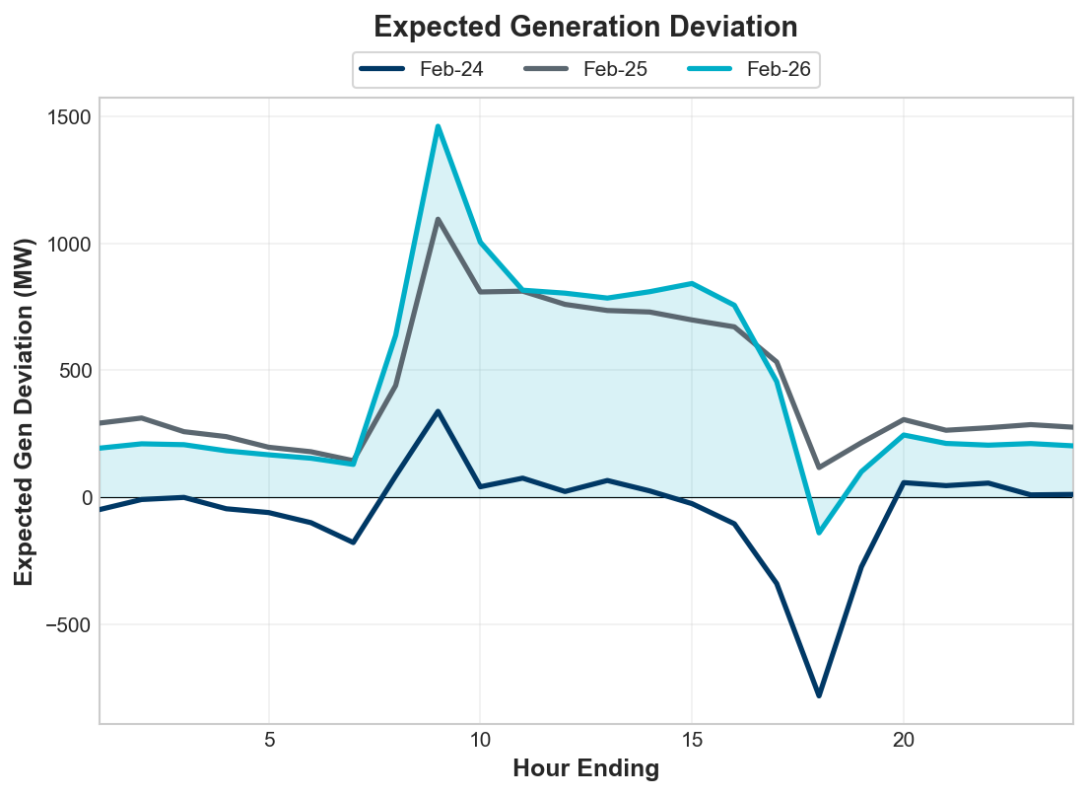
Expected Generation Deviation
Notes:
Largest expected generation deviation occurs during solar ramps. We see a positive average expected generation deviation in October.

Slide 25
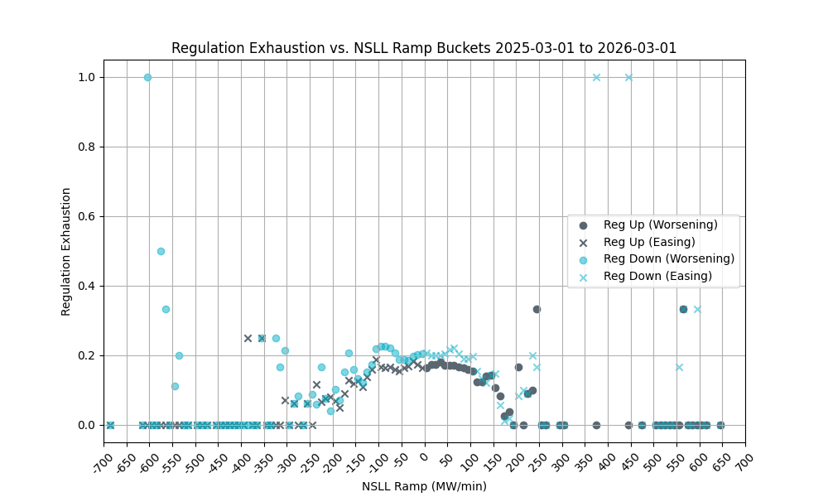
Non-SCED Qualified Large Load (NSLL) Ramping
Notes:
1-min NSLL ramp values were examined in bins of 10 MWs (as tracked on x-axis) and the average rate of intervals during which regulation was exhausted (i.e. remaining regulation was less than 5 MW) was computed (as tracked on y-axis).
NSLL includes Large Loads and Steel Mills that are not following SCED dispatch.
Trend is the same: we see low correlation between regulation exhaustion and NSLL ramp

Slide 26
Questions?
Thank you!

