Slide 1
ERCOT Frequency Events
February 2026
ERCOT
Operations Planning
PDCWG | Mar 18, 2026

Slide 2
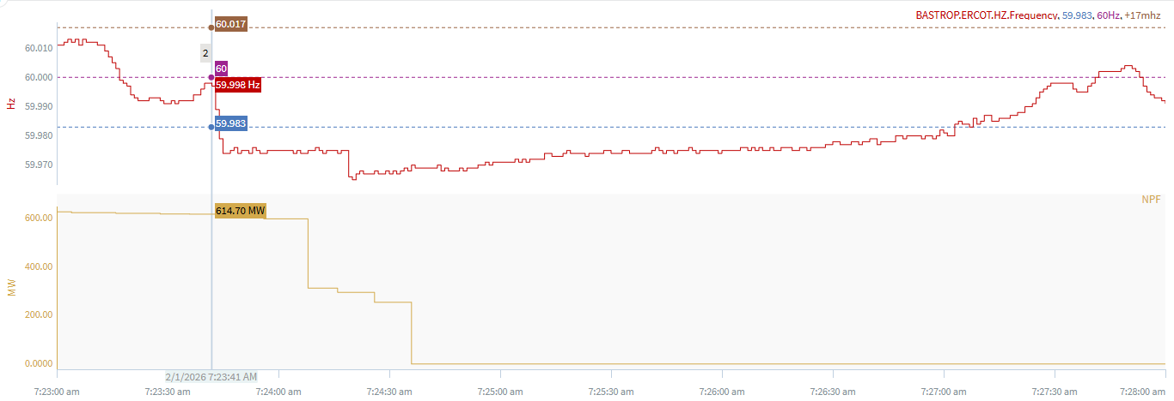
2/1/2026 7:23:41 (Non-FME)
Notes:
The unit tripped in steps while carrying ~596 MW
Starting Frequency: 59.998 Hz
Minimum Frequency: 59.965 Hz
A-C Time : 39 seconds
Recovery Time(back to deadband): 3 minutes 22 seconds
ECRS Released: 0 MW
Trip Reason: An air compressor trip
Contextual Information: A total of 272 MW of regulation Up was deployed during the event.
Reason for no selection: Partial trip and C point is 59.965

Slide 3
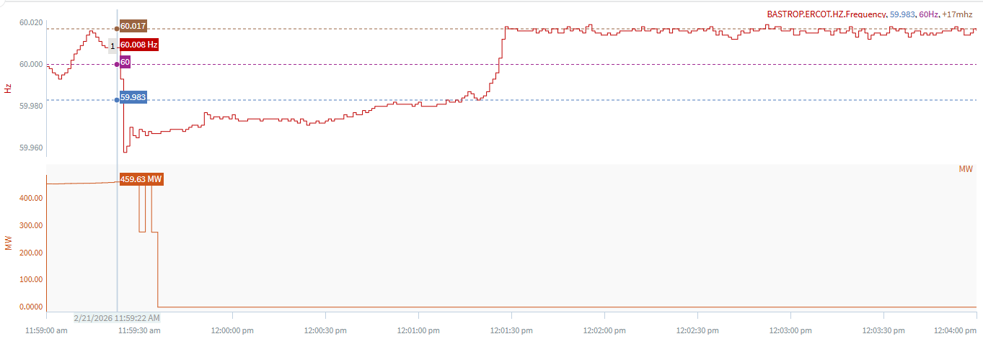
2/21/2026 11:59:22 (Non-FME)
Notes:
A unit tripped offline while carrying ~469 MW
Starting Frequency: 60.008 Hz
Minimum Frequency: 59.958 Hz
A-C Time : 3 seconds
Recovery Time(back to deadband): 1 minutes 57 seconds
ECRS Released: 0 MW
Trip Reason: Unknown at this time
Contextual Information: A total of 164 MW of regulation Up was deployed during the event.
Reason for no selection: Partial trip and C point is 59.958

Slide 4
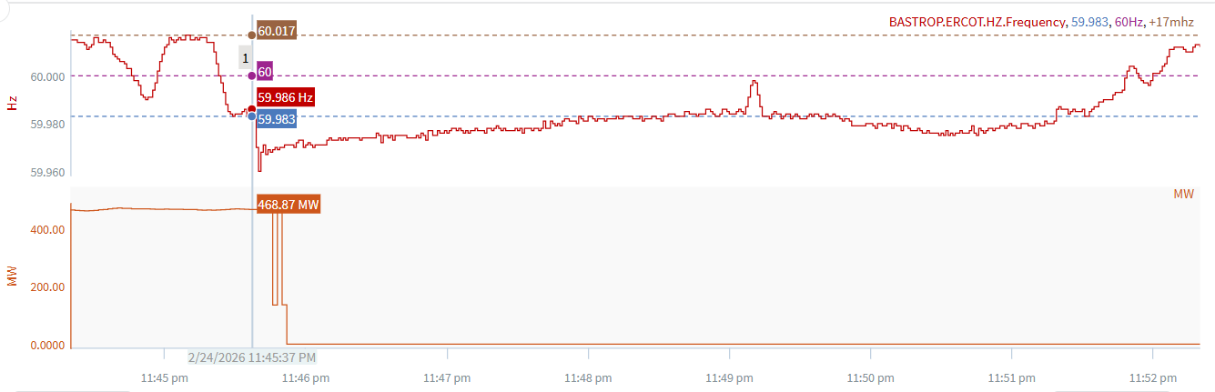
2/24/2026 23:45:37 (Non-FME)
Notes:
The unit tripped offline while carrying ~466 MW
Starting Frequency: 59.986 Hz
Minimum Frequency: 59.960 Hz
A-C Time : 3 seconds
Recovery Time(back to deadband): 2 minutes 56 seconds
ECRS Released: 0 MW
Trip Reason: Unknown at this time
Contextual Information: A total of 355 MW of regulation Up was deployed during the event.
Reason for no selection: Partial trip and C point is 59.958

Slide 5
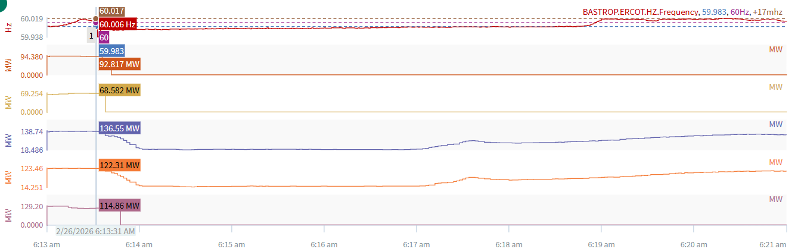
2/26/2026 6:13:31 (Non-FME)
Notes:
Multiple units tripped while carrying a total of ~492 MW
Starting Frequency: 60.006 Hz
Minimum Frequency: 59.938 Hz
A-C Time : 2 seconds
Recovery Time(back to deadband): 4 minutes 16 seconds
ECRS Released: 0 MW
Trip Reason(s): Transmission line failure and voltage incursion
Contextual Information: A total of 355 MW of regulation Up was deployed during the event.
Reason for no selection: Some units experienced run backs and C point is 59.938

Slide 6
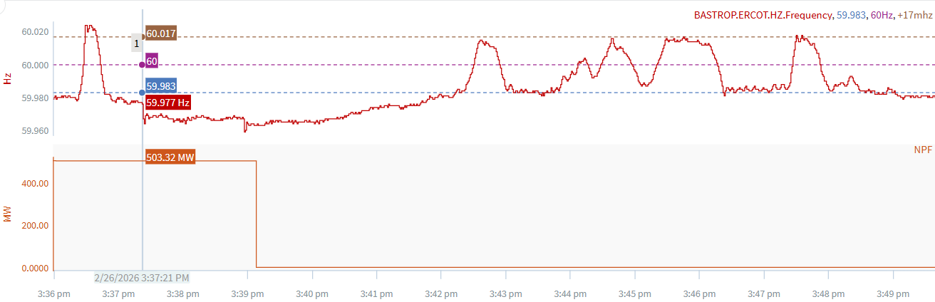
2/26/2026 15:37:21 (Non-FME)
Notes:
The combine cycle tripped while carrying ~503 MW
Starting Frequency: 59.977 Hz
Minimum Frequency: 59.958 Hz
A-C Time : 1 minutes 36 seconds
Recovery Time(back to deadband): 4 minutes 51 seconds
ECRS Released: 0 MW
Trip Reason: Unknown at this time
Contextual Information: A total of 320 MW of regulation Up was deployed during the event.
Reason for no selection: C point is 59.958

Slide 7
Questions?
Thank you!

