Slide 1
CRR Updates at CMWG
Samantha Findley
March 16, 2026

Slide 2
Agenda
LTAS transactions and solution times
CRR auction limits table – no changes
Draft language for NPRRxxxx_Restructure_LTAS_to_Six_Monthly_Optimizations
Upcoming data removal from the CRR MUI (data > 7 years old)

Slide 3
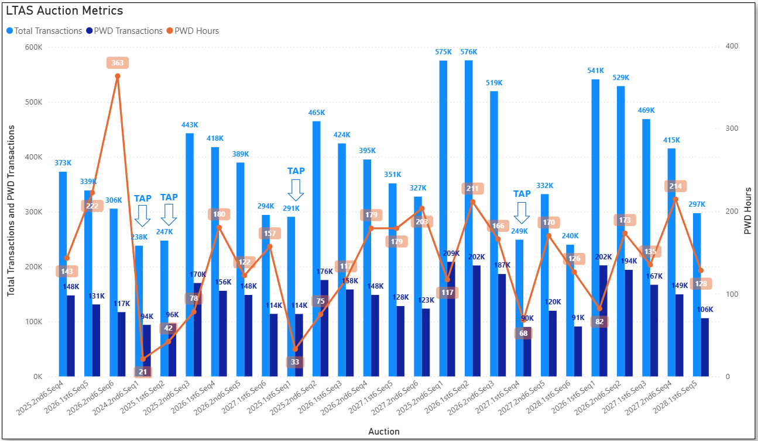
Historical LTAS transactions and solution times

Slide 4
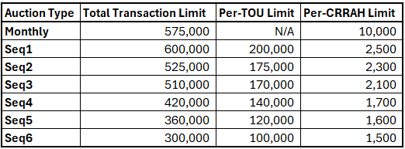
CRR auction transaction limits

Slide 5
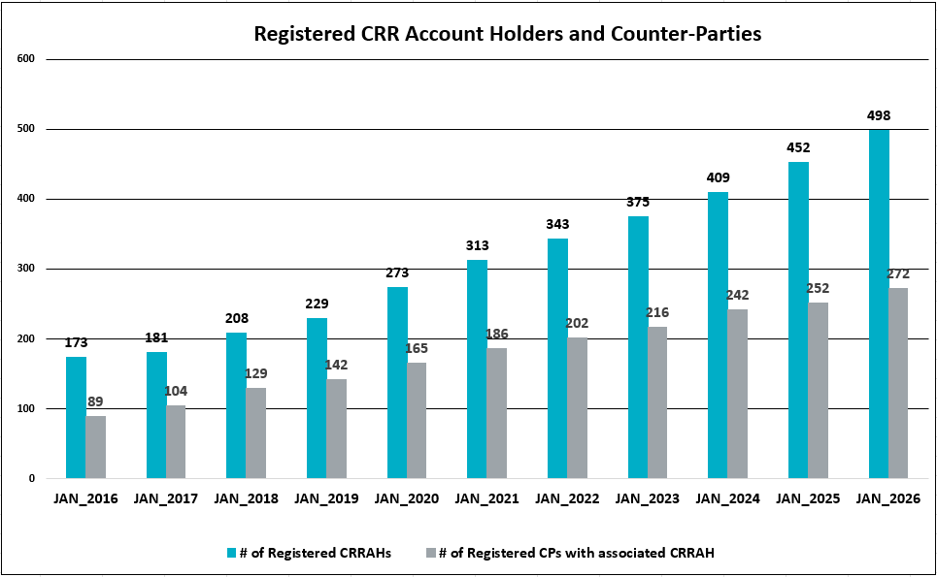
Registered CRR Account Holders and Counter-Parties

Slide 6
DRAFT NPRRxxxx Restructure Long-Term Auction Sequence Auctions to Six Monthly Optimizations
Nodal Protocol Sections Requiring Revision | 7.5.2.1, CRR Auction Offer Criteria 7.5.2.3, CRR Auction Bid Criteria
Revision Description | This Nodal Protocol Revision Request (NPRR) will restructure the Long-Term Auction Sequence auctions, currently structured as three time-of-use optimizations, to six single-month optimizations.
Justification of Reason for Revision and Market Impacts | Restructuring the LTAS auctions from 3 TOU optimizations to 6 single-month optimizations will increase optimization efficiency by defining credit constraints for each month, rather than the current credit constraint that spans all 6 months of a TOU optimization.

Slide 7
DRAFT NPRRxxxx Restructure Long-Term Auction Sequence Auctions to Six Monthly Optimizations
7.5.2.1 CRR Auction Offer Criteria
(1) A CRR Auction Offer indicates a willingness to sell CRRs at the auction clearing price, if it equals or exceeds the Minimum Reservation Price. It must be submitted by a Participating CRR Account Holder and must include the following:
(a) The short name of the Participating CRR Account Holder;
(b) The unique identifier for each CRR being offered, which must include the single type of CRR being offered;
(c) The source Settlement Point and the sink Settlement Point for the block of CRRs being offered;
(d) The month, or strip of consecutive months, for which the block of CRRs is being offered, including time-of-use designation except that a 7x24 offer may not be designated;
[NPRR1288: Replace paragraph (d) above with the following upon system implementation:] (d) The month for which the block of CRRs is being offered, including time-of-use designation except that a 7x24 offer may not be designated;

Slide 8
DRAFT NPRRxxxx Restructure Long-Term Auction Sequence Auctions to Six Monthly Optimizations
The quantity of CRRs in MW, which must be the same for each hour within the block, for which the Minimum Reservation Price is effective; and
A dollars per CRR (i.e. dollars per MW per hour) for the Minimum Reservation Price.
The Participating CRR Account Holder may submit a self-imposed credit limit for the CRR Monthly Auction or for each time-of-use month in a CRR Auction that is part of a CRR Long-Term Auction Sequence, if desired.
A Participating CRR Account Holder can only offer to sell one-month or multi-month strips of CRRs for which it is the CRR Owner of record at the time of the offer. Multi-month CRR offers must consist of consecutive months that are within the period of the relevant CRR Auction and can only be submitted as part of a CRR Long-Term Auction Sequence.
(4) A CRR offer for a specified MW quantity of CRRs constitutes an offer to sell a quantity of CRRs equal to or less than the specified quantity. A CRR offer may not specify a minimum quantity of MW that the Participating CRR Account Holder wishes to sell.
[NPRR1289: Replace paragraph (e) above with the following upon system implementation:] (e) The quantity of CRRs in MW with a minimum of 0.1 MW, which must be the same for each hour within the block, for which the Minimum Reservation Price is effective; and
[NPRR1288: Replace paragraph (3) above with the following upon system implementation:] (3) A Participating CRR Account Holder can only offer to sell one-month strips of CRRs for which it is the CRR Owner of record at the time of the offer.

Slide 9
DRAFT NPRRxxxx Restructure Long-Term Auction Sequence Auctions to Six Monthly Optimizations
7.5.2.3 CRR Auction Bid Criteria
(1) A CRR Auction Bid indicates a willingness to buy CRRs at the auction clearing price, if it is equal to or less than the Not-to-Exceed Price. It must be submitted by a Participating CRR Account Holder and must include the following:
(a) The short name of the Participating CRR Account Holder;
(b) The single type of CRR being bid;
(c) The source Settlement Point and the sink Settlement Point for the block of CRRs being bid;
(d) The month or strip of consecutive months for which the block of CRRs is being bid, including time-of-use designation, which may include a 7x24 block in a CRR Monthly Auction but not in a CRR Auction held as part of a CRR Long-Term Auction Sequence;
[NPRR1288: Replace paragraph (d) above with the following upon system implementation:] (d) The month for which the block of CRRs is being bid, including time-of-use designation, which may include a 7x24 block in a CRR Monthly Auction but not in a CRR Auction held as part of a CRR Long-Term Auction Sequence;

Slide 10
DRAFT NPRRxxxx Restructure Long-Term Auction Sequence Auctions to Six Monthly Optimizations
(e) The quantity of CRRs in MW, which must be the same for each hour within the block, for which the Not-to-Exceed Price is effective; and
[NPRR1289: Replace paragraph (e) above with the following upon system implementation:] (e) The quantity of CRRs in MW with a minimum of 0.1 MW, which must be the same for each hour within the block, for which the Minimum Reservation Price is effective; and
(f) A dollars per CRR (i.e. dollars per MW per hour) for the Not-to-Exceed Price.
(2) The Participating CRR Account Holder may submit a self-imposed credit limit for the CRR Monthly Auction or for each time-of-use month in a CRR Auction that is part of a CRR Long-Term Auction Sequence, if desired.
(3) A bid to buy a PTP Option cannot specify a non-positive Not-to-Exceed Price less than the Minimum PTP Option Bid Price.
(4) A bid to buy a PTP Obligation can specify a negative Not-to-Exceed Price.
(5) A CRR bid for a specified MW quantity of CRRs constitutes a bid to buy a quantity of CRRs equal to or less than the specified quantity. A CRR bid may not specify a minimum quantity of MW that the Participating CRR Account Holder wishes to buy.
(6) A CRR bid may not contain a source Settlement Point and a sink Settlement Point that are Electrically Similar Settlement Points, nor may CRR bids be submitted by any combination of Participating CRR Account Holders within the same Counter-Party to create the net effect of a single PTP Obligation bid containing a source Settlement Point and a sink Settlement Point that are Electrically Similar Settlement Points.

Slide 11
Removal of historical data from the CRR system
The production database currently contains data from all markets back to Nodal go-live (~16 years of data).
CRR system performance is negatively impacted by containing this much data.
Historical data more than 7 years old will be removed from the CRR system on April 24, 2026, in alignment with ERCOT’s data retention policy. After the data is removed from production, it will no longer be available in the CRR Market User Interface.
30-day and 10-day market notices announcing the data removal will be sent prior to April 24, 2026.

