Slide 1
NOGRR282 Updates
Patrick Gravois
Principal Operations Engineer
LLWG Meeting
March 13, 2026

Slide 2
NOGRR282 Updates - Agenda
Texas Blockchain Council 2/18/26 Comments
ERCOT 3/11/2026 Comments
Response to AEP comments and DWG feedback
Response to Data Center Coalition 2/9/2026 comments
Next Steps

Slide 3
Texas Blockchain Council 2/18/26 Comments
TBC comments
ERCOT response (verbal)

Slide 4
ERCOT 3/11/2026 Comments – AEP/DWG Feedback
DWG discussed NOGRR282 on 2/12/2026 and presented feedback to ROS on 3/5/2026
AEP’s 12/5/2025 comments were addressed at DWG
ERCOT submitted comments on 3/11/2026 in response:
ERCOT and DWG agreed to increase high frequency ride-through threshold in Table A in Section 2.6.4(3) from 61.8 Hz to 63.0 Hz; as per AEP’s comments
LEL developer feedback indicates high frequency is not a ride-through concern
Increased high frequency threshold improves system reliability during events
New Proposed FRT curve
Frequency (f) in (Hz) | Minimum Ride-Through Time (seconds)
f > 61.863.0 | May ride-through or trip
61.2 < f ≤ 61.863.0 | 299
58.8 ≤ f ≤ 61.2 | continuous
57.0≤ f < 58.8 | 299
f < 57.0 | May ride-through or trip

Slide 5
ERCOT 3/11/2026 Comments – AEP/DWG Feedback
DWG members wanted clarifying language for Section 2.15(3)(d)
Paragraph defines allowable overcurrent of 125% during voltage disturbance
ERCOT Comments included the following added sentence:
The allowable overcurrent up to 125% shall only persist during the voltage transient with a duration not to exceed 0.5 seconds.
Additional AEP feedback not addressed in ERCOT comments
AEP comments suggested increasing low frequency thresholds from 57.0 Hz to 58.2 Hz
ERCOT and DWG members agreed to keep the criteria as currently written so LELs would not trip on underfrequency events unless they are performing in accordance with UFLS or Ancillary Service obligations
AEP comments suggested additional requirement that LELs shall return to pre-disturbance consumption within 2 seconds when voltage conditions exceed “must ride-through” curve
ERCOT decided not to include additional requirement since it could lead to the unintended consequence of LELs choosing to trip rather than riding through these conditions
However, ERCOT agrees this should be the desired performance

Slide 6
ERCOT Response to DCC 2/9/2026 Comments
DCC comments propose the following revisions:
Replace Large Electronic Load with Large Load in all of NOGRR282
Change exemption date from 11/14/2025 to 1/1/2027
Apply VRT requirements to only 50% of the Demand at the facility
ERCOT response does not agree with these revisions
LELs pose a more imminent risk to ERCOT System reliability than other LLs
LELs are more sensitive to voltage disturbances than traditional LLs
LELs are >80% of the projected Demand growth in ERCOT
Additional requirements on other LLs may still be needed (VFDs, hydrogen, etc.)
Many operational and approved LELs will be exempt from RT requirements
Extending the exemption date would worsen existing reliability risk
Applying VRT requirements to only 50% of the load would not mitigate risk
ERCOT provided additional supporting evidence in response to DCC comments
Referenced multiple LLWG and LL workshop presentations showing need for LEL RT requirements
ERCOT continues to examine transmission and market solutions to help mitigate risks; but maintain these solutions alone cannot mitigate risk without improved LEL RT capability

Slide 7
Next Steps
ERCOT provides update to TAC – March 25
ROS vote - April 2
Additional comments received and potential revisions may be discussed at ROS before vote
PRS vote - April 15 (NPRR 1308 only)
Only comments received on NPRR1308 were DCC comments; no proposed revisions to definition itself
TAC provides update to BOD - April 20-21
Part of Board Priority Revision Request Process
TAC vote - April 29
Target June BOD vote
ROS Vote
April 2
PRS Vote
April 15
BOD Update
April 20-21
TAC Vote
April 29
BOD Vote
June 1-2
TAC Update
March 25

Slide 8
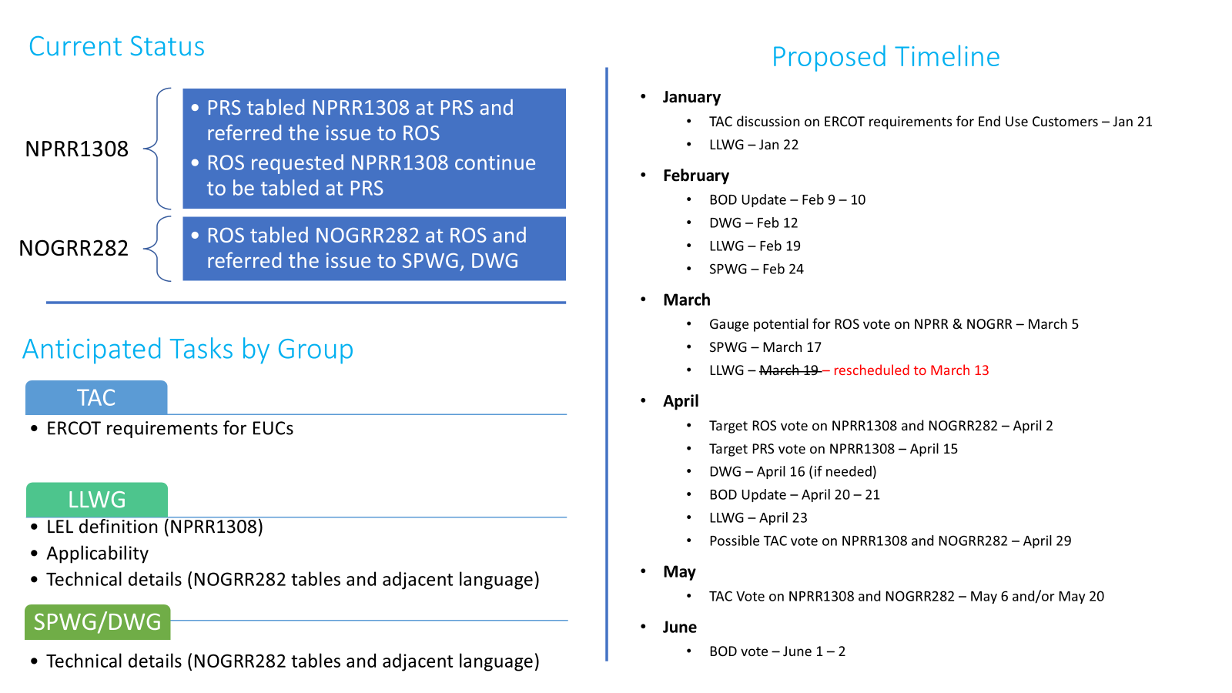
NPRR1308 and NOGRR282 Timeline

