Slide 1
LEL Frequency Limit Study Update
Luis Hinojosa
ERCOT Operations Planning
LLWG
03/13/2026

Slide 2
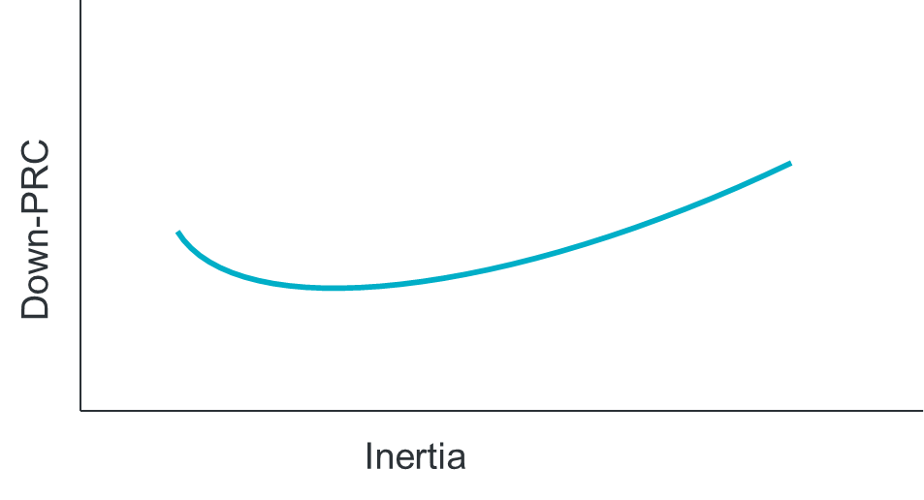
LL Frequency Limit Study
Questions to Answer:
How do different inertia and down-PRC conditions impact the previously-identified³ 3,200 MW loss of load frequency stability limit?
What would be the benefit of a down-frequency response Ancillary Service such as FFR?
Scope:
TSAT snapshot cases for various inertia and down-PRC conditions
Identify load loss level that causes steady-state frequency to exceed 60.4 Hz for each case
Goals:
Identify frequency stability limit for loss of load.
Table showing load loss limit for various inertia and down-PRC conditions
This will serve as input into SOL monitoring criteria (see LL VRT SOL Study)
Identification of amount of down-PRC needed to increase loss of load frequency stability limit at various inertia levels
https://www.ercot.com/files/docs/2025/12/10/Large_Load_Loss_Analysis_121125_LLWG.pptx

Slide 3
Status Update
Analyze impacts of various inertia and PRC down conditions to build a table with frequency stability limit based on the various conditions.
We have analyzed 28 different historical cases to support this analysis.
Cases range from 122-335 GW*s of inertia and ~6.2k-22.9k PRC down from 2024 and 2025.
We are close to wrapping up this analysis, but we need more time to validate the results and identify operational impacts of a potential dynamic limit.
We plan to share findings in Q2 2026.
We are at the early stages of analyzing potential for Fast Frequency Response (FFR) down studies
FFR down scenarios are applied to the same cases utilized to build the frequency stability limit table.
Each case requires multiple scenarios to identify impact of various levels of FFR down.
We plan to share results after the above frequency stability limit table has been shared.

Slide 4
Questions?

