Slide 1

Incorporating DRRS Demand Curve into AORDC
Andrew Reimers, Ph.D.
Deputy Director, ERCOT IMM
Potomac Economics
In Collaboration With ERCOT Market Operations
TAC DRRS Workshop 3
March 9, 2026

Slide 2
Background and Objective
In the IMM’s comments on NPRR 1309 from February 3, 2026, we offered qualified support for the proposal for the design of DRRS as a new ancillary service product
One of our recommendations was that ERCOT implement a demand curve for DRRS that more accurately reflected its reliability value and didn’t overrate DRRS relative to other AS products
Since then, we also realized that implementing a distinct demand curve for DRRS on top of the prevailing AORDC would only exacerbate the over-procurement of reserves relative to the AS Plan
The IMM and ERCOT collaborated on a concept to incorporate the DRRS demand curve into the AORDC by expanding upon the methodology established by NPRR 1268
Notes:
2

Slide 3
Assumptions about DRRS Volumes and Duration Requirements
ERCOT and the IMM agree that the implementation of DRRS should correspond with two changes to the Non-Spin methodology:
The Non-Spin Plan should be scaled down, though not necessarily on a one-to-one basis with DRRS
The duration requirement for Non-Spin should be reduced from four hours
Assumptions for this analysis
We considered two variations of procurement targets relative to the current Non-Spin Plan:
Scale Non-Spin to 40%, add 60% DRRS (Total AS Plan unchanged)
Scale Non-Spin to 50%, add 60% DRRS (Total AS Plan increased)
Duration constraint for Non-Spin relaxed to two hours

Slide 4
Disaggregate and Back-fill Concept
Like NPRR 1268, our proposal introduces a methodology for disaggregating the AORDC into individual ASDCs
Unlike NPRR 1268, which dealt extensively with how to apportion AS products along the flat part of the AORDC, this proposal only considers the curved portion of the AORDC (i.e., reserves greater than 3,000 MW)
To start, minimum prices are assigned to each ASDC. The purpose of these minimum prices are to ensure the following:
That each ASDC reflects the relative reliability value of each product
That SCED can go short on each product under appropriate system conditions
Minimum prices defined as follows:
RegUp -> $250
RRS -> $100
ECRS -> $15
Non-Spin -> $5
DRRS -> $0.01

Slide 5
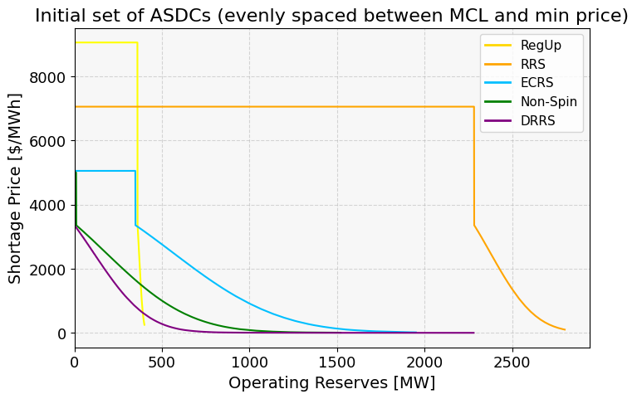
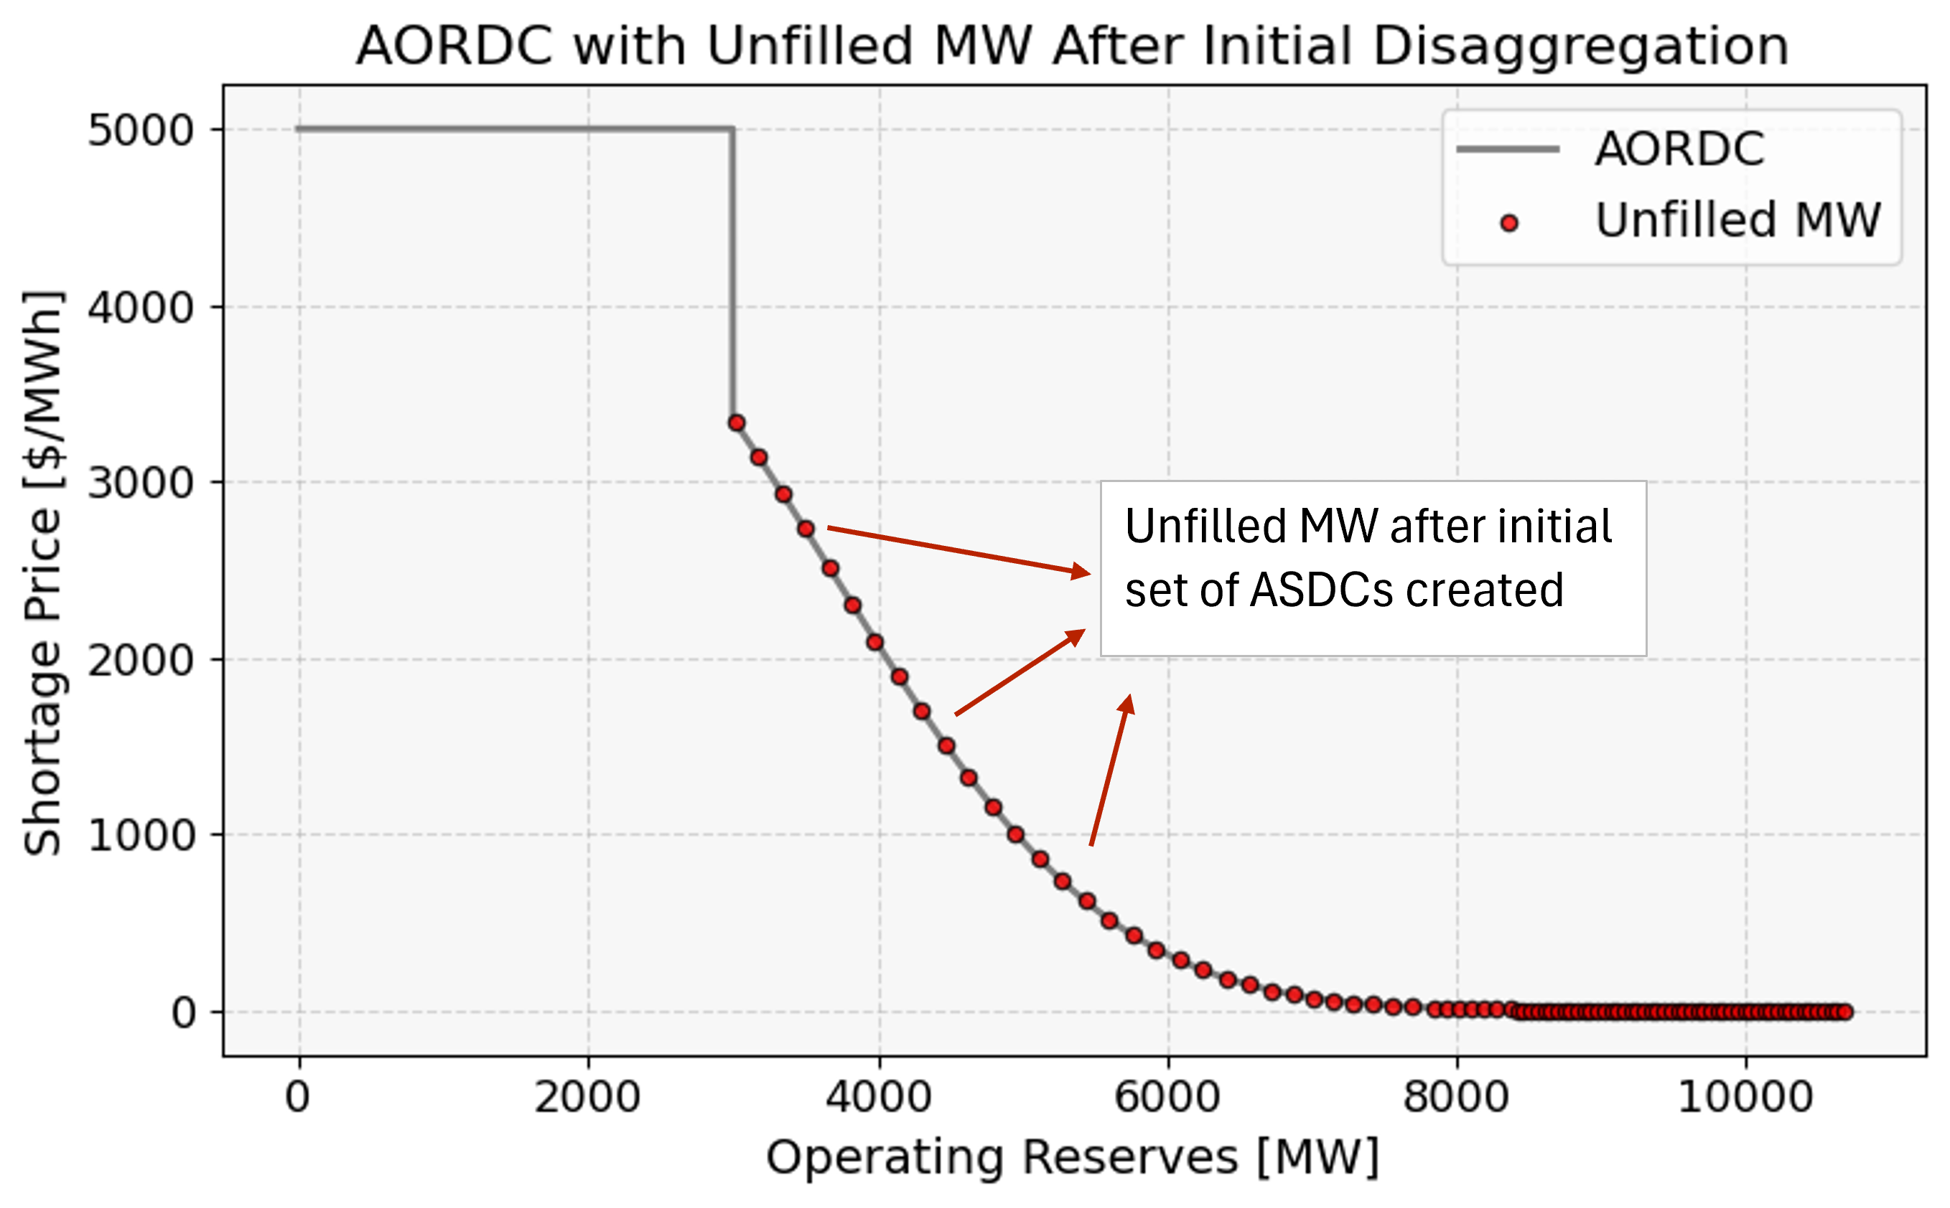
Disaggregate and Back-fill Concept
An initial set of ASDCs is produced by taking the capacity for each product not apportioned to the flat portion of the AORDC and evenly spacing it along the AORDC between the MCL and that products minimum price
Once this is done, if these ASDCs are re-aggregated, there are holes throughout the curved portion of the AORDC that need to be filled
How to fill them while preserving the relative value of each product?

Slide 6
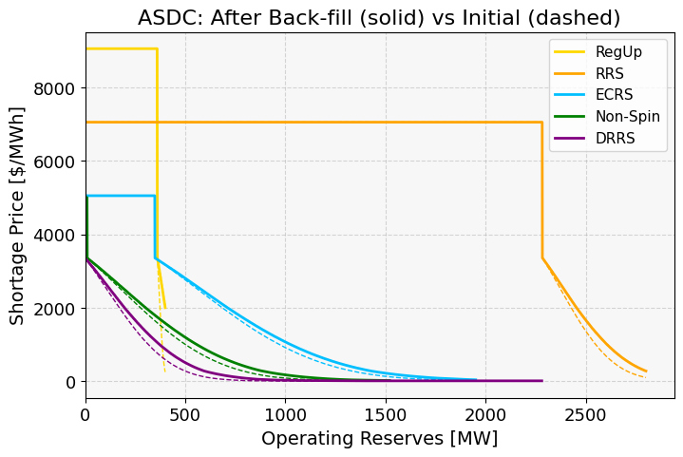
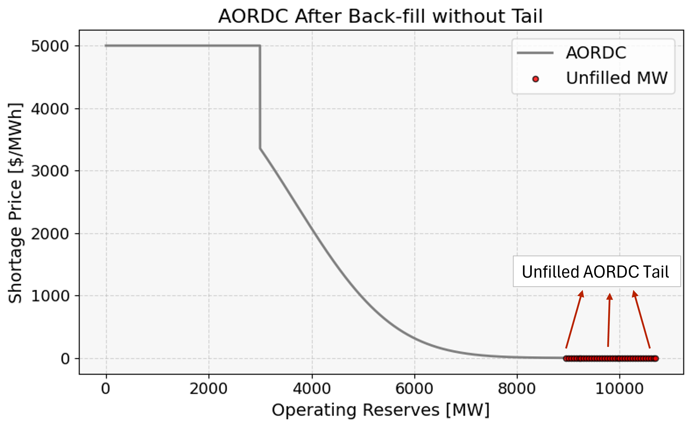
Disaggregate and Back-fill Concept
Solution - back-fill empty volume in AORDC by alternatively removing the points from each ASDC
First, remove the last point on the RegUp ASDC and fill it into the highest value empty space on the AORDC.
Repeat with RRS, then ECRS, then Non-Spin, then DRRS
Start again with RegUp until there are no longer any gaps on the AORDC

Slide 7
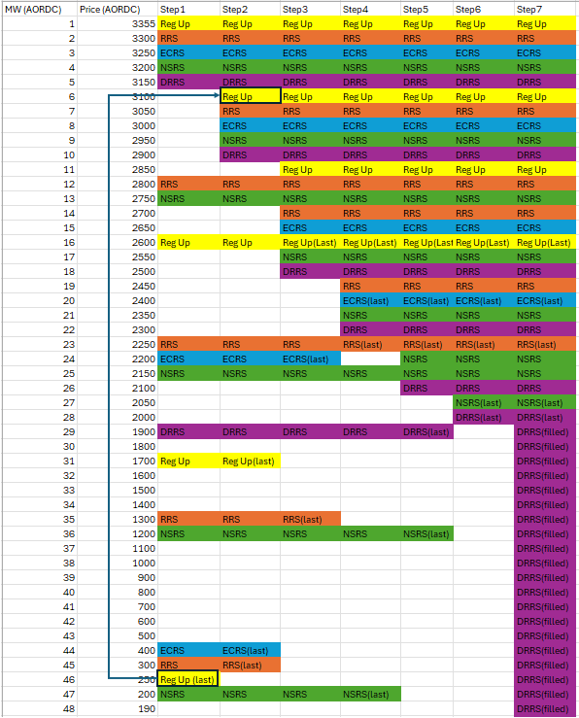
An example of Disaggregate and Back-Fill Concept

Slide 8
What about the tail of the AORDC?
Initial thought from the IMM is to fill it with DRRS, which would reduce the extent to which SCED over-procures Non-Spin
There is a concern that this could result in excess procurement of DRRS and elevated pricing for DRRS relative to other AS products, especially if ESRs are not qualified to provide DRRS
DRRS supply considerations:
ESRs provided almost 25% of Non-Spin in 2025, up from only 6% in 2024. This ratio is likely to climb with more than 8,000 MW of new ESR capacity entering the system in 2026, most of which has a rated duration of at least two hours
Incremental thermal capacity qualified to provide offline DRRS based on two-hour start time is roughly equivalent to the current volume of Non-Spin provided by ESRs

Slide 9
IMM Recommendation to Avoid DRRS Supply Constraints Interfering with Price Formation
Allow ESRs to provide DRRS using methodology included in NPRR 1310 (See Joint ESR Commenters on NPRR 1309, February 14, 2026)
Cut off the excess volume from the AORDC according the magnitude of the AS Plan
Barring either of those recommendations, excess AORDC volume could be split between Non-Spin and DRRS

Slide 10
Closing Thoughts on the AORDC and Shortage Pricing
Designing the individual ASDCs according to the prevailing AORDC results in arbitrary shortage prices that do not reflect the reliability value of operating reserves
We look forward to working with ERCOT to reformulate shortage pricing independent of the AORDC, ideally before DRRS goes live
Until then, this methodology results in ASDCs that appropriately reflect the relative reliability value of each AS product and that allow SCED to effectively co-optimize between products

Slide 11
Contributors
Special thanks to Dave Maggio for facilitating this collaboration between ERCOT and the IMM
Credit for much of the work belongs to ERCOT staff, especially Weifeng Li and Matthew Schmidt

