Slide 1
HEN Request for Greater Detail in ERCOT’s OBDRR055 Changes
Shams Siddiqi, Ph.D.
Hunt Energy Network (HEN)
(512) 619-3532
shams@crescentpower.net
WMS Meeting
March 4, 2026

Slide 2
ERCOT’s OBDRR055 Changes
HEN appreciates ERCOT changes to OBDRR055 to fix identified issues
Even though HEN agrees with ERCOT changes to address the issues, HEN is concerned about the lack of specificity in the proposed OBDRR055 language
The deployment of Offline Non-Spin impacts market prices and may distort/suppress real-time prices
As such, HEN believes that OBDRR055 needs to have the specificity required for Market Participants to be aware of the exact formula ERCOT is using to deploy Non-Spin
This allows Market Participants to also propose changes if the exact formula is found to be inadequate
Absent such specificity, Market Participants must be aware of ERCOT’s presentation at WMS today, which is difficult to find in a few months even if the Market Participant is present today and lacks a process to change
HEN’s proposed OBDRR055 language is on the next slide – HEN requests WMS to direct ERCOT to include this level of detail in their comments
HEN also requests, as a separate matter, that WMS direct ERCOT to provide this level of detail for other practices impacting the market, such as ERCOT’s conservative operations, in some binding document

Slide 3
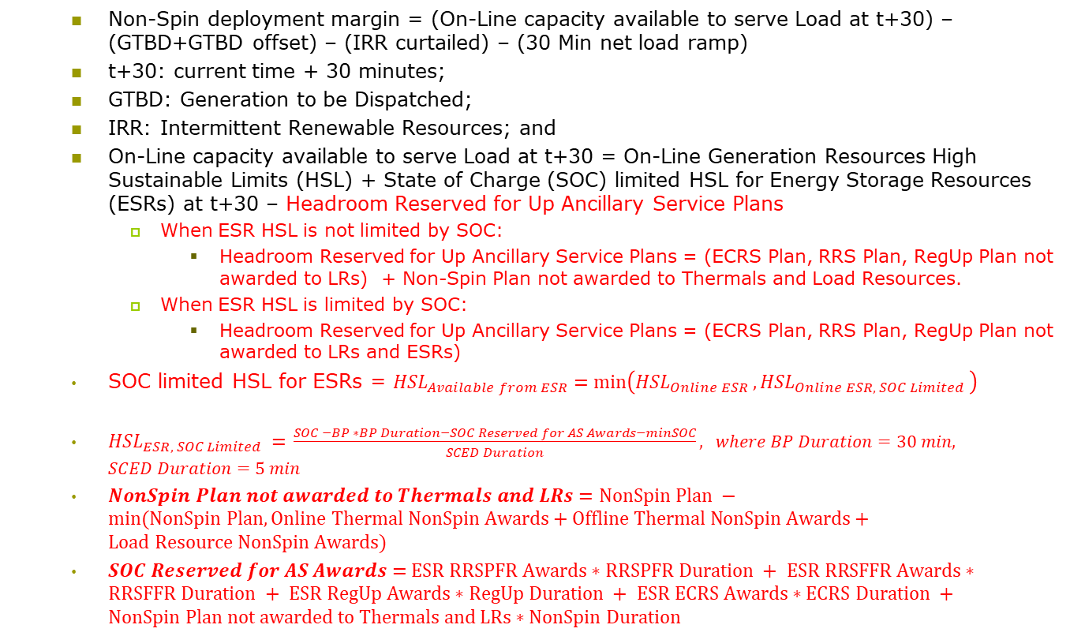
HEN’s Requested OBDRR055 Changes
Non-Spin deployment margin = (On-Line capacity available to serve Load at t+30) – (GTBD+GTBD offset) – (IRR curtailed) – (30 Min net load ramp)
t+30: current time + 30 minutes;
GTBD: Generation to be Dispatched;
IRR: Intermittent Renewable Resources; and
On-Line capacity available to serve Load at t+30 = On-Line Generation Resources High Sustainable Limits (HSL) + State of Charge (SOC) limited HSL for Energy Storage Resources (ESRs) at t+30 – Headroom Reserved for Up Ancillary Service Plans
When ESR HSL is not limited by SOC:
Headroom Reserved for Up Ancillary Service Plans = (ECRS Plan, RRS Plan, RegUp Plan not awarded to LRs) + Non-Spin Plan not awarded to Thermals and Load Resources.
When ESR HSL is limited by SOC:
Headroom Reserved for Up Ancillary Service Plans = (ECRS Plan, RRS Plan, RegUp Plan not awarded to LRs and ESRs)
SOC limited HSL for ESRs = ${HSL}_{Available from ESR}=\min\left({HSL}_{Online ESR },{HSL}_{Online ESR, SOC Limited }\right)$
${HSL}_{ESR, SOC Limited }=$ $\frac{SOC −BP ∗BP Duration−SOC Reserved for AS Awards−minSOC}{SCED Duration}, where BP Duration=30 min, SCED Duration=5 min$
$NonSpin Plan not awarded to Thermals and LRs=NonSpin Plan −min⁡(NonSpin Plan, Online Thermal NonSpin Awards+Offline Thermal NonSpin Awards+Load Resource NonSpin Awards)$
$SOC Reserved for AS Awards=$ $ESR RRSPFR Awards∗RRSPFR Duration + ESR RRSFFR Awards∗RRSFFR Duration + ESR RegUp Awards∗RegUp Duration + ESR ECRS Awards∗ECRS Duration +NonSpin Plan not awarded to Thermals and LRs∗NonSpin Duration$

