Slide 1
Inverter-Based Resource Disturbances in the
Western Interconnection
Dave Grover
Senior Reliability Specialist
March 27, 2026

Slide 2
IBR Disturbance Report
NERC and Regional Entities continue to analyze disturbances involving widespread reduction of inverter-based resources (IBR) to identify any systemic reliability issues to support affected facilities as they develop mitigating measures, and to share key findings and recommendations with industry for increased awareness and action.
The events identified in this report confirm that the ongoing widespread reduction of IBR resources is a notable reliability risk to the bulk power system (BPS).
IBR Report Link
Notes:
This report was a joint effort with NERC, WECC, and the California ISO.
These continuing events show the need to press forward with corrective actions still exists.
The full report is posted on the WECC website at the link shown.

Slide 3
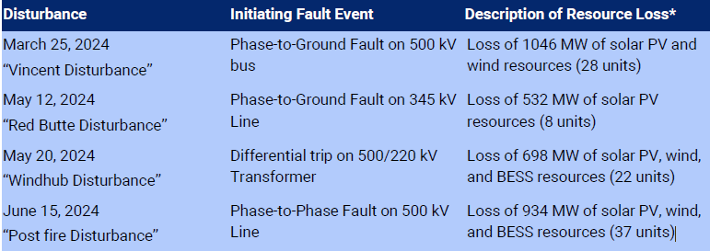
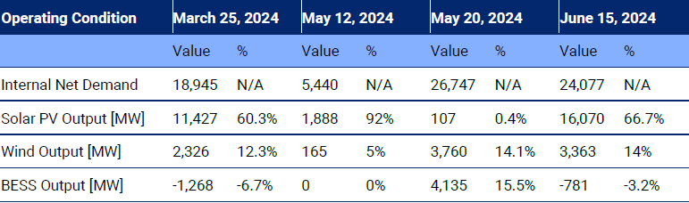
IBR Disturbances
Notes:
Each of these events occurred during normally cleared system faults and each resulted in the of IBR generation facilities.
The May 20th event occurred at 9:10 PM and you can see that solar made up only .4% of the IBR mix when the event occurred with the majority trip being wind and BESS.
The facilities that were involved in these events were a mixture of legacy facilities and non-legacy. Many had been involved in previous IBR tripping events.

Slide 4
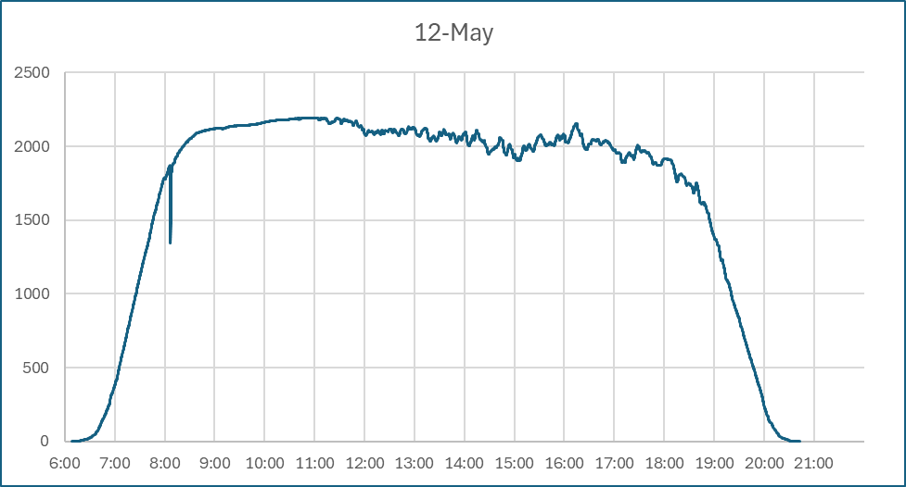
Solar profiles
CAISO
PACE
Notes:
Looking at the solar profiles of these events, it is much easier to identify when the loss occurred in the PACE chart than the CAISO chart based simply on the size of the solar footprint in each area.

Slide 5
Industry Efforts
FERC
NERC
On October 30, 2023, FERC issued Order No. 901 Reliability Standards to Address Inverter-Based Resources, directing NERC to develop new or modified standards to address reliability gaps identified through the performance of IBRs since 2016.
The four areas identified to be addressed are:
• IBR Data Sharing,
• IBR Model Validation,
• IBR Planning and Operational studies, and
• IBR Performance Requirements.
In response to FERC Order 901, NERC developed an implementation plan composed of four milestones:
1. Order No. 901 Work Plan submission,
2. Standards development and filing to address performance requirements and post-performance requirements and post-performance validations for Registered IBRs,
3. Development and filing of Reliability Standards to address data sharing and model validation for all IBRs, and
4. Development and filing of Reliability Standards to address use of performance data in Operational and Planning studies.
Notes:
During the analysis of these four events and given the current and ongoing industry efforts in addressing performance issues associated with IBR generation, the team chose to provide this report not only to confirm that these events are still occurring, but also to identifying some of those efforts to address identified performance issues with the IBR generation fleet.

Slide 6
Industry Efforts
WECC
CAISO
WECC, using the Level 2 NERC alert data and disturbance report recommendation, identified 77 IBR facilities within the Western Interconnection that indicated their IBR inverters were not optimized for performance based on equipment limitations.
Building on previous outreach efforts, in April 2024, WECC began contacting these facilities requesting they voluntarily work with their OEM for the equipment and adjust the inverter settings using the maximum capability of the equipment.
By October 2024, WECC had received responses from 87% of the identified facilities.
CAISO IBR Operational Performance Investigations
Technical requirements for IBRs are set out in the ISO’s Large Generator Interconnection Agreement (LGIA).
After seeking to enlist support for adding requirements to NERC Standards, the ISO conducted a stakeholder process and revised its pro forma LGIA and SGIA agreements to include specific technical IBR requirements. FERC adopted the changes in April 2019.
The ISO monitors and investigates non-compliance with the performance requirements
Notes:
In its November 2023 Inverter-Based Resource Performance Issues Report, NERC reported that results show less than one-third of the inverter settings reported are set based on equipment capability, meaning there is significant underused ride-through capability across the BPS.
In the report June 2022 Odessa Disturbance Report, NERC strongly recommended that all GOs with these inverters seek immediate updates (when available) to their in-service inverters to mitigate the possibility of unexpected and abnormal tripping for BPS faults.
In 2019, CAISO revised their LGIA and SGIA to include specific and enforceable technical requirements for IBR generation
CAISO also has a very robust program to actively investigate non-compliance with these requirements within their footprint and work with the facilities on corrective actions.

Slide 7
Inadvertent settings changes
Finding:
  In one of the events, it was found that IBRs that had made changes in settings to improve their performance due to faults, had reverted to the previous settings during a firmware update. These previous settings allowed tripping of the facility due to the fault during this event.
Recommended action:
  During updates to the firmware or software of IBR control equipment, IBR owners/operators should understand what changes are being made and why. All changes should be approved by the owners/operators.
Notes:
In working with the CAISO it was identified that there had been tripping at an IBR facility that was involved in a previous tripping event.
This facility had worked with their inverter OEM and made changes to correct the tripping.
During a firmware update which occurred between the corrections and this event, the IBR settings had been re-set to their previous settings, which resulted in the trip during the fault.

Slide 8
Interconnection Agreements
Finding:
  Due to the current time frame required for developing and implementing Reliability Standards, some entities have made modifications to their interconnection agreements to allow better ability to manage the implementation of IBRs within their area and allow for effective corrective actions to be taken if misoperations occur.
Recommended action:
  Transmission Service Providers may consider what changes, if any, are required in their interconnection agreements to establish an appropriate framework to ensure that IBR-based generation resources perform safely and reliably while interconnected to the BES.
Notes:
With the early adoption of IBR generation in addition to tripping events that occurred in their footprint, CAISO was an early proponent of Reliability Standards for IBR generation facilities, but there was little support from industry at the time.
What we recommend in the report and are seeing across industry are companies incorporating language into their interconnection agreements to help guide the successful integration of these resources in their areas.

Slide 9
IBR user-level settings
Finding:
  One of the IBR owner/operators reported identifying and modifying user-level inverter grid protection settings to improve the performance of their IBR facilities during BES fault events.
Recommended action:
  IBR owners/operators should identify the user-level inverter grid protection settings for their equipment and adjust these settings utilizing the maximum capability of the equipment.
  IBR owners/operators should work with the OEM for their equipment to adjust the OEM inverter settings utilizing the maximum capability of the equipment. Making these changes will allow your equipment to better support the reliability of the BES.
Notes:
These devices were identified as TMEIC Samurai inverters. The changes made were only to the user adjustable settings not those that require TMEOC kits to be modified.
These settings were in the Grid Protection settings section for the Over-Voltage (OVR) and Under-Voltage (UVR) region settings and the Over-Frequency (OFR) and Under-Frequency region (UFR) settings.

