Slide 1
PDCWG Report to ROS
Chair: Bracy Nesbit, LCRA
Vice Chair: ERCOT
ROS
March 5th, 2026

Slide 2
Report Overview & Notes
Report Overview
Meeting Minutes
Frequency Control & Regulation Reports (January)
TRE Report
Analysis of Disturbances
BAL-001-TRE-2 FMEs and IMFR
No FMEs in January
Frequency Control Report

Slide 3
Frequency Measurable Events Performance

Slide 4
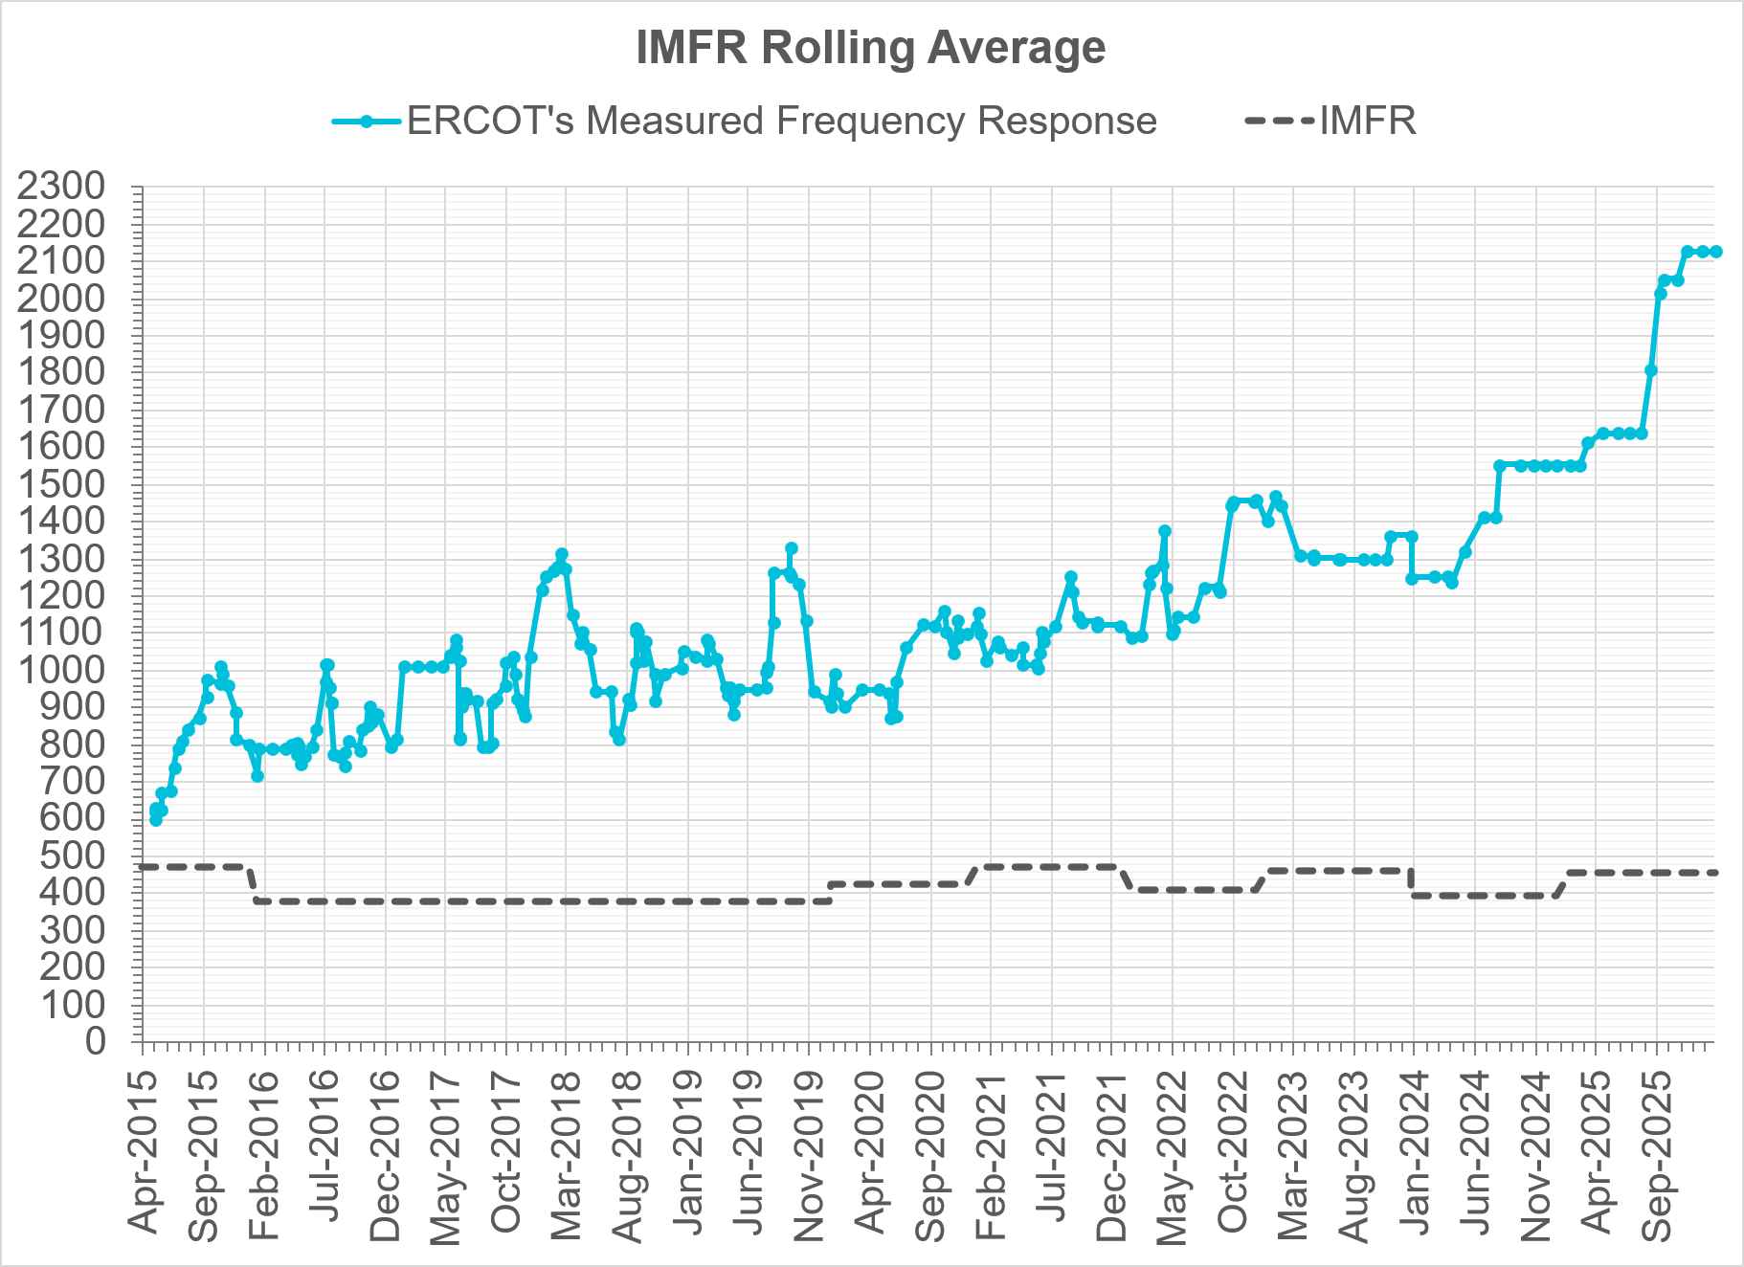
Interconnection Minimum Frequency Response (IMFR) Performance
IMFR Performance currently
2127.33 MW/0.1HZ
Frequency Response Obligation (FRO): 455 MW/0.1 Hz

Slide 5
Questions?

Slide 6
Frequency Control Report
January 2026

Slide 7
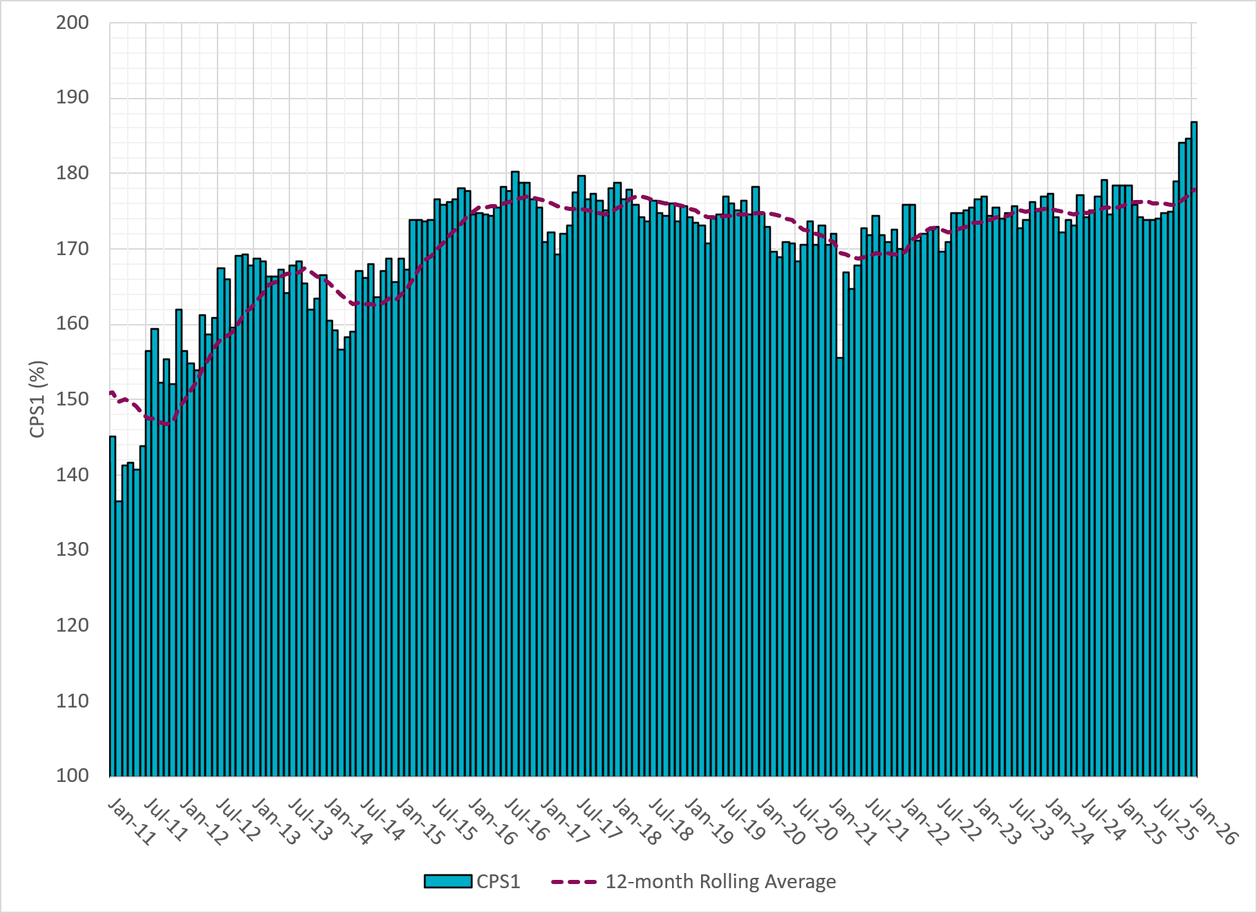
CPS1 Performance
Current 12-Month Rolling Average: 177.89%
Notes:
12 month rolling average CPS1 score is 177.89 which is continuing the increasing trend of CPS1 scores.

Slide 8
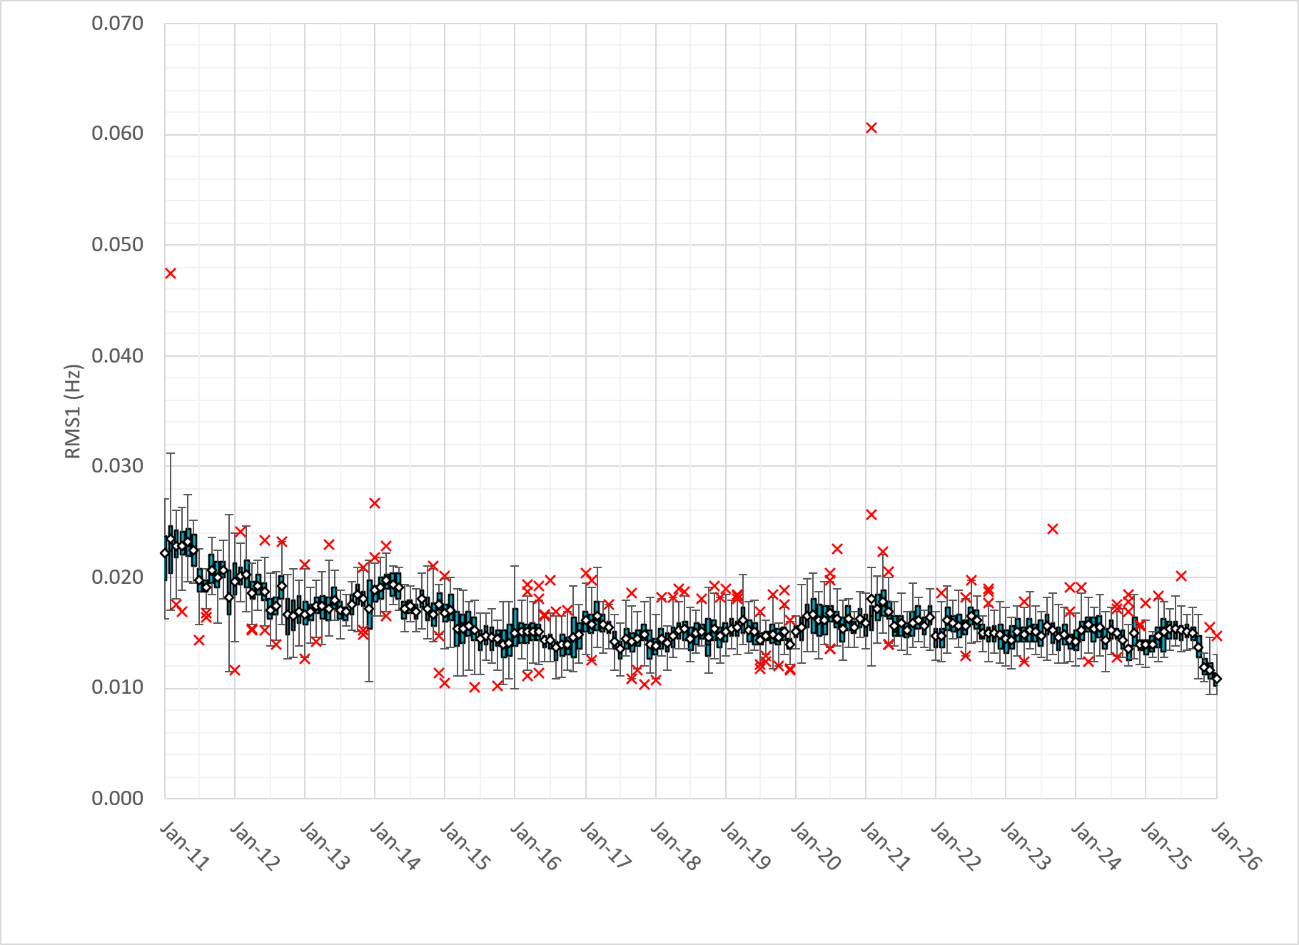
RMS1 Performance of ERCOT Frequency
Notes:
A More granular look at last 15 years of RMS1 by month
10.85 mHz on avg for January 2026

Slide 9
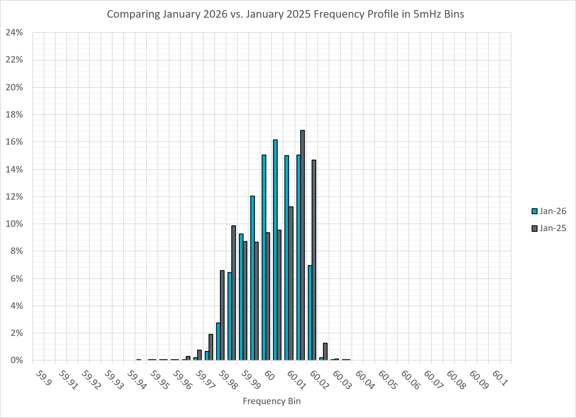
Frequency Profile Analysis
Notes:
Comparison of frequency profile between January 2025 and January 2026. Compared to last year, there are slightly less instances of frequency hovering around the lower dead bands.

Slide 10
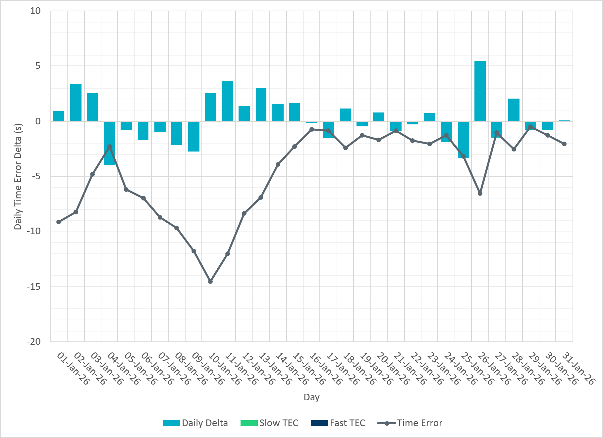
Time Error Corrections
Notes:
No time error corrections in the month of January.

Slide 11
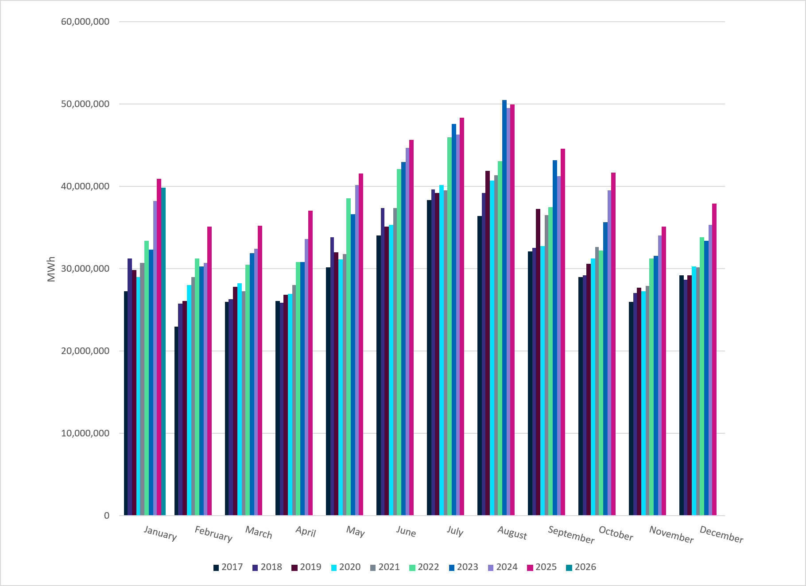
ERCOT Total Energy
Notes:
39,818,889 MWh – Increase in total energy compared to last month

Slide 12
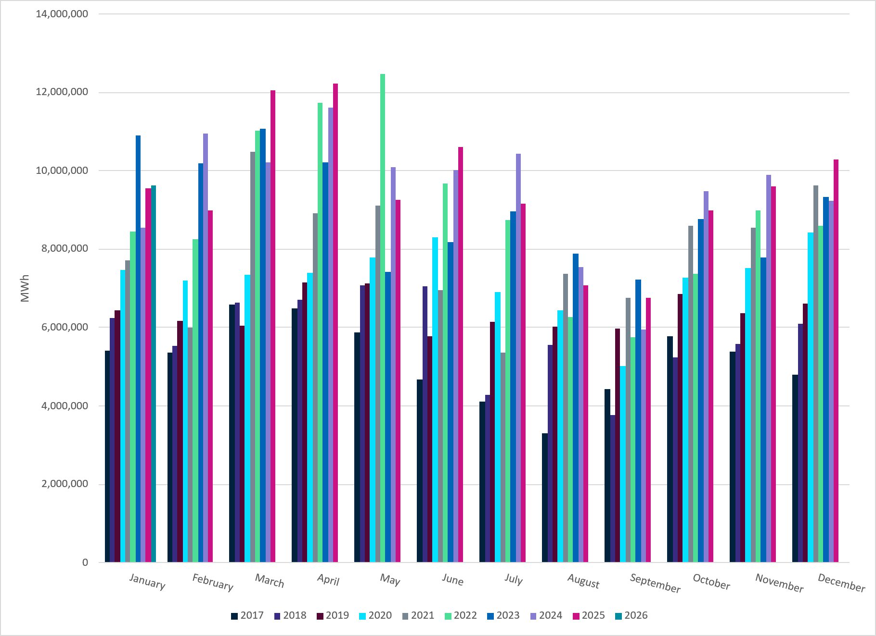
ERCOT Total Energy from Wind Generation
Notes:
9,632,919 MWH – Increase in total energy from wind compared to last month

Slide 13
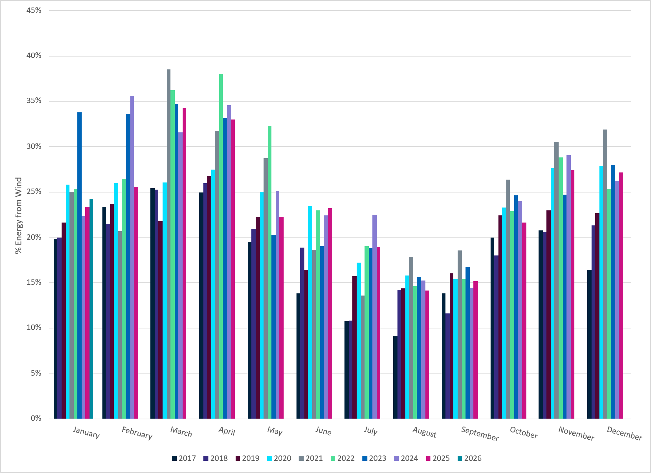
ERCOT % Energy from Wind Generation
Notes:
24.19% of total energy was provided by wind generation

Slide 14
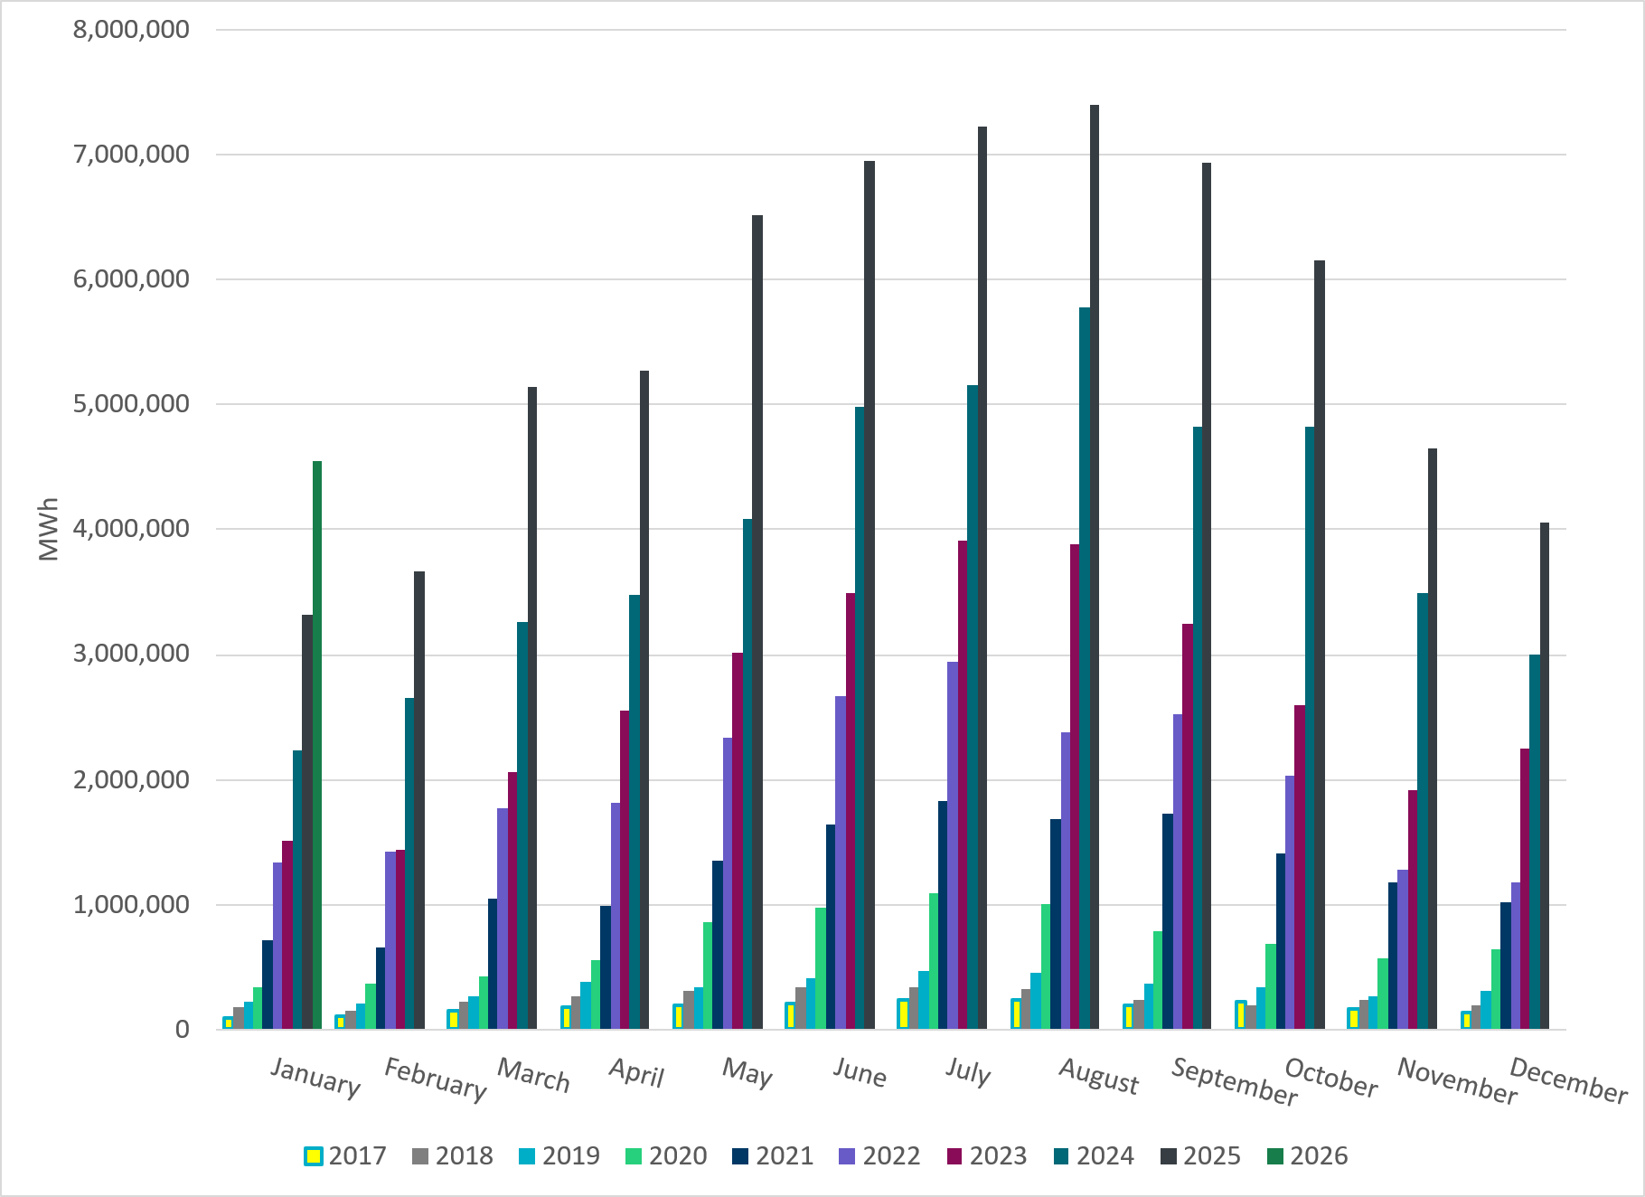
ERCOT Total Energy from Solar Generation
Notes:
4,548,988 MWh – Decrease in total energy from Solar

Slide 15
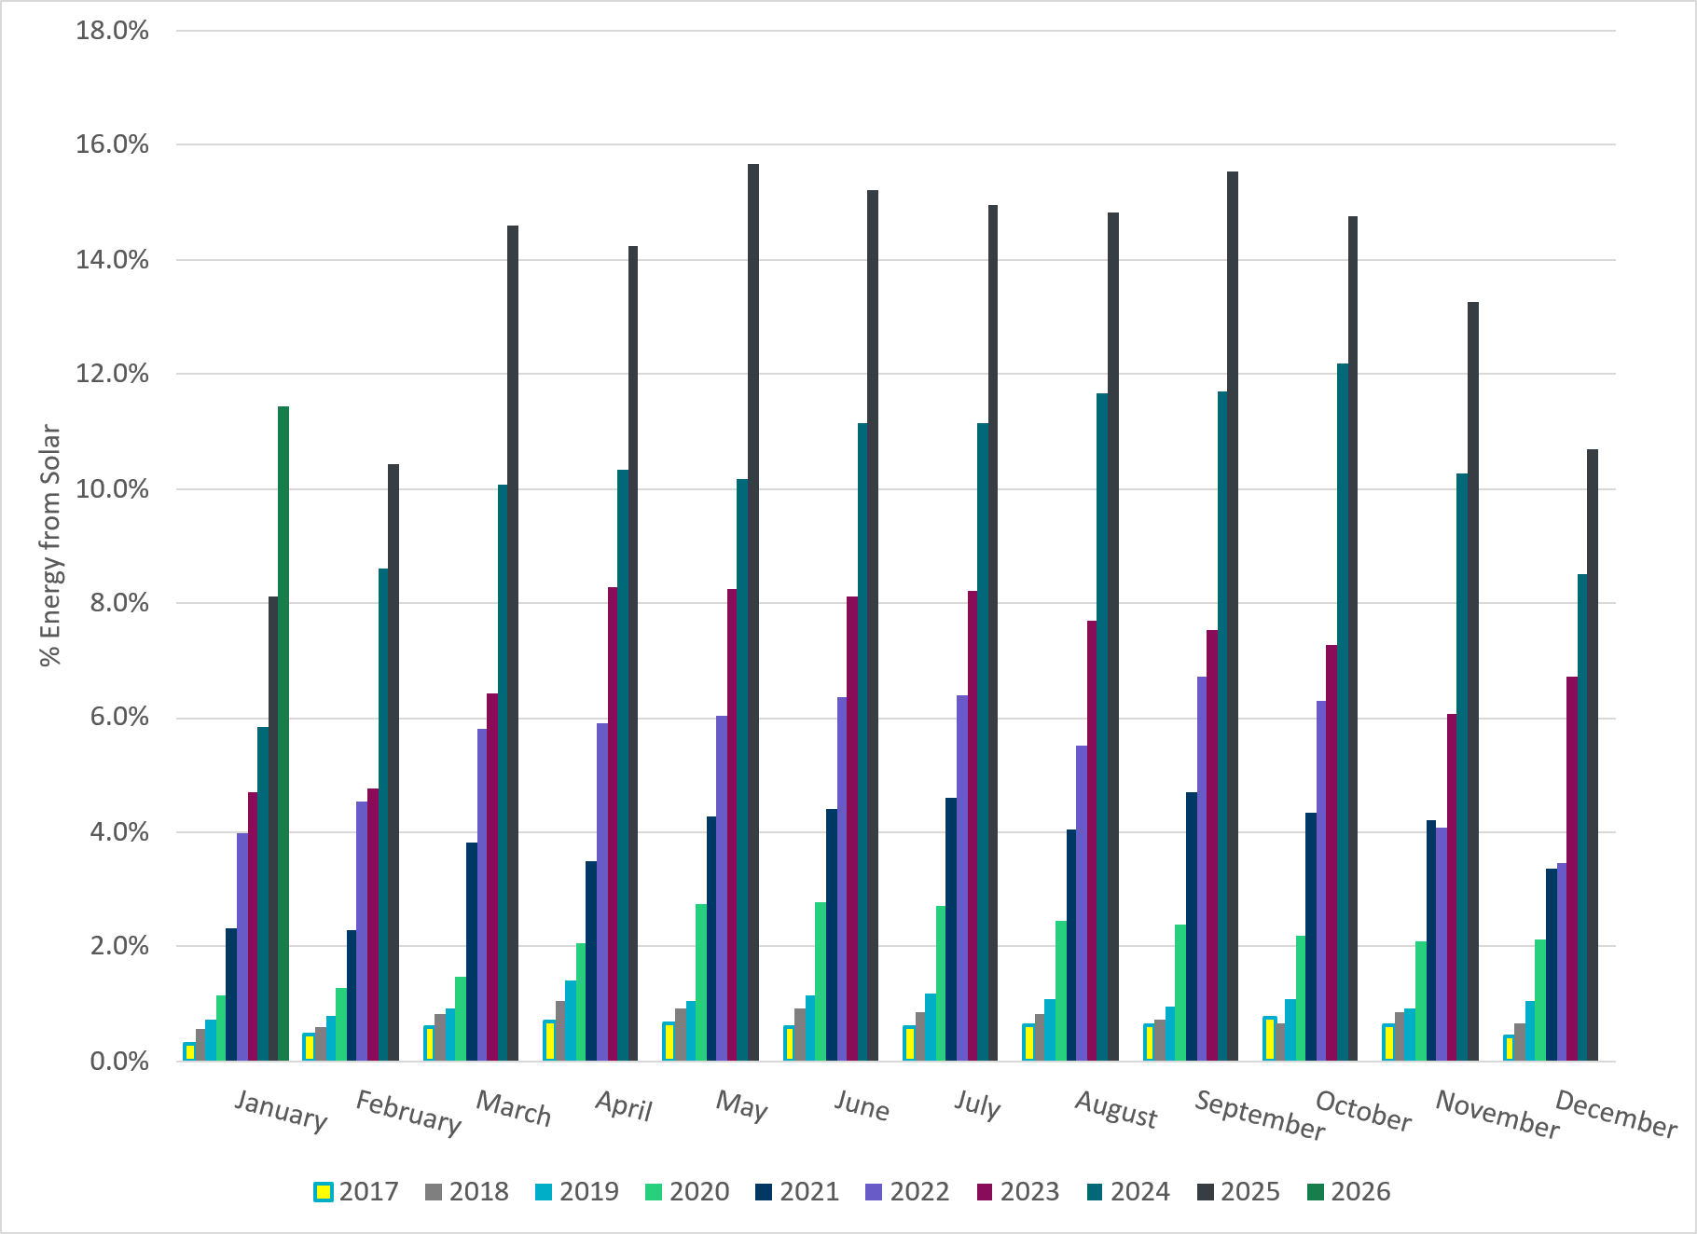
ERCOT % Energy from Solar Generation
Notes:
11.42% of total energy was provided by solar generation

Slide 16
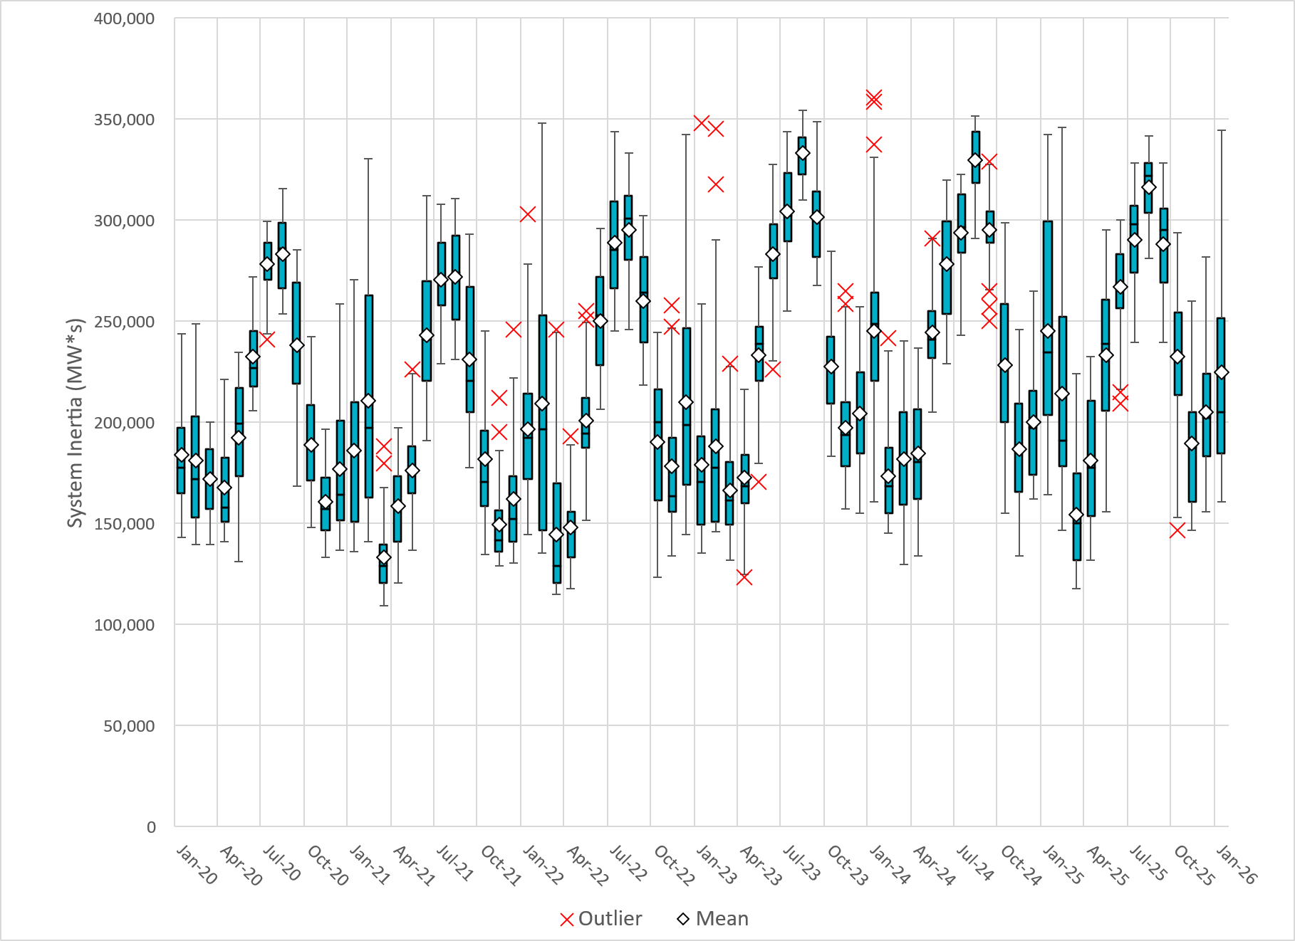
ERCOT Daily Minimum System Inertia
Notes:
Minimum Inertia in January 2025 = 164,095 MW*s on January 30th
Historical Overall Minimum was 109,029 MW*s on 3/22/2021
January Data:
Mean: 245,600 MW*s
Max: 342,313 MW*s on January 21st
Min: 164,095 MW*s on January 30th

Slide 17
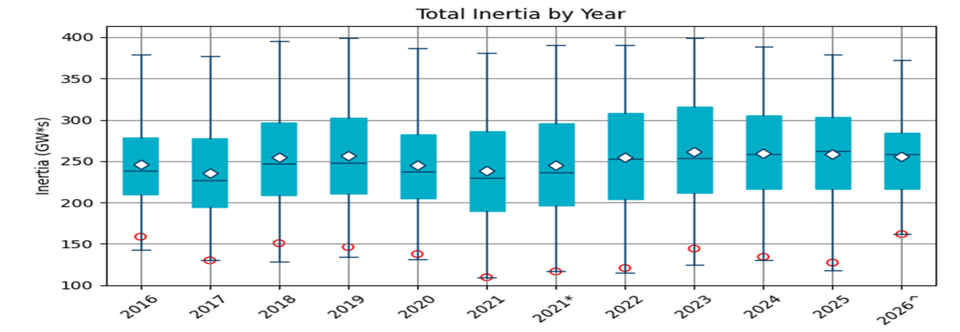
ERCOT Inertia Trend
Date and Time | 2016 4/10 2:00 AM | 2017 10/27 4:00 AM | 2018 11/03 3:30 AM | 2019 3/27 1:00 AM | 2020 05/01 2:00 AM | 2021 03/22 00:00 AM | 2022 03/21 01:00 AM | 2023 04/18 02:00 AM | 2024 03/29 03:00 AM | 2024 03/29 03:00 AM | 2025 01/30 2:00 AM | 2026 01/16 11:00 AM
Min synch. Inertia (GW*s) | 143 | 130 | 128.8 | 134.5 | 131.1 | 109 | 115 | 124 | 130 | 130 | 164.1 | 164.6
System load at minimum synch. Inertia (MW) | 27,831 | 28,425 | 28,397 | 29,883 | 30,679 | 32,599 | 33,365 | 35,799 | 37,297 | 37,297 | 49,389 | 52,559
Non-synch. Gen. in % of System Load | 47 | 54 | 53 | 50 | 57 | 65 | 66 | 61 | 68 | 68 | 64 | 74
Notes:
Summary of ERCOT inertia for the previous 10 years. Lowest inertia this year was on March 18th.
For each box, the central mark (red line) is the median, the edges of the box (in blue) are the 25th and 75th percentiles, the whiskers correspond to +/- 2.7 sigma (i.e., represent 99.3% coverage, assuming the data are normally distributed. The corresponding lowest inertia in each year is given in the table.
The circle on each boxplot is showing inertia during time when highest portion of load was served by wind/solar generation in that year.

