Slide 1
OBDRR055 - Revisions to Non-Spinning Reserve Deployment and Recall Procedure for RTC+B
WMS
3/4/2026

Slide 2
Overview
ERCOT has submitted OBDRR055 to reflect these key changes:
Remove outdated references of Ancillary Service Responsibility and Schedules, telemetered schedule performance monitoring, HASL calculation, Non-Spin deployment grouping, online Generation Resource sand Controllable Load Resources
Add in references for RTC+B AS Awards
Enhance the offline Non-Spin deployment trigger
ERCOT previously presented at RTCBTF on 12/15/2025, and 1/20/2025, PDCWG on 2/18/2026, and TAC on 2/25/2026 to share updates needed for Non-Spinning Reserve Deployment and Recall Procedure. These changes were needed to align the procedure with ERCOT market rules that are now effective post implementation of RTC+B. This OBDRR also enhances the trigger calculation that is used to recommend deployment of offline Non-Spin such that it takes the available energy into account when assessing capability to meet the 30-minute out forecasted Load.
The following slides will focus on the changes needed for the Non-Spin deployment trigger and suggested enhancements.

Slide 3
Non-Spin Deployment Trigger Analysis
Initial changes to align the Non-Spin Deployment Trigger with RTC+B required the replacement of HASL
since this concept was retired with implementation.
Pre-RTC Trigger:
HASL – (GTBD + GTBD Offset) – IRR Curtailment – 30 min Net Load Ramp Forecast
Current Trigger (as of 12/10):
HSL – Gen AS Awards – (GTBD + GTBD Offset) – IRR Curtailment – 30 min Net Load Ramp Forecast
While working on previous changes ERCOT identified additional enhancements that would improve the deployment trigger to better align with RTC+B and the evolving grid. ERCOT has performed additional analysis and proposes these additional changes:
Preserves the AS plan, without considering the excess Online Non-Spin procurements
Accounts for Non-Spin shortages, when the Non-Spin plan is not fully procured
Is aware of ESR State of Charge energy constraints

Slide 4
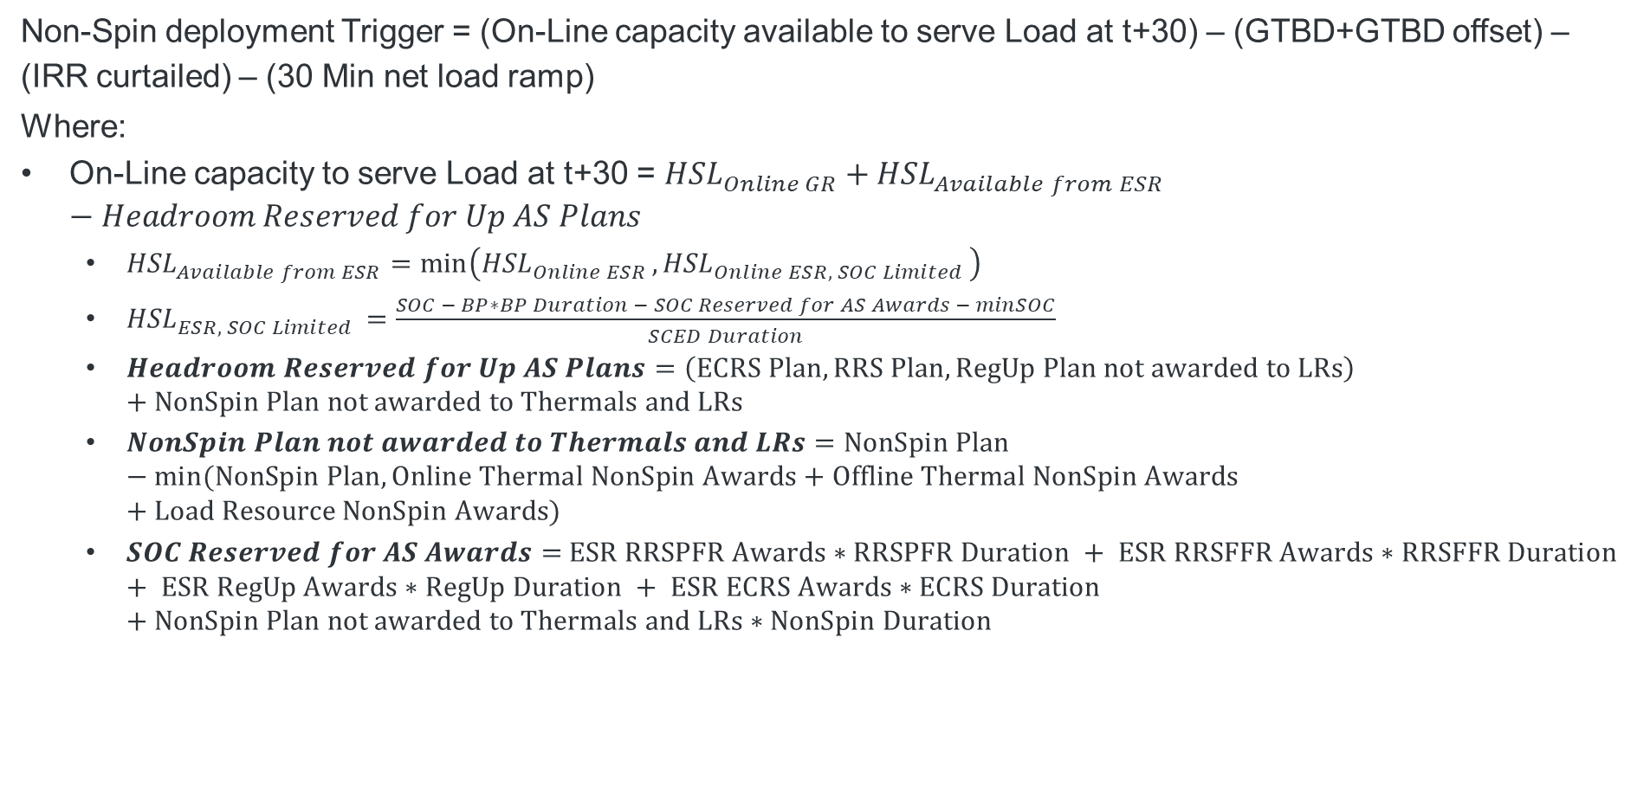
Formula for Trigger Proposed in OBDRR55
Non-Spin deployment Trigger = (On-Line capacity available to serve Load at t+30) – (GTBD+GTBD offset) – (IRR curtailed) – (30 Min net load ramp)
Where:
On-Line capacity to serve Load at t+30 = ${HSL}_{Online GR}+{HSL}_{Available from ESR}−Headroom Reserved for Up AS Plans$
${HSL}_{Available from ESR}=\min\left({HSL}_{Online ESR },{HSL}_{Online ESR, SOC Limited }\right)$
${HSL}_{ESR, SOC Limited }=\frac{SOC − BP∗BP Duration − SOC Reserved for AS Awards − minSOC}{SCED Duration}$
$Headroom Reserved for Up AS Plans=\left(ECRS Plan, RRS Plan, RegUp Plan not awarded to LRs\right)+NonSpin Plan not awarded to Thermals and LRs$
$NonSpin Plan not awarded to Thermals and LRs=NonSpin Plan −min⁡(NonSpin Plan, Online Thermal NonSpin Awards+Offline Thermal NonSpin Awards+Load Resource NonSpin Awards)$
$SOC Reserved for AS Awards=$ $ESR RRSPFR Awards∗RRSPFR Duration + ESR RRSFFR Awards∗RRSFFR Duration + ESR RegUp Awards∗RegUp Duration + ESR ECRS Awards∗ECRS Duration +NonSpin Plan not awarded to Thermals and LRs∗NonSpin Duration$
Notes:
OBDRR Language:
When the Non-Spin deployment margin is less than zero megawatts (MW), deploy sufficient Non-Spin capacity so that such margin is greater than 500 MW;
Wherem
Non-Spin deployment margin = (On-Line capacity available to serve Load at t+30) – (GTBD+GTBD offset) – (IRR curtailed) – (30 Min net load ramp)
t+30: current time + 30 minutes;
GTBD: Generation to be Dispatched;
IRR: Intermittent Renewable Resources; and
On-Line capacity available to serve Load at t+30 = On-Line Generation Resources High Sustainable Limits (HSL) + State of Charge (SOC) limited HSL for Energy Storage Resources (ESRs) at t+30 – Regulation Up AS Plan – ECRS AS Plan – RRS AS Plan – (Non-Spin AS Plan – min (Non-Spin AS Plan, Non-Spin awards on Off-Line Generation Resources + Non-Spin awards on On-Line thermal Resources + Non-Spin awards on Load Resources)).

Slide 5
Feedback received since last PDCWG
Shams raised a concern that the trigger proposed in slide 4 may be double counting Up AS awards expected on ESRs.
ERCOT has assessed this and agrees that the trigger on slide 4 has there is a potential double counting of AS awards on ESRs for Reg Up, RRS-PFR and ECRS during the times when SOC is declining and impacts the accounted ESR HSL. During all other times, the portion of the Reg-Up, RRS and ECRS plan that will be procured on ESRs should be accounted for in the trigger.
ERCOT has modified the proposed trigger based on this feedback. The next few slides will share details on this.

Slide 6
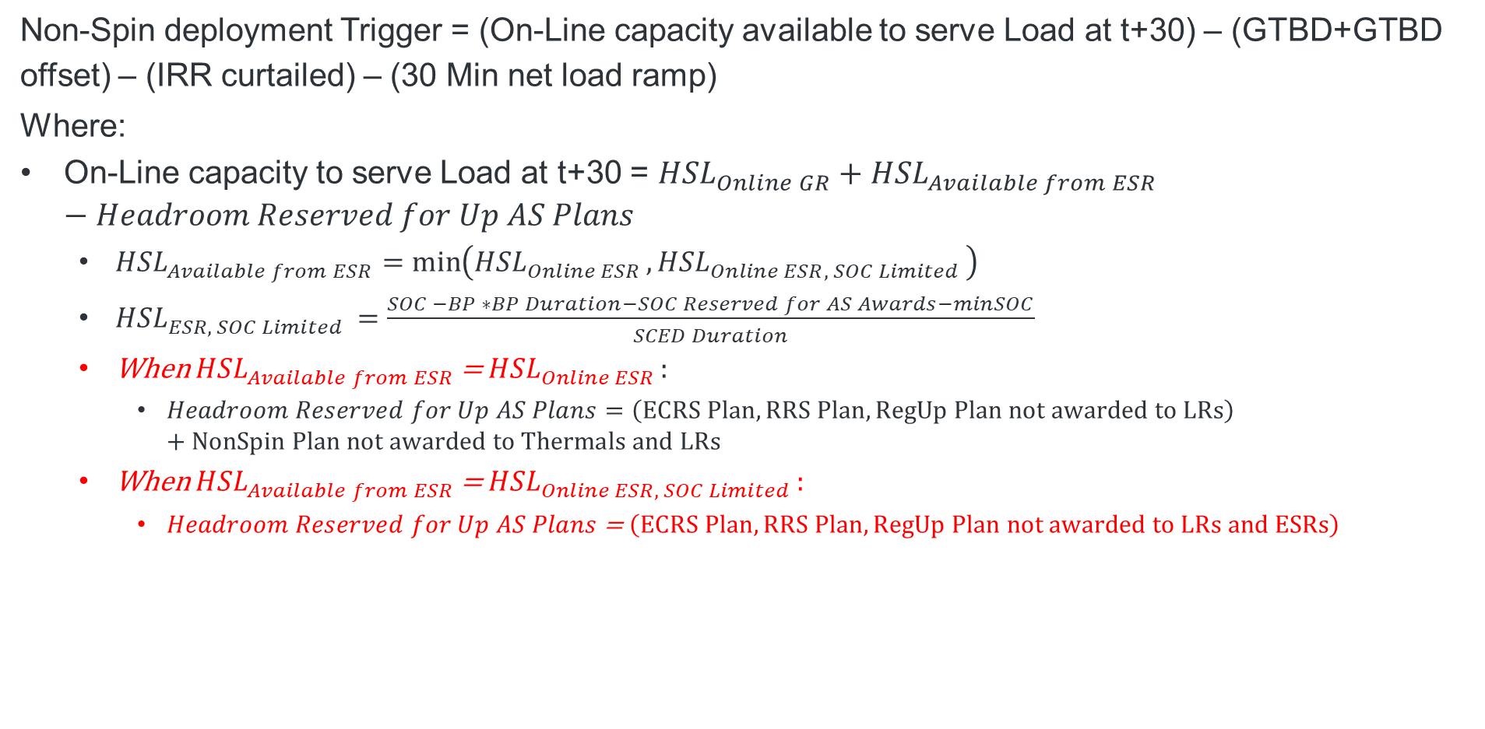
Modified Trigger based on Feedback
Non-Spin deployment Trigger = (On-Line capacity available to serve Load at t+30) – (GTBD+GTBD offset) – (IRR curtailed) – (30 Min net load ramp)
Where:
On-Line capacity to serve Load at t+30 = ${HSL}_{Online GR}+{HSL}_{Available from ESR}−Headroom Reserved for Up AS Plans$
${HSL}_{Available from ESR}=\min\left({HSL}_{Online ESR },{HSL}_{Online ESR, SOC Limited }\right)$
${HSL}_{ESR, SOC Limited }=$ $\frac{SOC −BP ∗BP Duration−SOC Reserved for AS Awards−minSOC}{SCED Duration}$
When ${HSL}_{Available from ESR}$ = ${HSL}_{Online ESR }:$
$Headroom Reserved for Up AS Plans=\left(ECRS Plan, RRS Plan, RegUp Plan not awarded to LRs\right)+NonSpin Plan not awarded to Thermals and LRs$
When ${HSL}_{Available from ESR}$ = ${HSL}_{Online ESR, SOC Limited }:$
$Headroom Reserved for Up AS Plans$ = $\left(ECRS Plan, RRS Plan, RegUp Plan not awarded to LRs and ESRs\right)$
Notes:
Revised OBDRR Language:
When the Non-Spin deployment margin is less than zero megawatts (MW), deploy sufficient Non-Spin capacity so that such margin is greater than 500 MW;
Where
Non-Spin deployment margin = (On-Line capacity available to serve Load at t+30) – (GTBD+GTBD offset) – (IRR curtailed) – (30 Min net load ramp)
t+30: current time + 30 minutes;
GTBD: Generation to be Dispatched;
IRR: Intermittent Renewable Resources; and
On-Line capacity available to serve Load at t+30 = On-Line Generation Resources High Sustainable Limits (HSL) + State of Charge (SOC) limited HSL for Energy Storage Resources (ESRs) at t+30 – Headroom Reserved for Up Ancillary Service Plans
When ESR HSL is not limited by SOC: Headroom Reserved for Up Ancillary Service Plans = RRS AS Plan + ECRS AS Plan + Regulation Up AS Plan + Non-Spin Plan not awarded to Thermals and Load Resources.
When ESR HSL is limited by SOC: Headroom Reserved for Up Ancillary Service Plans = RRS AS Plan not awarded to ESRs and Load Resources + ECRS AS Plan not awarded to ESRs and Load Resources + Regulation Up AS Plan not awarded to ESRs and Load Resources.

Slide 7
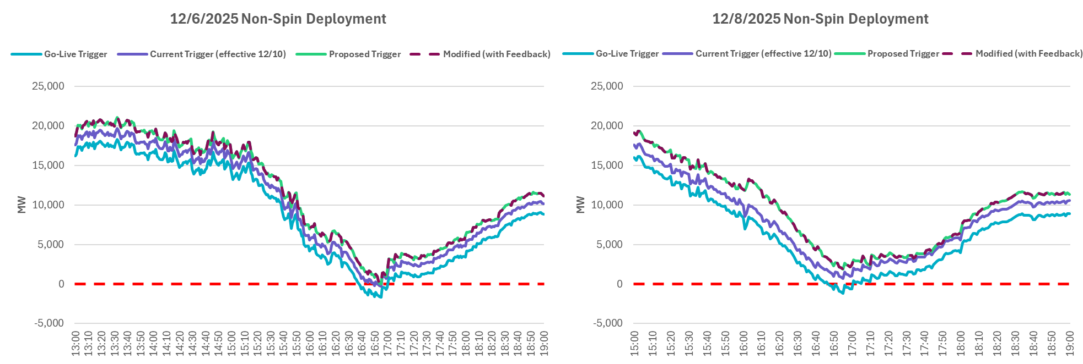
Impact on Non-Spin Deployments, 12/6/2025 and 12/8/2025
Trigger was driven by under forecast of net load.
Non-Spin may have been deployed a few minutes later, under the updated Trigger.
Non-Spin may not have been deployed on 12/8/2025 under the proposed Trigger.

Slide 8
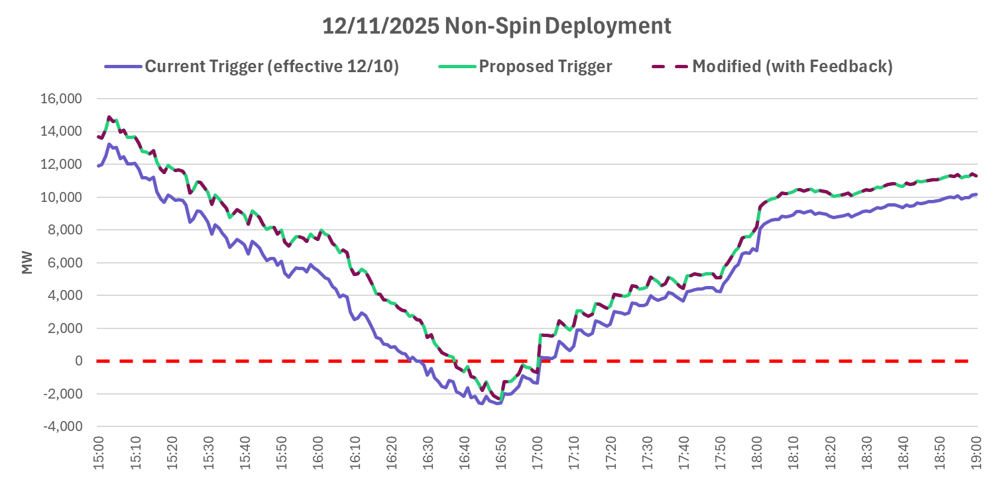
Impact on Non-Spin Deployment for 12/11/2025
Non-Spin would have been deployed ~ 12 minutes later under the Proposed RTC Trigger.

Slide 9
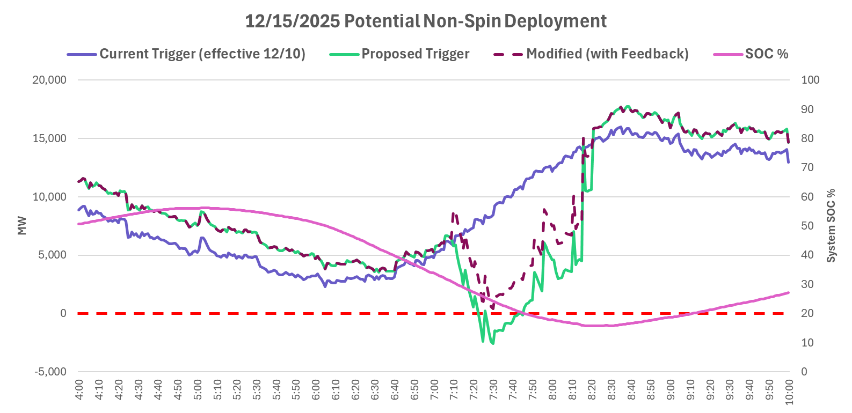
Impact on Non-Spin Trigger for 12/15/2025
Non-Spin was not deployed under the Current Trigger.
The Proposed Trigger would have suggested deployment, the Modified version would not.

Slide 10
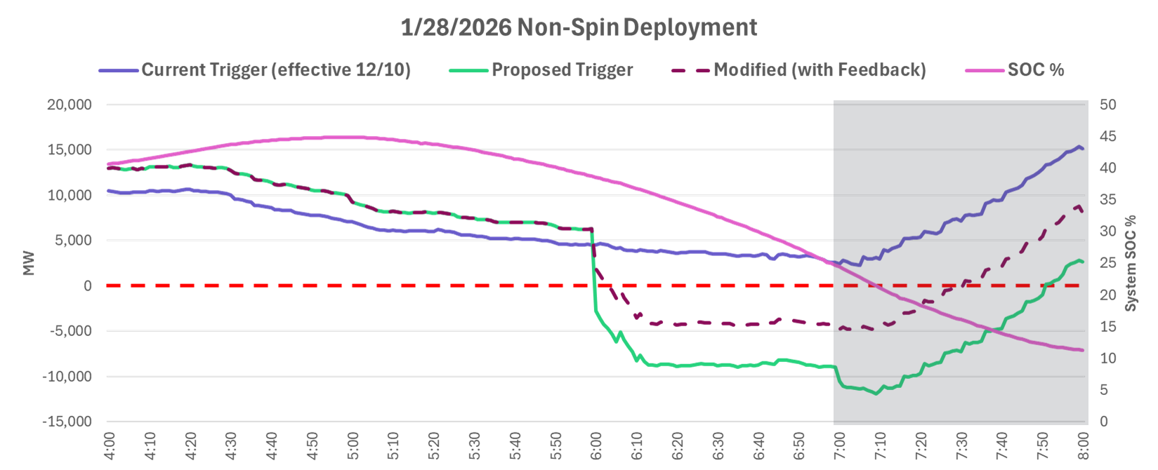
Impact on offline Non-Spin Deployment for 1/28/2026
On this morning, we see the current trigger does not indicate a need to deploy offline Non-spin, which is due to some of the short limitations mentioned on the previous slide.
Operators, using awareness system conditions deployed offline Non-Spin at ~7:00.
The Proposed Trigger suggests a deployment at ~6am due to AS Plan shortfall and dwindling ESR capability, and increased Non-Spin not covered by thermal Resources.
Shaded area represents offline Non-Spin Deployment

Slide 11
Proposed Update to OBDRR055
Non-Spin deployment margin = (On-Line capacity available to serve Load at t+30) – (GTBD+GTBD offset) – (IRR curtailed) – (30 Min net load ramp)
t+30: current time + 30 minutes;
GTBD: Generation to be Dispatched;
IRR: Intermittent Renewable Resources; and
On-Line capacity available to serve Load at t+30 = On-Line Generation Resources High Sustainable Limits (HSL) + State of Charge (SOC) limited HSL for Energy Storage Resources (ESRs) at t+30 – Headroom Reserved for Up Ancillary Service Plans
When ESR HSL is not limited by SOC:
Headroom Reserved for Up Ancillary Service Plans = (ECRS Plan, RRS Plan, RegUp Plan not awarded to LRs) + Non-Spin Plan not awarded to Thermals and Load Resources.
When ESR HSL is limited by SOC:
Headroom Reserved for Up Ancillary Service Plans = (ECRS Plan, RRS Plan, RegUp Plan not awarded to LRs and ESRs)

Slide 12
Summary and Next Steps
The proposed changes in the OBDRR055 will result in recommending offline Non-Spin deployments when the 30 minute out available capacity based on expected energy is not sufficient to serve the forecasted net load and procure the planned Reg Up, RRS and ECRS. During the 4 historic deployments that were analyzed, with the proposed changes,
In 2 events, Non-Spin deployment would have been delayed
In 1 event, Non-Spin deployment may not have been needed
In 1 event, Non-Spin would be triggered.
ERCOT’s requests that OBDRR055 be put on a timeline so that it can be approved for Summer 2026 (endorsement at Mar TAC will help achieve this).
ERCOT will submit comments by March 11, 2026 to update the trigger in OBDRR055 based on the discussions today.
ERCOT requests that any further feedback or comments be shared with JoseLuis.Hinojosa@ercot.com or filed as soon as practicable so that we can continue moving this OBDRR forward.

Slide 13
Questions?

Slide 14
Appendix

Slide 15
Durations
Type | Duration (min) | Rational
SCED | 5 | SOC capability for one additional SCED interval at t+30
BP | 30 | Assume the BP is sustained for the t+30 horizon
Non-Spin | 240 | Non-Spin Duration Requirement
ECRS | 60 | ECRS Duration Requirement
RRS-PFR | 30 | RRS-PFR Duration Requirement
RRS-FFR | 15 | RRS-FFR Duration Requirement
RegUp | 30 | Regulation Up Duration Requirement
Notes:
OBDRR Language:
When the Non-Spin deployment margin is less than zero megawatts (MW), deploy sufficient Non-Spin capacity so that such margin is greater than 500 MW;
Wherem
Non-Spin deployment margin = (On-Line capacity available to serve Load at t+30) – (GTBD+GTBD offset) – (IRR curtailed) – (30 Min net load ramp)
t+30: current time + 30 minutes;
GTBD: Generation to be Dispatched;
IRR: Intermittent Renewable Resources; and
On-Line capacity available to serve Load at t+30 = On-Line Generation Resources High Sustainable Limits (HSL) + State of Charge (SOC) limited HSL for Energy Storage Resources (ESRs) at t+30 – Regulation Up AS Plan – ECRS AS Plan – RRS AS Plan – (Non-Spin AS Plan – min (Non-Spin AS Plan, Non-Spin awards on Off-Line Generation Resources + Non-Spin awards on On-Line thermal Resources + Non-Spin awards on Load Resources)).

