Slide 1
SSWG Report to ROS
March 5, 2026
Chair: Chris Ramirez (cramirez@wettllc.com)
Vice Chair: Weiwei Hu (weiwei.hu@austinenergy.com)

Slide 2
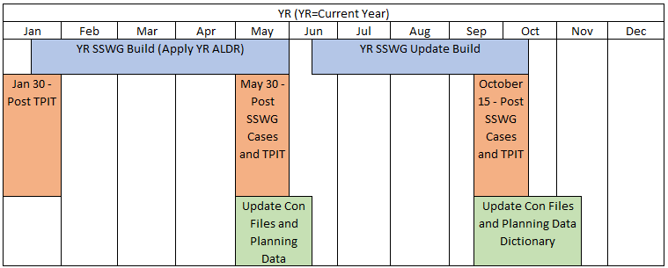
SSWG Report
Key Updates
26SSWG TPIT Update #1
  Transmission Project & Information Tracking (TPIT)
  Updated report published Jan 29th
  https://www.ercot.com/gridinfo/planning
26SSWG Case Build #1
  Currently Ongoing
  Load Data / Topology Deadline: March 27th
  In-Person Post-Dispatch Tuning Meeting
    April 27th – 29th
  Target Posting: May 22nd
SSWG Procedure Manual Revisions
  Specifying that ESRs are online in off-peak cases for VAR support
  A rework of extraordinary dispatch for PGRR127
  Language updates to be presented for April ROS combo ballot
SSWG Report to ROS External

