Slide 1
Resource Integration - AVR Test for a Small Conventional DGRs
John Lawson, Supervisor of Small Generation
RIWG Meeting
February 23, 2026

Slide 2
Conventional DGR (Gas Turbine, Steam Turbine, Nuclear Generators) - AVR Testing Objectives
The purpose of the AVR test is to test the DGRs ability to go from LSL to HSL and back while the AVR keeps the reactive power to 0 MVAr (unity power factor) at the Point of Common Coupling (PCC/POI). New procedure is posted on the Resource Integration website (https://www.ercot.com/services/rq/integration)
During the AVR test, the Unit will ramp from LSL to 25%, 50%, 75% and 100% of the HSL at the registered ramp rate to reach a steady state.
Keep voltage flicker at the POI to less than 1%, 2% or 3% depending on the frequency of voltage dips
Minimize MVAR transients to the POI
AVR test data will be entered on an Excel worksheet in 4 second time intervals. Column A is for the time-stamp (CST). Column B is for POI kV, Column C is for MW flow at the POI (+ for flow from the DGR to the PCC). Column D is for MVAr flow at the POI (+ for flow from the DGR to the PCC).

Slide 3
Voltage Setpoint for AVR test For Unity Power Factor
Control DGR
During the AVR test, measurements must be taken and recorded at each the following MW levels:
25% output
50% output
75% output
100% output
Allow MW output to settle for each scenario
HSL
50% Output
75% Output
100% Output
25% Output
MW
LSL
Coordinate test with ERCOT and DSP and/or TSP
Report data in 4 second intervals
t

Slide 4
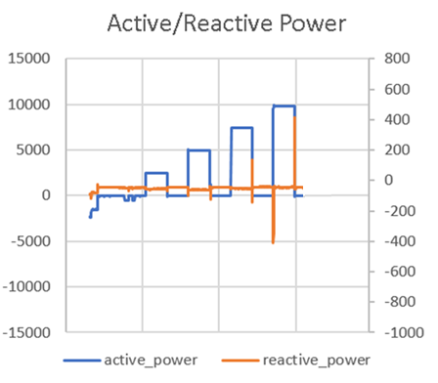
Example of MVAr Transients:
These occur mostly during changes from LSL to HSL and need to be kept to a minimum
Switching Transients

Slide 5
PASS/FAIL Criteria (Without Taking
Transients Into Consideration):
Each test point is evaluated using the following rules:
  For when the absolute value of the DGR MW PCC flow is > 30% of maximum MW DGR capability
    A test measurement will “pass” if the absolute value of the DGR MVAr PCC flow is <= 3.5% of absolute value of the DGR MW PCC flow
  For when the absolute value of the DGR MW PCC flow is <= 30% of maximum installed MW DGR capability
    A test measurement will “pass” if the absolute value of the DGR MVAr PCC flow is <= 1.3% of the maximum installed MW DGR capability

Slide 6
Overall AVR Test Evaluation:
For the test points that “fail” the above 2 rules, the voltage dips (flicker) must be less than the following to minimize MVAr transients to the PCC. (Refer to IEEE Std 1453-2015 IEEE Recommended Practice for the Analysis of Fluctuating Installations on Power Systems – Figure 1 --- GE flicker curve.)
  Voltage dips resulting in a <= 3% change in PCC voltage will “pass” if the frequency of voltage dips is <= 10 voltage dips per hour (for typical operations)
  Voltage dips resulting in a <= 2% change in PCC voltage will “pass” if the frequency of voltage dips is <= 1 voltage dip per minute (for typical operations)
  Voltage dips resulting in a <= 1% change in PCC voltage will “pass” if the frequency of voltage dips is <= 15 voltage dips per minute (for typical operations)
  Voltage dips resulting in a <= 0.5% change in PCC voltage will “pass” regardless of frequency of voltage dips (for typical operations)
ERCOT will consult DSP/TSP if there is a question of the AVR Test passing

Slide 7
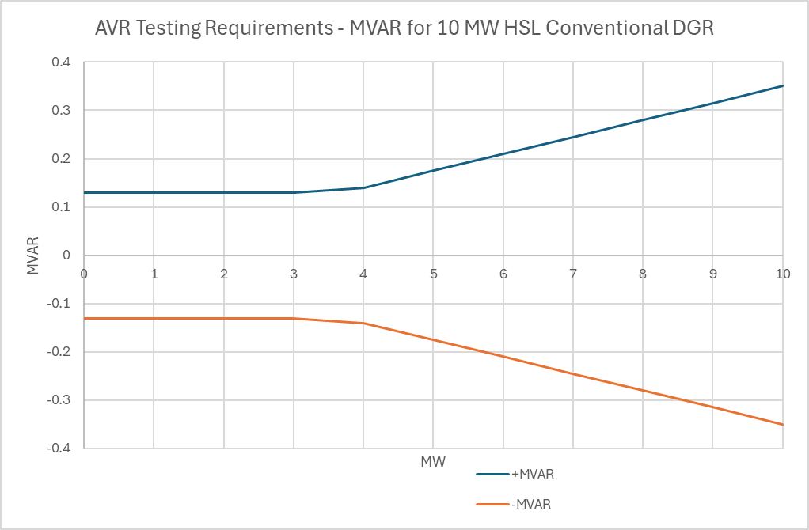
PASS/FAIL Criteria:
This is a visualization for a 10 MW Conventional DGR as an example:

Slide 8

Questions?
Thank you!

