Slide 1
Full Registration Data Requirements
Daniel Lizarraga & Luis Gonzalez
Resource Integration
2/23/2026

Slide 2
Overview
Production Load Date (PLD) – Associated Deadlines
Common Issues found during Registration calls
Site Code Confirmation
Required documentation prior to Full Registration Call
  MPT Factory Acceptance Test Report
  OEM Inverter Specification Document
  One-Line Diagram marked-up with Connectivity Nodes
  Standard Generation Interconnection Agreement (SGIA)
  Point of Interconnection Bus (POIB) Bus Number/Station Code
Tie Line Ownership
Connectivity Explained

Slide 3
Registration Data Submission Overview
NPRR1254 implemented on March 1st, 2025, requires that Registration Data must be submitted 120 days prior to targeted PLD month. (Requirement communicated first during the 12/19/2024 RIWG).
RE Registration can take up to two months or longer.
Nodal Protocol Section 3.10.1(4)
Full schedule found here – PLD Schedule
EPS Meter Design Proposal must be submitted by the deadline for Resource Registration Data to meet Criteria for ERCOT Acceptance (90 days prior to PLD month)
Deadline for Resource Entity to Submit Complete Information to ERCOT Note 1 | Deadline for Resource Registration Data to Meet Criteria for ERCOT Acceptance Note 2 | Model Complete and Available for Test Note 3 | Updated Network Operations Model Testing Complete Note 4 Paragraph (6) | Update Network Operations Model Production Environment Notes 5, 6
December 1 | January 1 | February 15 | March 15 | Month of April
January 1 | February 1 | March 15 | April 15 | Month of May
February 1 | March 1 | April 15 | May 15 | Month of June
March 1 | April 1 | May 15 | June 15 | Month of July
April 1 | May 1 | June 15 | July 15 | Month of August
May 1 | June 1 | July 15 | August 15 | Month of September
June 1 | July 1 | August 15 | September 15 | Month of October
July 1 | August 1 | September 15 | October 15 | Month of November
August 1 | September 1 | October 15 | November 15 | Month of December
September 1 | October 1 | November 15 | December 15 | Month of January (the next year)
October 1 | November 1 | December 15 | January 15 | Month of February (the next year)
November 1 | December 1 | January 15 | February 15 | Month of March (the next year)

Slide 4
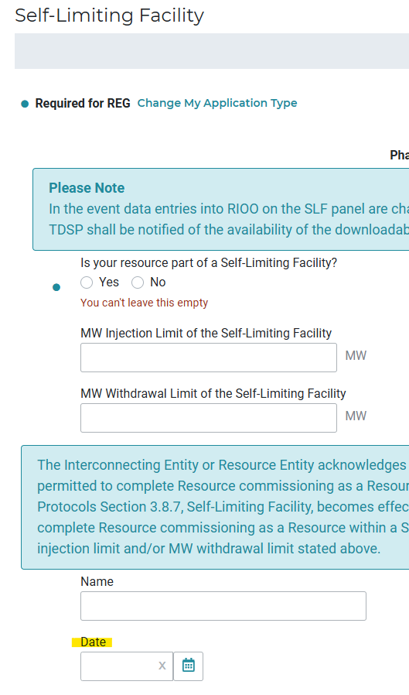
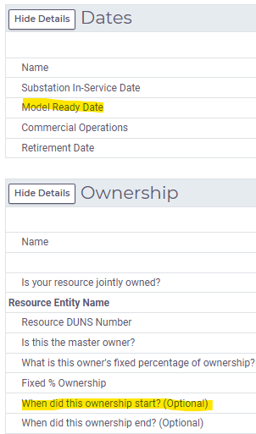
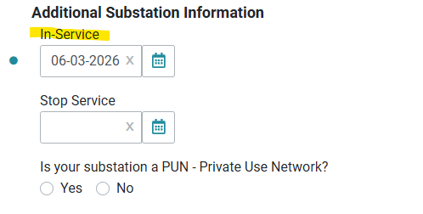
Common Issues Found During Registration Calls
Resource → Dates
The highlighted dates in the specified sections should all correspond to the targeted PLD
Resource → Ownership
Substation → Details
Substation → Self-Limiting Facility

Slide 5
Site Code Confirmation
Solar INRs typically contain _SLR
Wind typically contain _WND
ESRs typically contain _BES or _ESR
Co-located projects will only use one of the above. Use the INR that will COD first or is considered the primary project.
For new generation projects requiring a separate RE owned station to be modeled (transmission connected), please provide your RI engineer with 2-3 potential site code options. This will allow us to confirm the code with ERCOT Operations as early as possible.
For distribution connected small generators (DGR/DESRs), the Resource will be modeled at the existing TDSP station.
Limited to 8 characters with site code being abbreviated to still be unique
When adding additional generation to an operational site or TDSP station, note the following:
  RIOO does not allow reuse of an existing site code unless that site was selected during the initial application.
  Appending a ‘1’ to the end of the Site Code (replacing characters as needed to respect 8-char limit) is a convention that indicates to ERCOT Modeling and Database teams that the sites will be merged internally post-PLD.

Slide 6

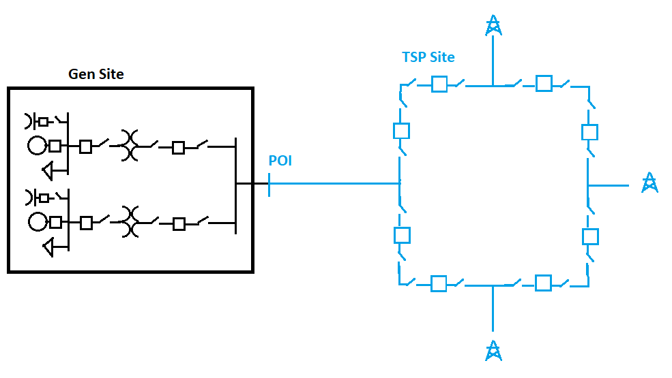
Documentation to Have Ready – Prior to Full Registration Call
Inverter Specification Sheet and Factory Acceptance Test (FAT) Report
Provide OEM spec sheet information to verify the values given in Substation Details.
Upload to RIOO as ERCOT Planning will also use this for Future Year Case Build Planning Models and verify the data submitted
POIB number and POIB Substation Code
Resource Entities should verify with the TSP the correct POIB number and POIB substation code.
If a new station is being built, RE should verify with the TSP the PLD for when the station will be in the model, as well as Network Operations Model Change Request (NOMCR).
SGIA
Include most recent amendments.
If an amendment is currently underway, please have a draft available.
Items of interest:
Resource Entity name
Project name
Exhibit C – Project description
  Tie Line ownership
  Project size
  Equipment description

Slide 7
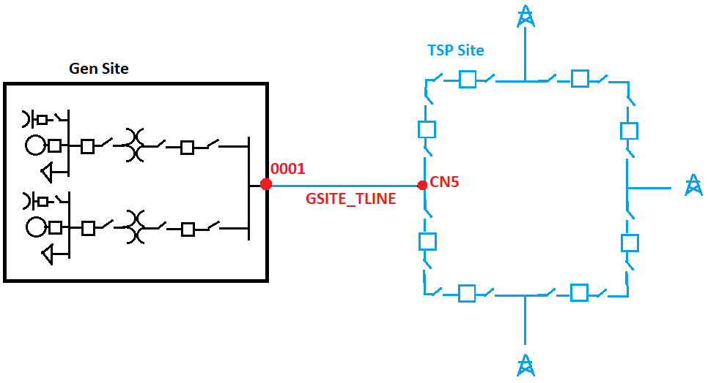
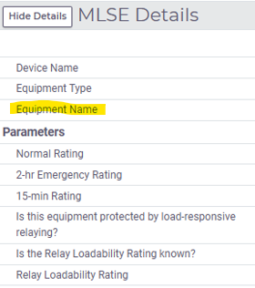
Tie Line Ownership – TSP
If the TSP owns the tie line, the RE should fill out Most Limiting Series Element data.
The RE should contact the TSP to obtain the name of the tie line that the TSP will model after ERCOT has modeled the islanded Generation site.

Slide 8
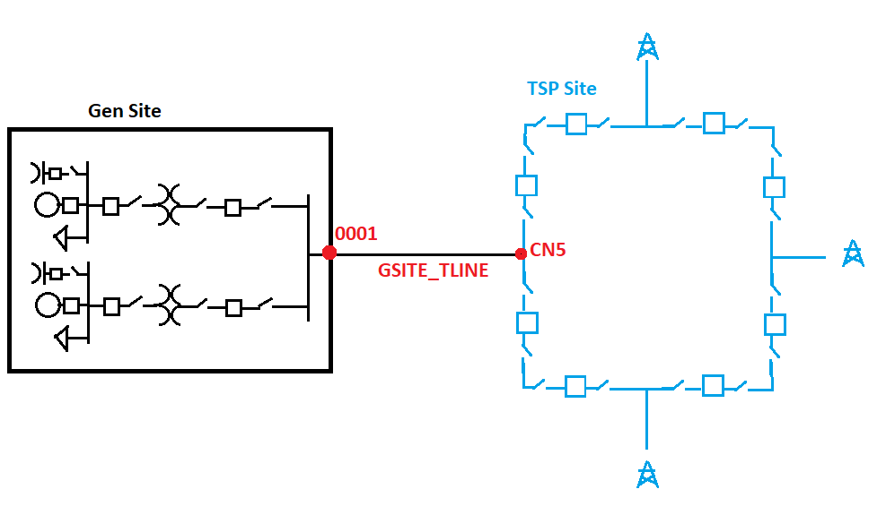
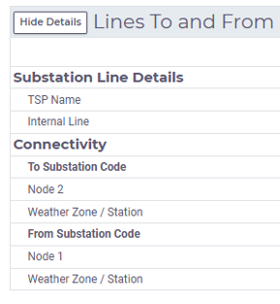
Tie Line Ownership – RE
If the RE owns the tie line, ERCOT will model the line along with the rest of the Generation Site.
The RE will need to contact their TSP to obtain the Connectivity Node number at the POIB station where the RE’s tie line will connect
TSP Sitecode
CN5

Slide 9
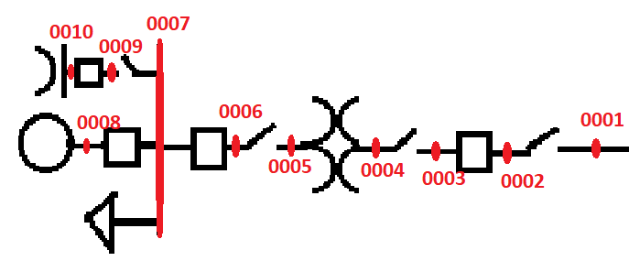
Marked-up Oneline
Prior to the first Data Review call, please post to RIOO-IS a marked-up One-Line Diagram with equipment names and Connectivity Nodes that match the data in Substation Details.
Connectivity Nodes represent points of electrical connectivity between the respective Terminals of equipment in the Operations Model.
For Connectivity Node numbering, our conventional advice is: start at the tie line and call that node 0001, then increment as you work your way down toward the Unit(s).
We generally ask that REs adhere to a 4-digit incrementing naming convention for model consistency and understandability

Slide 10
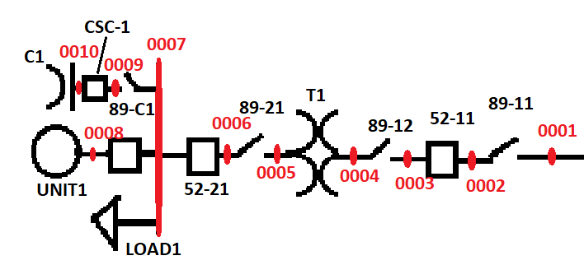
Connectivity Nodes - example
Type | Name | CN1 | CN2
DSC | 89-11 | 0001 | 0002
CB | 52-11 | 0002 | 0003
DSC | 89-12 | 0003 | 0004
XFMR | T1 | 0004 | 0005
DSC | 89-21 | 0005 | 0006
CB | 52-21 | 0006 | 0007
DSC | 89-C1 | 0007 | 0009
CB | CSC-1 | 0009 | 0010
CB | VIRTUAL_BKR1 | 0007 | 0008
Gen | UNIT1 | 0008 | -
Load | LOAD1 | 0007 | -
Shunt | C1 | 0010 | -

Slide 11
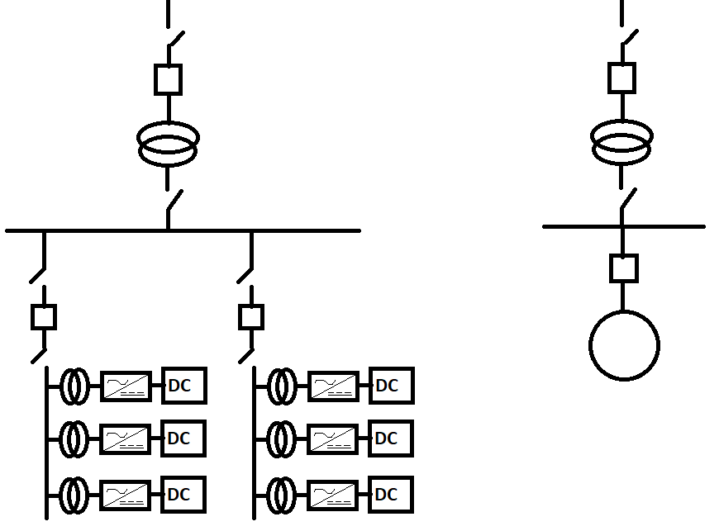
Virtual Breakers
In ERCOT’s Operations Model, IBR Collector Systems are equivalized into a single Resource at the medium-voltage bus.
A Virtual breaker is likewise an equivalization of collector feeder switches and breakers, and represents the logical condition of the Resource.
The RE should call this equivalized breaker VIRTUAL_BKR1 or PSEUDO_BKR1 (or 2, 3, …) to match the Resource’s identifier.

Slide 12
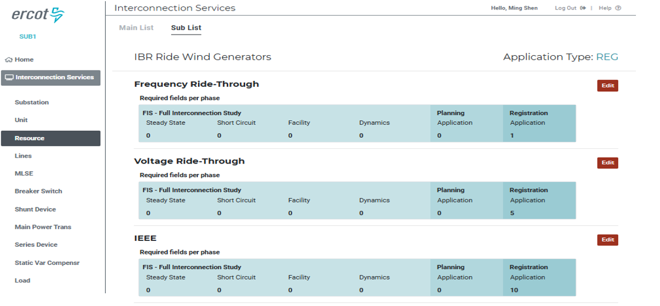
NOGRR245 Panels
The new NOGRR245 Panels are required to be submitted prior to model inclusion. The Resource should update the FRT, VRT and IEEE 2800-2022 information.
Per Nodal Operating Guide Sections 2.9.1, 2.6.2.1, and 2.9.1.2, Resources must meet specific requirements at different milestones. The relevant requirements are:
  NOG 2.9.1(8) requires Resources to meet the IEEE 2800 requirements by 12/13/2025 or Commercial Operations Date (COD).
  NOG 2.6.2.1(6) requires Resources to meet the frequency ride-through requirements by 12/13/2025 or synchronization date.
  NOG 2.9.1.2(8) requires Resources to meet the voltage ride-through requirements by 12/13/2025 or COD.
Below are some resources related to these new panels:
  - Market Notice 10/30/2025 – M-A103025-01 RIOO NOGRR245 Release to Production
  - NOGRR245 Workshop #3 – Event Details

