Slide 1
OBDRR055 - Revisions to Non-Spinning Reserve Deployment and Recall Procedure for RTC+B
PDCWG
2/17/2026

Slide 2
Background
ERCOT previously presented at RTCBTF on 12/15/2025 and 1/20/2025 to share updates needed for Non-Spinning Reserve Deployment and Recall Procedure. These changes were needed to align the procedure with ERCOT market rules that are now effective post implementation of RTC+B. This OBDRR also enhances the trigger calculation that is used to recommend deployment of Non-Spin such that it takes available energy into account when assessing capability to meet the 30-minute out forecasted Load.
ERCOT has since submitted OBDRR055 to reflect these key changes:
Remove references of Ancillary Service Responsibility and Schedules/Add references for Awards
Remove HASL references
Enhance the Non-Spin deployment trigger*
Remove Non-Spin deployment grouping
Removal of AS schedule telemetry evaluation for performance
Removal of online deployment of Generation Resource sand Controllable Load Resources
Modified the expectations for deployment of online Non-Spin that use power augmentation
The following slides will focus on the changes needed for the Non-Spin deployment trigger and suggested enhancements.

Slide 3
Non-Spin Deployment Trigger Analysis
Initial changes to align the Non-Spin Deployment Trigger with RTC+B required the replacement of HASL
since this concept was retired with implementation.
Pre-RTC Trigger:
HASL – (GTBD + GTBD Offset) – IRR Curtailment – 30 min Net Load Ramp Forecast
Current Trigger (as of 12/10):
HSL – Gen AS Awards – (GTBD + GTBD Offset) – IRR Curtailment – 30 min Net Load Ramp Forecast
While working on previous changes ERCOT identified additional enhancements that would improve the deployment trigger to better align with RTC+B and the evolving grid. ERCOT has performed additional analysis and proposes these additional changes:
Preserves the AS plan, without considering the excess Online Non-Spin procurements
Accounts for Non-Spin shortages, when the Non-Spin plan is not fully procured
Is aware of ESR State of Charge energy constraints

Slide 4
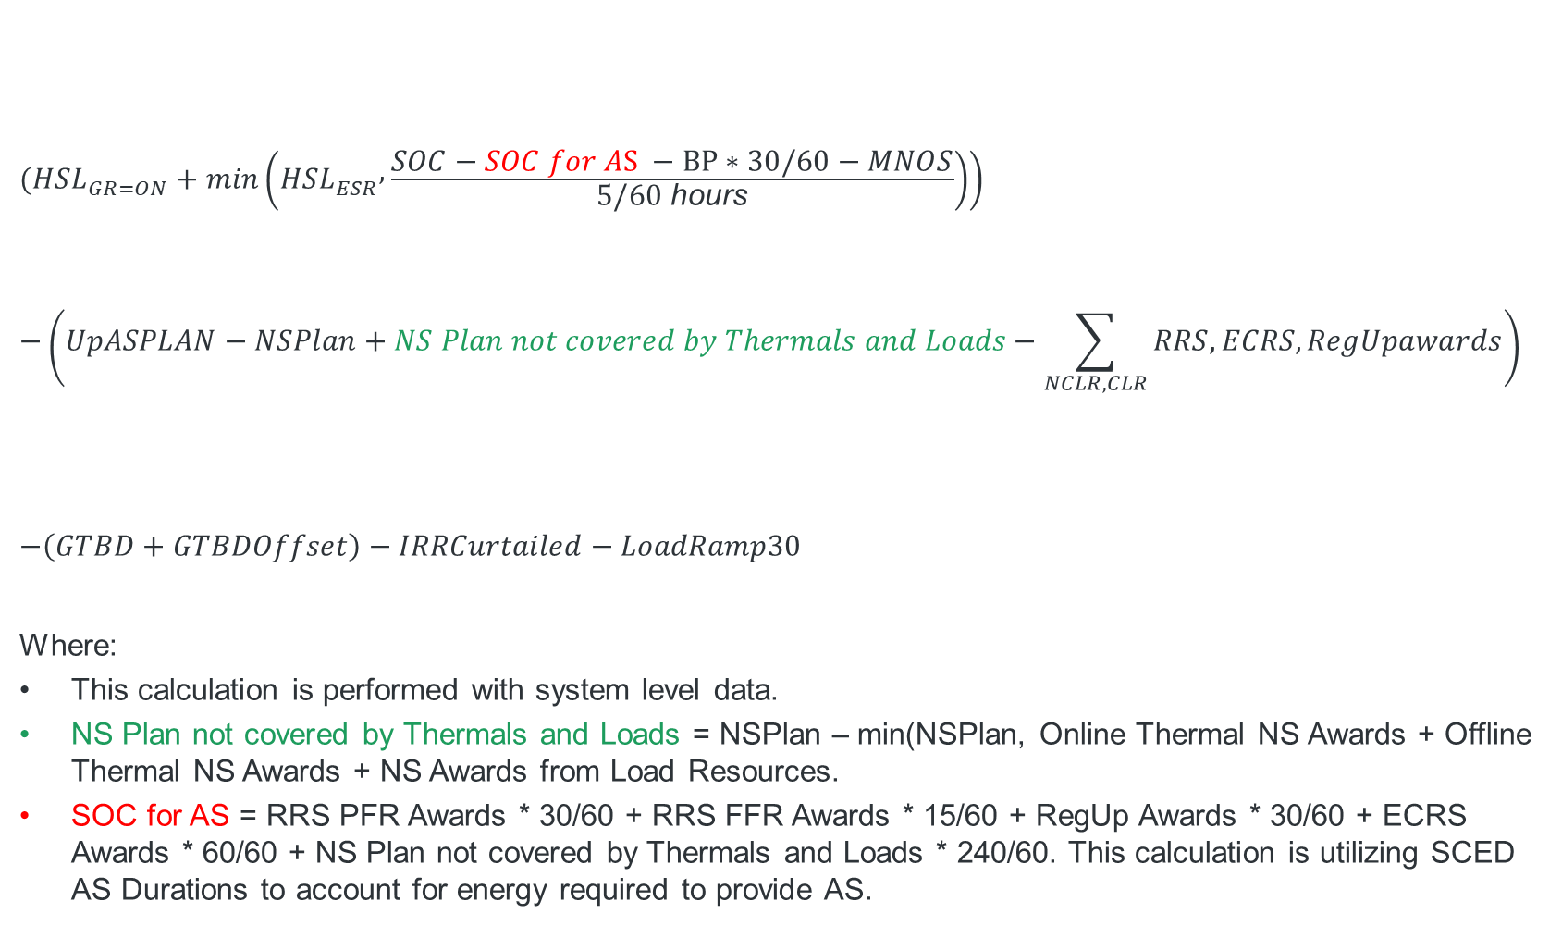
Proposed Trigger Formula
$$\left.(HSL_{GR=ON}+\min\left(HSL_{ESR} , \frac{SOC−SOC for AS −BP∗30/60−MNOS}{5/60 \text{hours}}\right)\right)$$
$$−\left(UpASPLAN−NSPlan+NS Plan not covered by Thermals and Loads−\sum_{NCLR,CLR}{RRS,ECRS,RegUpawards}\right)$$
$$−\left(GTBD+GTBDOffset\right)−IRRCurtailed−LoadRamp30$$
Where:
This calculation is performed with system level data.
NS Plan not covered by Thermals and Loads = NSPlan – min(NSPlan, Online Thermal NS Awards + Offline Thermal NS Awards + NS Awards from Load Resources.
SOC for AS = RRS PFR Awards * 30/60 + RRS FFR Awards * 15/60 + RegUp Awards * 30/60 + ECRS Awards * 60/60 + NS Plan not covered by Thermals and Loads * 240/60. This calculation is utilizing SCED AS Durations to account for energy required to provide AS.
Available System Capacity with SOC consideration for ESRs
Preserve the Reg Up, RRS, ECRS Plans, and the remainder of Non-Spin Plan not covered by Thermal Resources and Load Resources
Remove the RRS, ECRS and RegUp Awards covered by Load Resources
Notes:
OBDRR Language:
When the Non-Spin deployment margin is less than zero megawatts (MW), deploy sufficient Non-Spin capacity so that such margin is greater than 500 MW;
Wherem
Non-Spin deployment margin = (On-Line capacity available to serve Load at t+30) – (GTBD+GTBD offset) – (IRR curtailed) – (30 Min net load ramp)
t+30: current time + 30 minutes;
GTBD: Generation to be Dispatched;
IRR: Intermittent Renewable Resources; and
On-Line capacity available to serve Load at t+30 = On-Line Generation Resources High Sustainable Limits (HSL) + State of Charge (SOC) limited HSL for Energy Storage Resources (ESRs) at t+30 – Regulation Up AS Plan – ECRS AS Plan – RRS AS Plan – (Non-Spin AS Plan – min (Non-Spin AS Plan, Non-Spin awards on Off-Line Generation Resources + Non-Spin awards on On-Line thermal Resources + Non-Spin awards on Load Resources)).

Slide 5
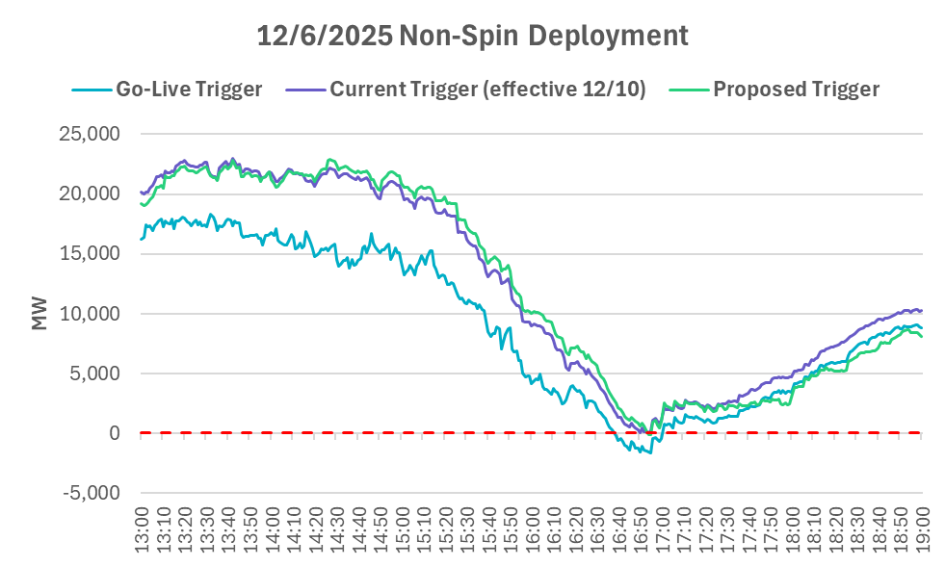
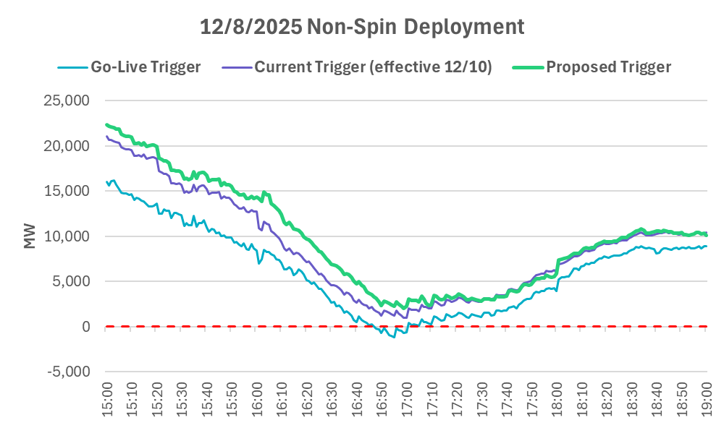
Impact on Non-Spin Deployments
Trigger was driven by under forecast of net load.
Non-Spin would have been deployed a few minutes later, under the updated Trigger.
Non-Spin may not have been deployed on 12/8/2025 under the proposed Trigger.

Slide 6
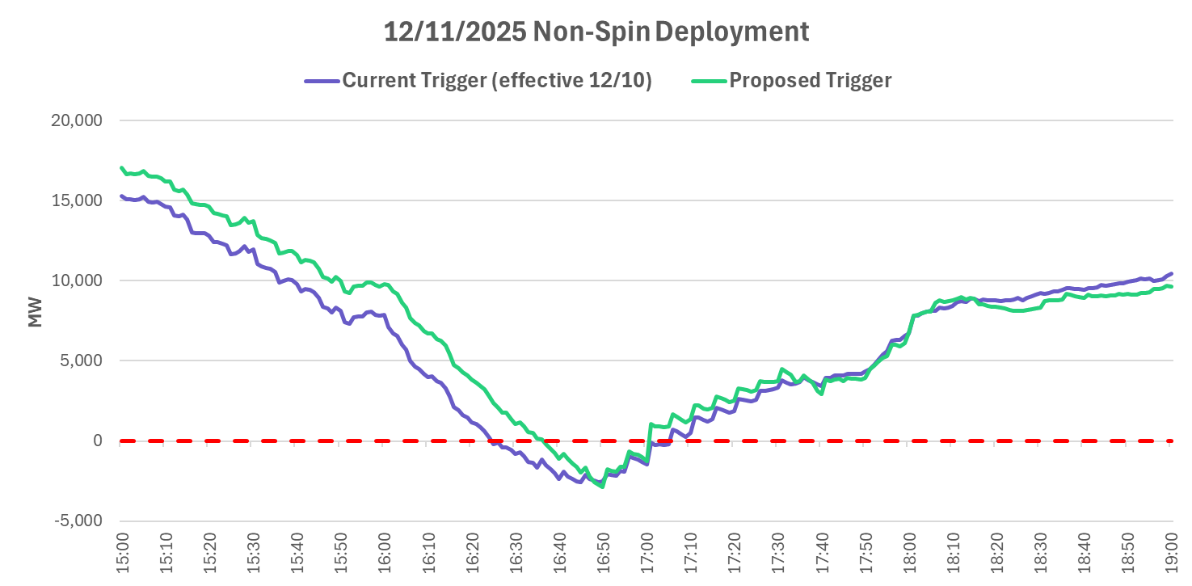
Impact on Non-Spin Deployment for 12/11/2025
Non-Spin would have been deployed ~ 12 minutes later under the Proposed RTC Trigger.

Slide 7
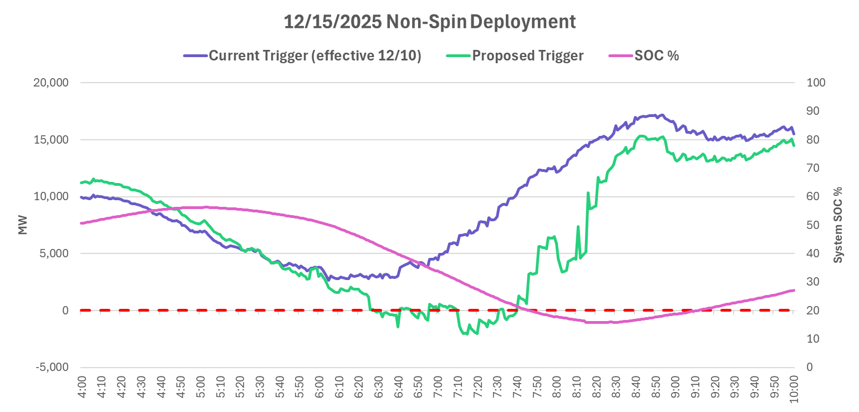
Impact on Non-Spin Deployment for 12/15/2025
Non-Spin was not deployed under the Current Trigger.
The Proposed Trigger would have suggested deployment due to dwindling ESR capability.

Slide 8
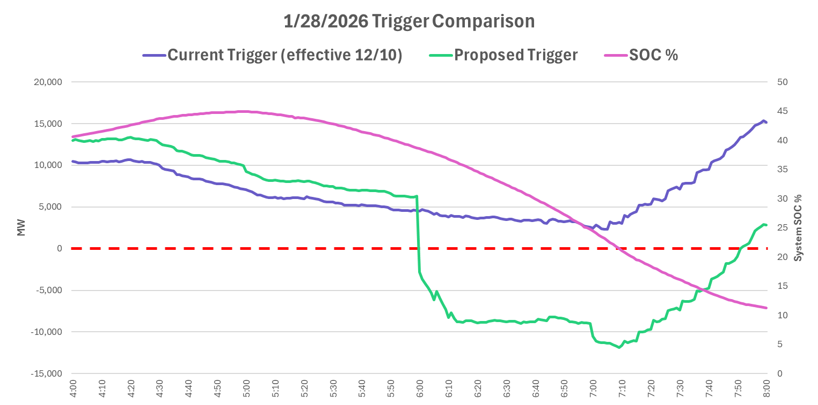
Impact on Non-Spin Deployment for 1/28/2026
Operators deployed Non-Spin ~7am
The Proposed Trigger would have suggested deployment ~6am due to dwindling ESR capability and increased Non-Spin needed from ESRs (NS Plan not covered by Thermals and Loads).

Slide 9
Next Steps
ERCOT has submitted OBDRR055 for the Non-Spinning Reserve Deployment and Recall Procedure to align the language with RTC+B and propose trigger enhancements discussed in this slide deck.
ERCOT is looking for stakeholder feedback on the analysis.
ERCOT hopes to have the OBDRR approved by TAC, Board, and PUC with an effective date of Summer 2026.

Slide 10
Questions?

